Slide 1
To
and Beyond...

Slide 2
Who am I?
prof. stucki...
Education
M.S. THE Ohio State University (Computer Science)
B.S. Wheaton College, Chicago (Mathematics)
Research Interests
History & Philosophy of Mathematics
Computer Science Education
Professional Activities
Software Developer:
Hobbies
Reading
Remodeling projects at home
Spending time in the Rocky Mountains, Colorado
Disc Golf

Slide 3
Who are YOU?
Round 1
Name
Dream job
Favorite sport, team, and/or athlete
Why are you here?

Slide 4
Course Themes
Beauty
Mathematics has more in common with music than with engineering!
Unity of Knowledge
Academic disciplines are not as independent and isolated as it may seem
Thought
What are its limits?
How do we conceptualize the world?

Slide 5
David Hilbert (1862-1943)
No other question has ever moved so profoundly the spirit of man; no other idea has so fruitfully stimulated his intellect; yet no other concept stands in greater need of clarification than that of the infinite.

Slide 6
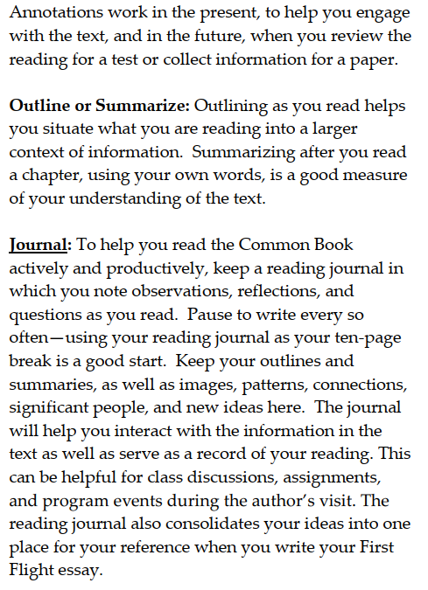
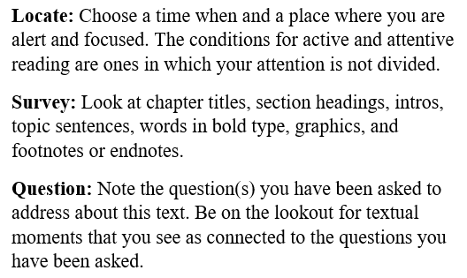
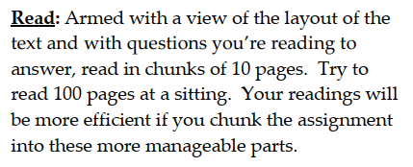
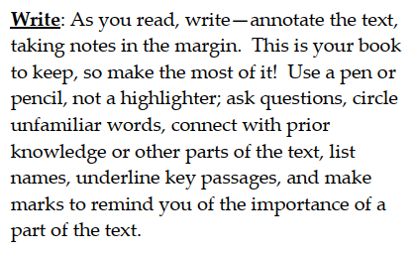
Course Overview
Syllabus: read carefully & bring questions on Wednesday
Textbooks
Brightspace
Reading Assignment
Journal
FYS/IS

Slide 7
Who are YOU?
Round 2
Name
Favorite dessert?
What is your earliest memory?
What are your hopes/expectations for this course?
Homework: Make a table tent with your name

Slide 8
Bloom’s Taxonomy
Over a period of several years in the 1940s and 1950s, Benjamin Bloom, Max Englehart, Edward Furst, Walter Hill and David Krathwohl developed and proposed a model of learning to the annual meetings of the American Psychological Association
In 1956 this was published as the Taxonomy of Educational Objectives, and was organized into three areas:
Cognitive (mental)
Affective (emotional)
Psychomotor (physical)
The cognitive domain formed a pyramid with 6 levels

Slide 9
