Slide 1
The Architecture of
Scala Collections
Kevin Collins

Slide 2
Design of the Collection Library
Achieve design requirements of natural collection types
Define operations and functions to apply to these functions
Reduce duplicate code as much as possible

Slide 3
Operation Design Requirements
Returning same concrete collection
Returning same collection with variable element types
Varying numbers of parameters
Returning different collections based on element type
Additional implicit parameters when required
Strict verses non-strict collections
Notes:
filter List[Int] to List[Int]
map on List[Int] to List[String]
List[A] vs Map[K,V]
map on Map, Map if result is K/V pair, else Iterable
map SortedSet requires Ordering
Elements evaluated at creation, verses when collection is traversed

Slide 4
Strict vs Non-strict Collections
Strict
Elements added and computed when added
Non-strict or Lazy Collections
Only requested elements are computed
Can be infinite
Notes:
Normal collections

Slide 5
Non-strict Example: LazyList
Constructed with #:: operator
scala> val lazyList = LazyList(1, 2, 3)
val lazyList: scala.collection.immutable.LazyList[Int] = LazyList(<not computed>)
scala> val otherList = 4 #:: lazyList
val otherList: scala.collection.immutable.LazyList[Int] = LazyList(<not computed>)
scala> otherList(2)
val res0: Int = 2
scala> otherList
val res1: scala.collection.immutable.LazyList[Int] = LazyList(4, 1, 2, <not computed>)

Slide 6
Fibonacci as LazyList
scala> def fibFrom(a: Int, b: Int): LazyList[Int] =
|a #:: fibFrom(a, a+b)
def fibFrom(a: Int, b: Int): LazyList[Int]
scala> val fibs = fibFrom(1,1).take(7)
Fibs: scala.collection.immutable.LazyList[Int] = LazyList(<not computed>)
scala> fibs.toList
val res8: List[Int] = List(1, 1, 2, 3, 5, 8, 13)
scala> val allFibs = fibFrom(1,1).take(7)
allFibs: scala.collection.immutable.LazyList[Int] = LazyList(<not computed>)
scala> val someFibs = (allFibs(5), allFibs(15), alLFibs(4212))
val someFibs: (Int, Int, Int) = (8,987,691399513)

Slide 7
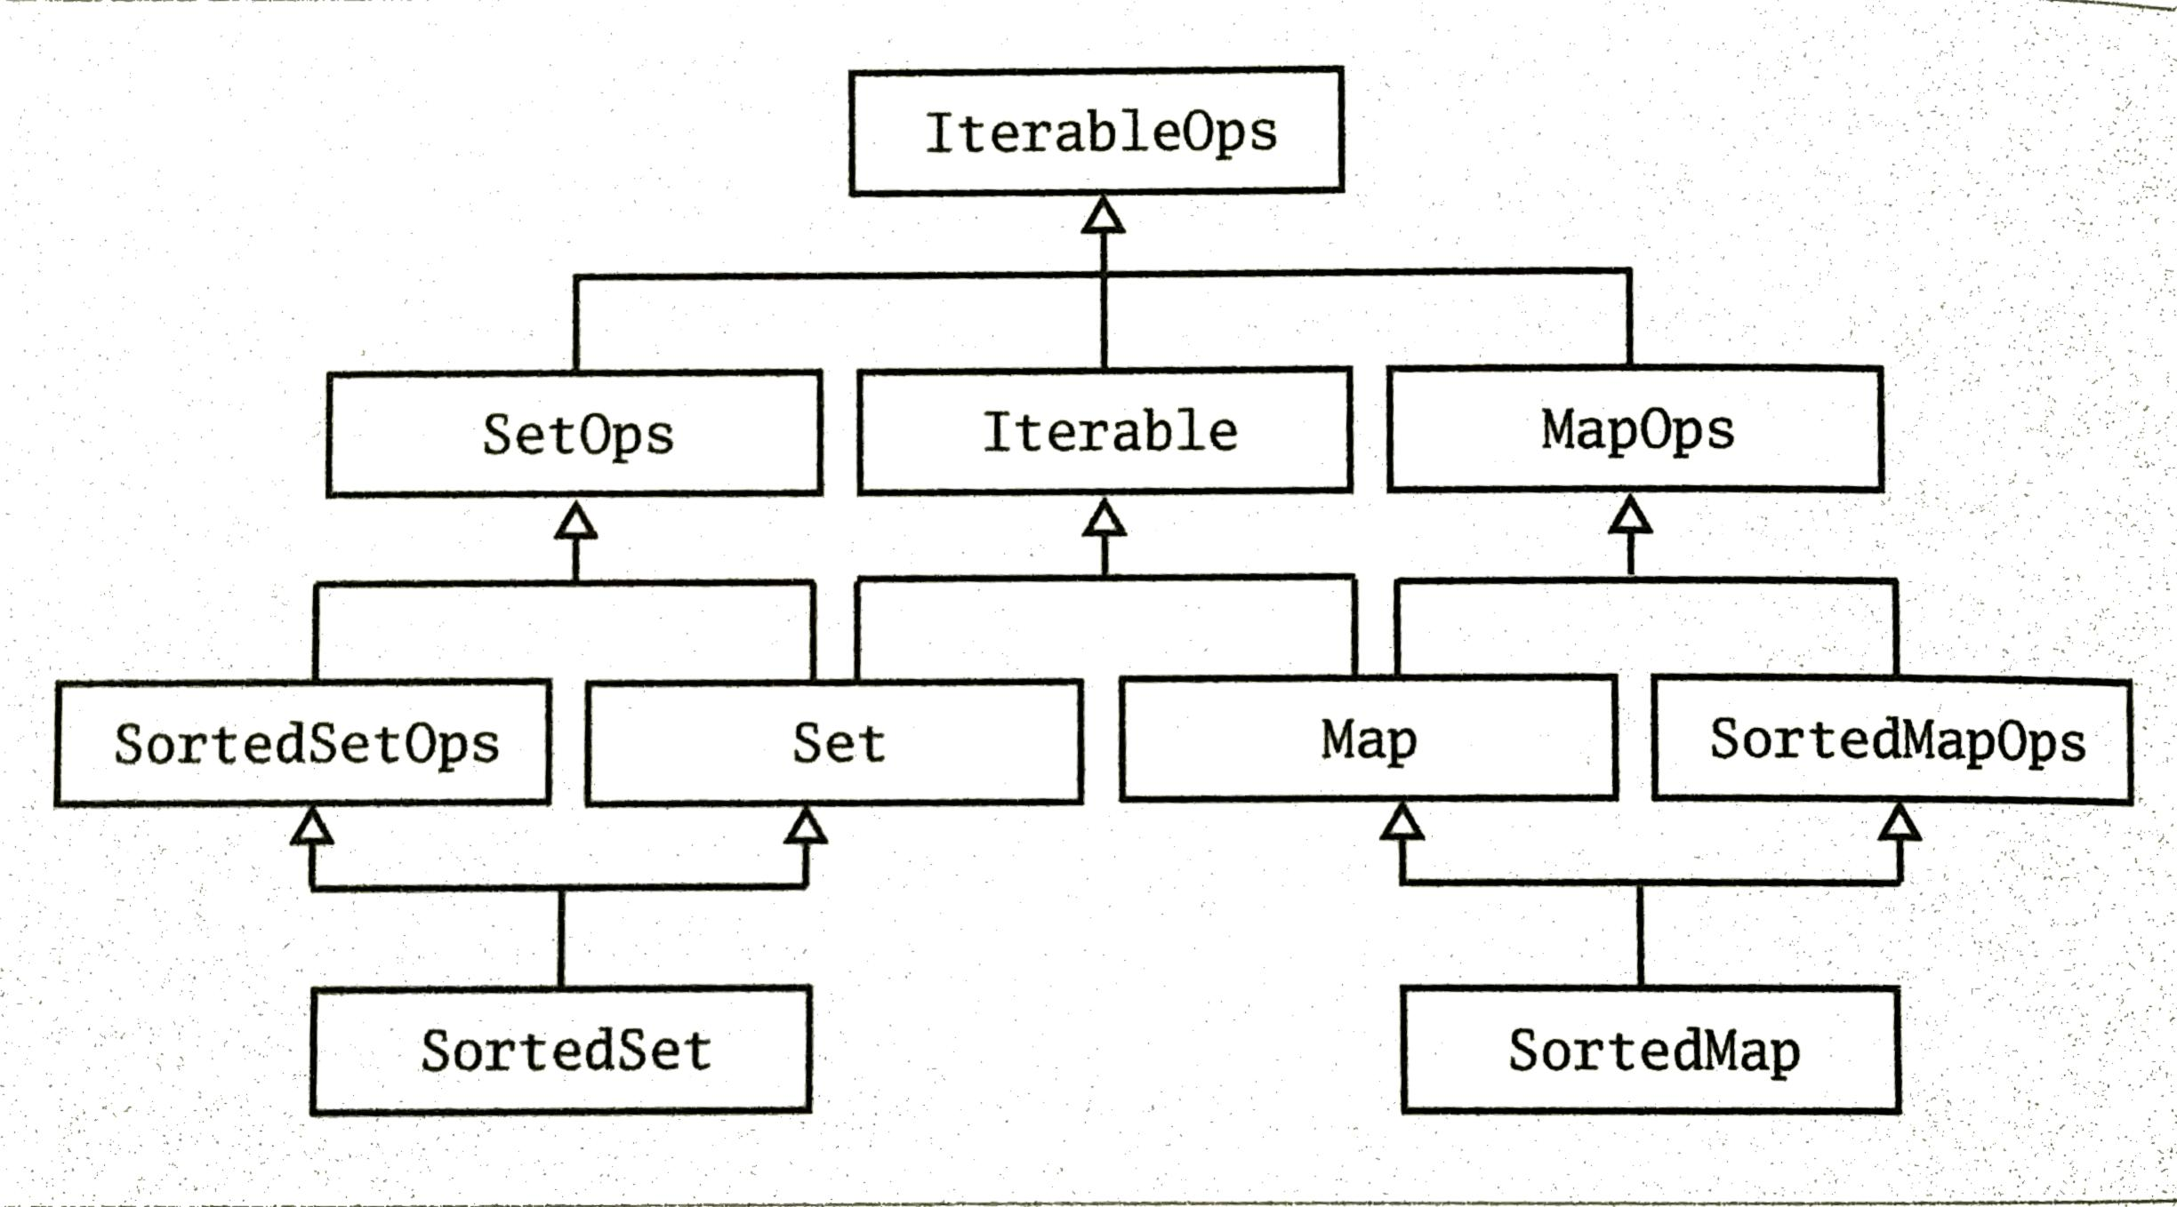
Trait Organization

Slide 8
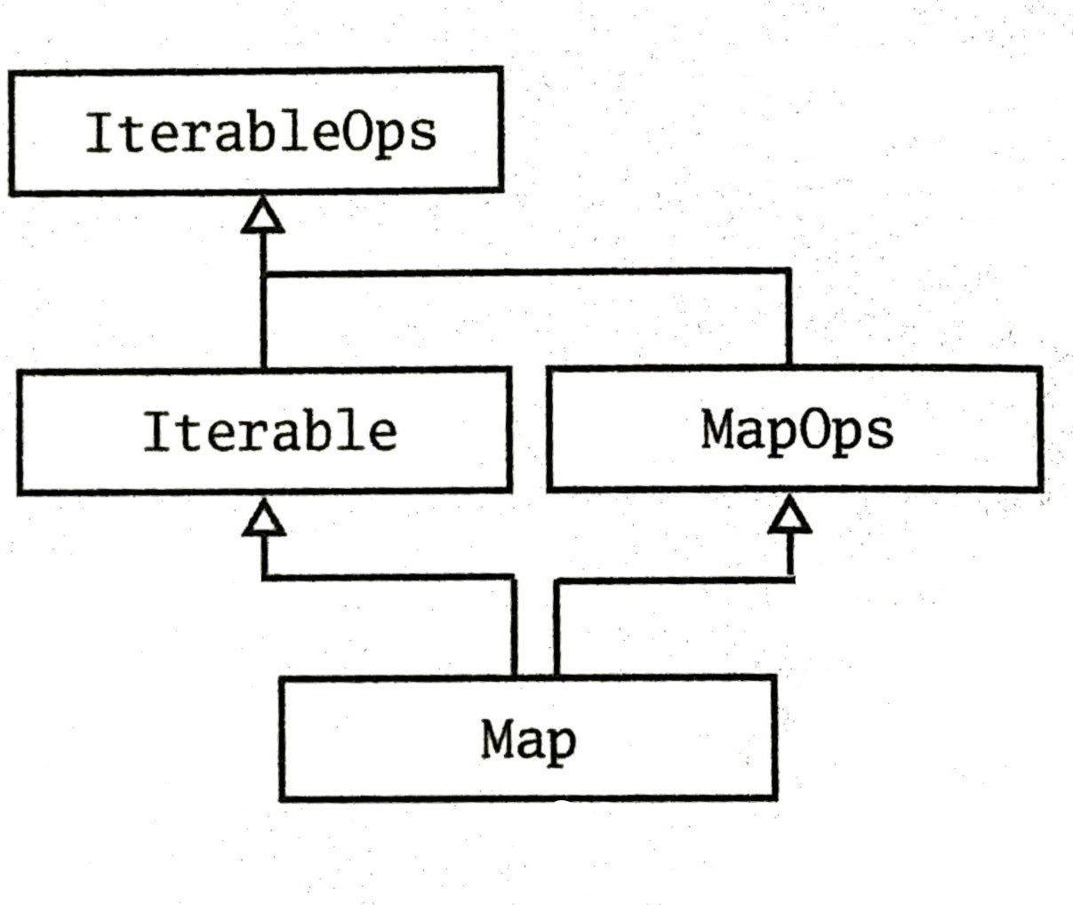
Tracing Map in Collections Framework
trait IterableOps[+A, +CC[_], +C]
A: element type
CC: type constructor
C: complete type

Slide 9
Tracing Map in Collections Framework
trait IterableOps[+A, +CC[_], +C]
trait Iterable[+A] with IterableOps[A, Iterable, Iterable[A]]
trait MapOps[K, +V, +CC[_], +C]
extends IterableOps[(K, V), Iterable, C]
trait Map[K, +V] extends Iterable[(K, V)]
with MapOps[K, V, Map, Map[K, V]]

Slide 10
Tracing Map in Collections Framework
filter operation
IterableOps:
def filter(pred: (A) => Boolean: C
Iterable:
def filter(pred: (A) => Boolean: Iterable[A]
MapOps:
def filter(pred: ((K, V)) => Boolean: C
Map:
def filter(pred: ((K, V)) => Boolean: Map[K,V]

Slide 11
Implementing Strict and Non-strict
def fromSpecific(source: IterableOnce[A]): C
def from[E](source: IterableOnce[E]): CC[E]
Companion objects

Slide 12
Implementing Strict and Non-strict
Non-strict implementation by default
trait IterableOps[+A, +CC[_], +C] {
def filter(pred: A => Boolean): C =
fromSpecific(new View.Filter(this.pred))
def map[B](f: A +> B): CC[B] =
from(new View.Map(this, f))

Slide 13
Implementing Strict and Non-strict
List implementation of from method (strict)
def from[E](source: IterableOnce[E]): List[E] =
(new ListBuffer[E] ++= source).toList
Notes:
Normal collections

Slide 14
Implementing Strict and Non-strict
Factory and Companion operations
trait IterableOps[+A, +CC[_], +C] {
  def map[B](f: A => B): CC[B]=
    iterableFactory.from(new View.Map(this, f))
  def iterableFactory: IterableFactory[CC]
}
From Companion Object
trait IterableFactory[+CC[_]] {
  def from[A](source: IterableOnce[A]): CC[A]
}

Slide 15
Integrating New Collections
Mutable or Immutable?
Pick base Traits.
Choose Template Trait to inherit most operations.
Overload operations to return most Specific collections.
Collection Library: https://www.scala-lang.org/api/current/scala/collection/index.html

Slide 16
Capped Sequences Example
final class Capped[A] private (val capacity: Int, val
length: Int, offset: Int, elems: Array[Any])
extends immutable.iterable[A]
with IterableOps[A, Capped, Capped[A]]
with StrictOptimizedIterableOps[A, Capped, Capped[A]]
def this(capacity: Int) = this(capacity, length=0,
offset=0, elems=Array.ofDim(capacity))

Slide 17
Capped Sequences Example
IterableFactory from IterableOps
override val IterableFactory: IterableFactory[Capped] =
  new CappedFactory(capacity)

Slide 18
Capped Sequences Example
class CappedFactory(capacity: Int)
extends IterableFactory[Capped] {
  def from[A](source: IterableOnce[A]): Capped[A] = source match {
    case capped: Capped[A] if capped.capacity == capacity => capped
    Case _ => (newBuilder[A] ++= source.result()
  }
  def empty[A]: Capped[A] = new Capped[A](capacity)
  ...

Slide 19
Capped Sequences Example
  ...
  def newBuilder[A]: mutable.Builder[A, Capped[A]] =
    new mutable.ImmutableBuilder[A, Capped[A]](empty) {
      def addOne(elem: A): this.type = {
        elems = elems :+ elem
        this
      }
    }
  }

Slide 20
Capped Sequences Example
override protected def fromSpecific(coll:
IterableOnce[A]): Capped[A]
  iterableFactory.from(coll)
override protected def newSpecificBuilder:
mutable.Builder[A, Capped[A]]=
  iterableFactory.newBuilder
override def empty: Capped[A] = iterableFactory.empty

Slide 21
Questions?

