Slide 1
Scala Collections Framework
Connor May

Slide 2
Collections
Why to use them
  Safe
  Fast
  Universal
  Easy
  Concise

Slide 3
Collections Types
All collections are located in scala.collection
Three subclasses
  Mutable
  Immutable
  Generic
All collections are immutable by default
Notes:
Immutable are immutable for all people
Mutable are mutable for all people
Generic are building blocks for abstracting concrete classes

Slide 4
Ordered Concept
When traversing ordered collections the elements are in the same order
HashSet is unordered
LinkedHashSet is ordered

Slide 5
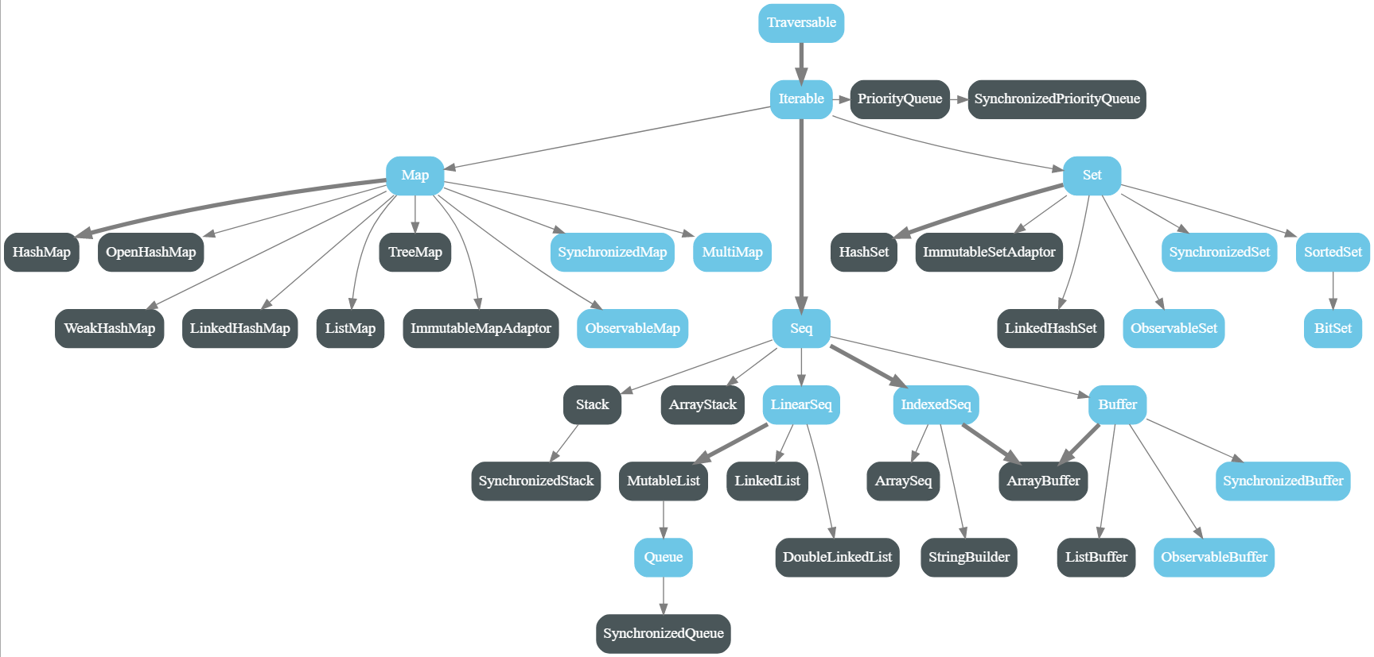

Slide 6
Iterators
Is a trait
Foreach
Sliding method
Grouped method

Slide 7
Grouped iterator
Chunks elements of the collection into increments
Example:
trait Collection[A] {
def grouped(m: Int): Iterator[Collection[A]]
}

Slide 8
Grouped Example
val list = List( 1, 2, 3, 4, 5)
val iteratror = list grouped 3 // gives me a grouped iterator
iterator.next() // gives a List[Int] ( 1, 2, 3)
iterator.next() // gives a List[Int] ( 4, 5)

Slide 9
Sliding Example
val list = List( 1, 2, 3, 4, 5)
val iteratror = list sliding 3 // gives me a sliding iterator
iterator.next() // gives a List[Int] ( 1, 2, 3)
iterator.next() // gives a List[Int] ( 2, 3, 4)
iterator.next() // gives a List[Int] ( 3, 4, 5)

Slide 10
Familiar Collections Methods
copyToArray
++
isEmpty
Size
Map
toList

Slide 11
Unfamiliar Collections Methods
knownSize – number of elements if it can be computed in constant time, otherwise -1
patch(i, ys, r) – replaces r elements starting with i using the patch ys
updated(i, x) – a copy of the list with x at index i changed

Slide 12
Performance Characteristics
Most Scala Collections take Constant or Linear Time to operate on
list.head is constant time as is tail
Prepending a list is constant but appending is linear
Update is linear at worst
See pg. 548 for full performance characteristics table

Slide 13
Making your own Collections
Calling list(1, 2, 3) is actually calling apply
  identical to calling List.apply(1, 2, 3)
Create your own apply method
All collections have an empty method which returns an empty collection

Slide 14
Using Java Collections
Scala provides a wrapper for JCF
import collection.JavaConverters
Some Collections can be converted to and from while others can only be converted to JCF

Slide 15
Java Collections
Scala Collections | Java Collections
Iterator | java.util.Iterator
Iterator | java.util.Enumeration
Iterable | java.lang.Iterable
Iterable | java.util.Collection
mutable.Buffer | java.util.List
mutable.Set | java.util.Set
mutable.Map | java.util.Map
Scala Collections | Java Collections
Seq | java.util.List
mutable.Seq | java.util.List
Set | java.util.Set
Map | java.util.Map

Slide 16
Using Java Conversions
scala> import collection.JavaConverters._
import collection.JavaConverters._
scala> import collection.mutable._
import collection.mutable._
scala> val jul: java.util.List[Int] = ArrayBuffer(1, 2, 3).asJava
jul: java.util.List[Int] = [1, 2, 3]
scala> val buf: Seq[Int] = jul.asScala
buf: scala.collection.mutable.Seq[Int] = ArrayBuffer(1, 2, 3)
scala> val m: java.util.Map[String, Int] =
HashMap("abc" -> 1, "hello" -> 2).asJava
m: java.util.Map[String,Int] = {hello=2, abc=1}

