Slide 1
Smart Pointers
Cameron Uhl

Slide 2
What are smart pointers?
First, what are regular pointers?
  A simple reference to another value
Smart pointers are not just simple references
They have special capabilities and also metadata
3 kinds of smart pointers:
  Box
  Rc
  RefCell

Slide 3
Why Do We Need Smart Pointers?
Heap allocation
Multiple ownership
Recursive data structures
Shared state across components
Smart pointers make memory safety possible without garbage collection

Slide 4


Box Smart Pointer
Rust allocates everything on the stack
If you want to store something on the heap so you can:
  Transfer ownership of data
  Share data across multiple parts of your program
Use a Box Smart Pointer!
Declaration of a Box Smart Pointer uses the Box::new keyword:
The variable y is now a box pointer, pointing to some heap memory containing the value

Slide 5
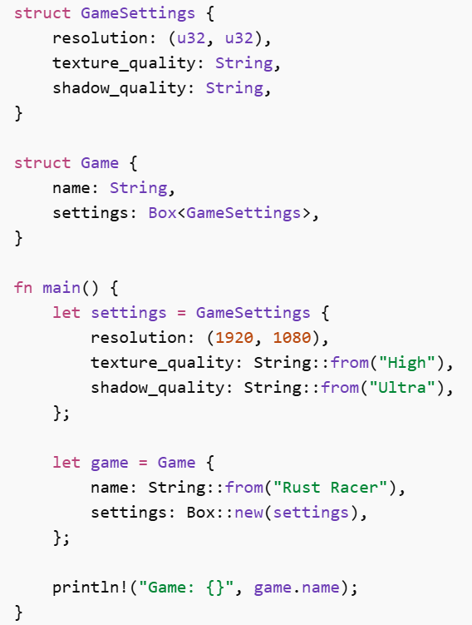
Box Smart Pointer Example
The use of Box pointers here is to:
  Move the large struct onto the heap
  Keeps Game stack size small
  Useful for performance in large systems

Slide 6
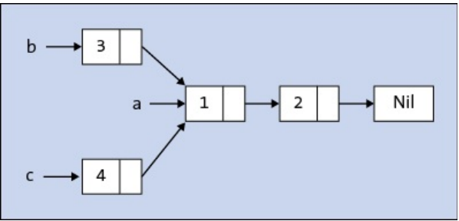
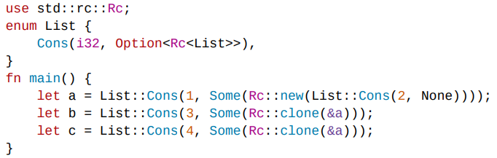
Rc Smart Pointer
Rc stands for reference counted
Enables multiple ownership of data by keeping track of how many references point to the same value
Allows several parts of the program to share ownership of a value
Can use Rc pointers for:
  Graph structures
  Shared configuration
  Tree nodes with multiple parents
Notes:
List “a” contains a pointer to 1
List “b” contains a pointer to 3, which then points to a
List “c” contains a pointer to 4, which then points to a

Slide 7
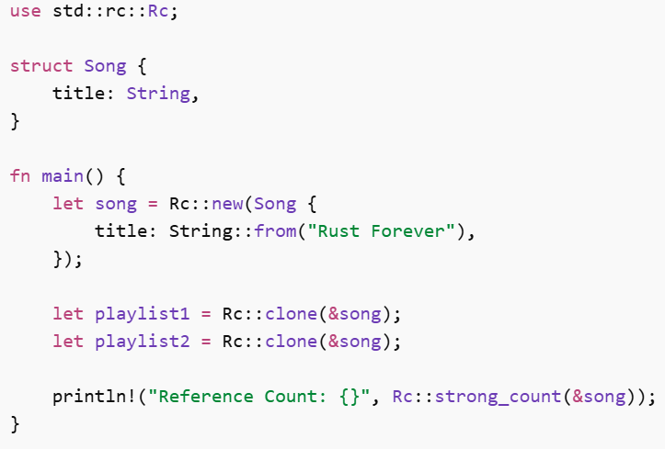
Rc Smart Pointer Example
Shared Playlist!
Rc::clone() does not copy the data
  It increments the reference count
The data is then dropped when the reference count hits 0

Slide 8
RefCell Smart Pointer
Used for interior mutability
Enforces borrowing rules to be checked at runtime
Allows mutation even when immutable
Uses:
  borrow()
  borrow_mut()
Why do we need this?
Sometimes you have immutable ownership, but still need to mutate internal data

Slide 9
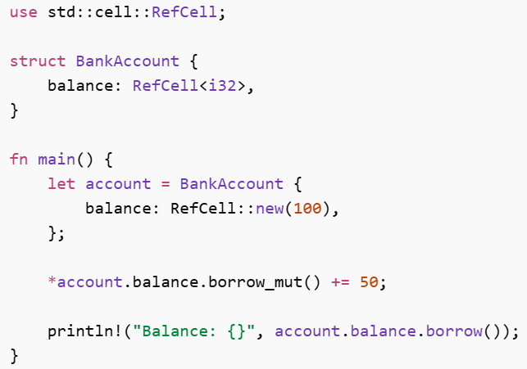
RefCell Smart Pointer Example
Bank Account Logger!
Compile time rules would normally prevent this
RefCell checks at runtime instead to allow it
Notes:
Balance inside of BankAccount is a RefCell<i32> type to tell us that it MIGHT be mutated later, even if the struct isn’t
The account is not mutable, but we can still mutate balance if we need to
We borrow the value at balance through the smart pointer, but the * is to dereference the value so we can actually change it

Slide 10
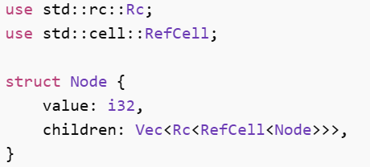
Combining Rc and RefCell
Common patterns include both Rc and RefCell smart pointers
Can be used in:
  Trees
  Graphs
  UI component hierarchies
Notes:
Rc -> multiple owners
RefCell -> allows mutation

Slide 11
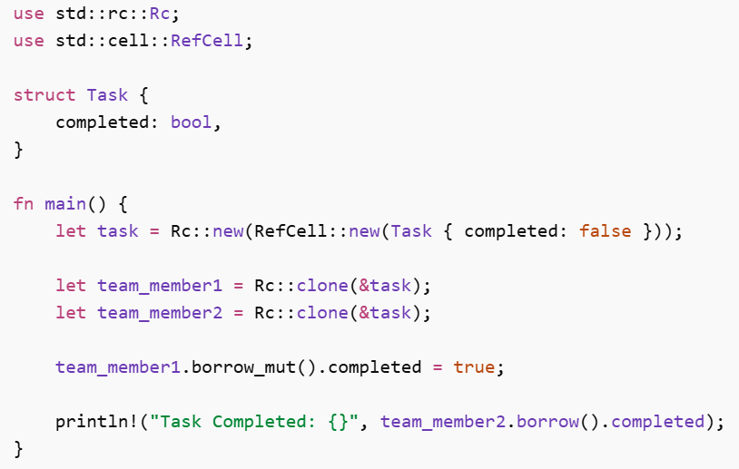
Rc and RefCell Combined Example
Shared Task Board!
Both team members can see the same updated value
Shared and mutable

Slide 12
Real World Applications
Game engines
UI frameworks
Graph data structures
Shared caches
Dependency trees

Slide 13
Conclusion
Smart pointers allow Rust to:
  Allocate memory on the heap instead of the stack
  Share ownership safely
  Mutate data safely
  Prevent data races
  Avoid garbage collection
Smart pointers are Rust’s way of giving you power without sacrificing safety

