Slide 1

Iterators
Kristin Nickerson

Slide 2
What are Iterators?
Iterators are a design pattern meant to process a series of elements.
It's a trait in the Rust standard library that any type can implement.
They are most often used with collections, such as vectors and hash maps.

Slide 3
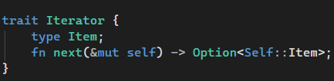
What does one look like?
Item is what's known as an associated type, and the type it contains is what's returned from the iterator.
Associated types are a placeholder type that has to be specified by the implementor.
Next method returns one item at a time wrapped in a Some, and once all items are iterated over returns None.

Slide 4
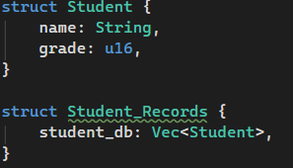
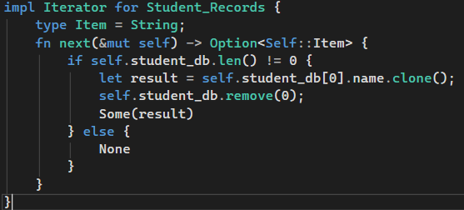
What is the next method?
An iterator must define its next method.
Each call to next consumes an item from the iterator.

Slide 5
Why use iterators?
Can be responsible for logical iterating over items and determining when a sequence is finished.
This is referred to as 'lazy', since there is no effect until a method is called to use up the iterator.
They are typically used inside of for loops
When they are used outside for loops, they need to be made mutable.
When they are inside for loops they are made mutable behind the scenes.

Slide 6
Methods implementing iterators
There are methods in the Rust standard library that have default implementations
Some require a defined next while others do not.
Consuming adapters require a defined next and consume the iterator once they are completed.
Iterator adapters do not require a defined next and do not consume the iterator, instead they produce some different iterator based off the first one.

Slide 7
Into Iterators
It takes a collection and a type and turns that into an iterator with a defined next.
There is a value called self and a function called into-iter, which takes self and consumes it to return an iterator.

Slide 8
Combinators
Combinators are a type of iterator that allow a given iterator to be changed in some way.
Filters are combinators that use conditionals to remove some items from iterators.
Map is a combinator that allows values inside an iterator to change from one form or type to another.
Collect is a combinator that puts values into a collection, where the type is specified using Turbo Fish Syntax.

Slide 9
Turbo Fish Syntax
Turbo Fish Syntax is used with the collect combinator to define the type that the collection is going to be.
:: is supposed to be the fish body
<T> is the fish's tail
T is a substitute for the type we are specifying

Slide 10
Iterator inside of Option
IntoIterator is implemented inside of Option
Since it could contain zero or one element, for loops can be used to check if a value is present

Slide 11
Other that I didn't know where to put
Iterators can take closures as arguments
Flatten is a function that makes an iterator of iterators into a single iterator.

