Slide 1
A rust functional language feature: closures
Presented by Olivia Crespo

Slide 2

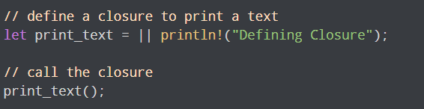
What are closures???
Closures are functions anonymous that can be stored in a variable or passed to a function.
We use the same syntax to call a closure as when we call a regular function

Slide 3
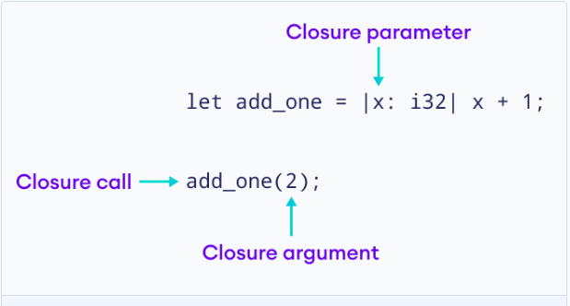
Closures with parameters
Parameters are the variables within the -vertical bars ex: let c = |x| x + 1
Rust will infer the parameter and return type, but you can also explicitly declare it.

Slide 4

Closures with return type
If you declare the return type: You must use a block {} for the body of the closure. If you don’t the complier will yell at you.
?????
Much better.

Slide 5

Closures Look very similar to functions. Especially when declaring the types explicitly.
The main difference is that they can access local variables.

Slide 6
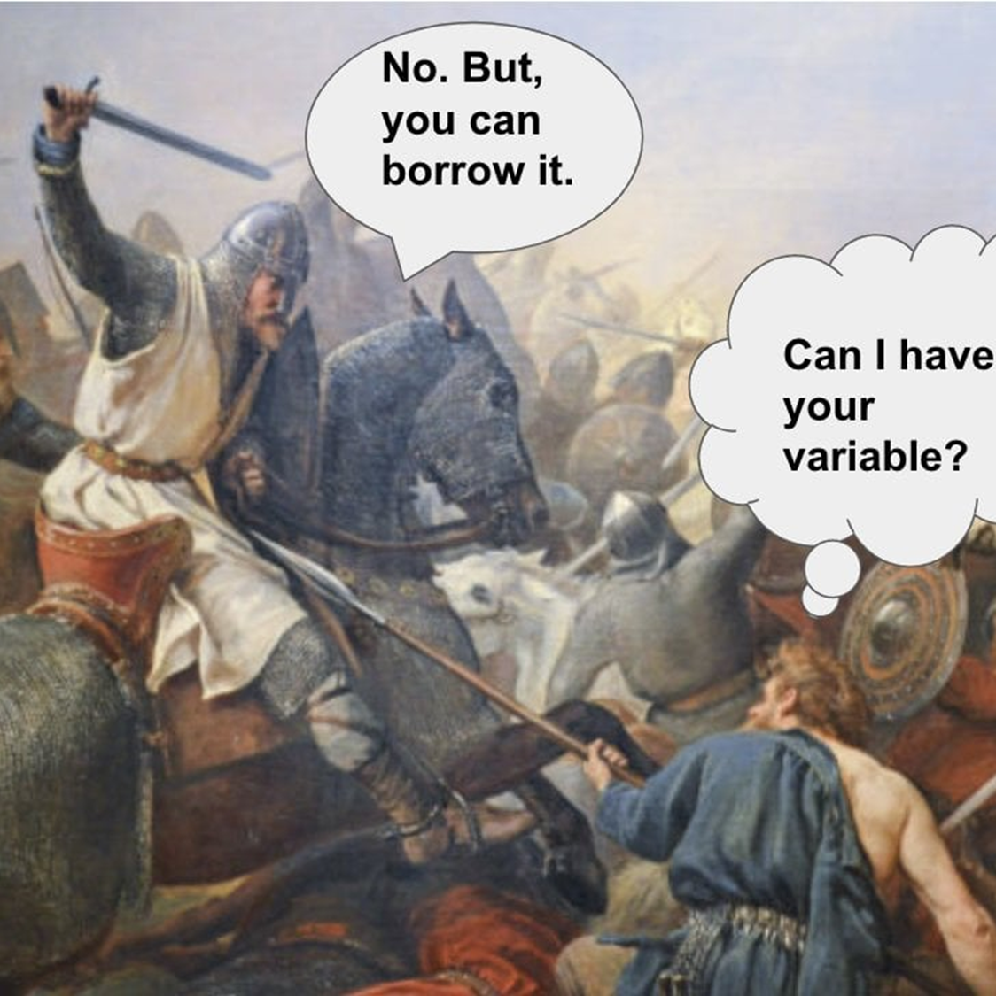
Ownership and Environment capturing
Closures follow the same ownership rules that Functions do. This applies to the variables in their surrounding scope.

Slide 7
Closures & Fn traits
Closures will automatically implement one, two, or all three of these Fn traits,
Fn Trait | Description
FnMut | Captures by mutable reference (&mut)
FnOnce | Consumes variables (moves them)
Fn | Captures by immutable reference (&)

Slide 8
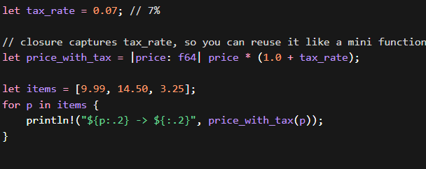
Example 1
Here the closure is used as a variable within the loop to calculate the tax. Very simple and the closure does not modify the original values here.
Notes:
Closure is some float price times the tax rate plus one

Slide 9
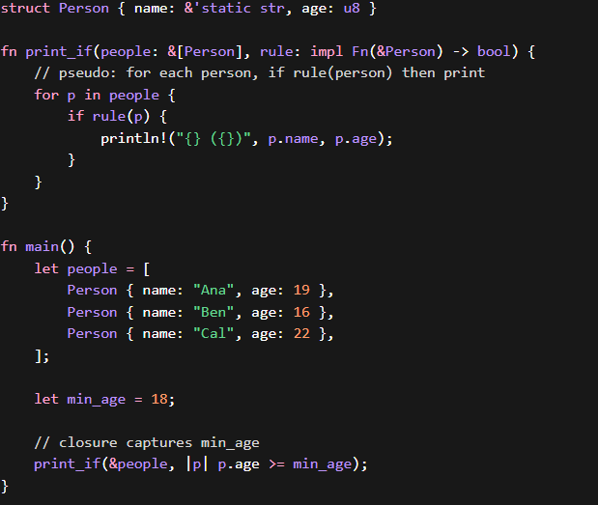
Example 2
Passing the Closure into a function directly.
This closure is comparing the ages within the array of People to the minimum age.
The print_if function takes the closure in as a variable ‘rule’
And prints all the people structs with age >= 18.
Notes:
The closure takes a variable P and returns false if P.age is less than 18

Slide 10
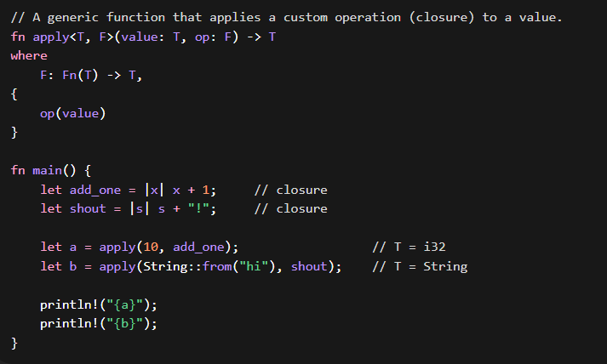
Example 3
Here The closures add_one and shout provide functionality to the generic function apply.
The function also specifies that the closure possess the Fn trait

Slide 11
Closures
In conclusion, Closures are useful for manipulating local variables and writing small one-off functions that you can pass around to save yourself some time. They may not be used very often but are still good (like with custom behaviors for a generic function)

Slide 12
The end
thanks

