Slide 1
Rust: Closures
COMP 4210
David J Stucki

Slide 2
ALERTS
Read chapter 9
Assignment 3 is due Friday
Questions?
Conference report

Slide 3
A rust functional language feature: closures
Presented by Olivia Crespo

Slide 4
Closure Comparison
So, from what Olivia shared, closures in Rust are similar to lambda functions in Java or Python
Aspect | Rust Closures | Java Lambdas | Python Lambdas
Capture | By borrow/mut/move (inferred) | By value of reference; var must be effectively final | By reference (late binding)
Mutate captured state | Via FnMut, Cell/RefCell, Arc<Mutex> | Not variable; mutate object via holder (e.g., AtomicInteger) | Yes; rebind needs nonlocal (not in lambdas)
Typing | Static; Fn/FnMut/FnOnce traits | Target-typed to functional interface | Dynamic; single expression only
Lifetimes | Enforced by compiler | GC; no lifetime checking | GC/refcount; late binding pitfalls
Concurrency | Send/Sync bounds enforced | Manual synchronization required | GIL limits CPU-bound; sync primitives for safety
Performance | Zero-cost, inlined | JIT-optimized, generally fast | Same as normal Python callables
Comparison from Copilot

Slide 5
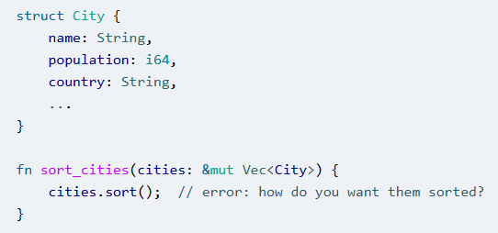

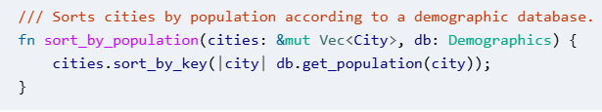
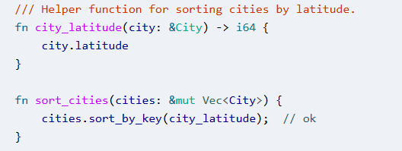
Closure Example
What can we do with closures?
We have to be careful with borrowing rules with this last example…

Slide 6

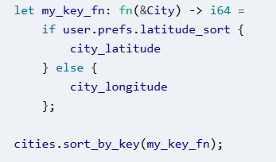
Function Pointers
Anywhere that Rust is expecting a closure parameter you can also pass a stand-alone function that was defined with an fn declaration
Unlike closures, these functions don’t have access to enclosing context unless you pass them as parameters

Slide 7
Next Time...
Iterators

