Slide 1
Traits
Abiral Pokharel

Slide 2
Problems
  OOPS → Polymorphism , Inheritance etc.
Rust avoids inheritance due to:
      Tight coupling, high dependability in parent classes
      Hidden implementation of methods
      Goal: Polymorphism without inheritance
Code Bloat (WDYM)

Slide 3
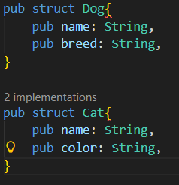
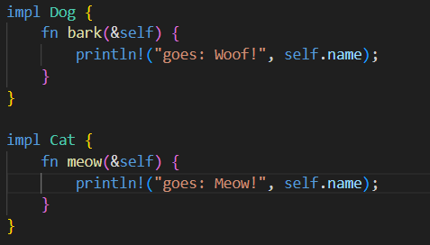

Slide 4
Traits
Define shared behaviors
Enables composition
Interface on Steroids

Slide 5
Defining traits

Slide 6
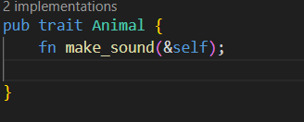
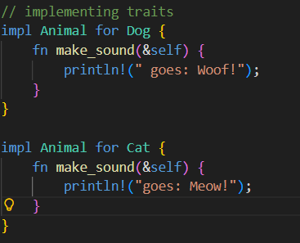

Slide 7
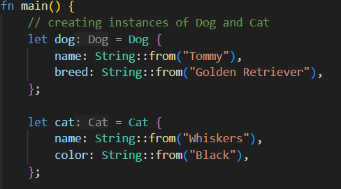
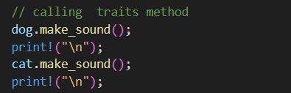

Slide 8
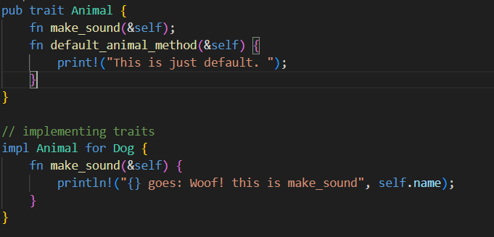

Slide 9
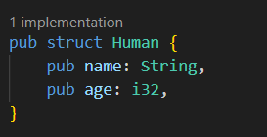
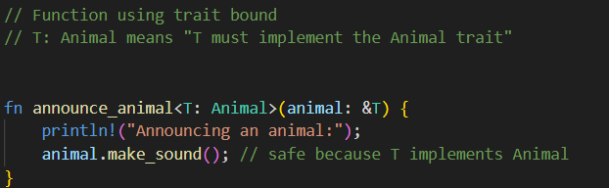
Trait Bounds

Slide 10
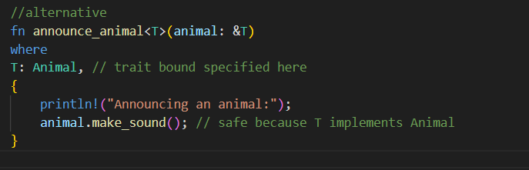
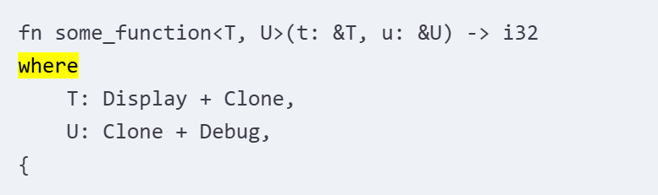
Rewriting Trait Bounds

Slide 11

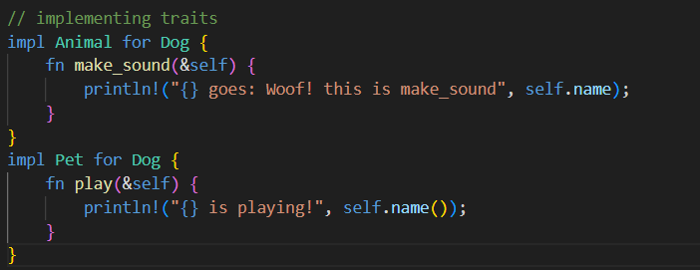
Supertraits

Slide 12
Additional Traits…
Marker Traits
Associated Types (book goes more into detail)
Static and Dynamic Dispatch (prof. stucki)

Slide 13
Conclusion
Traits → way to organize shared behavior
Enable Polymorphism
Cleaner, reusable modular code

