Slide 1
Error Handling
Paul Gosu

Slide 2
Rust Error Handling
Error handling is different to other languages like Java that uses exceptions.
Error handling exists in Rust to acknowledge that something could go wrong before you compile.
Ensures a more robust program development and help handle errors.

Slide 3

2 Types of Errors:

Slide 4
Unrecoverable Errors
Are usually bugs.
Example: Accessing a location past the end of an array.
Stops program execution.
Rust uses the panic! macro to define these errors.

Slide 5
Recoverable Errors
Attempts to report the issue to the user and to retry operation.
Example: A file not found error.
Rust uses the type Result<T, E> to handle these errors.

Slide 6
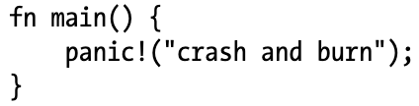
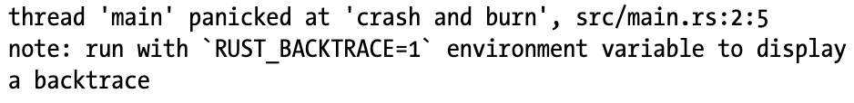
panic!()
Code:
The panic! macro will print a failure message, unwind, clean up the stack & quit the program.
Best used for when bad things happen in the code and you have to stop the program.
Running with RUST_BACKTRACE=1, will display more information by back tracing on the stack.
Output:

Slide 7
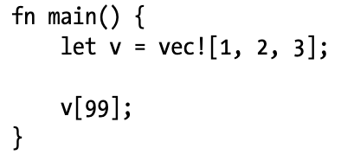
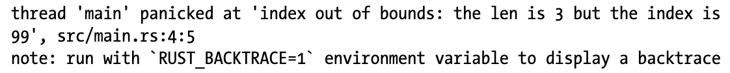
panic! being called by Rust
The panic! call can also come form the Rust library if it has detected a bug.

Slide 8

panic! Demo

Slide 9
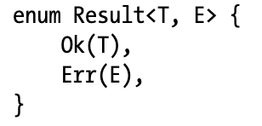
Result<T, E>
The Result<T, E> type is used when you want to watch errors that aren’t serious enough to break your program.
These are used for when there is a more obvious fix for an issue that was caught by Result<T, E>.
T & E are Generic types, where T represents the type returned on a success and E is the type returned on an error.
Like the Option Enum, except Result returns a Value or an Error while Option return a success or failure.

Slide 10
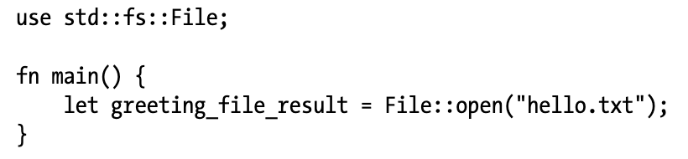
Result<T, E>

Slide 11
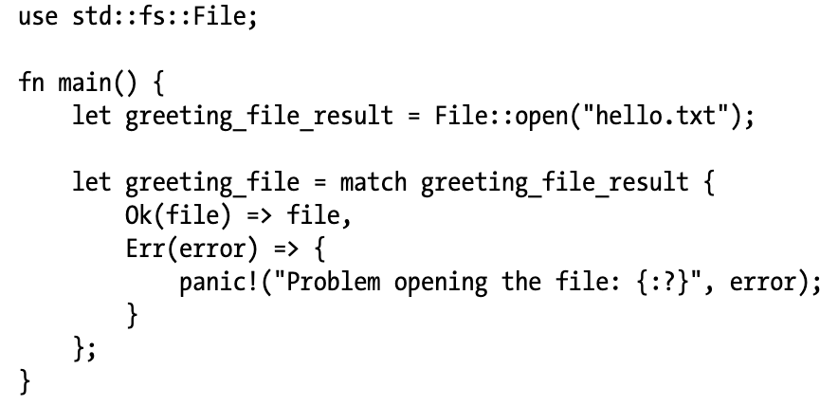
Result<T, E>

Slide 12
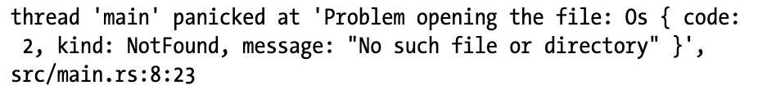
Result<T, E>

Slide 13
Using expected and unwrap
Using match can be verbose as seen.
Using expected and unwrap can more clearly convey to the user what error we might catch.

Slide 14
Expected and unwrap demo

Slide 15
Using error.kind() with Result types
Using the .kind() method to find error types, we can fix errors automatically as the program is being run
We do this by:
Finding the kind of error
Creating a solution for the error that was caught
Catching any errors that might occur while trying to fix an issue

Slide 16
error.kind() demo

Slide 17
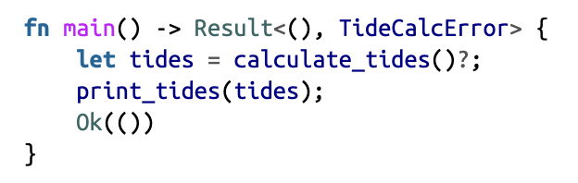
Propagation ?
Is done by using ‘?’ as the propagation symbol.
Works a bit like the match function.
Instead of handling the error inside the function, you return the error back to the calling code.
This gives more control to the calling code.
The calling code might have more info on how to handle the error.

Slide 18
Summary
Error handling should be used for more robust code design
The panic! macro signals that your program is in a state it cannot handle
The Result<T, E> Enum signals your program could fail in a way, but your code can still recover
Using panic! and Result Enum in their appropriate ways can help you debug your code

