Slide 1
Rust, 6.3-6.4 (Cargo & Privacy)
Hussein Al-Ani

Slide 2
Introduction
6.3 - Visualizing and organizing modules
6.4 - Re-exporting and privacy

Slide 3
What Is A Module?
A module is a way to group related code in Rust
Modules help organize large programs
Modules control what code is visible

Slide 4
What A Module Can Contain
Structs
Enums
Functions
Other modules

Slide 5
The Crate and the Module Tree
Every Rust Project has a crate that contains a root module
lib.rs or main.rs is the crate root
All modules form a tree under the crate

Slide 6
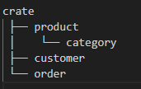
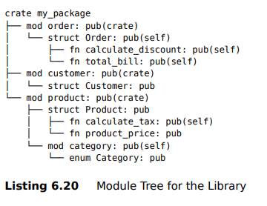
Examples

Slide 7


Using Cargo to Visualize Modules
Cargo helps manage Rust projects
Tools like cargo-modules show module structure
Helps understand large codebases

Slide 8


Modules vs Files in Rust
Files do not define modules in Rust
Modules are defined using mod
Files are just a way to organize code
Not a module by itself
This creates the module

Slide 9
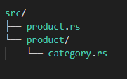

Organizing Modules into Files and Folders
Simple modules can be placed in separate .rs files
Submodules must follow folder conventions
Parent modules must declare their submodules

Slide 10
Re-exporting and Why It’s Needed
Not all modules should be public
External code often needs only specific items
Re-exporting creates a cleaner public interface

Slide 11

Re-exporting with pub use
pub use makes specific items public
Modules can stay private
Creates shorter and cleaner paths

Slide 12
Privacy of Structs
pub struct does not make fields public
Struct fields are private by default
Controlled access is done using methods like a constructor function

Slide 13
Privacy: Structs vs Enums
Privacy works differently for each
Struct fields are private by default
Enum variants are public when the enum is public

