Slide 1
Rust: enums
COMP 4210
David J Stucki

Slide 2
ALERTS
Read chapters 5-6
Assignment 2 is due next Monday
Questions?

Slide 3
enums
What is an enum?
Short for “enumerated type”
In C/C++/Java?
Basically, a user-defined type with a finite number of possible values
Values are typically identifiers
Each identifier is internally represented as a unique unsigned integer
Rust supports this notion of what an enum is
enum Suit {Spades, Hearts, Clubs, Diamonds} let card_suit = Suit::Spades;
But it doesn’t stop there…

Slide 4


enum
enum Order {
LessThan,
Equal,
GreaterThan
}
fn compare(n: i32, m: i32) -> Order {
if n < m {
Order::LessThan
} else if n > m {
Order::GreaterThan
} else {
Order::Equal
}
}
let result = compare(12, 3);

Slide 5
enums with data
Rust has generalized and extended this notion of enum to a much more powerful primitive language feature
Each variant (the term Rust uses for the individual values in an enum), in addition to being an identifier, may also possess a value, which can be of any type
No data
tuple-like
struct-like
Ownership rules apply. PAY ATTENTION TO THE HEAP!
These enums with data are similar to the concept of unions in C
What is a union??

Slide 6
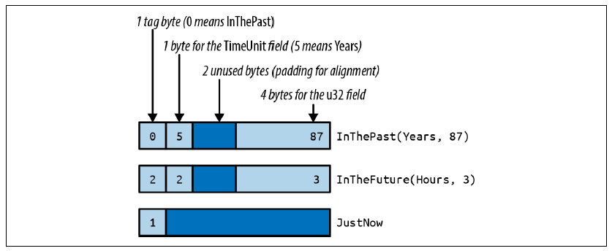
enums in Memory
#[derive(Copy, Clone, Debug, PartialEq, Eq)] enum TimeUnit { Seconds, Minutes, Hours, Days, Months, Years, }
/// A timestamp that has been deliberately /// rounded off, so our program can say /// "6 months ago" instead of /// "February 9, 2016, at 9:49 AM".
#[derive(Copy, Clone, Debug, PartialEq)] enum RoughTime { InThePast(TimeUnit, u32), JustNow, InTheFuture(TimeUnit, u32), }

Slide 7
enum Examples
enum IpAddrKind {V4, V6}
struct IpAddr { kind: IpAddrKind, address: String, }
let home = IpAddr { kind: IpAddrKind::V4, address: String::from("127.0.0.1") };
let loopback = IpAddr { kind: IpAddrKind::V6, address: String::from("::1") };
enum IpAddr { V4(u8, u8, u8 u8), V6(String) }
let home = IpAddr::V4(127,0,0,1);
let loopback = IpAddr::V6(String::from("::1"));
let ipval = match home { IpAddr::V4(a,b,c,d) => (a,b,c,d), IpAddr::V6(s) => s };

Slide 8
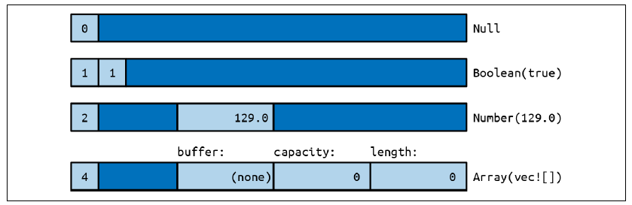
Rich Data Structures using enums
use std::collections::HashMap;
enum Json { Null, Boolean(bool), Number(f64), String(String), Array(Vec<Json>), Object(Box<HashMap<String, Json>>), }
What is JSON?
What types of things can be in a JSON object?
Null
Boolean
Number
String
List
Dictionary

Slide 9
Option & Result
enum Option<T> { None, Some(T), }
enum Result<T, E> { Ok(T), Err(E), }
fn plus_one(x: Option<i32>) -> Option<i32> { match x { None => None, Some(i) => Some(i + 1), } }
Rust uses Option as an alternative to null pointers
Tony Hoare sidebar…
It allow for values to be present or not, but with type-safety.
Rust uses Result as an alternative to try-catch error handling
A computation can return a value or an error.
In both cases, matching can determine which outcome was produced

Slide 10
HashMap & HashSet
use std::collections::HashMap;
let mut m: HashMap<&str, u32> = HashMap::new();
m.insert("a", 10);
m.insert("b", 100);
m.insert("c", 1000);
m.insert("d", 10000);
m.insert(“c", 100000);
assert_eq!(m["a"], 10);
assert_eq!(m["c"], 10000);

Slide 11
Next Time...
Chapter 6
Modules & Cargo

