Slide 1
Rust Ownership: Borrowing
COMP 4210
David J Stucki

Slide 2
ALERTS
Finish reading chapter 4
Begin reading chapter 5
Presentation schedule
Only 4 people submitted ranked topics on time
Only 7 people submitted at all
I'll have the schedule on Friday, provided I get the rest
If you haven't send me yours, send ranked 5 from each list
Questions?

Slide 3
Recall
Variables are immutable by default, and mutable when declared explicitly as such
let x = 36;
let mut y = 45;
Values that reside entirely on the stack are of copy-types
Assignment makes a copy
Values that reside on the heap always have (exactly) one owner
Assignment transfers ownership
Functions can take ownership and give ownership
Why?
No garbage collection: memory is returned as soon as it is no longer needed
Which means no memory leaks
No dangling pointers or null pointer references
Which means references are always valid
What's the cost of this?
Requires new discipline
Which means things that should be easy might now be harder

Slide 4
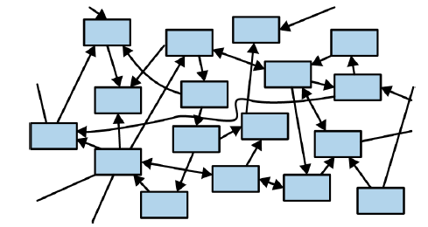

HELP!
Does Rust provide any relief?
Yes, you can create references to any value!
What is a reference?
It's basically a pointer.
Well doesn't that violate the ownership rule?
No, references borrow the value but don't take ownership!!
Wait, now we're back to unconstrained references and we can have spaghetti
Nope! There's rules...
Of course there are; what are they?

Slide 5
References
A reference to a value can be immutable (default) or mutable
A value at any point in time can have either:
One mutable reference (a single writer), or
Many immutable references (many readers)
These are mutually exclusive options
When there is a mutable reference to a value, its owner is not allowed to modify it
References MUST always be valid. In other words, they are never null.
Let's look at some examples...

Slide 6
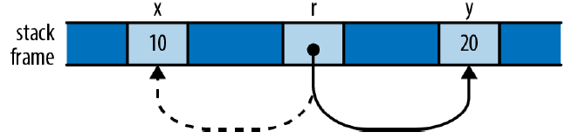
References
Enhanced Table 4.1
Reference Type | Meaning | Example
ref: &T | Immutable binding of an immutable reference | let x = 10; let r = &x; assert_eq!(*r, 10);
mut ref: &T | Mutable binding of an immutable reference | let x = 10; let y = 20; let mut r = &x; if b {r = &y;}
ref: &mut T | Immutable binding of a mutable reference | let mut y = 32; let m = &mut y; *m += 32; assert_eq!(*m, 64);
mut ref: &mut T | Mutable binding of a mutable reference | let x = 10;let y = 20; let mut r = &x; if b {r = &y;} *r += 15;

Slide 7
References
Enhanced Table 4.1
Reference Type | Meaning | Example
ref: &mut &T | Immutable binding of a mutable reference to an immutable reference | let mut v1 = vec![1,2]; let mut v2 = vec![3,4]; let r = &mut &v1; *r = &mut &v2;
mut ref: &mut &T | Mutable binding of a mutable reference to an immutable reference | let mut v1 = vec![1,2]; let mut v2 = vec![3,4]; let mut r = &mut &v1; r = &mut &v2;
v1
r
v1
v2
stack frame
4
2
4
2

Slide 8
Next Time...
Chapter 5
structs

