Slide 1
RUST Ownership
COMP 4210
David J Stucki

Slide 2
ALERTS
Assignment #1 is due Monday, 1/29, by 11:59pm
Presentation topics due by Tuesday, 1/30, by noon

Slide 3
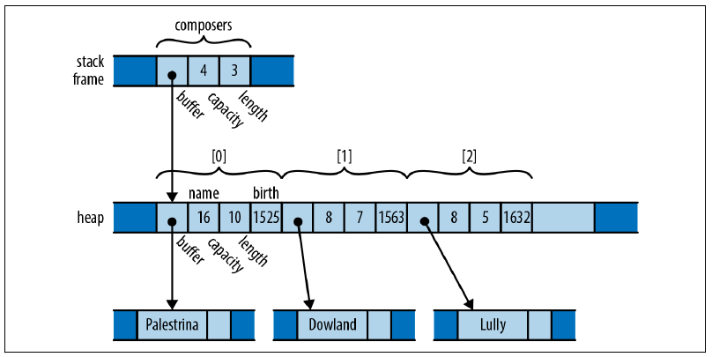
Review
Last time we talked about:
The system stack
Used by the runtime to allocate memory for statically sized method parameters and local variables in a stack frame
The system heap
Used by the runtime to allocate memory for dynamically sized objects referenced by the stack frame
Memory safety: garbage collection vs. manual memory management
Parameter passing modes
By value
By reference
By address
By result
By name
Rust Ownership
Each value has a single owner
References can only form trees, not graphs or networks
Eliminates dangling pointers & memory leaks

Slide 4
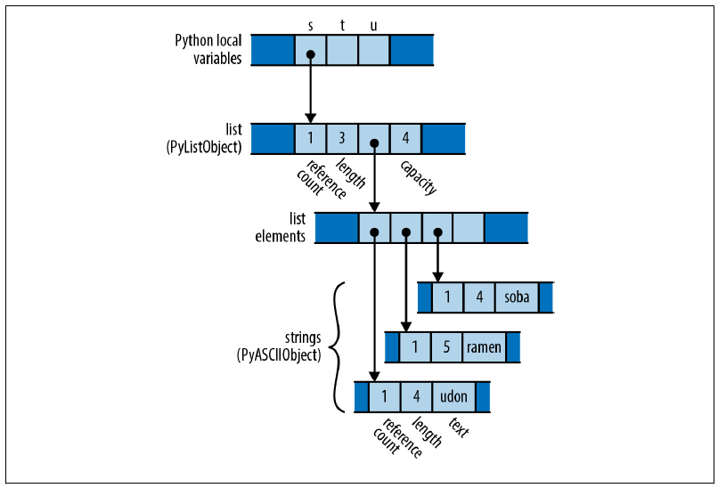

Ownership
Move vs. Copy
In Rust when we assign the value of one variable to another, the value is moved. Ownership changes.
Let’s compare this with what happens in Python and C++
Python
s = ['udon', 'ramen', 'soba']
t = s
u = s

Slide 5
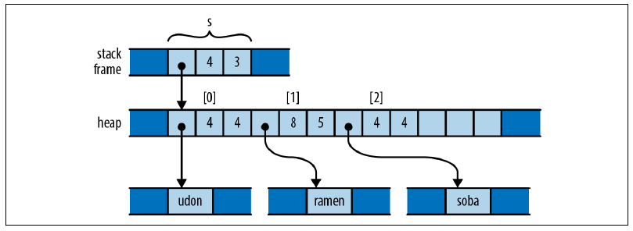
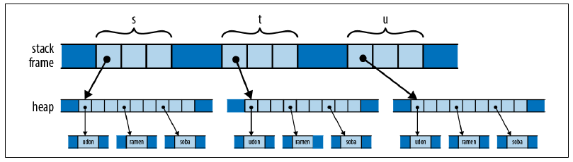
Ownership
Move vs. Copy
In Rust when we assign the value of one variable to another, the value is moved. Ownership changes.
Let’s compare this with what happens in Python and C++
C++
using namespace std;
vector<string> s = {"udon", "ramen", "soba"};
vector<string> t = s;
vector<string> u = s;

Slide 6
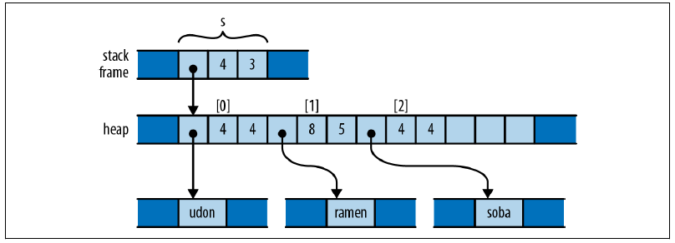
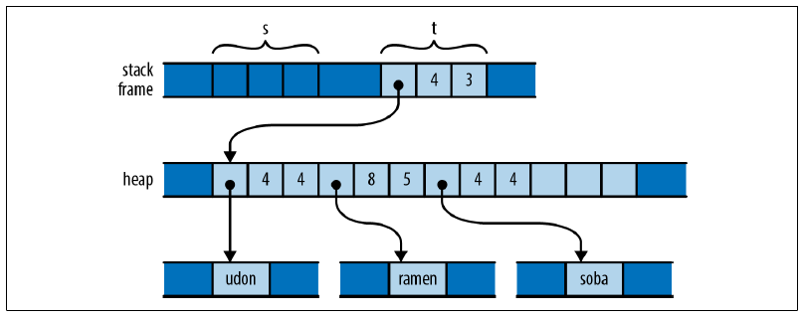
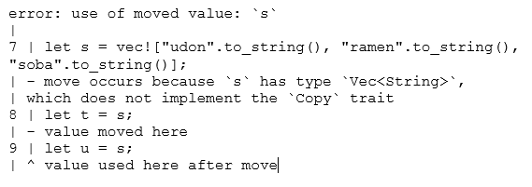
Ownership
Move vs. Copy
In Rust when we assign the value of one variable to another, the value is moved. Ownership changes.
So, what happens in Rust?
Rust
let s = vec![ "udon".to_string(), "ramen".to_string(), "soba".to_string()];
let t = s;
let u = s;

Slide 7


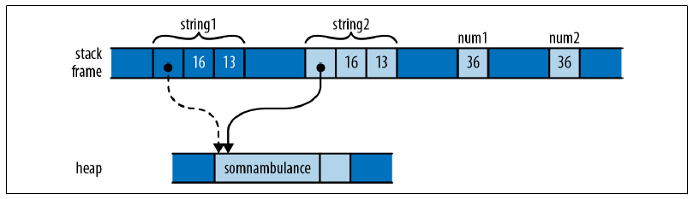
Copy-Types
Rust does make exceptions for types that can reside completely in the stack:
Integers
Floating-point numbers
Booleans
Characters

Slide 8
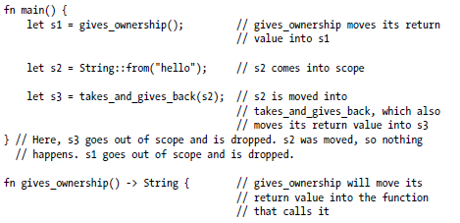
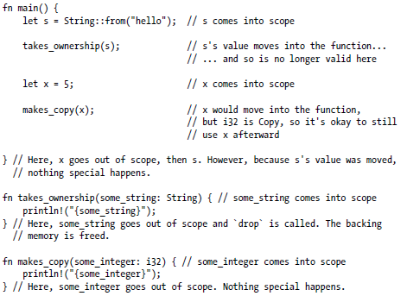
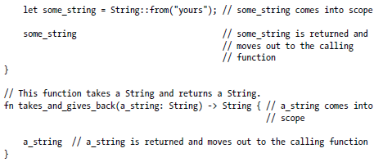
Functions
Passing non-copy values (located on the heap) to a function transfers ownership to the function.
Passing values from the stack does not.
A function that returns a value on the heap transfers ownership to the calling scope
Functions can take ownership and return ownership of the same object

Slide 9
Next Time...
Chapter 4
Finish Ownership

