Slide 1
Introduction to Scala
COMP 4210
David J Stucki

Slide 2
ALERTS
Get Scala 4th ed. text asap
Read chapters 1-3 for Monday (or asap)
Download, install, & become familiar with IntelliJ (with Scala addin)
You should join CS Club!!

Slide 3
4th Annual Women in STEM Panel Tuesday, Jan. 26 4:00-5:00 pm
Panelists: Carol Ventresca, President & CEO, Syngenics
Reagan Nemec, Virtual Maturation Engineer, Honda
Sarah Hoagland, Tax Manager, SchneiderDowns
Allie Brackbill, Customer Support Manager, CEM Corp.
Dr. Nita Seibel, Head of the Pediatric Solid Tumor Therapeutics, National Cancer Institute
Alexis McQueen, Software Engineer, JP Morgan Chase Moderated by Dr. Elena Caruthers, Assistant Professor, Engineering
Register via Handshake https://otterbein.joinhandshake.com/

Slide 4
History
École Polytechnique Fédérale de Lausanne (EPFL) (in Lausanne, Switzerland)
Martin Odersky, in 2001, began working on a new language
He previously had worked on Generic Java (added to Java 5) and implemented the GJ compiler that became the basis of the javac compiler
Scala was designed to be both functional and object-oriented from the beginning, and was also designed as a statically typed language that would run on the JVM.
A public version was released in 2004, with version 2 following in 2006.
The current version is 2.13.4

Slide 5
Scala by Design
What does it mean to be object-oriented?
Objects, classes, inheritance, polymorphism, overloading, encapsulation, info-hiding, ...
What does it mean to be functional?
Mathematics, recursion, side-effects, first-class functions, lambda functions (literals), ...
What does it mean to be statically-typed?
Type annotation, type inference, mutable & immutable, type-checking, ...
What does it mean to run on the JVM?
Java bytecode (.class), interoperability, ‘run everywhere’, ...

Slide 6
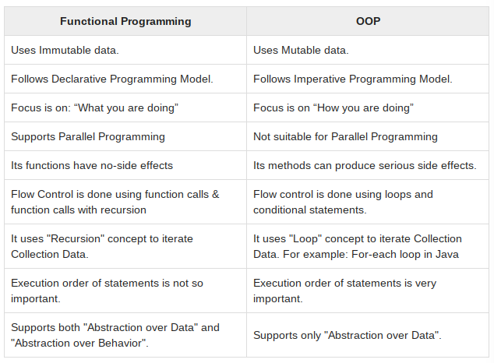
Multi-paradigmatic
Functional programming has its origins in the 1930s research of Alonzo Church and the 1958 introduction of John McCarthy’s LISP language
Object-oriented programming has its origins in the 1960s language Simula and Alan Kay’s Smalltalk of the 1970s
Historically these paradigms have been independent and largely incompatible
Modern languages such as Ruby & Python have incorporated aspects of both (and Java and Scheme have both evolved to include both), but none of these fully integrated the two paradigms
Scala is fully object-oriented: every value is an object
Scala is fully functional: every function is a value (including methods)

Slide 7
Scala...BLE
The language design incorporated modern abstractions that allow the language to be easily extended in ways that make new features ‘look and feel’ like they are built in syntactically even though they are not.
Methods can be named with non-traditional non-identifier symbols and be defined to use operator syntax
In fact, every operator in Scala is really a method
Ex: recipient ! msg (see chapter 1)
Ex: mywhile (i < 1) {...
New types can also be cleanly integrated into Scala’s natural syntax
The language can ‘grow’ organically without becoming cumbersome.

Slide 8
Why Scala? (if you’re not already convinced...)
Runs on the JVM (Compatible)
Can use any Java code in Scala
Almost as fast as Java (within 10%)
Much shorter code (Concise)
Odersky reports 50% reduction in most code over Java
Local type inference
Fewer errors (Safe)
No Null Pointer problems
More flexibility (Fun)
As many public classes per source file as you want
Operator overloading
in Java 1.5: Pair p = new Pair<Integer, String>(1, "Scala");
in Scala: val p = new MyPair(1, "scala");

Slide 9
DEMO
Let’s play around with it a bit...

