Slide 1
Docker
Kyle Miller & Austin Rheyne

Slide 2
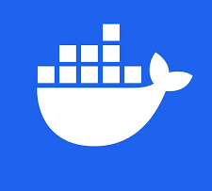
What is docker
Open source
Stores applications in containers
OS-level virtualization

Slide 3
Life before Docker

Slide 4
App deployment before docker
App built for Windows 7
Needs to query a database on a Linux server
Works fine on your machine…
…but fails in testing because of missing dependencies, version conflicts, or configuration differences
Deployment requires manual setup and environment matching across machines
What if Windows 7 becomes obsolete?

Slide 5
Containers before Docker
Package code + dependencies together
Run consistently across any environment
Build once, run anywhere
Start up fast and use few resources
Difficult to set up
Requires deep knowledge about RunC

Slide 6
Why Docker?

Slide 7
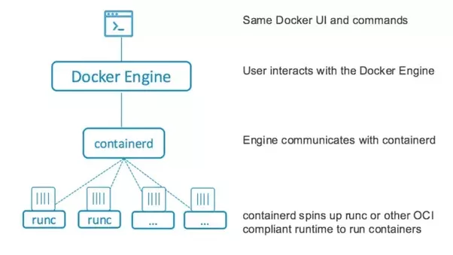
Containerization through docker

Slide 8
Docker Images
Just as a Java class defines how objects behave, an image defines how containers behave.
Blueprints for containers
Contain code, dependencies, and configurations
Typically immutable once built
Created from Dockerfiles

Slide 9
Docker Containers
Just like Java objects are created from classes, containers are created from images.
Instances of Docker images
Contain a running copy of the image
Mutable while running (you can modify data inside)
Changes disappear when the container stops (unless saved via volumes)

Slide 10
Dockerfiles
Common commands:
FROM – base image
RUN – execute shell commands
COPY – move files into the image
WORKDIR – set working directory
EXPOSE – declare ports
CMD – define default command to run
Define how to build your own image
Contain step-by-step instructions

Slide 11
Docker Compose
Compose simplifies orchestration. One command can launch your entire stack.
Uses a compose.yaml file
Launches multiple containers together
Handles networking and dependencies automatically
Ideal when your app needs databases, APIs, or frontends running together

Slide 12
Key Takeaways
Consistency – If it works on your machine, it works on the server.
Efficiency – Run many lightweight containers instead of heavy VMs.
Speed – Start, stop, and test apps in seconds.
Isolation – Each app has its own environment, no dependency conflicts.

Slide 13
Why It Matters
Scalability – Build small, lightweight systems that scale easily.
Portability – Run containers anywhere — local, cloud, or server.
Real-world impact:
Faster development cycles
Easier collaboration across teams
Predictable deployments every time

Slide 14
Live Demo

