Slide 1

Flask
Colm Oneacre

Slide 2
History
The why?

Slide 3


April fools gone right
Released by Armin Ronacher in 2010
Released for free with open-source distribution
Named after existing Python framework "Bottle"

Slide 4
Overview
What is it?

Slide 5

Micro framework
Called lightweight or micro
  Core functionalities are very limited
Minimal dependencies
  Werkzeug, Jinja, ItsDangerous, Click, Blinker
One of the most popular python frameworks

Slide 6
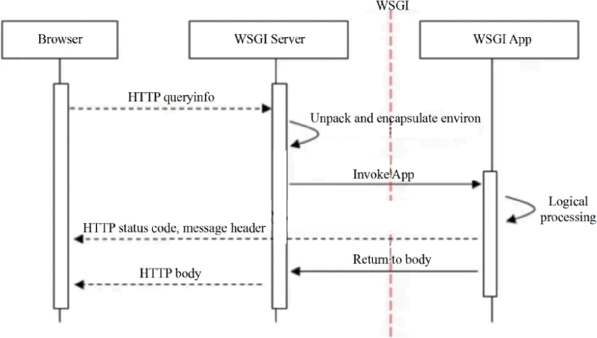
Basics
After the user sends an HTTP request to the Server through the client browser, WSGI Server forwards the request to WSGI App, which completes the logical processing of the request and returns the processing result to the server. WSGI App can include several stack middlewares, which need to implement both Server and App at the same ...
Based on WSGI standard
Routes URLs to functions
Supports Jinja2 templates
Additional extensions allow for much more versatility

Slide 7
Nice and simple
Creating a functioning flask program requires only 5 lines
Import
Create 'application'
Assign route (decorator)
Create function
Run application
Notes:
Make hello world application in intellij
Explain each line, especially route/decorator

Slide 8
Dynamic URLs
Placeholders are used as variables
Can be declared in route(decorator), and passed as an argument in the function
Defaults to string but can be converted
Notes:
Modify previous hello world example
Add new function that gets the <username> in the route

Slide 9
Templates
Flask uses Jinja2 for templates
Templates contain both static and dynamic content
Usually stored in a folder called 'templates'
In templates, {{ }} allow us to use variables,
{% %} allows us to use loops and logic
render_template()
  Function used to load html file called upon
  Flask automatically knows to look into template folder
Notes:
Show an example of render_template

Slide 10
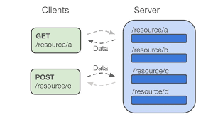
Forms and Requests
request.method - HTTP method (GET, POST, etc)
request.form - POST form data
request.args - Query string data (GET)
request.json - JSON data from API request
request.files - uploaded files
request.headers - HTTP headers
request.cookies - browser cookies
Forms allow for user input
Request object in Flask allows you to access POST and GET requests

Slide 11
Extensions
Flask-SQLAlchemy --> database
Flask-login --> authentication
Flask-mail --> email
Flask-RESTful --> APIS's

Slide 12
Flask vs. django
FLASK
Microframework
Lightweight
Very fleixble
Best for APIs, or small to medium sized apps
DJANGO
Full-stack
Heavy (with structure)
Moderate flexibility
Best for large apps

Slide 13
Thank you
Questions?

