Slide 1
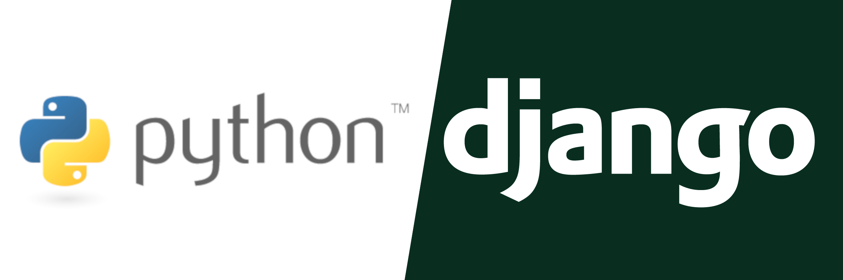
Django
With thanks to Eric Terranova, Shabib Ahmed and Dylan Burns

Slide 2

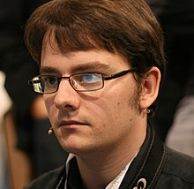
History
Created in 2003 by Adrian Holovaty and Simon Willison
Released in July 2005
Named after the guitarist Django Reinhardt
In 2008, the Django Software Foundation (DSF) was established to maintain Django
Was made from a practical need to match the fast pace of a newsroom

Slide 3
What can Django do? – Project Types
Financial platforms with features for analyzing and calculating results based on data
Customer Relationship Management (CRM) systems
Platforms that provide communication between a business and consumer
Shopping platforms
Mobile apps that support web applications
Many more high-load platforms

Slide 4



Who uses Django?
Instagram
Spotify
Reddit
Pinterest
Dropbox
Mozilla
NASA

Slide 5
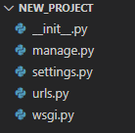
Creating a Project
__init__.py – empty file, tells Python that this directory is a Python package
manage.py – command-line utility for admin tasks
settings.py – settings for the project, like the host
urls.py – URL declarations for the project
wsgi.py – entry point for WSGI web servers to access your project

Slide 6
How Django Works
The Django Server receives a URL request
Urls.py checks the URL and then calls the matching view
The view in view.py checks the models for the correct information
The view then sends the correct information to a template
The template then inputs the data needed into the correct Django tags within itself
The completed template is then sent to the user

Slide 7
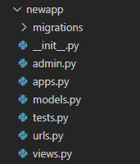
Projects vs Apps
Django projects house different apps, which are made in a different Python package
Apps carry out a task or system, the project is a collection of all of the apps
Creates a new directory for your app that houses the application

Slide 8
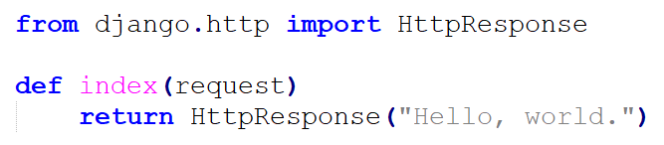
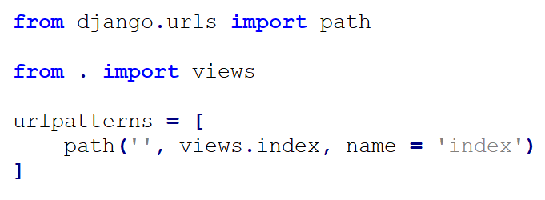
Hello World
In the newapp/views.py file
Next step is to map the view to a URL, done in the newapp/urls.py file

Slide 9
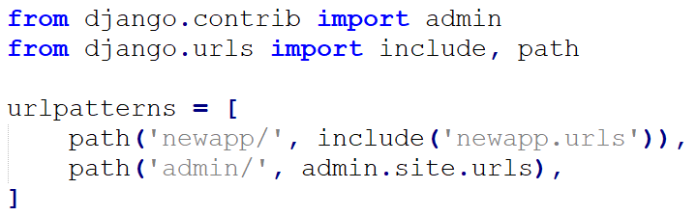
Hello World
The next step is to point the app URL to the project URL, in new_project/urls.py
You must always use include() when pointing URLs from apps, with the exception of admin.site.urls

Slide 10
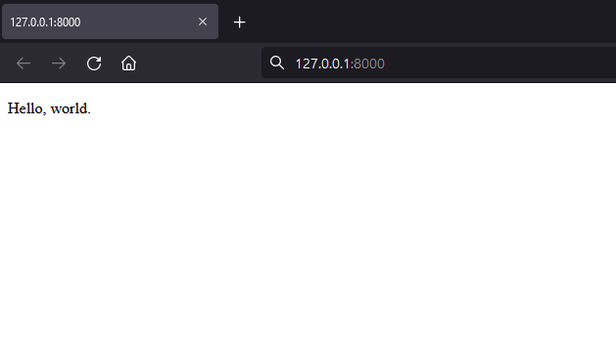
Hello World
Go to http://localhost:8000/newapp in your browser

Slide 11
Other Topics
Object-relational mapper
URLs and views
Templates
Forms
Authentication
Admin
Internationalization
Security

Slide 12
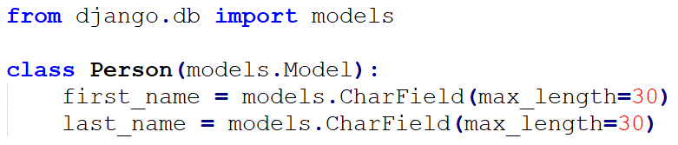
Object-Relational Mapper
Allows you to define data models and classes entirely in Python
A model is a Python class that inherits from django.db.models.Model
Models are used in databases, where each model attribute represents a database field
first_name and last_name are the fields of the model, specified as a class attribute, and each attribute maps to a database field

Slide 13
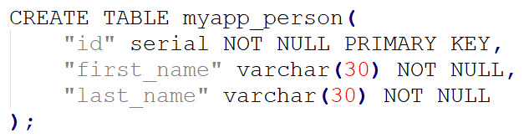
Object-Relational Mapper – Models
The Person model would create the following database table:

Slide 14
Object-Relational Mapper – Fields
Models are built off of Fields, which should be an instance of the Field class
The instance determines the type of the database column, which could be different types (integer, varchar, text)
Assists with HTML in determining how to render a field
Field classes contain options, like max_length, on_delete, null, blank, and more

Slide 15
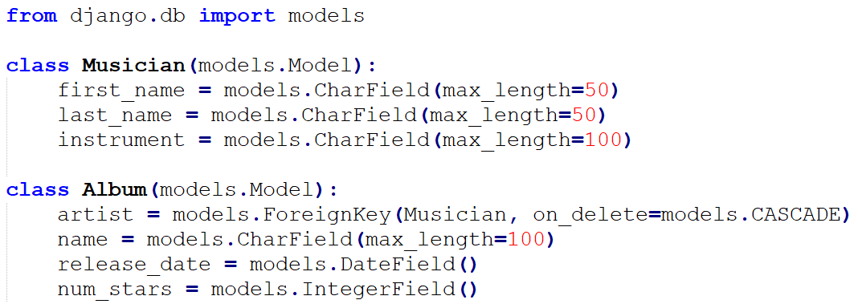
Object-Relational Mappers – Model Example
Defines Musician and Album models, each taking several fields
models.ForeignKey(Musician) is known as a many-to-one relationship, for example an Album model has a Musician, which can make multiple albums but each Album only has one Musician

Slide 16
Object-Relational Mappers – Model Relationships
Relationships are commonly many-to-one, many-to-many, and one-to-one
models.ForeignKey: many-to-one, a Car model has a Manufacturer, which makes multiple cars but each Car only has one Manufacturer
models.ManyToManyField: Pizza model could have many Topping models
models.OneToOneField: used when a primary object extends another object, say you have a database of places (address, phone number, etc). Now say you want a database of restaurants on top of these places, rather than re-creating each place as a restaurant would could make a Restaurant model have a OneToOneField to Place

Slide 17
URLs & Views
When a user requests a page, the system goes through several steps to determine which Python code to run
Django determines the root URLconf module to use, usually the value of the ROOT_URLCONF, located in the myapp.urls file
Module is then loaded, and Django looks for the variable urlpatterns
Django runs each URL pattern in order and stops when it finds one that matches the requested URL

Slide 18
URLs & Views – Example
URLconf file from the Hello World example

Slide 19
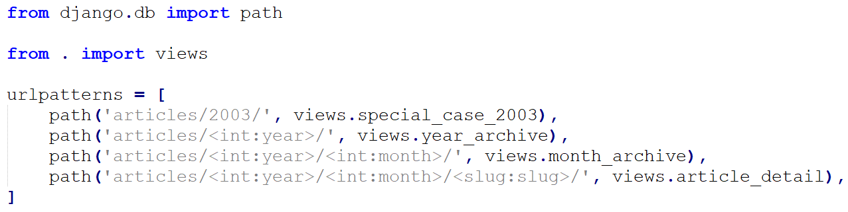
URLs & Views – Example
Sample URLconf
A request to /articles/2003/ would match the first pattern on the list, because patterns are tested in order. The function views.special_case_2003 would be called

Slide 20
Templates
Generate HTML dynamically, using a template engine
Text document or Python string marked-up using the Django template language
Variables ({{ variable }}, tags ({% tag %}), filters ({{ title|lower }} ), and comments (# comment)
django.template.Engine is an instance of the Django template system
django.template.Template is a compiled Template
django.template.Context is passed to Template.render() for rendering a template

Slide 21
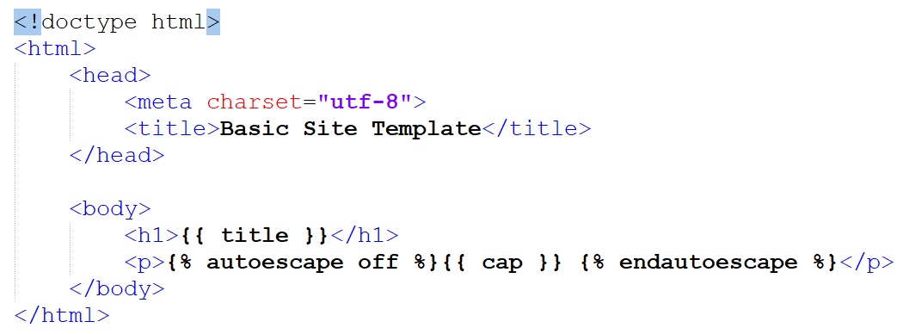
Templates – Example
Basic template file, called home.html
Plain html besides the variables title and cap, inside {{ var }}
{% autoescape off %} allows actual HTML to be output and not plaintext

Slide 22
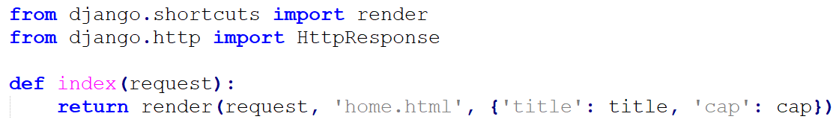
Templates – Example
After creating a template, add the render() function to the \events\views.py file
This calls the render function, which looks for the home.html template file
render() takes a template and returns an HttpResponse object

Slide 23
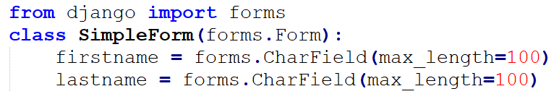
Forms
Required if you want to accept input from users
Used alongside HTML’s <form> tag, but must validate data entered
Django’s Form class takes care of most form processing and validation through the use of Form.is_valid() and Form.errors methods
Add path to form file in the urlpatterns variable in urls.py

Slide 24
Other Concepts
User authentication: Django handles accounts, groups, permissions, and cookie-based sessions
Issues that come along with core Django are solved through third-party packages
Django admin site: provides an interface where trusted users can manage content on your site
Internationalization and localization: allows a single Web application to offer its content in languages and formats catered to the audience
Django has full support for text translation, date/time formatting, and time zones
Security: Django protects against cross-site scripting, forgery, SQL injections, clickjacking, user-uploaded content, and more

Slide 25
References
https://www.djangoproject.com/
https://www.pythonforbeginners.com/learn-python/what-is-django
https://djangostars.com/blog/why-we-use-django-framework/
https://www.education-ecosystem.com/guides/programming/django/history
https://cs-geonode.readthedocs.io/en/2.8_a/tutorials/devel/django_overview/getting_ started_w_django.html
https://djangobook.com/

