Slide 1
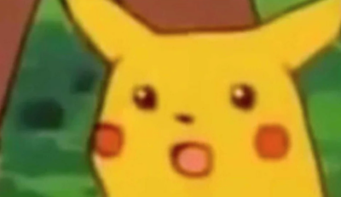
Django presentation
Website development in Python!?!?!?
By Paul Boris

Slide 2

What is Django?
Django is...
A web framework that is based in Python and made for complex data driven websites.
Free to use and open source.
Easy to use, codes fast and eliminates redundancy in the coding process.
Has regular updates and bugfixes from the developers, alongside an active community of users on.

Slide 3
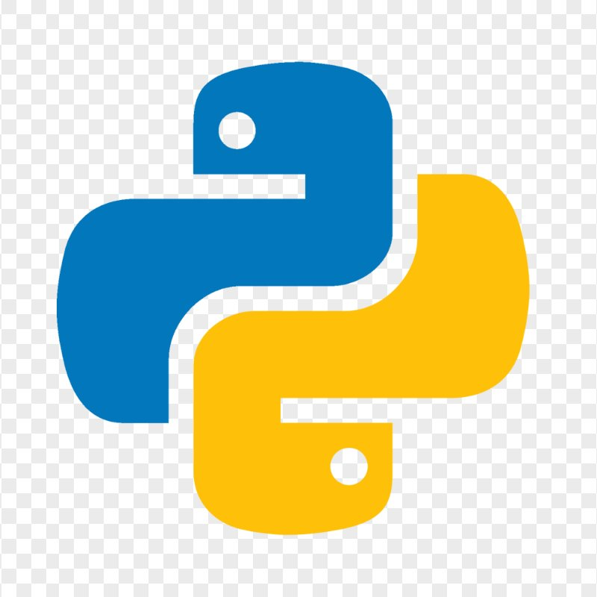
Why use Python over JavaScript?
Python syntax makes for easy to read and simple code, alongside a vast collection of libraries to implement.
The web developments tools using python, like Django and Flask, are traditionally better at secure backend elements of your website like handling databases, math and logic. Thought this is not a hard and fast rule as Node.js was designed as a back end focused development tool for JavaScript.
Don't need to choose just one, many websites may use both, or add other languages, all for different aspects of the website.

Slide 4
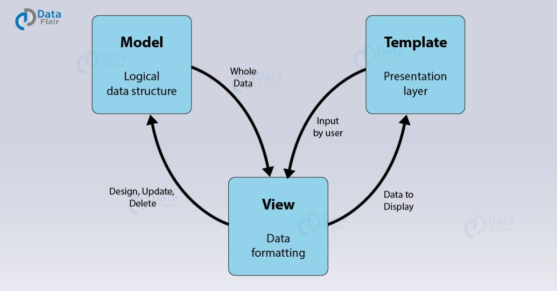
How does Django work? With MVT!
Django uses the Model View Template (MVT) design pattern to divide tasks.
Model – Data you wish to use or display from a database.
View - Holds functions that interacts with HTML requests, pulls information from the model and returns the relevant data.
Template - Dictates layout and format or data presented.
Other files do exist like URL files that stores the distinct URL configs for each page or your website, and apps that divide your project into distinct elements, like a home page or a poll system, but the backbone of Django is in these 3 concepts.

Slide 5
Model- data storage
Django stores data as Object Relational Mapping (ORM) instead of requiring complex SQL statements, this makes interacting and finding your data easier. On the developer end, the model portion is typically stored in a models.py file and contains classes that dictate what kind of information the class type stores via django.db models methods.

Slide 6
View – deals with information
The view is comprised of Python functions that interact with and connect the model and the template. These functions are stored in a views.py file. Each function inputs a specific HTTP request, gets relevant data from the model, and returns an HTML file from the template section.

Slide 7
Template- the HTML
Traditionally the template portion of the design pattern is comprised of a templates file storing HTML files that dictate how your webpages look and how your data is displayed on it. Django is also compatible with other formats, though we will not be covering that. Unlike basic HTML, Django allows you to add python script directly into the HTML files with Django Tags, brackets that look like this {% %}.
For example...
{% if message == True %}
<h1>Hello special user!<h1>
{% else %}
<h1>Hello.<h1>
{% endif %}

Slide 8
Before we get into coding!
I only have a Windows machine to show you. Mac and Linuix users will need to go through the same operations, but they have different syntax then the Windows examples I am showing. If you have any questions or are not using WIndows, I recommend using Django's official start page and/or W3 schools' Django learning tutorial, which will both show you how to install Django and create a simple project.
https://www.djangoproject.com/start/
https://www.w3schools.com/django/index.php

Slide 9
Installing Django.
Before you install Django, you'll want to make sure you have the latest versions of Python and Pip.
You must also create a Virtual Environment for your project and Django to reside in, you can do this via python commands through your command prompt with the line "python –m venv myenviornment" where myenviornment is the name of the folder you want your virtual environment to be contained in and can be any name you want.
Then activate the environment by typing "myenviornment\scripts\activate.bat" This must be done every time you want to work in the environment.
Finally, we can install Django through pip by typing "python –m pip install Django"

Slide 10
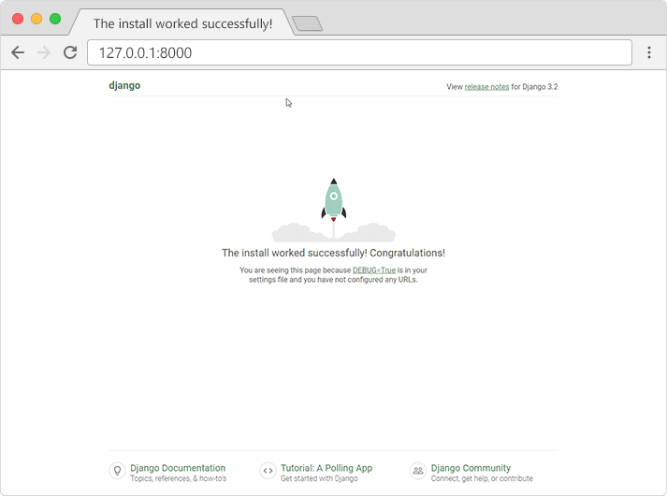
Starting a Project folder
Simply navigate to your folder in the virtual environment, and type into the command prompt,
"django-admin startproject myproject" Where again, my_project will be the name of the project file created and can be whatever you want it to be. By navigating to the project folder you can type
"python manage.py runserver" and type the HTTP link it gives you into a browser to confirm you successfully created a project!
Example: Starting development server at http://127.0.0.1:8000/

Slide 11
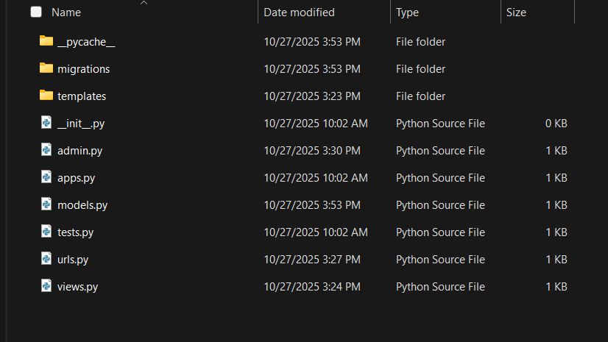
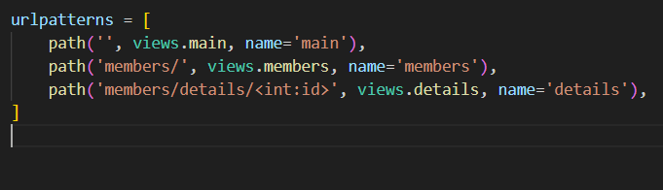
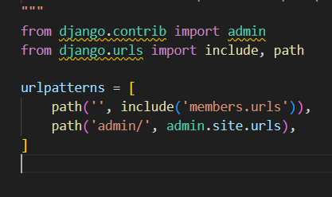
Creating an app
Simply calling "python manage.py startapp appname" will create a folder with several mostly empty .py files in it. Afterwards you'll need to edit the urlpatterns data in both the urls.py files in appname and myproject to connect them. Appname's urls adds
"path('appname/', views.appname, name='appname')," and myproject's urls gets "path(' ', include('appname.urls'))," This will allow us to connect to our template page via the views.py file once we finish building that.

Slide 12
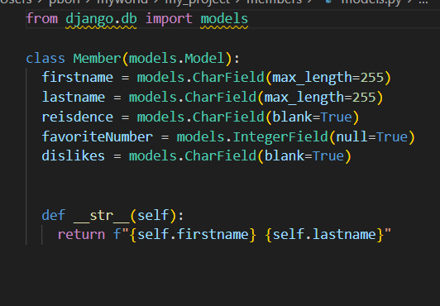
Making the Model
For each model you wish to use in your app, you must make a class of that data type in models.py. After updating the model you'll need to run some commands to update the database. Run both the
"python manage.py makemigrations modelname"
And
"python manage.py migrate"
And a table of that data type will be created.

Slide 13
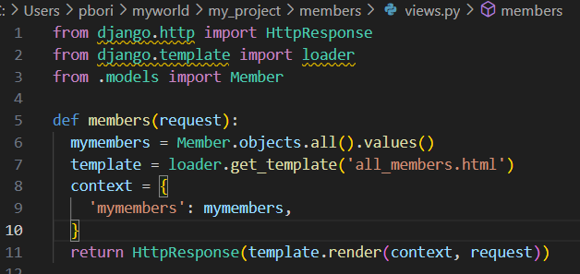
Editing the view
For each page views.py will need a new function, and you need to import each of your model classes. Each function will input a request, get the relevant model data and template file and return it with the HttpResponse method.

Slide 14
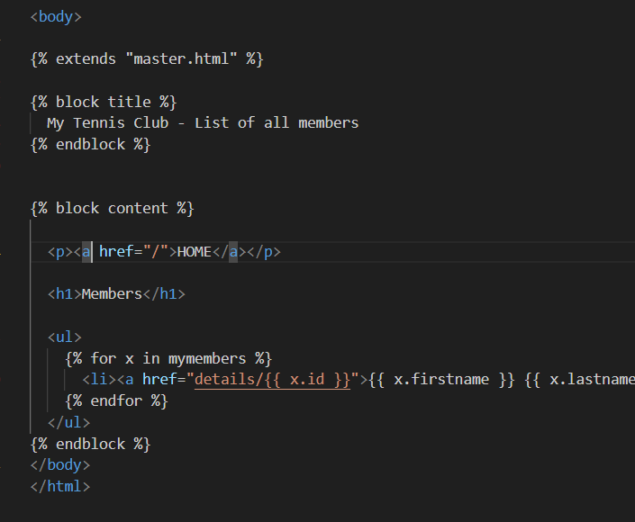
Add the template
Each view function you make will need a different HTML file, usually with Django tags to display whatever data you want from the model. Just like the if statement example earlier, Django lets you use loops in the same way to easily display multiple data points.

Slide 15
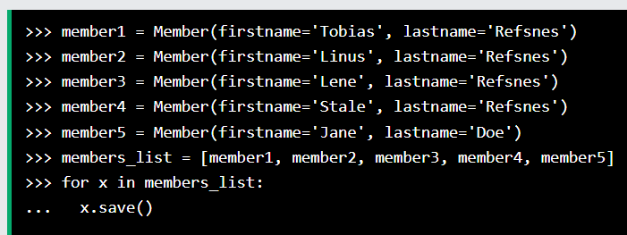
Adding data via command prompt
To add data via command prompt, call the Python shell by "python manage.py shell" Then import "from appname.models import Modelname" From here you can add to the model by making an instance of the model and calling "Modelname.save"

Slide 16
Running your test server
Typing "python manage.py runserver" will run the server and allow you to run the website on a browser with the given link, like when starting a project. Remember to add /appname/ to the end of the initial link from when you first ran the webpage to get the right page.

Slide 17
QuerySets
This is how Django stores the information you make in the model section. QuerySets have several associated functions you can call in your python scripts, including but not limited to.
values() - returns objects as a Python dictionary.
Values_list() - returns specified column of data.
Filter() - returns specific object or row as dictionary.
Order_by() - sorts set by ascending value inputted. Can sort by descending with a – value and by two inputted values.

Slide 18
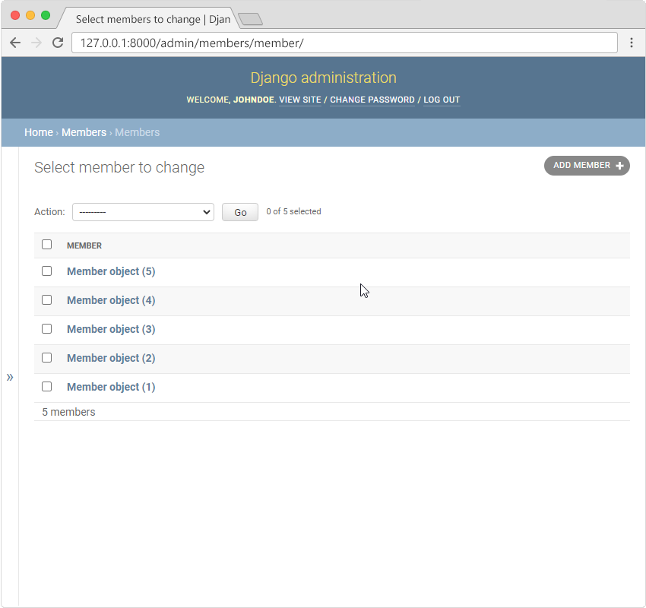
Django admin
Django lets you add to your database via the command prompt, but while this is fine for testing if your code is working right, it's clunky and hard to share with multiple people in a big project, which is where Django Admin comes in. Simply run "python manage.py createsuperuser" and input your username, Email, and password to creat a user for your project, then in the admin.py file import the models you want to edit form members and add "admin.site.register(modelex)" and you can use the admin server link to edit your data from there!

Slide 19
Pros of Django?
Free, scalable and easy to use, with very good documentation from developers.
Eliminates redundancy.
Very good security features employed without any setup required, important for many kids of data.
Lots of community support.
Versatile

Slide 20
Cons?
Specialized- Overkill for simple projects or ones not focused on data.
Needs a virtual environment to code.
Can make your website slow to load.
Often requires the programmer to know all aspects of the project before they start coding.
No coding conventions- not always a downside for some developers but combined with the above point could slow development for coders new to Django or reading someone else's code.

Slide 21
Resources
Django website - https://www.djangoproject.com/
W3Schools - https://www.w3schools.com/django/index.php

