Slide 1

Ahmed and Ashley

Slide 2
What is it
Express is a fast, unopinionated minimalist web framework for Node.js
Simplifies server-side deployment
Provides an easy way to create a web server and render HTML pages for different HTTP requests by configuring routes for your application
Handles HTTP requests, routing, and middleware

Slide 3
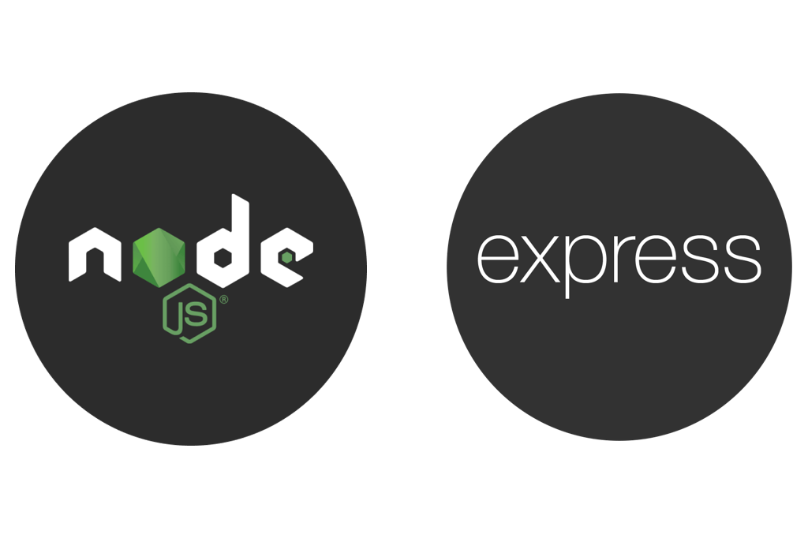
History
Created in 2010 by TJ Holowaychuk
Node.js allowed developers to write web applications using JavaScript, the language of the web, and to use asynchronous and event-driven programming, which enabled high performance and scalability.
However, Node.js also lacked some of the features and abstractions that web developers were used to, such as routing, templating, middleware, and error handling.

Slide 4
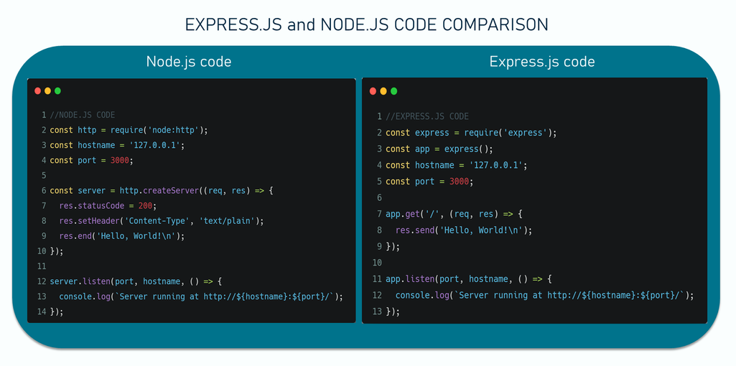
Node.js runs JavaScript on the server and provides core HTTP tools
Creating a full server in Node.js often requires repetitive code
Express.js is built on top of Node.js to simplify server development
Uses routes and middleware to handle requests efficiently
Provides flexibility to organize the project as desired

Slide 5
Basic Structure of an Express application
helloworld

Slide 6
Key features | Description
Middleware | Process request before they reach route
Routing | Map URLs to handler functions
Template engines | Render dynamic html pages
Robust API | Built-in methods for handling requests and responses
Community and ecosystem | Large support, plugins, and libraries

Slide 7
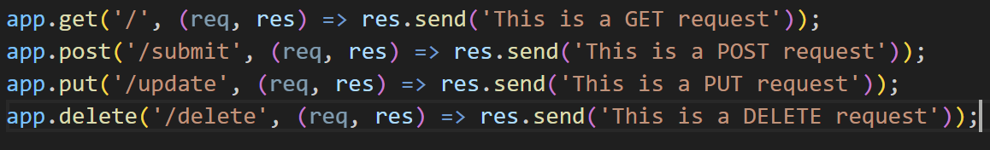
HTTP methods
Express allows you to handle different types of HTTP requests using methods
The most common methods are:
  GET: used to request data from the server
  POST: used to send data to the server
  PUT: used to update existing data on the server
  DELETE: used to remove data from the server
Each method has its own function in Express
You define a route and a callback function to handle what happens when that request is received

Slide 8

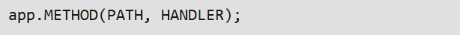
Mapping incoming HTTP requests to specific handler functions
Enables configurations of endpoints for various paths and operations
Tasks like rendering view and processing form data
Routing

Slide 9
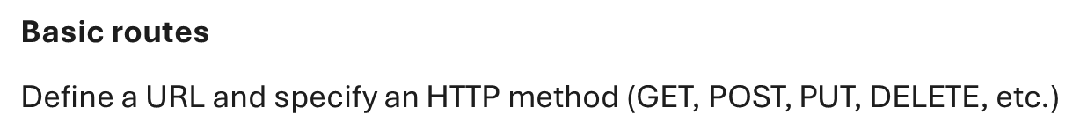

Types

Slide 10
Middleware
Functions that process requests before reaching the route handlers
Modify the request and response object
End the request-response cycle
Call the next middleware function
Executed in the order they are defined
Some tasks are authentication, logging, or error handling
Help separate concerns and manage complex routes efficiently

Slide 11
Types
Application-level
Bound to the entire Express application using app.use() or app.METHOD()
Executes all routes in the application
Commonly used for logging, authentication checks, and setting headers for every incoming request
Router-level
Applied to a specific router instance using router.use() or router.METHOD()
Executes to routes defined within the particular router
Commonly used in group related routes like user management to apply middleware logic to them
Error-handling
Used to catch and respond to errors during the request-response cycle
Essential for sending an error response and preventing unhandled exception
Built-in
Helps with common tasks like serving static files and parsing data

Slide 12
Error Handling

Slide 13
Types
Default Error Handler
Built-in to catch any errors that aren’t handled
500 Internal Server Error is default response
Custom Error-Handling Middleware
Logs errors and send user friendly response
Handling Error with next(err)
Forwards errors to Express's error handler manually inside
Synchronous Error Handling
Express.js automatically catches errors in synchronous function
Asynchronous Error Handling
Async functions are not caught automatically by Express.js
Need to handle them manually using try-catch or pass them to Express.js using next(err)

Slide 14
Request and Response Objects
Arguments passed to route handlers and middleware functions enabling interaction with the client and server

Slide 15
Properties
Request
Response
req.app: Reference to the instance of the Express application
req.body: Contains key-value pairs of data sent in the request body
req.cookies: Contains cookies sent
req.ip: Remote IP address of the request
req.path: The path portion of the request URL
req.route: The currently matched route
res.app: Reference to the instance of the Express application using the middleware
res.locals: Object that contains response local variables scoped to the request

Slide 16
Methods
Request
Response
req.get(field): Returns the specified HTTP request header field
req.accepts(types): Checks which content types are acceptable based on the request accept HTTP header field
req.param(name [, defaultValue]): Fetches the value of param name when present
res.append(field, [value]): Appends the specific value to the HTTP response header field
res,attachment([path]): Sends a file as an attachment in the HTTP response
res.cooke(name, value [,options]): Sets a cookie name to value
res.download(path [, filename] [, fn]): Sends a file to be downloaded by the user
res,end([data] [, encoding]): Ends the response process
res.get(field): Returns HTTP response header specified by field
res.json([body]): Returns the response in JSON format
res.status(code): Sets an HTTP status for the response
res.type(type): Sets the content-type HTTP header

Slide 17
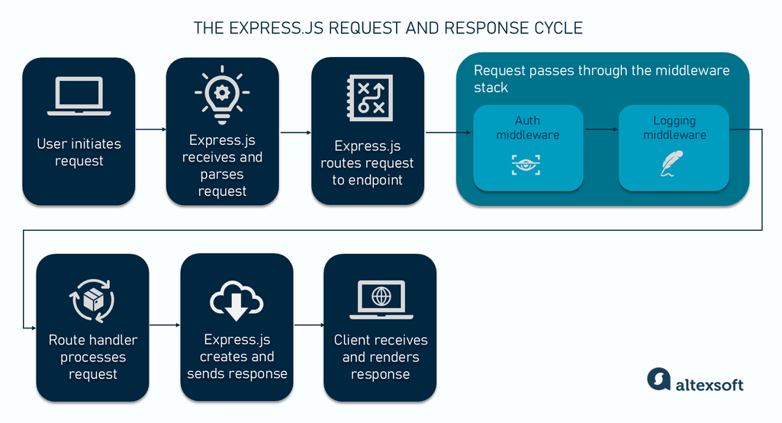

Slide 18
Pros
Lightweight and easy to use
Well-documented
Fast server-side development
Easily integrates with JS tools, libraires, and frontend frameworks
High performance and scalability
Supports many third-party plugins
Large community support
Cons
Unopinionated structure
Potential overhead
Limited built-in features

Slide 19
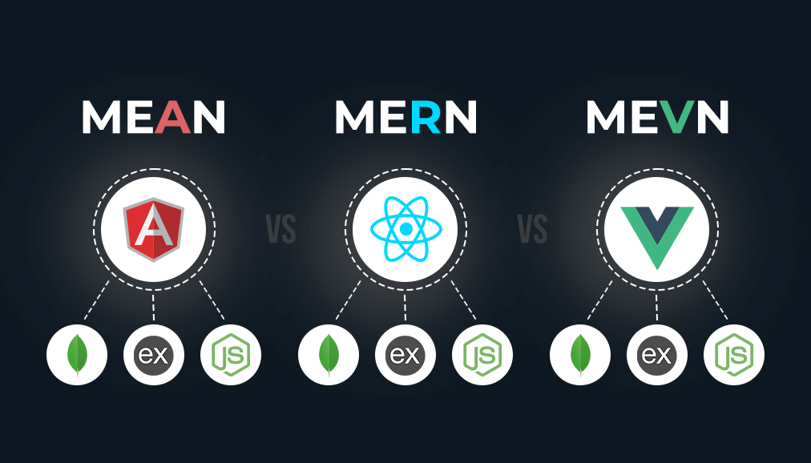
Delivering with confidence
Real world usage
Widely adopted across industries for fast, scalable web development
Core backend framework
Works with frontend frameworks (Angular, React, and Vue) and databases (MongoDB and MySQL)
Used by major companies like Uber, Netflix, IBM, and PayPal to manage APIs and backend services
Serves as the bridge between the frontend and database, handling routes, data requests, and responses

Slide 20
Conclusion
Express.js is a powerful and flexible framework that streamlines web development with Node.js. Its simplicity, modular design, and built-in support for routing and middleware make it an efficient choice for building modern web applications.

Slide 21
Questions

