Slide 1

Vue.js
Liticia Makhloufi & Kristin Nickerson

Slide 2

So, you might be wondering, what exactly is Vue.js
I don’t know… is it like a landscape view or something…

Slide 3

What is Vue.js?
Vue (pronounced view) is a JavaScript framework for building user interfaces. It builds on top of standard HTML, CSS, and JavaScript and provides a declarative, component-based programming model that helps you efficiently develop user interfaces of any complexity.

Slide 4

What is a framework again?
A JavaScript framework is a collection of JavaScript code libraries that provide a web developer with pre-written code for routine programming tasks.
Frameworks are structures with a particular context and help you create web applications within that context.

Slide 5
Back to Vue:
Vue is a front-end (the client-side of an application or website) JavaScript framework written in JavaScript.
Vue is distributed as a JavaScript file, and can be added to a web page with a script tag:

Slide 6
Why even use a frontend framework?
Enhanced UI
Organization
Performance
Modularity
Makes it easy to create UIs that are dynamic and interactive
UI is broken into components with their own state and properties
Optimized for performance with features such as the virtual DOM
Allow developers to break down their applications into smaller, reusable components.

Slide 7


Vue History
Evan You, a Google employee using AngularJS, started to develop Vue in 2013 as a personal side project.
Today, Vue is actively maintained by a team of both full-time and volunteer members from all around the world , where Evan serves as the project lead.
Vue version 1.0 was released in 2015.

Slide 8

Vue extends HTML attributes with Directives, and binds data to HTML with Expressions.

Slide 9

Data Binding
Yeah, I still don’t know what data binding means.
The most basic form of data binding is text interpolation using the "Mustache" syntax (double curly braces) {{ }}

Slide 10
What does data binding mean?
Data binding is the process of connecting and synchronizing two or more sources of data, so that when one changes, the other is automatically updated too.

Slide 11
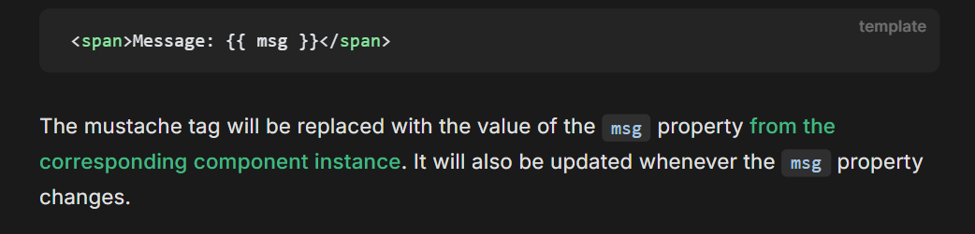
Text interpolation
The process of inserting new material into an existing text, often to alter its meaning, context, or to add new information.

Slide 12
MINI-DEMO TIME!!!
https://www.w3schools.com/vue/tryit.php?filename=tryvue_helloWorld

Slide 13
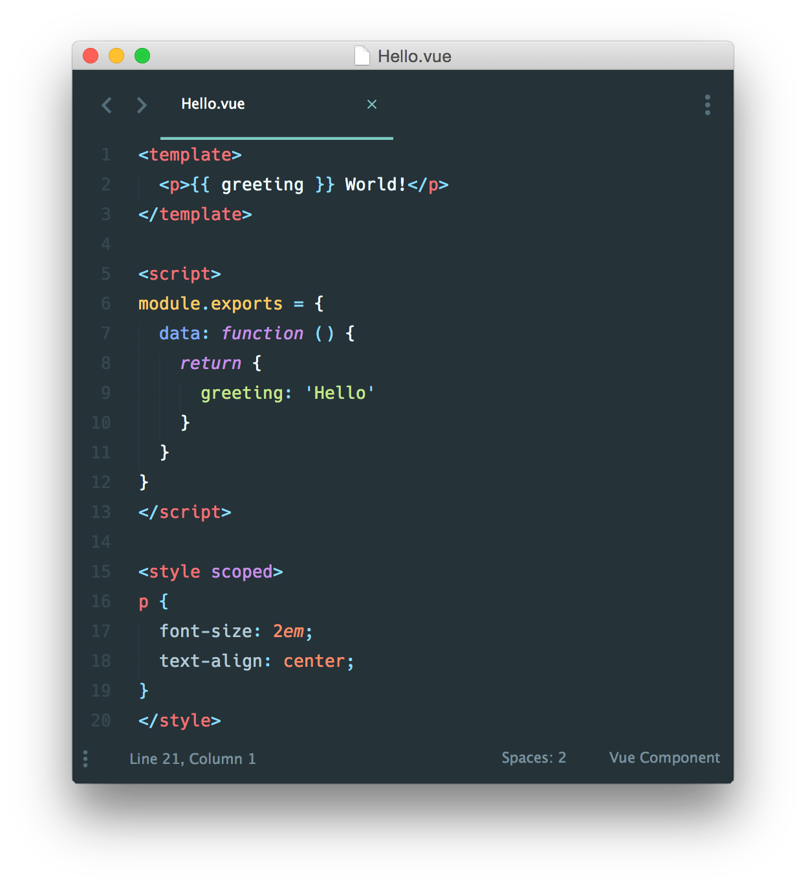
General Syntax
New Vue objects are created with "var object = new Vue()"​
"el: name" binds a Vue object to an HTML element with a specified ID​
HTML elements change when the bound vue elements change
{{ }} is used as a placeholder for data

Slide 14
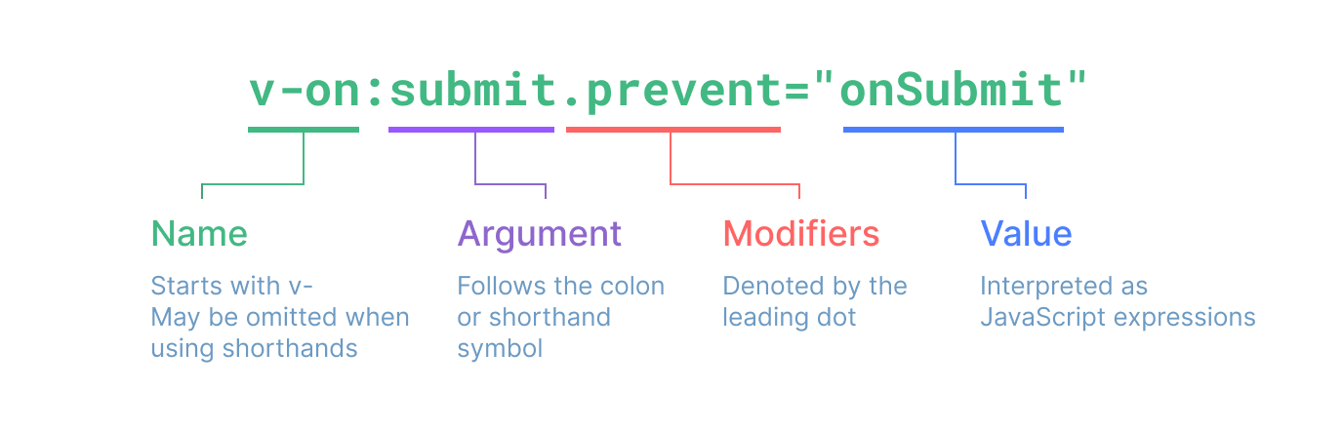
Directives Info
Directives are html elements with prefix v-
Directives offer functionality to HTML applications
Provides built in and user-defined directives

Slide 15
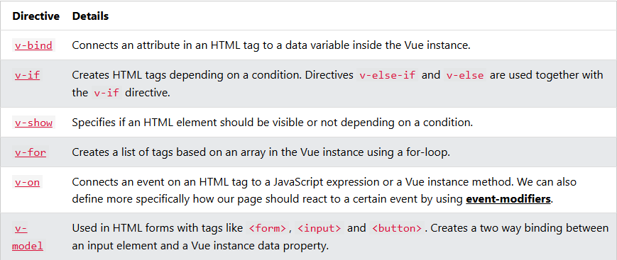
Directives

Slide 16
What are uses for Vue?
Standalone Scripts
Embedded Web Components
Single Page Application (SPA)
Server-Side Rendering (SSR)
Static-Site Generation (SSG)

Slide 17
Standalone Script
Easy way to integrate Vue, like a declarative replacement of jQuery
* Useful if the backend is already rendering most of the HTML or the frontend isn’t complex enough for a build step
There used to be a version called petite-vue, but that has stopped being maintained

Slide 18
EMBEDDED WEB COMPONENT

Slide 19
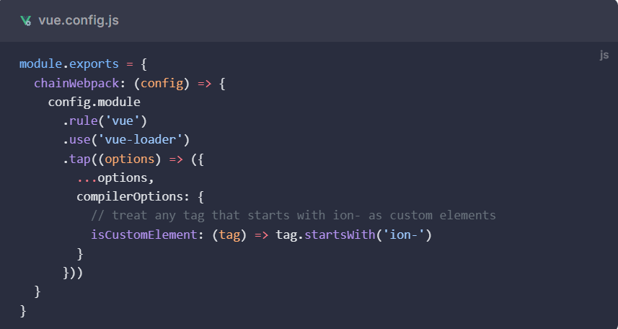
Vue will try to resolve non-native HTML symbols as Vue elements before considering a custom element
Custom elements can be specified using compilerOptions.isCustomElement

Slide 20
Vue automatically checks DOM property presence when creating properties for custom elements using the in operator and sets values as DOM property if the key is present
Means you won’t need to think about if a custom element follows the recommended best practices most of the time

Slide 21
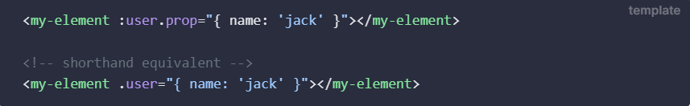
However there are cases where a custom element doesn’t properly define a property and causes an in-test to fail.
In this case you can force a binding to be seen as a DOM property using the .prop modifier

Slide 22
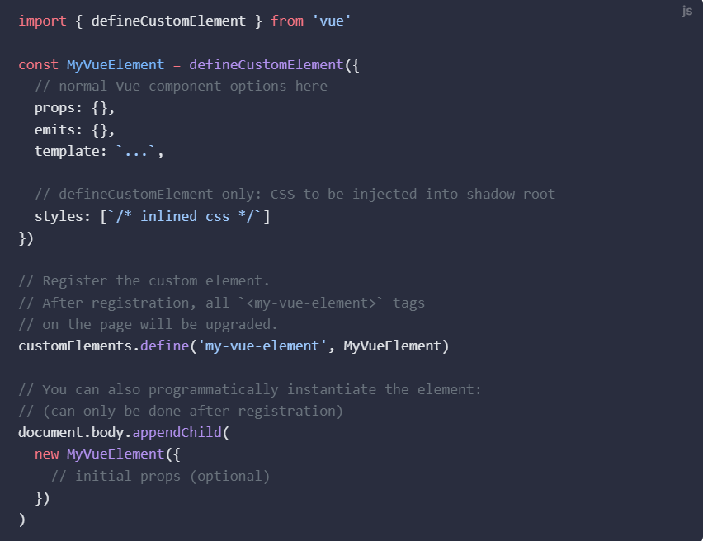
Vue allows creation of custom elements via the defineCustomElement method, returning a custom element constructor that extends HTMLElement

Slide 23
Properties declared in the props option will be defined on the element as properties. Vue automatically handles reflection between attributes and properties.
Attributes are reflected to corresponding properties.
Properties with primitive types are reflected as attributes.

Slide 24
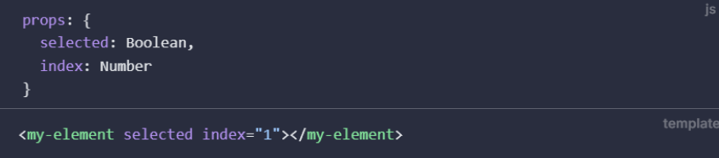
Vue also casts props declared with Boolean and Number types into the desired types when set as attributes.
In this example, selected will be true and index will be 1

Slide 25
Events triggered by this.$emit or setup emit are made to be CustomEvents on a CustomElement.
Any other event arguments will be put into an array as the detail property for the CustomEvent.

Slide 26
Single Page Applications
Web applications that require a lot of interactivity from the user
Vue handles the entire page, updating data and navigation without reloading the page
Vue also provides many libraries and comprehensive tools for building SPA’s

Slide 27
Server Side Rendering
SPA’s can take a while to load because of the high amount of JavaScript
Vue offers the ability for Vue to be rendered as HTML strings, so the user can see the content while the JavaScript downloads
This is referred to as a “hydrating” a website as Vue makes it interactive

Slide 28
Static Site Generation
Server-Side Rendering done before hand if the data is mostly static, improving performance and making deployment easier
Vue is able to still “hydrate” these pages to provide interactivity
There are two types of SSG’s, single page and multipage

Slide 29
Single Page SSG’s
After the initial page load the page is “hydrated” into a SPA
Requires more upfront JS and hydration costs, but navigations are faster since page content only needs to be updated instead of reloaded
Single Page SSG’s are better if you expect lots of interactivity, long session times, or consistent elements or states across navigations

Slide 30
Multi Page SSG’s
Loads a new page after every navigation, causing little to no JS to be shipped
Some frameworks allow for “partial hydration”, allowing use of Vue components to make interactive islands in static HTML
Better in most cases then Single Page SSG’s, so when in doubt use a Multi Page SSG

Slide 31
Transition
Vue offers two built-in components that can help work with transitions and animations in response to changing state:
<Transition> for applying animations when an element or component is entering and leaving the DOM.
<TransitionGroup> for applying animations when an element or component is inserted into, removed from, or moved within a v-for list.
Aside from these two components, we can also apply animations in Vue using other techniques such as toggling CSS classes or state-driven animations via style bindings.

Slide 32
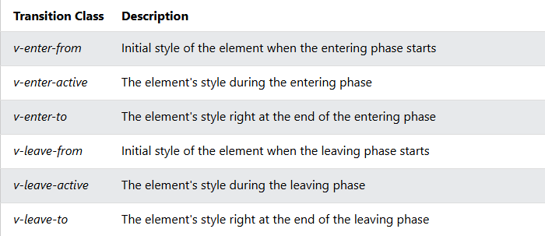
When we use the <Transition> component, we automatically get six different CSS classes we can use to animate elements when they are added or removed.
These classes are active at different stages when elements are added (enter) or removed (leave):

Slide 33
MINI-DEMO TIME!!!
https://www.w3schools.com/vue/ref_transition.php

Slide 34

If you think about it, these transitions are somewhat similar to the animations that power point provides.

Slide 35
There are two different ways to write code in Vue: The Options API and The Composition API.
The underlying concepts are the same for both the Options API and Composition API, so after learning one, you can easily switch to the other.

Slide 36
VS
Options API
Composition API
The Options API in Vue.js is the traditional method of building Vue components and has been a core feature of Vue since its inception. The Options API in Vue organizes component logic into clearly defined options like data, methods, and computed, offering a familiar and structured approach to managing component behavior.
On the other hand, the Composition API is a new way of building components in Vue 3 that was introduced to address some of the limitations of the Options API. The Composition API in Vue allows developers to use a functional, reactive programming style to build components, and it offers a more flexible and expressive way of defining component behavior.

Slide 37
Options API Limitations:
Even though the Options API is simple and easy to understand, as it follows a clear, declarative pattern that is familiar to many developers, and it is well-documented in the Vue official documentation.
However, one issue of this API is that it can become cumbersome to manage a large number of options as the complexity of a component increases. This can lead to a phenomenon known as "option explosion", where a component becomes so large that it is difficult to maintain.

Slide 38
Reusability Limitation
Another limitation of the Options API is that it can be inflexible when it comes to sharing logic between Vue components. If you want to reuse a piece of logic across multiple components, you need to either copy and paste the code or abstract it into a mixin. This can make it difficult to manage code dependencies and maintain code quality as the size of a project grows.
Note: In object-oriented programming languages, a mixin (or mix-in) is a class that contains methods for use by other classes without having to be the parent class of those other classes.

Slide 39
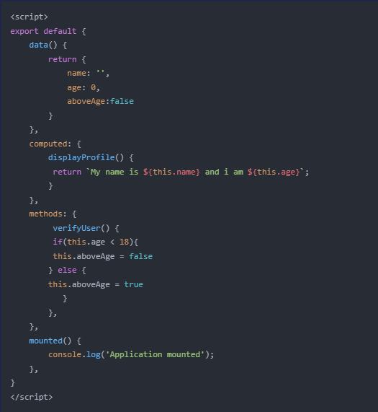
As you can see, this code is separated into mainly three options:
Data, computed, and methods.

Slide 40
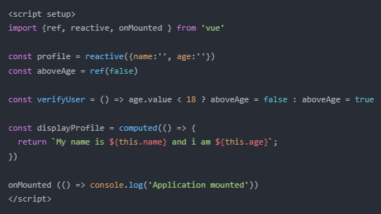
In Composition API the code style is more flexible

Slide 41
Well… All this is cool, but why bother learning Vue.js?

Slide 42
Why Learn Vue?
It is simple and easy to use.
It is able to handle both simple and complex projects.
Its growing popularity and open-source community support.
In normal JavaScript we need to write HOW HTML and JavaScript is connected, but in Vue we simply need to make sure that there IS a connection and let Vue take care of the rest.
It allows for a more efficient development process with a template-based syntax, two-way data binding, and a centralized state management.

Slide 43
You know… All this talk sounds like React.js… What is the difference?

Slide 44



Slide 45
VS
Vue
React
Adaptability: It gives bother free migration, basic, and efficient structure.
Components: They help in creating custom elements that can be reused in HTML.
Transition: Various methodologies are given in Vue.js to apply a transition to HTML components when they are included or expelled from the DOM.
Detailed Documentation: It gives a simple learning curve through the point by point documentation.
Scalability: It is reasonable for enormous scale applications because of its adaptable structure and scalability.
Rich JavaScript Library: Developers from everywhere throughout the world are placing in an exertion to include significantly more features.
Code Reusability: It enables the developers to reuse the code components of different levels while working on the project.

Slide 46
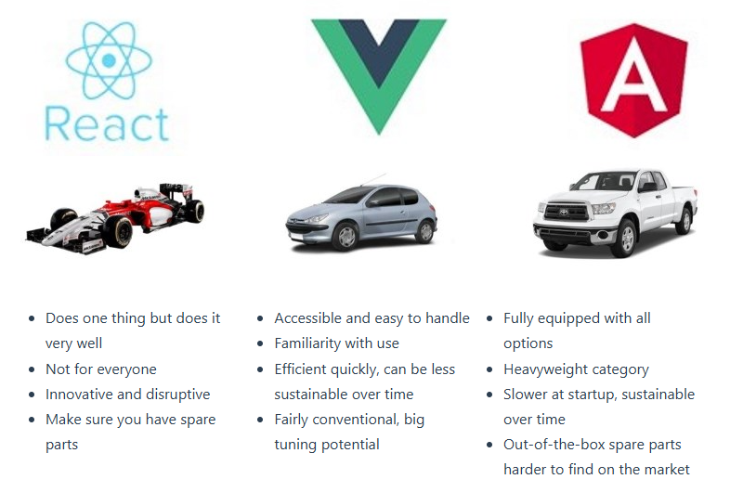

Slide 47
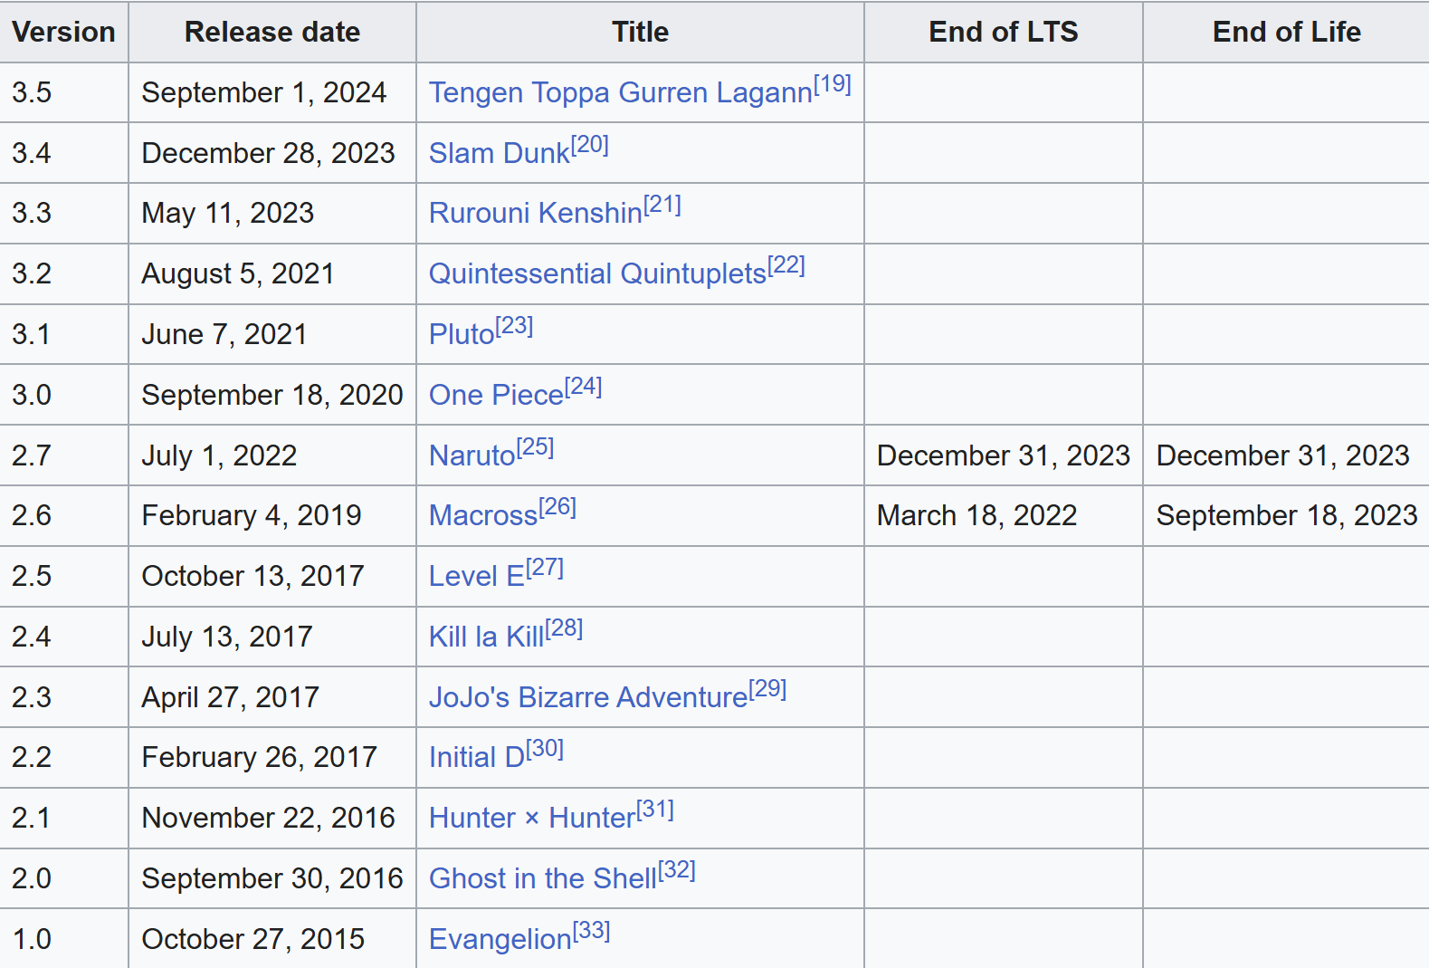
Fun Fact:
Every new version of Vue has an anime or manga title usually from the science fiction genre:

Slide 48
DEMO THE SEQUEL!!!
https://vuejs.org/examples/#temperature-converter
https://www.w3schools.com/howto/tryit.asp?filename=tryhow_js_temp_converter_fahrenheit_to_celsius

Slide 49
Questions?

Slide 50
Resources
https://generalassemb.ly/blog/what-is-a-javascript-framework/
https://www.geeksforgeeks.org/reactjs/what-is-a-frontend-framework/
https://www.w3schools.com/whatis/whatis_vue.asp
https://www.youtube.com/watch?v=VeNfHj6MhgA
https://vuejs.org/guide/extras/web-components.html
https://vuejs.org/guide/extras/ways-of-using-vue
https://polymer-library.polymer-project.org/3.0/docs/devguide/data-binding
https://www.w3schools.com/vue/vue_intro.php
https://www.geeksforgeeks.org/reactjs/difference-between-reactjs-and-vue-js/
https://worldline.github.io/vuejs-training/presentation/#comparison-between-the-frameworks
https://vueschool.io/articles/vuejs-tutorials/options-api-vs-composition-api/

