Slide 1

Understanding AngularJS: Building Dynamic Web Apps
Samuel Costa and Aidan Kent

Slide 2

Understanding AngularJS: Building Dynamic Web Apps
A Look into Google’s Early Front-End Framework
AngularJS is a JavaScript-based framework created by Google in 2010 to simplify web development.
It allows developers to create interactive, single-page applications with less code and better structure.

Slide 3
The Web Before AngularJS
Before frameworks like AngularJS, developers relied on basic HTML, CSS, and jQuery to create dynamic sites.
Updating the DOM manually was repetitive and error-prone, making code harder to maintain as sites grew.
AngularJS introduced an organized way to handle data and the user interface using a declarative approach.
It changed front-end development by reducing direct DOM manipulation and promoting structure.

Slide 4
What is AngularJS?
AngularJS is an open-source JavaScript framework developed by Google in 2010.
It was designed to simplify building single-page applications (SPAs) by extending HTML syntax with directives.
Developers can bind data directly to HTML elements and create responsive, interactive web pages easily.
Its main goal was to bridge the gap between static documents and dynamic applications in the browser.

Slide 5
Core Concepts
AngularJS is built around several key concepts that define how applications are structured:
Modules – Containers that group parts of the application such as controllers and services.
Controllers – Handle logic and control data between the model and the view.
Directives – Extend HTML with custom behavior (e.g., ng-model, ng-repeat).
Services – Provide reusable functionalities such as HTTP requests or data management.
Dependency Injection – Automatically provides components or services when needed.
Two-way Data Binding – Keeps the user interface and data model synchronized at all times.

Slide 6
MVC Architecture
AngularJS is based on the Model-View-Controller (MVC) design pattern:
Model – Represents application data and business logic.
View – The presentation layer that displays data to the user.
Controller – Connects the Model and View, managing communication between them.
This structure separates concerns, making code more readable, reusable, and easier to test.
It was one of the first frameworks to apply MVC directly in web front-end development.

Slide 7
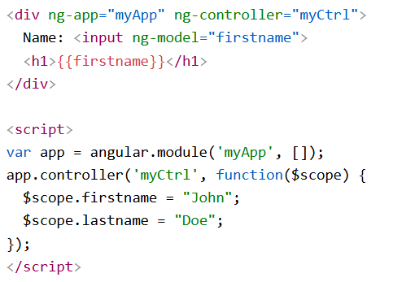
Two-Way Data Binding
Example

Slide 8
Directives in Action
AngularJS extends HTML through built-in directives that add behavior to elements.
Common examples include:
  • ng-app – Defines the root of the AngularJS application.
  • ng-model – Binds data from the input to the application model.
  • ng-repeat – Loops through items and displays them dynamically.
  • ng-if / ng-show – Controls visibility based on conditions.
These directives make HTML more expressive and adaptable for dynamic content.

Slide 9
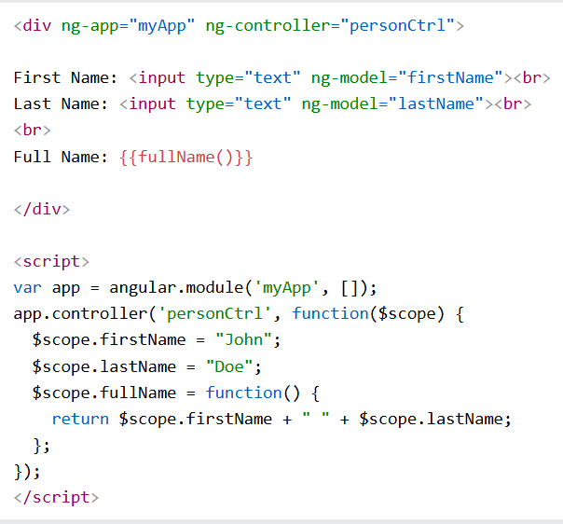
Working with Controllers
Controllers define the behavior and logic of different sections of an application.
They use the $scope object to link data between the view and the model.
Example:

Slide 10
Services and Dependency Injection
AngularJS includes built-in services such as $http for making API requests and $timeout for delays.
Developers can also create custom services to manage reusable logic.
Dependency Injection allows AngularJS to automatically supply components like $http where needed, improving modularity.
This design makes large applications more maintainable and easier to test.

Slide 11
Filters and Expressions
Filters allow developers to modify how data is displayed in the view without changing the model.
They can format numbers, dates, and text easily using simple syntax.
Examples: {{ product.price | currency }} or {{ today | date:'medium' }}
AngularJS also supports chaining multiple filters for complex formatting needs.

Slide 12
Routing and SPAs
AngularJS enables Single Page Applications (SPAs), where content dynamically updates without reloading the page.
It uses the ngRoute module to switch between different views or templates based on the URL.
This provides a smoother user experience, similar to desktop applications.
Example route setup:
$routeProvider.when("/home", { templateUrl: "home.html" }).when("/about", { templateUrl: "about.html" });

Slide 13
Advantages
Simplifies complex front-end development through modular architecture.
Promotes clean, organized, and reusable code.
Offers two-way data binding for real-time synchronization between model and view.
Strong community support and backed by Google ensured stability and updates for many years.
Ideal for small to medium-sized web applications requiring interactivity.

Slide 14
Limitations
Not well-suited for very large, complex web applications due to performance limitations.
Two-way data binding can cause lag when handling large datasets.
Syntax and architecture are outdated compared to modern frameworks like Angular (2+), React, and Vue.
Officially deprecated by Google in 2021, though still used in legacy systems.

Slide 15
AngularJS vs Angular (2+)
AngularJS and Angular (2+) share a name but differ greatly in structure and technology:
AngularJS uses JavaScript, while Angular (2+) uses TypeScript for better scalability.
AngularJS follows an MVC pattern; Angular (2+) uses a component-based structure.
Angular (2+) offers higher performance, better mobile support, and is actively maintained.
AngularJS remains historically important but is no longer the recommended framework for new projects.

Slide 16
Real-World Usage
Early versions of major platforms such as Gmail, Netflix, and Upwork were built using AngularJS.
Many organizations still maintain older AngularJS projects for stability and cost-saving reasons.
AngularJS’s success inspired modern frameworks like React and Vue, shaping the evolution of front-end development.
It set the foundation for a shift toward dynamic, interactive web applications.

Slide 17
Summary
AngularJS revolutionized web development by introducing two-way data binding and dependency injection.
It popularized the MVC pattern on the front end and inspired future JavaScript frameworks.
Though deprecated, its influence continues in modern frameworks like Angular, React, and Vue.
Understanding AngularJS helps appreciate the evolution of client-side web technologies.

Slide 18
Demos
Angular Application

