Slide 1


Introduction to Node.js & NPM
Presented by Grant Hutchison

Slide 2
SO what is node.js?
JavaScript Runtime (built on Chrome's v8 Engine)
Run JS outside the browser
Powers servers, tools and apps

Slide 3

Why Node.JS?
Event-driven, non-blocking I/O
Great for API's & real-time apps
Huge ecosystem + community

Slide 4
What Node.js powers
Uber – Handles millions of real-time ride requests
Netflix – Streaming backend, lightweight + fast
Walmart – Stable e-commerce platform
Slack – Messaging + real time updates
GitHub – parts of their API services
PayPal – Unified web + mobile app backend

Slide 5
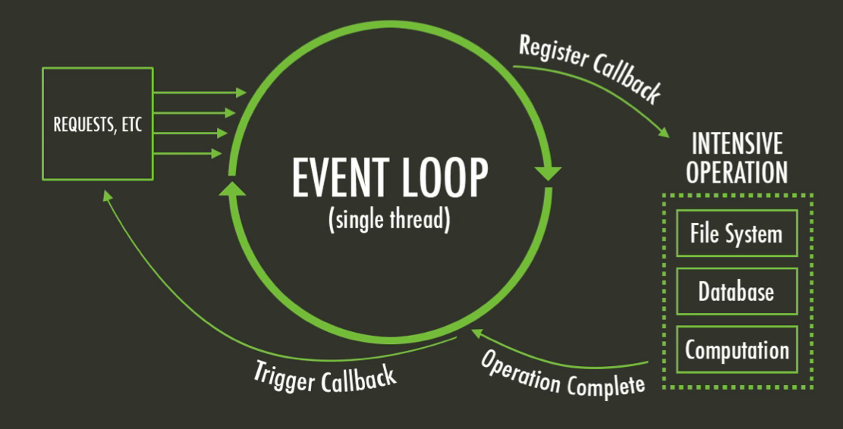
The Event Loop
Single-threaded model
Uses async I/O for scalability
Event loop handles tasks

Slide 6
Node.js in practice
Built-in modules (fs, http, path)
Automation, scripting, servers

Slide 7
Quick demo: Node in action
Run Node REPL
Simple code: math, console, file read

Slide 8
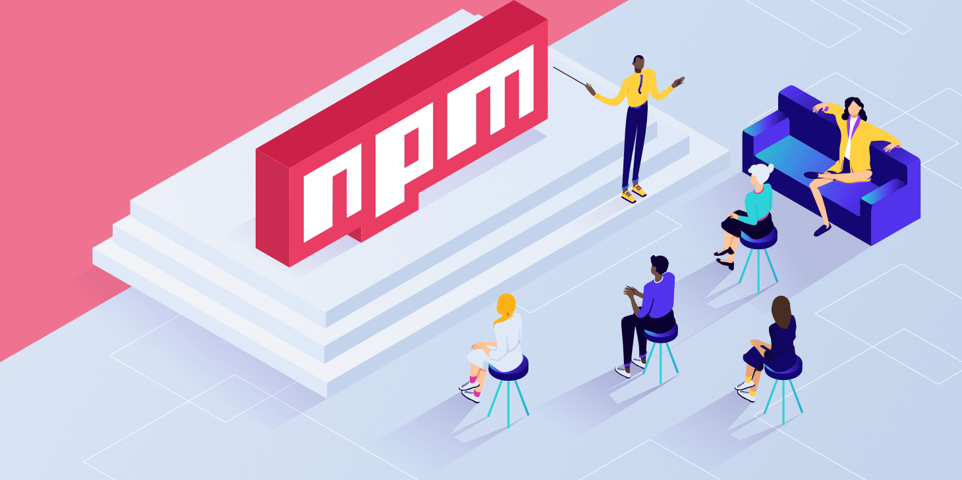
What is npm?
Node Package Manager
Registry of 2M+ packages
CLI for dependencies

Slide 9
Package.json
Project metadata
Dependencies + scripts
Created with "npm init"

Slide 10
Quick Demo: Npm in action
Initialize project
Install a package (dotenv)
Usage

Slide 11
Installing Bigger packages
Some packages are larger (like Jest)
More dependencies = longer installs (well, of course)
Used widely in production

Slide 12
Demo: JEst
Popular testing framework for Node.js
Write simple tests -> run with "npm test"

Slide 13
Demo: JEST (Continued)
Easy to add more testcases
Example: test multiple values

Slide 14
Npm scripts
Automate commands
Example: start and dev

Slide 15
Recap
Node.js = JS runtime
npm = package manager + ecosystem

Slide 16
Questions?

