Slide 1

XML & JSON
Anjala Adhikari & Andrea Richter

Slide 2

XML
Notes:
Ask audience what HTML is

Slide 3
What does XML stand for?
XML stands for eXtensible Markup Language.
Okay, but what is it...?
Essentially, it's HTML... but not really.
So then why is XML special?
DATA.
Notes:
XML doesn’t DO anything

Slide 4

How can we overcome the issue of different software and hardware?
Question
We think about one of the simplest, most common ways of communication…
TEXT
Which brings me to XML’s purpose:
“XML was designed to store and transport data” (w3Schools, 2019).
But you might be wondering…
Notes:
Different software/hardware can mean different versions and incompatibility issues
Important to note that this is a built in

Slide 5

But we’ve got to go over

Slide 6
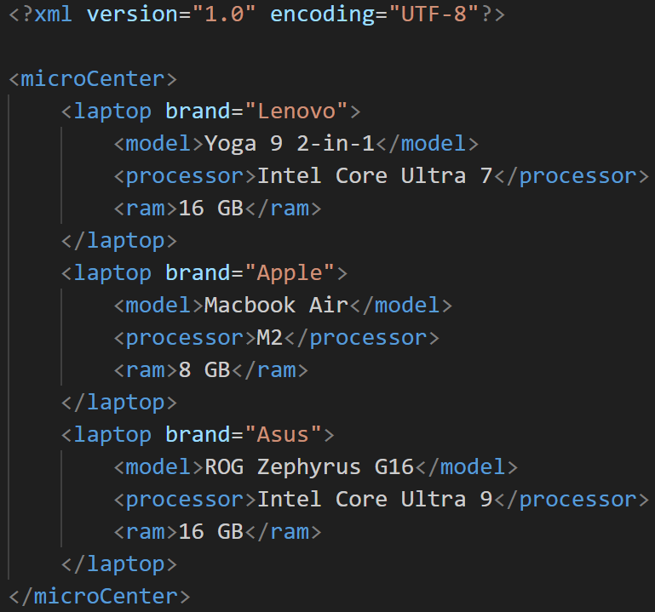
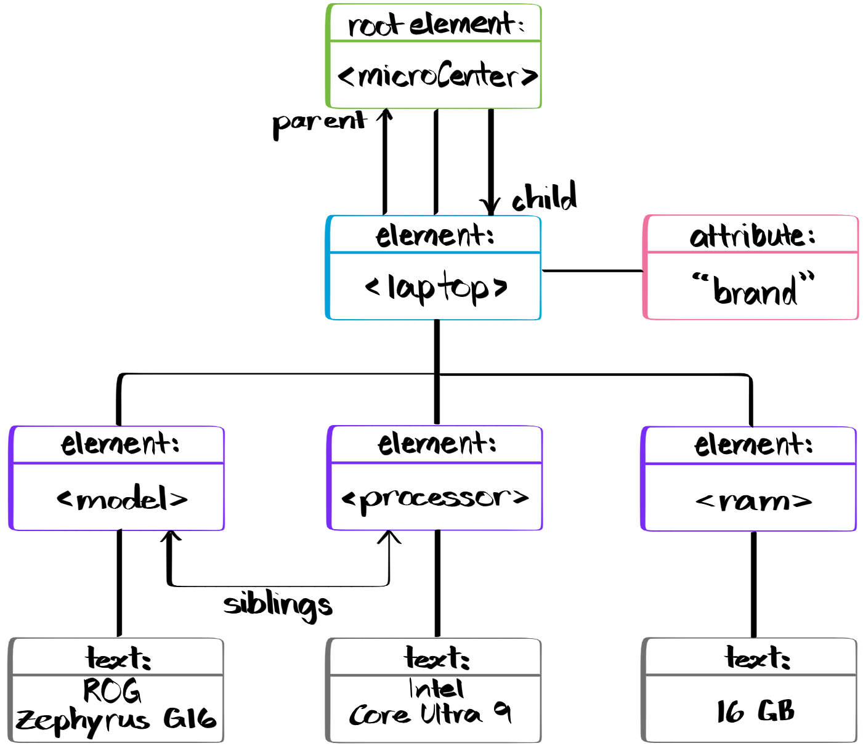
Structure
XML has a hierarchical structure:
One root element
Multiple child elements
And even more child elements!
Hmm… that looks familiar...
That’s because it is!
Notes:
As much as we, probably, need to touch grass, we certainly do love our trees.
Suppose you go to micro center to find a new laptop: here’s an example of how it could be organized in an XML file.
Now, here’s how we can visualize this document.

Slide 7
Syntax
XML doesn’t have any predefined tags!
<ol>
<li>
<p>
<th>
HTML tags?
<body>
<h1-h6>
<table>
<ul>
But then how does it work?
XML is supposed to be self-descriptive, and the only way to do that is to create our own tags. As a bonus, both us and the computer can read it as is.
The rules are simple:
The prolog (is optional, but strongly recommended) must go at the top
If you open a tag, you MUST close that tag
Case matters
Nest, nest, nest — did I say nest, yet?
Attribute values MUST be quoted
Entities… are tricky, but manageable
Note:
Comments are the same as in HTML & whitespace IS preserved
Notes:
Ask audience about defined tags in html
XML is supported by pretty much all browsers – no need for installation
The prolog is like <!DOCTYPE html>
No, I didn’t use AI
If your XML satisfies these rules, then it is considered to be a well-formed document

Slide 8
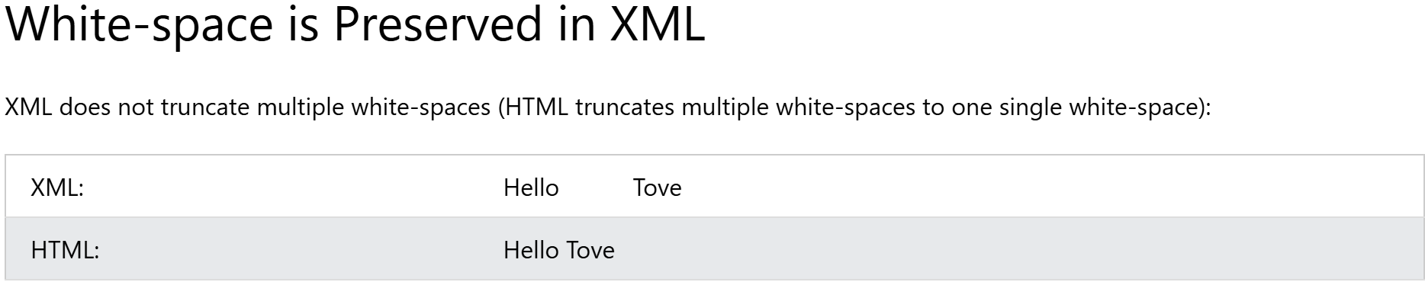
(w3Schools, 2019)
Notes:
Windows wouldn’t let me do a live demo, otherwise I would’ve done that.

Slide 9
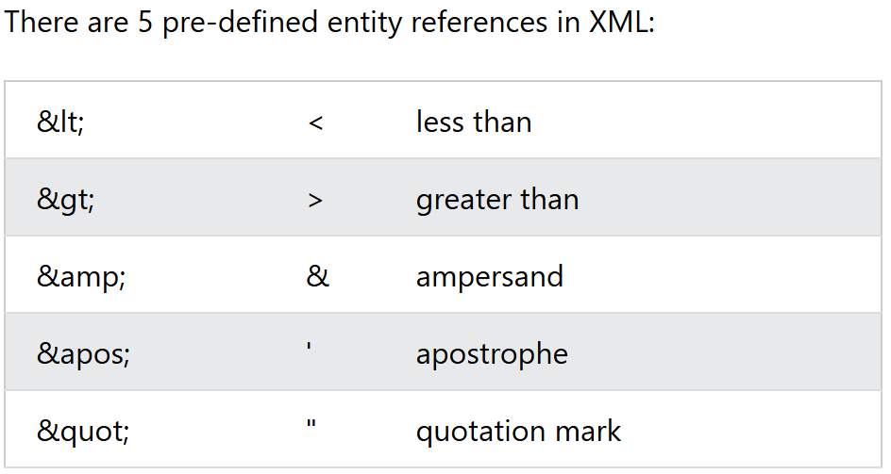
Syntax (continued)
Prolog
Tag sandwiches
Nested
Quoted attribute values
But I mentioned entities, too…
(w3Schools, 2019)
Notes:
Use laser pointer for verbal explanation of case sensitivity
& and < are strictly illegal, but it’s good practice to replace > with &gt; as well.

Slide 10
Elements & Attributes
Elements:
Names can only start with a letter or ‘_’
Any combination of the letters ‘xml’ are not allowed
Valid characters are letters, digits, ‘-’, ‘_’, and ‘.’.
Spaces? Nope
Note:
It’s recommended to avoid using ‘-’ and ‘.’.
Attributes:
Quote their values or fear the wrath of errors
The only rules for using attributes are the ones you create
Elements vs. Attributes
Attributes can only have one value
Attributes don’t have a structure
Attributes aren’t extensible
Notes:
Aside from just being case-sensitive…
Xml, or xMl, or xmL aren’t allowed
Different softwares might think we want to subtract two different elements or access a property of an element (respectively)
The id attribute works the same as in HTML

Slide 11
But why should you know these details about elements and attributes?
I mentioned extensibility…
But let’s talk about cars first.
You want to buy a new car, and you know what model you want, but then the salesperson asks what trim you want. There’s the base trim, but there are add-ons that give you more features, depending on the trim level.
Each trim above the base trim is an extension of the original but with an enhanced experience.
The point: you can add stuff, but it won’t interfere with the core mechanics and functionality

Slide 12
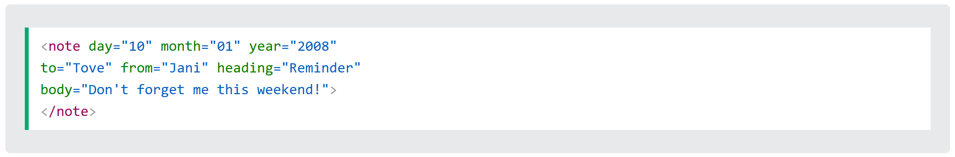
So…
It’s a good rule of thumb to only use attributes for metadata
Or risk your file looking like this:
(w3Schools, 2019)
…that’s it…that’s the slide…
Notes:
Making these numerous attributes elements allows us to have more extensibility.

Slide 13

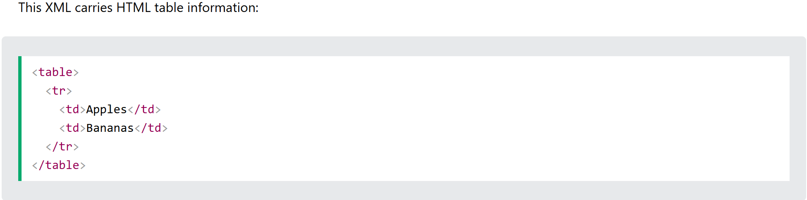
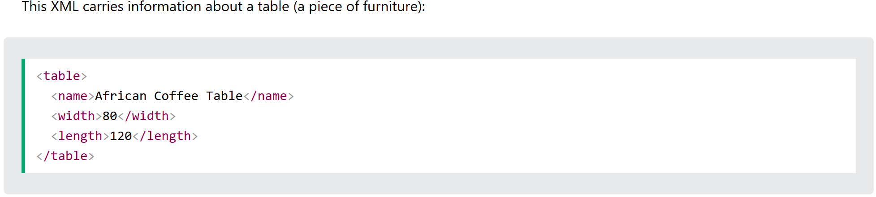
Namespaces
(w3Schools, 2019)
(w3Schools, 2019)
Notes:
Discuss what can go wrong if you have similar tags (xml and html conflicts)
When is this actually an issue? When using XSLT (eXtensible Stylesheet Language Transformations)
CSS but for XML
The following slide will have an xml and html sample with identical header information
Maybe a demonstration of how to set up a namespace (otherwise just a screenshot of an example)
Does anyone see a problem with this?
Alone, there’s no problem, but you remember XHTML?
Well, that’s XML transformed into HTML through the use of XSLT

Slide 14
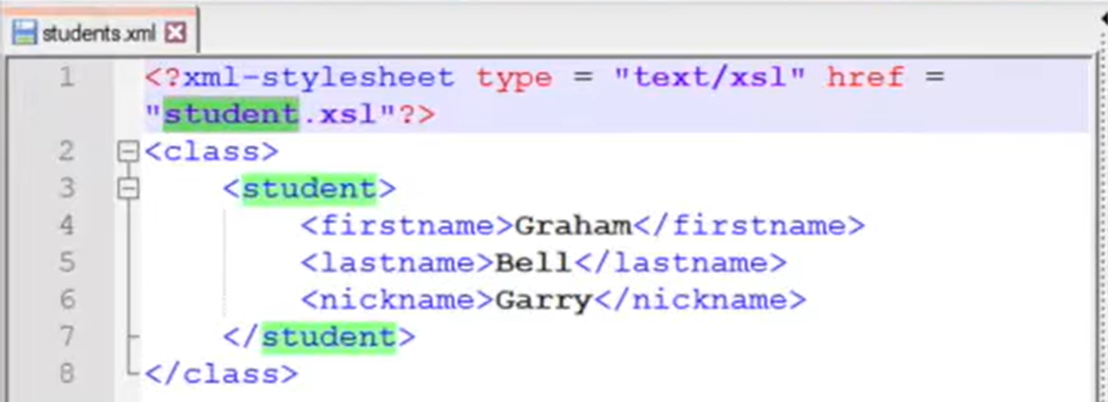
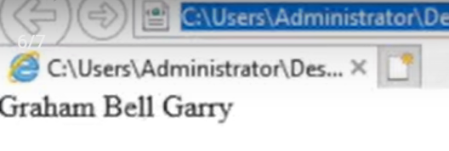
A slight detour: XSLT
eXtensible Stylesheet Language Transformations (XSLT) is basically just CSS but for XML.
(Pal, 2020)
(Pal, 2020)
Notes:
Mention XHTML and how we get there: XSLT
We have the data, now we need the structure

Slide 15
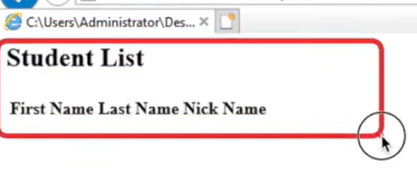
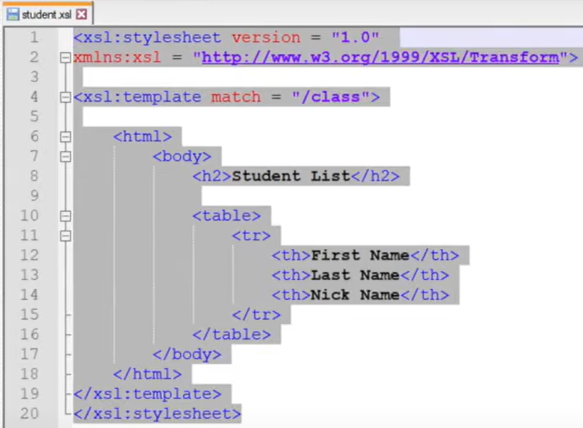
XSLT (continued)
(Pal, 2020)
(Pal, 2020)
Notes:
Notice that an xsl sheet must be proper xml.
Every xslt should have the default namespace http://www.w3.org/1999/XSL/Transform (laser pointer)

Slide 16
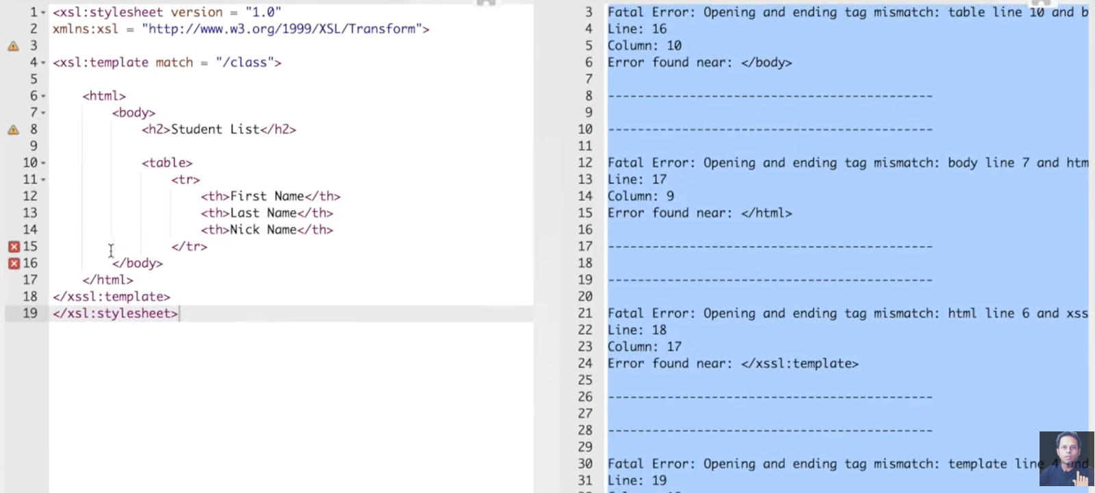
Another detour: Errors & Display
(Pal, 2020)
W3Schools Invalid XML Example
Notes:
Otherwise, you’ll end up with errors like these:
There are numerous validators online you use when creating your own XML files.
Should there be any errors in XML, then the program will stop processing the file. As w3schools put it, “The W3C XML specification states that a program should stop processing an XML document if it finds an error. The reason is that XML software should be small, fast, and compatible.”

Slide 17
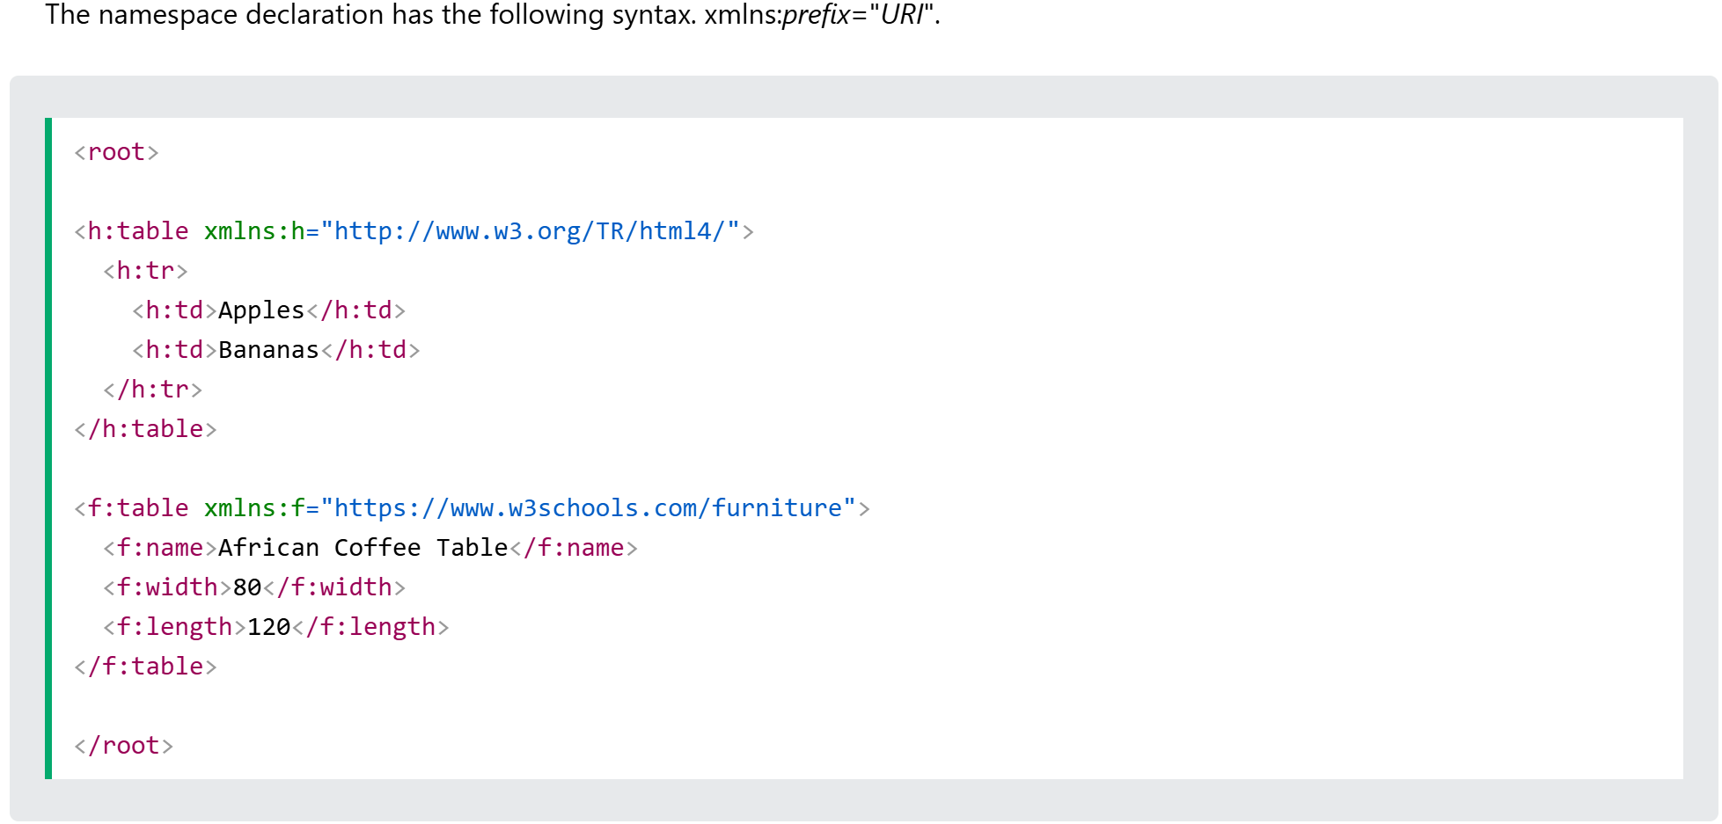
Namespaces (for real, this time)
(w3Schools, 2019)
Notes:
Namespaces are like the blank nametag for their assigned prefix
Prefixes solve our duplicate tag issue
URIs in this context are interpreted as strings, thus allowing element differentiation.
It’s important to note that the parser doesn’t use the URI for any data collection

Slide 18
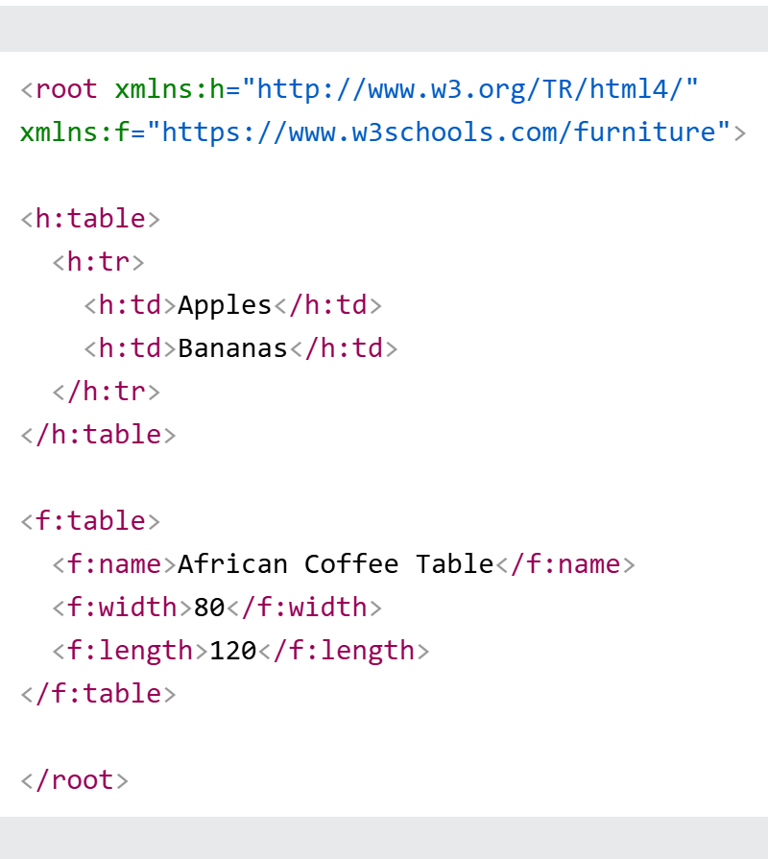
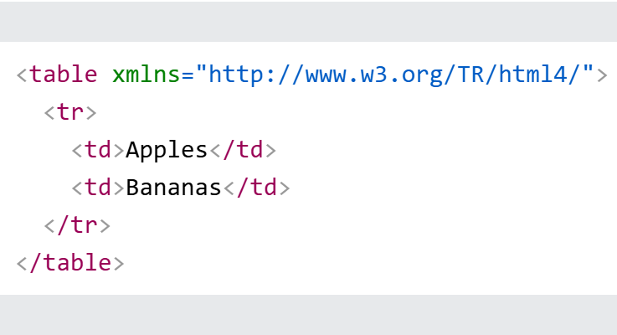
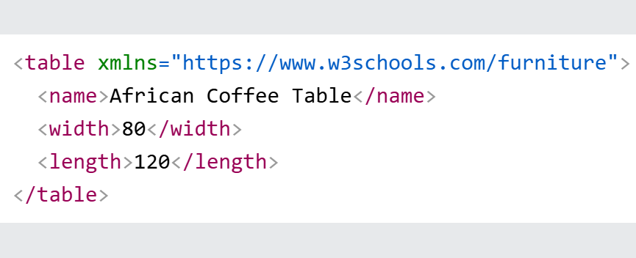
Namespaces (continued)
(w3Schools, 2019)
(w3Schools, 2019)
(w3Schools, 2019)
Notes:
Here are the different ways we can use prefixes and namespaces

Slide 19
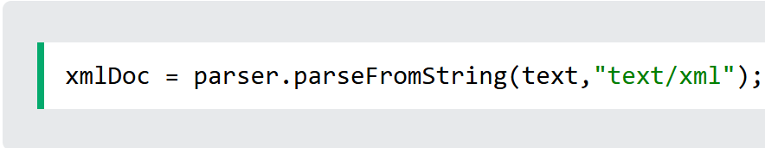
Parser & DOM
We all know that DOM is a framework that allows us to access and edit data. The same is true for XML.
BUT we can’t access something that doesn’t exist yet!
Thus, we must create an XML DOM object first.
(w3Schools, 2019)
(w3Schools, 2019)

Slide 20
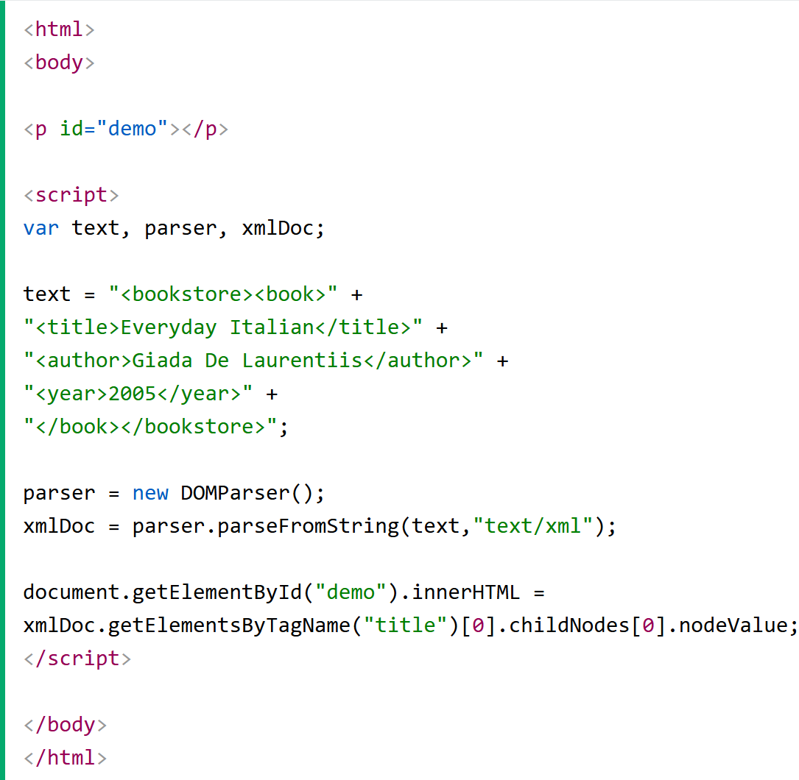
A practical use example:
(w3Schools, 2019)
Notes:
This example uses JavaScript in an HTML file.

Slide 21
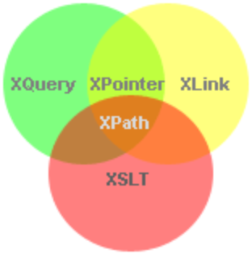
XPath, XQuery & XLink
XPaths are simply file paths for parts of XML documents. This is how we can find specific elements to modify or access with XSLT.
“XQuery for XML is like SQL for databases” (w3Schools, 2019)
XLink is a namespace that allows us to create hyperlinks in XML.
(w3Schools, 2019)
Notes:
Think of XPath like a librarian
Think of XQuery like a filter
ASK WHY WE CAN’T USE HYPERLINKS
Think of XLink like a GPS because that’s what a URL is
Example inspired by (Pal, 2020): go to a website and inspect it. Then enter a line for a relative path of an element.
XPointer works like XLink, but now we’re linking inside of the XML document and this is where ids are useful

Slide 22
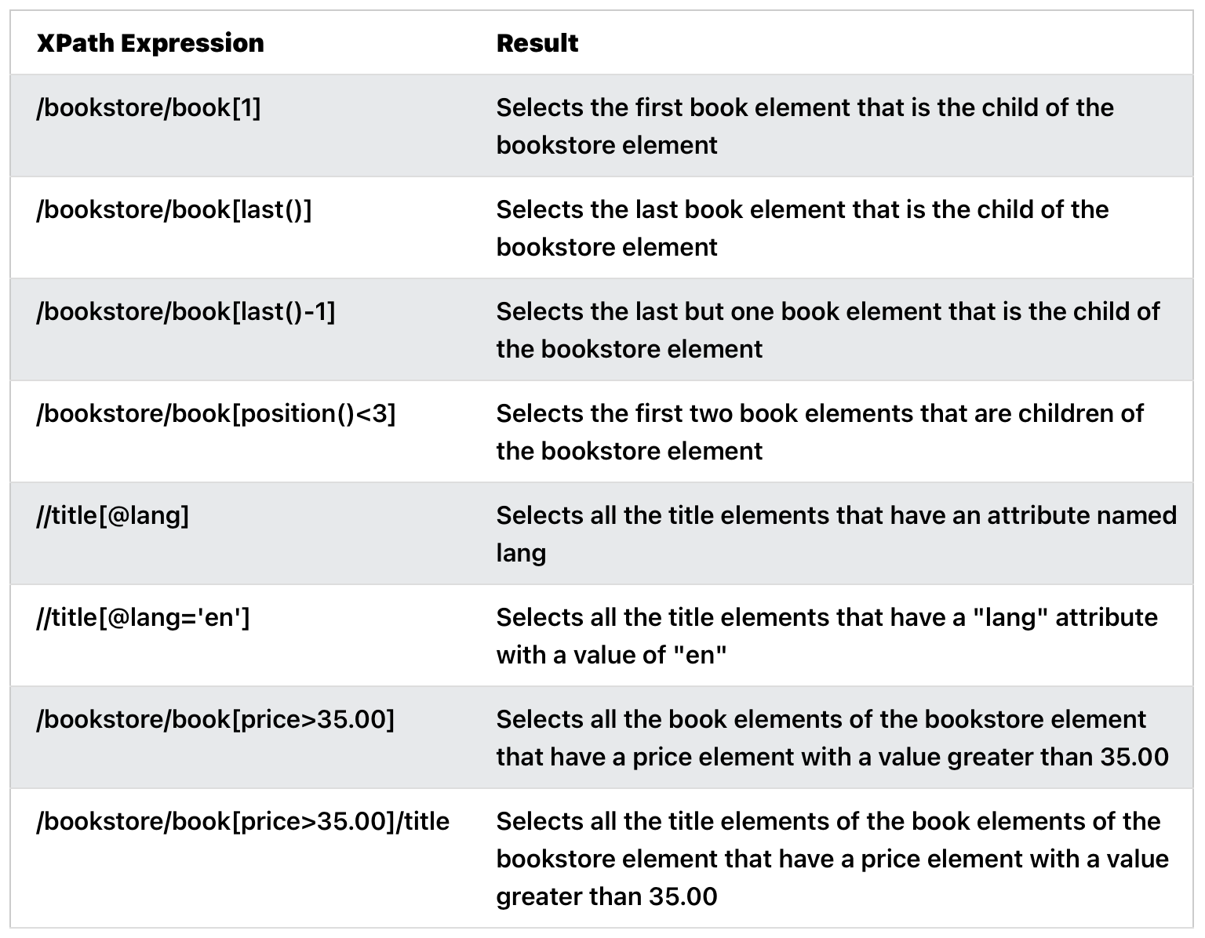
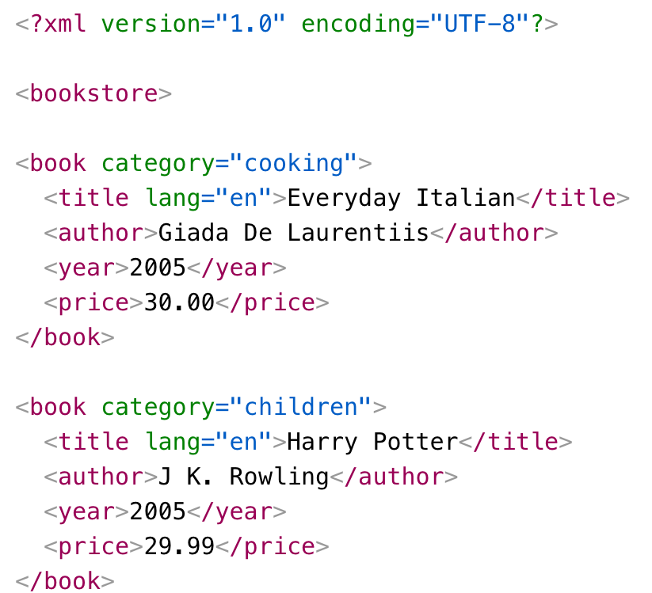
In execution…
(w3Schools, 2019)
(w3Schools, 2019)
Notes:
XPath
/ is an absolute path
// is a relative path

Slide 23
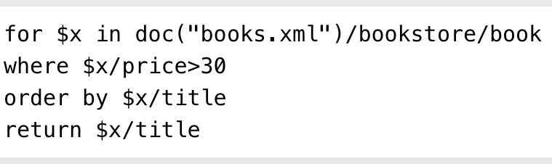
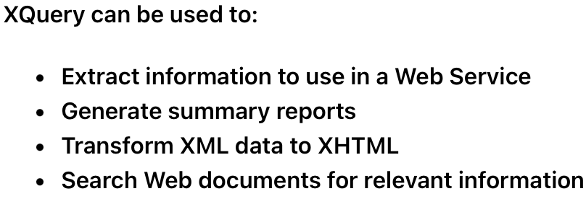
In execution…
(w3Schools, 2019)
(w3Schools, 2019)
Notes:
XQuery

Slide 24
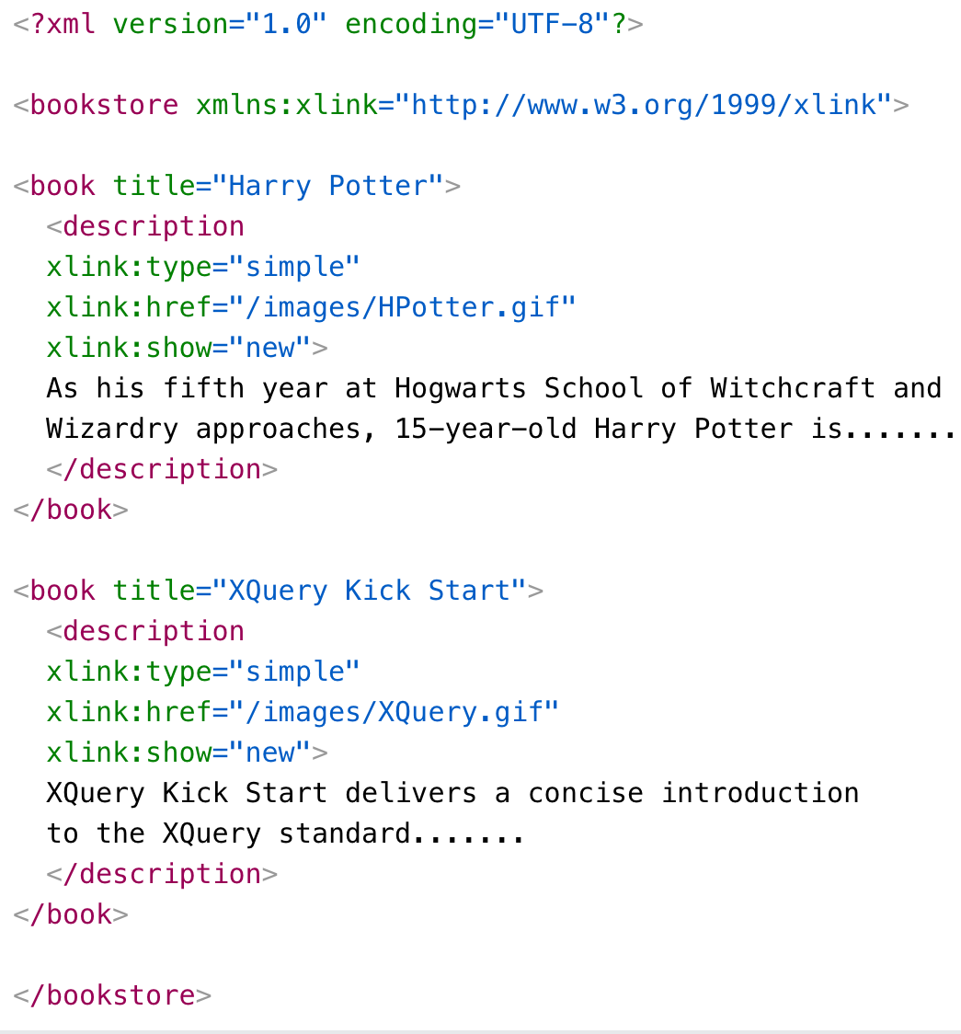
In execution…
(w3Schools, 2019)
Notes:
Note the xmlns for XLink
Type “simple” creates a simple HTML-like link
“new” indicates we want to open the link in a new window (just like target in HTML)

Slide 25
DTD & Schema
“DTD stands for Document Type Definition. A DTD defines the structure and the legal elements and attributes of an XML document” (w3Schools, 2019).
If you have a well-formed XML document that also follows a DTD, then your document is also considered to be valid.
W3Schools DTD
XML Schema is basically like DTD, but better.
Instead of just defining legal elements and attributes, we can define namespaces and data types.
GeeksforGeeks DTD vs. XML Schema
Notes:
Think of it like an outline
Individuals can set acceptable document forms and validate incoming information
Schema is more powerful though
Discuss when to use and not use a DTD/Schema: organizations/independent groups of people

Slide 26
XML on the web | W3Scools XML Server
Since XML files are just text, like with HTML, it stands to reason that they can be stored on a server.
Which is correct!
We can also generate XML and upload it to a server as either a PHP or ASP file.
But, wait, there’s more: We can do it with databases, too. Just make sure to save it as an ASP file on the server.
And everything is boring if we can’t transform the data, so that’s possible, too.

Slide 27
JSON

Slide 28

What is JSON?
JavaScript Object Notation
One of the two most popular methods for streaming data
Lightweight data format
Easy to read/write for humans
Easy to parse/generate for machines
Language independent
Invented by Douglas Crockford in 2001

Slide 29
Where is it used?
APIs (REST, Graphql, response, request)
Configuration files
Data storage
Web apps
Mobile apps

Slide 30
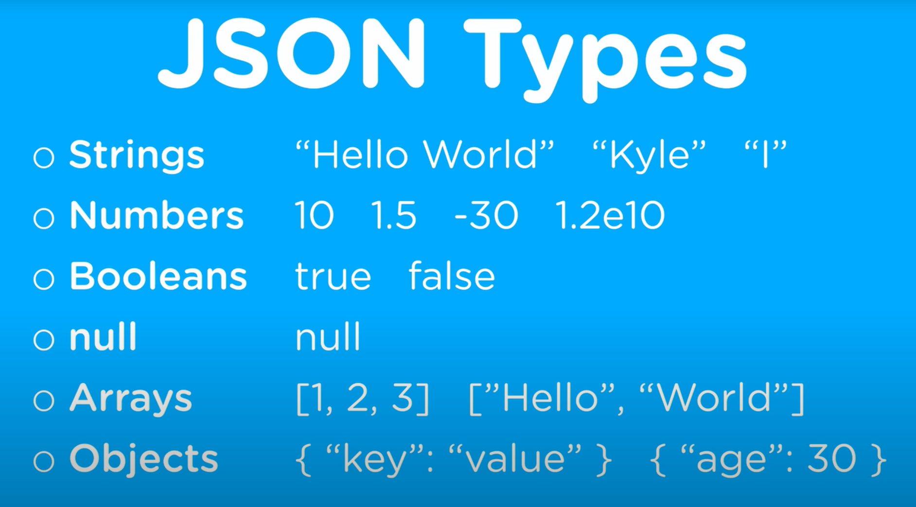
Basic Structure
Data is in a KEY-VALUE pair
Keys are always in String

Slide 31
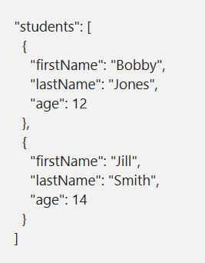
Example

Slide 32
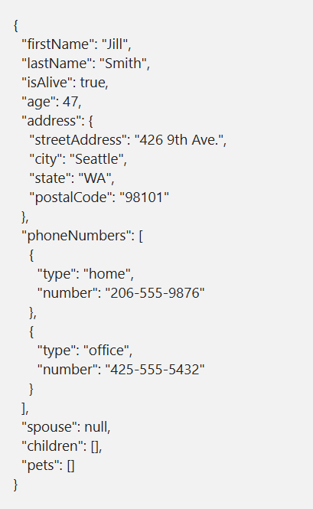
Example

Slide 33
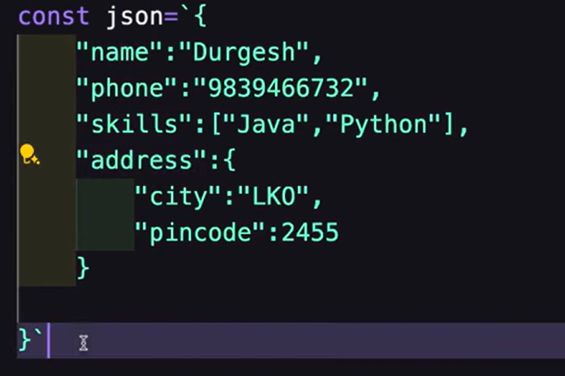
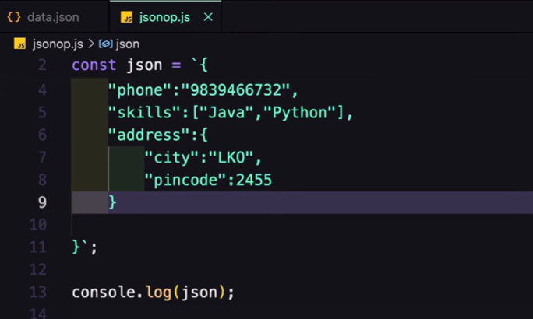
Using JSON in JavaScript

Slide 34
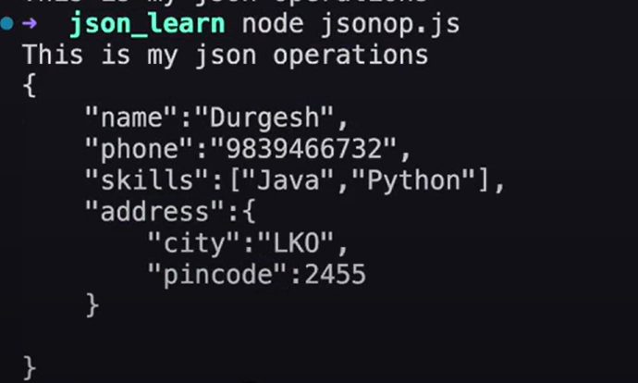
Using JSON in JavaScript

Slide 35
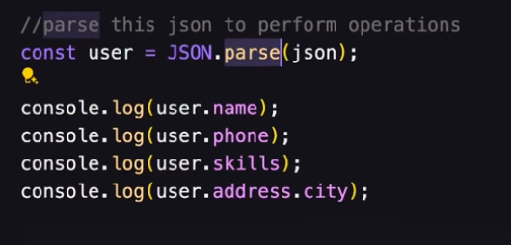
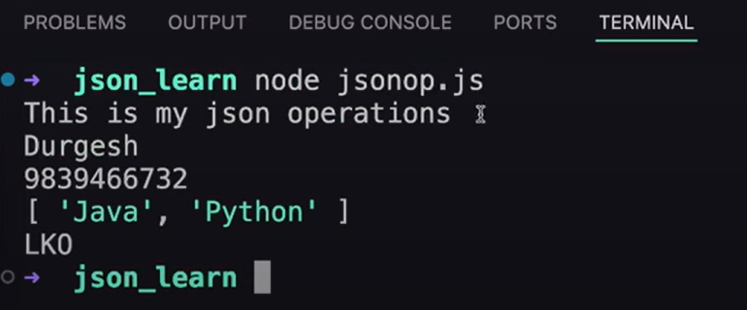
Parsing JSON

Slide 36
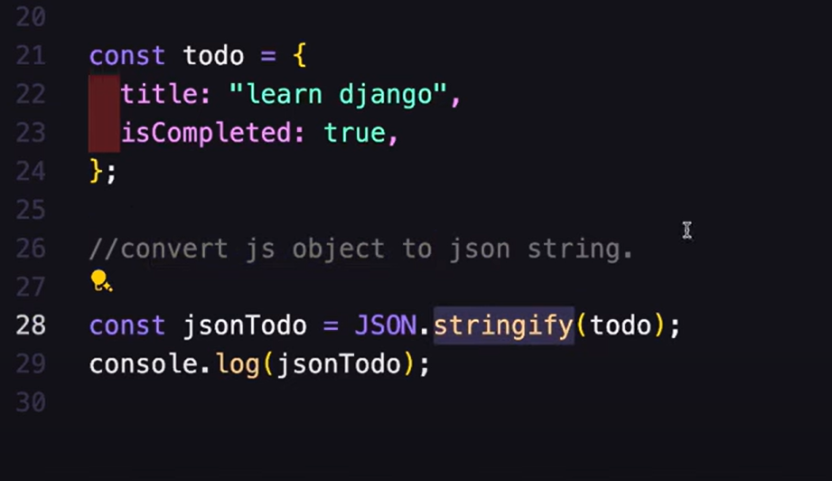
Converting JS to JSON

Slide 37
JSON Rules
Keys must be in double quotes
String must be in double quotes
No comments allowed
Data is key - value pair
Data is separated by commas
Curly braces for objects {}
Square brackets for arrays []

Slide 38
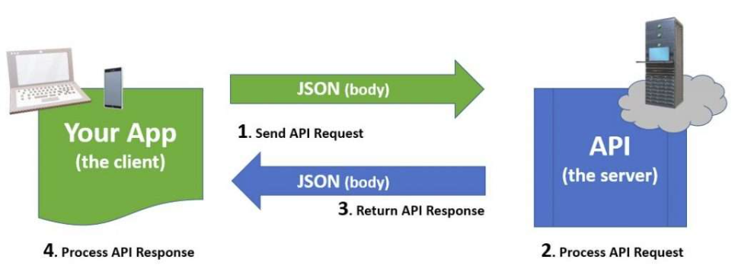

Slide 39

Sending data

Slide 40

Receiving data

Slide 41
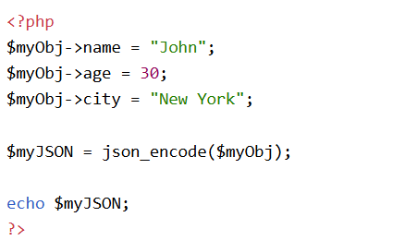
JSON PHP
PHP file has built-in function that handle JSON
There is a PHP function that converts object in PHP to JSON json_encode();
This example is converting the PHP to JSON

Slide 42
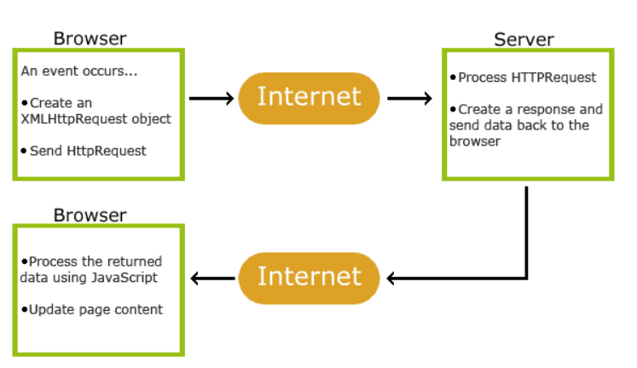
AJAX
Asynchronous JavaScript And XML
Uses XMLHttpRequest to request data from a web server
JavaScript and HTML DOM to display/use data
Websites can talk to the server behind the scenes to change parts of the page without refreshing everything.

Slide 43
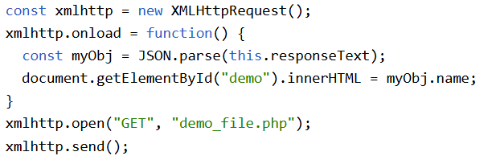
Requesting a PHP file

Slide 44
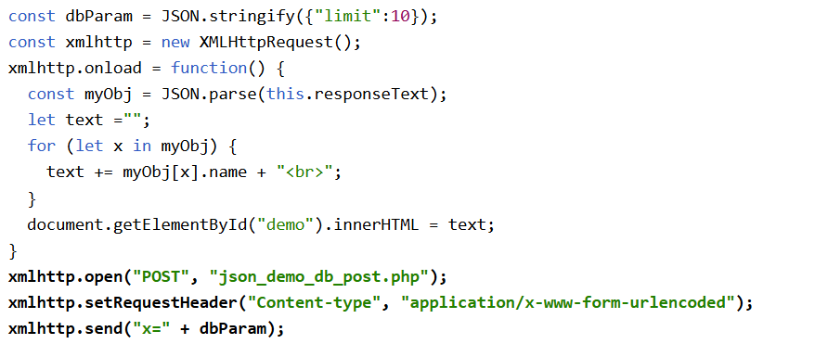
HTTP POST method

Slide 45

JSON JSONP
Stands for JSON with Padding
JSONP uses script tag to request files

Slide 46
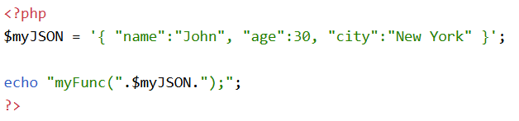
JSON JSONP

Slide 47


Slide 48
JSON vs. JavaScript
JSON
JavaScript
Has a stricter syntax
Used to exchange data
Language independent
Has flexible syntax
Used for general programming
Specific to JS programming language

Slide 49
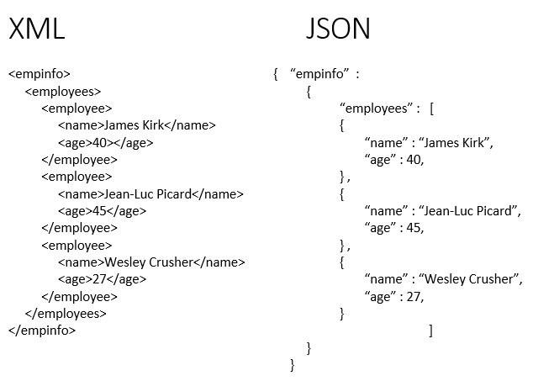

Slide 50
References
Introducing JSON. (n.d.). JSON.org. Retrieved September 27, 2025, from https://www.json.org/json-en.html
JavaScript JSON. (n.d.). W3Schools. Retrieved September 27, 2025, from https://www.w3schools.com/js/js_json.asp
JSON. (n.d.). API newbies. Retrieved September 28, 2025, from https://www.apinewbies.com/json/
JSON - Wikipedia. (n.d.). Wikipedia, the free encyclopedia. Retrieved September 28, 2025, from https://en.wikipedia.org/wiki/JSON
Learn Code With Durgesh. (2025, June 25). Json Beginner to Expert Level Tutorial 🔥| Most Important [Hindi] [Video]. YouTube. https://www.youtube.com/watch?v=1hwQCUJ8k0U.
Mendez, M. (2014). The Missing Link: An introduction to Web Development and Programming". https://knightscholar.geneseo.edu/cgi/viewcontent.cgi?article=1016&context=oer-ost
Web Dev Simplified. (2018, November 1). Learn JSON in 10 Minutes [Video]. Youtube. https://www.youtube.com/watch?v=iiADhChRriM
Mendes, M. (2014). The Missing Link: An Introduction to Web Development and Programming. Open SUNY. https://knightscholar.geneseo.edu/cgi/viewcontent.cgi?article=1016&context=oer-ost
GeeksforGeeks. (2020, July 6). Difference between Document Type Definition (DTD) and XML Schema Definition (XSD). GeeksforGeeks. https://www.geeksforgeeks.org/computer-networks/difference-between-document-type-definition-dtd-and-xml-schema-definition-xsd/
Pal, R. (2020, November 20). XML Beginner Tutorial. YouTube. http://www.youtube.com/playlist?list=PLhW3qG5bs-L9DloLUPwC3GdFimY5Ce_gS
w3Schools. (2019). XML Tutorial. W3schools.com. https://www.w3schools.com/xml/

