Slide 1

jQuery
Olivia & Adam

Slide 2
What is jQuery?
jQuery is a small JavaScript library that simplifies using (CSS style) selectors to find elements and manipulate them using jQuery methods.
It simplifies things like DOM manipulation, events, and animations.
"jQuery doesn't do anything you cannot achieve with pure JavaScript." (Duckett)

Slide 3

Why jQuery?
Task done with shorter code
Built in methods (Loops, Event handling, Ajax, Modify DOM tree, etc...)
Simple Familar Selectors ( CSS style)
Ex. element, .class, #id
Cross-browser support
jQuerys motto is : '' write less do more"​

Slide 4
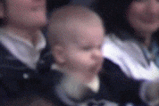
So… less typing? A small win is still a win.

Slide 5
How to include jQuery
CDN(put before your own scripts, usually before </body>
<script src="https://code.jquery.com/jquery-3.7.1.min.js"></script>
<script src="app.js"></script>
Tip Load jQuery first then you script!

Slide 6
Example 1: Writing less with jQuery
Element Group | jQuery | Plain java Script
ID | $('#myId'); | document.getElementById('myId');
class name | $('.myClass'); | document.getElementsByClassName('myClass');
CSS selector | $('.container p'); | document.querySelectorAll('.container p');
Notes:
$('#myId');
$('.myClass');
$('.container p');

Slide 7

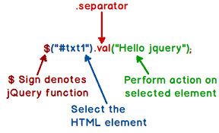
Syntax
Basic syntax: $(selector).action()
$ - define/access jQuery
selector – find HTML elements
ex.(p, h1, img, div, e.g.)
action() – the method called on element group

Slide 8
Basic selectors
$(”selector”).action()
* - All Elements | $("*").css("color", "blue");
(element) – a specific element | $(“p”).hide()
#id – Element with the matching id | “#test”).fadeIn();
$(.class - Element with matching class | $(“.box).fadeout();
Selector1, selector2 – Elements that match more than one selector | $(“nav”, “sidebar”).slideToggle

Slide 9
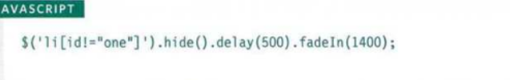
Chaining
Channing is used when you want to add more than one method to a element

Slide 10
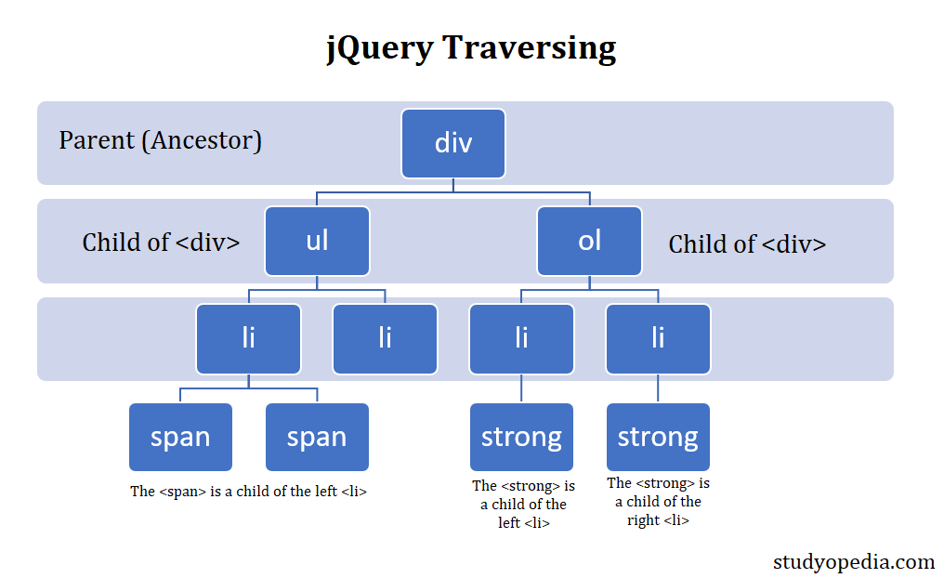
Hierarchy
Ancestor descendant - An element that is a descendant of another element
Parent > child - An element that is a direct child of another element
Previous + next – Adjacent sibling
Previous - siblings - Sibling selector will select all elements that are sibling of the previous element

Slide 11
Basic Filters
:not – All elements except those matching. $("div:not(#summary)")
:first – The first matched element.$("p:first")
:last – The last matched element. $("li:last")
:even – Elements with even index (0, 2, 4…). $("tr:even")
:odd -Elements with odd index (1, 3, 5…). $("tr:odd")
:animated – Elements currently animated. $(":animated")
:focus – The focused element. $(":focus")

Slide 12
JQUERY effect's
jQuery effects are the set of methods that can add visual dynamic behavior to the elements on a webpage
Some Different Effects include:
Hide / show
Fade
Slide
Animate
Stop()
Callback
Chaining

Slide 13
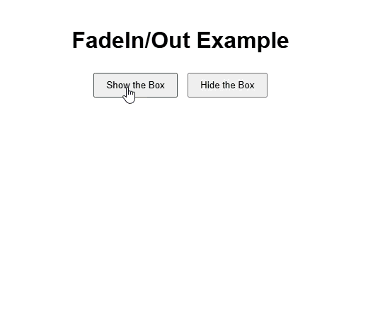
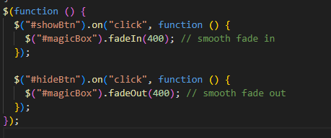
Example: fade element

Slide 14
Events
Events are the response from a webpage when a user interacts with the webpage.
Actions from user can be, moving a mouse over an element, selection a radio button, clicking on an element, etc. . .
Before jQuery runs; it must check to see if the html is fully loaded by using the .ready() event and the .load() event
Ex: .click() .hover() .keypress()

Slide 15
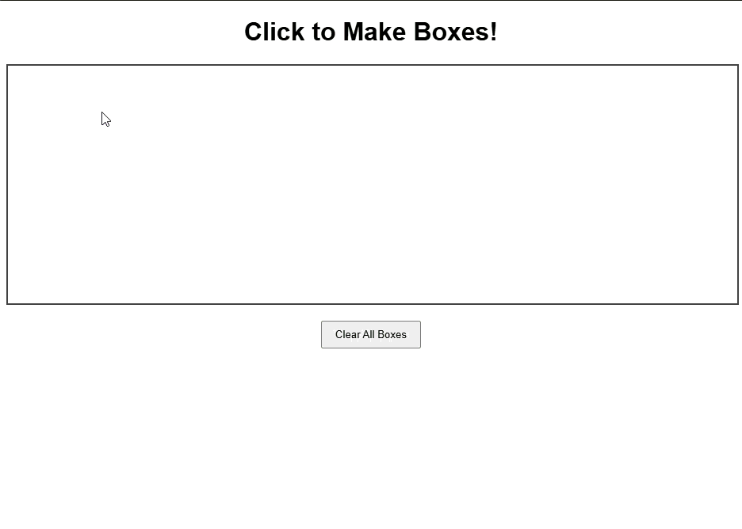
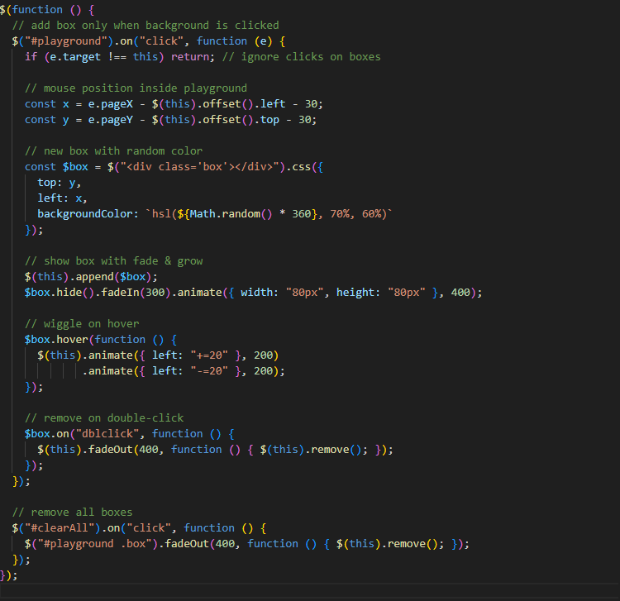
Example : events

Slide 16
DOM Manipulation
Add/Insert Elements | .append(), .prepend(), .before(), .after()
Change / Remove Elements | .attr(), .text(), .html(), .addClass(), .removeClass(), .toggleClass(), .remove()
Looping through elements | .each
It change or create HTML elements after the page loads.

Slide 17
Thank you!
Sources:
https://www.geeksforgeeks.org/jquery/jquery-introduction/
JavaScript & JQuery: interactive front-end web development, by Jon Duckett

