Slide 1
JavaScript: Events
with thanks to Dylan Duvall
Think of this slide deck as an example of a VERY GOOD student presentation

Slide 2
Alerts
Small project #3 due Monday, October 6
Quizzes!!

Slide 3
What is an event?
In JavaScript, an event is a way to add a sense of interactivity to your webpages.
They are essentially your browser’s way of saying “Hey, this just happened!”
Your script can respond to events by updating the webpage’s content through the Document Object Model (DOM)
This presentation should give you an overview of events, such as how user interactions create events, how events trigger code, and how code responds to users.

Slide 4
Event Terminology
Events fire or are raised when an event has occurred. For example, when a user clicks on a link, a click event would fire in the browser. This is how user interaction creates an event.
Events are said to trigger a function or script. For example, when a click event fires on an element, it could trigger a script that enlarges a specified item.
Example: https://www.w3schools.com/js/tryit.asp?filename=tryjs_event_onclick1

Slide 5
What types of events are there?
JavaScript has a wide range of events that can be used to trigger a function in your JavaScript code.
These range from UI events, which occur when a user interacts with the browser’s UI; Keyboard events, which occur when a user interacts with the keyboard; Mouse events, which occur when a user interacts with the mouse; Focus events, which occur when an element gains or loses focus; Form events, which occur when a user interacts with a form element; and Mutation events, which occur when the DOM structure has been changed by a script
The following slides will describe each of these events as defined on Duckett page 246, as well as examples which show these events in action.
https://www.w3schools.com/js/js_events_examples.asp

Slide 6
UI Events
Event | Description
load | webpage has finished loading
unload | webpage is unloading (usually because a new page was requested)
error | browser encounters a JavaScript error or an asset doesn't exist
resize | browser window has been resized
scroll | user has scrolled up or down the page

Slide 7
Keyboard Events
Event | Description
keydown | user first presses a key (repeats while key is depressed)
keyup | user releases a key
keypress | character is being inserted (repeats while key is depressed)

Slide 8
Mouse Events
Event | Description
click | user presses and releases a button over the same element
dblclick | user presses and releases a button twice over the same element
mousedown | user presses a mouse button while over an element
mouseup | user releases a mouse button while over an element
mousemove | user moves the mouse (not on a touchscreen)
mouseover | user moves the mouse over an element (not on a touchscreen)
mouseout | user moves the mouse off an element (not on a touchscreen)

Slide 9
Focus Events
Event | Description
focus/focusin | element gains focus
blur/focusout | element loses focus

Slide 10
Form Elements
Event | Description
input | value in any <input> or <textarea> element has changed or any element with the contenteditable attribute
change | value in select box, checkbox, or radio button changes
submit | user submits a form (using a button or a key)
reset | user clicks on a form's reset button (rarely used these days)
cut | user cuts content from a form field
copy | user copies content from a form field
paste | user pastes content into a form field
select | user selects some text in a form field

Slide 11
Mutation Events
Note: these are likely replaced with mutation observers (explained in misc. slides)
Event | Description
DOMSubtreeModified | change has been made to document
DOMNodelnserted | node has been inserted as a direct child of another node
DOMNodeRemoved | node has been removed from another node
DOMNodelnsertedlntoDocument | node has been inserted as a descendant of another node
DOMNodeRemovedFromDocument | node has been removed as a descendant of another node

Slide 12
Things to Note:
The UI events that relate to the browser window (rather than the HTML page loaded in it) work with the window object rather than an element node. Examples include the events that occur when a requested page has finished loading, or when the user scrolls.
Some events work with most element nodes, such as the mouseover event, which is triggered when the user rolls over any element. Other events only work with specific element nodes, such as the submit event, which only works with a form.

Slide 13
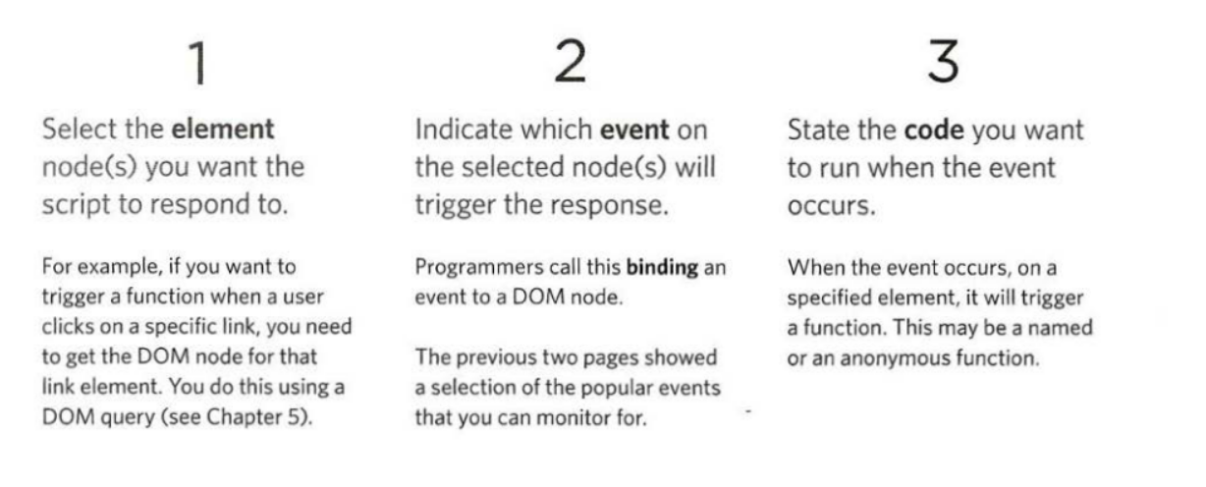
How Events Trigger JavaScript Code
When the user interacts with the HTML on a web page, there are three steps involved in getting it to trigger some JavaScript code. Together these steps are known as event handling.

Slide 14
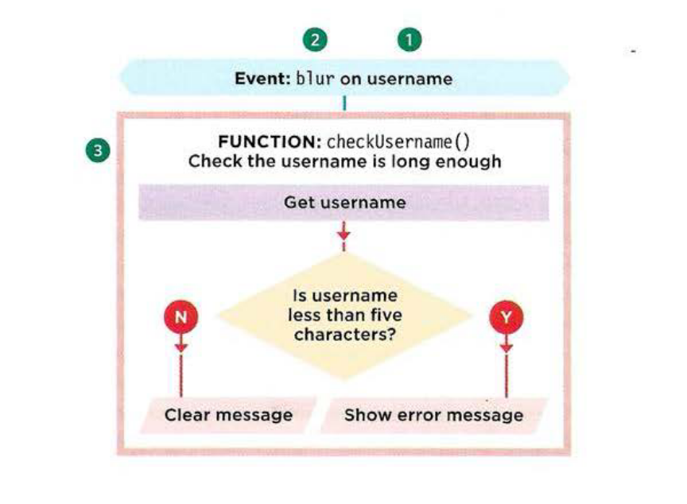
Event Handling Example
1) Select Element
The element that users are interacting with is the text input where they enter the username.
2) Specify Element
When users move out of the text input, it loses focus, and the blur event fires on this element.
3) Call Code
When the blur event fires on the username input, it will trigger a function called checkUsername().This function checks if the username is less than 5 characters.
In this example, event handling is used to provide feedback to users filling in a registration form. It will show an error message if their username is too short.

Slide 15
Event Handling Example (cont.)
If there are not enough characters, it shows an error message that prompts the user to enter a longer username.
If there are enough characters, the element that holds the error message should be cleared. This is because an error message may have been shown to the user already and they subsequently corrected their mistake.

Slide 16
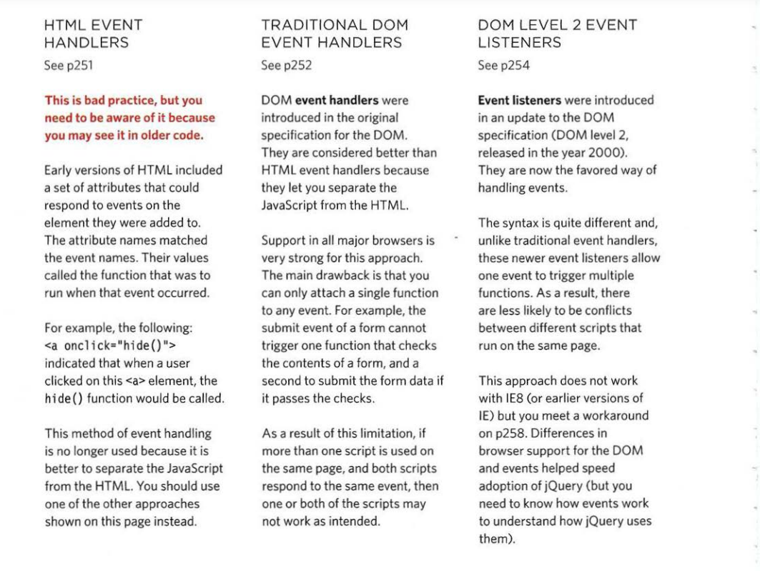
Three Ways To Bind an Element
Event handlers let you indicate which event you are waiting for on any particular element. There are three types of event handlers.

Slide 17
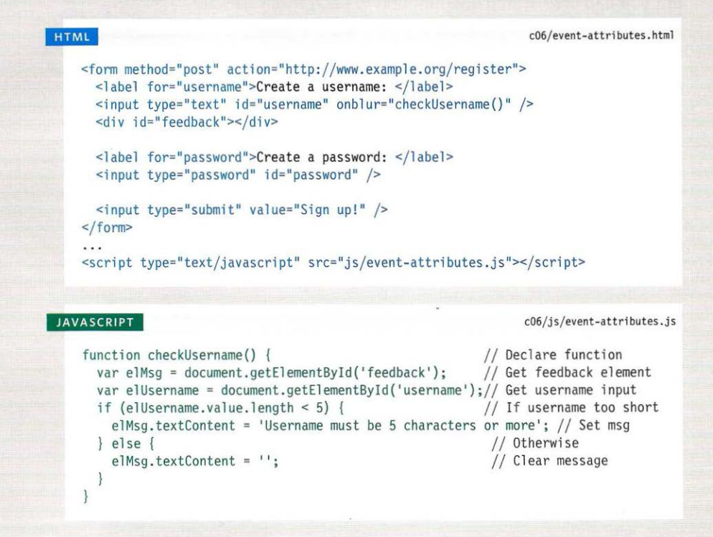
HTML Event Handlers (Do Not Use)

Slide 18
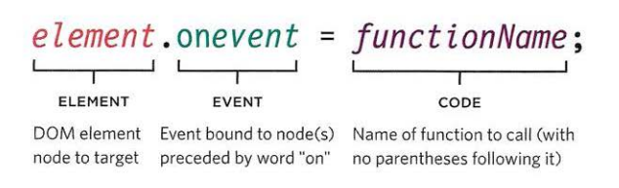
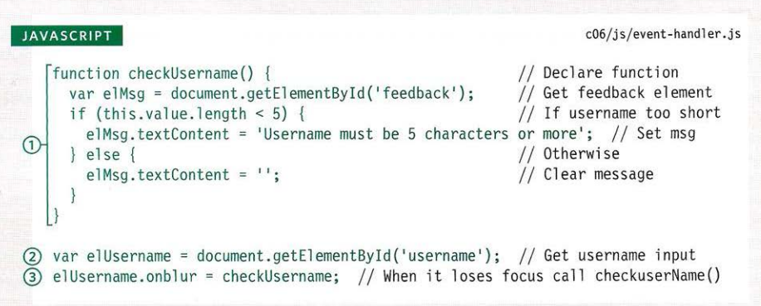
Traditional DOM Event Handlers
Syntax for binding an event to an element using an event handler

Slide 19
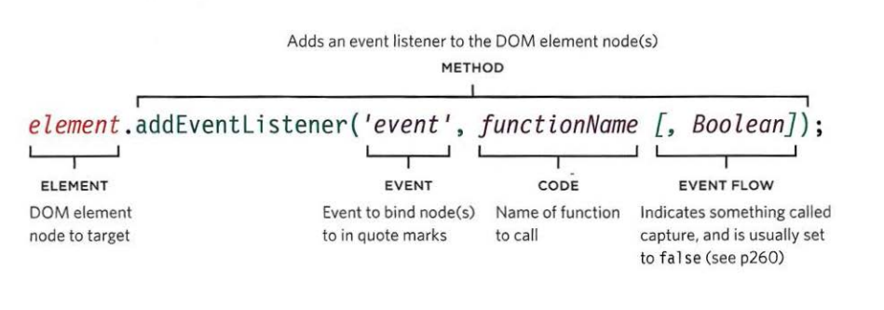
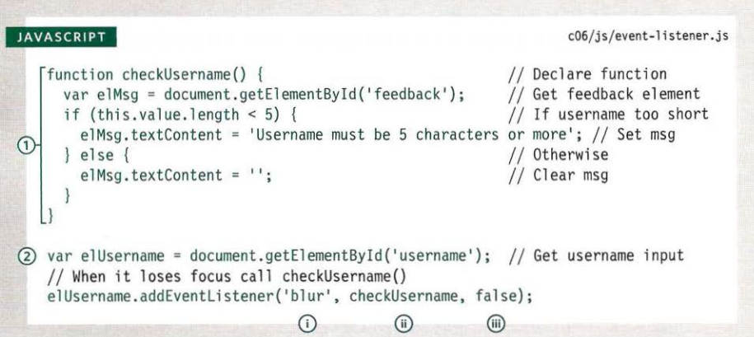
DOM Level 2 Event Listeners

Slide 20
Using Parameters with Event Handlers and Listeners
You cannot have parentheses after the function names in event handlers or listeners. This is because the interpreter runs the code as soon as it sees the parenthesis after a function call
In an event handler, we want to wait until the event triggers the function. This means that passing arguments requires a workaround.
To pass arguments to a function that is called by an event handler or listener, you wrap the function call in an anonymous function.
This is illustrated on the next slide.

Slide 21
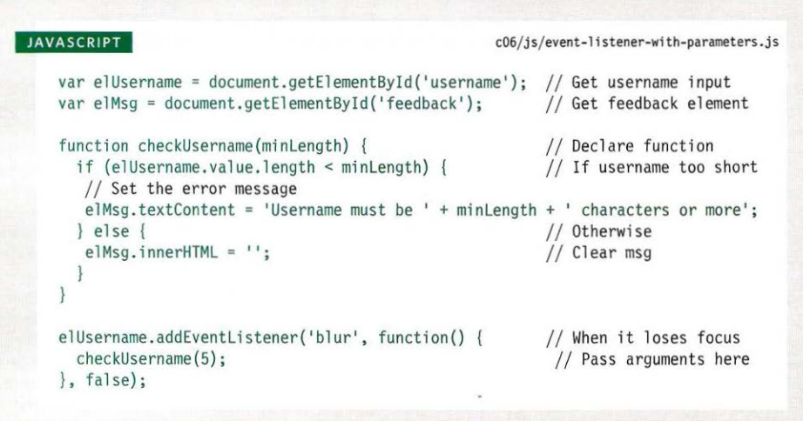
Using Parameters with Event Handlers and Listeners

Slide 22
Event Flow
HTML elements nest inside other elements. If you hover over or click on a link, you will also be hovering or clicking on its parent elements.
Imagine a list item contains a link. When you hover over the link or click on it, JavaScript can trigger events on the <a> element, and also any elements the <a> element sits inside.
Event handlers and listeners can be bound to the containing <li>, <ul>, <body>, and <html> elements, plus the document object, and the window object. The order in which the events fire is known as event flow, and events flow in two directions.

Slide 23
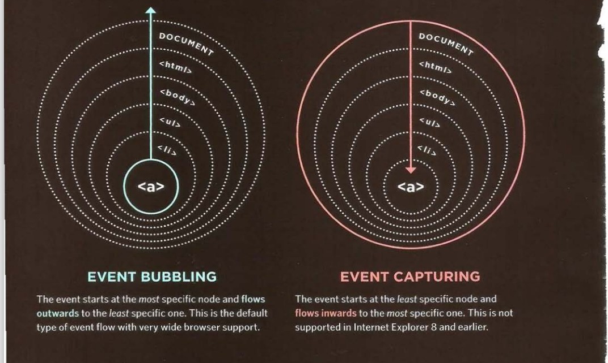
Event Flow Illustrated

Slide 24
Why Flow Matters
The flow of events really only matters when your code has event handlers on an element *and* one of its ancestor or descendant elements.
The example here has event listeners that respond to the click event on div and span elements, and demonstrate the two types of event flow.
For traditional DOM event handlers, all modern browsers default to using event bubbling rather than capturing. With event listeners, the final parameter in the addEventListener() method lets you choose the direction to trigger events.

Slide 25
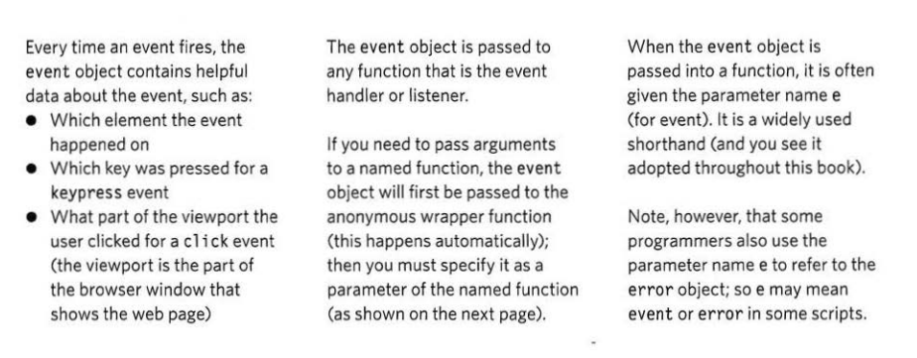
The Event Object
When an event occurs, the event object tells you information about the event, and the element it happened upon.

Slide 26
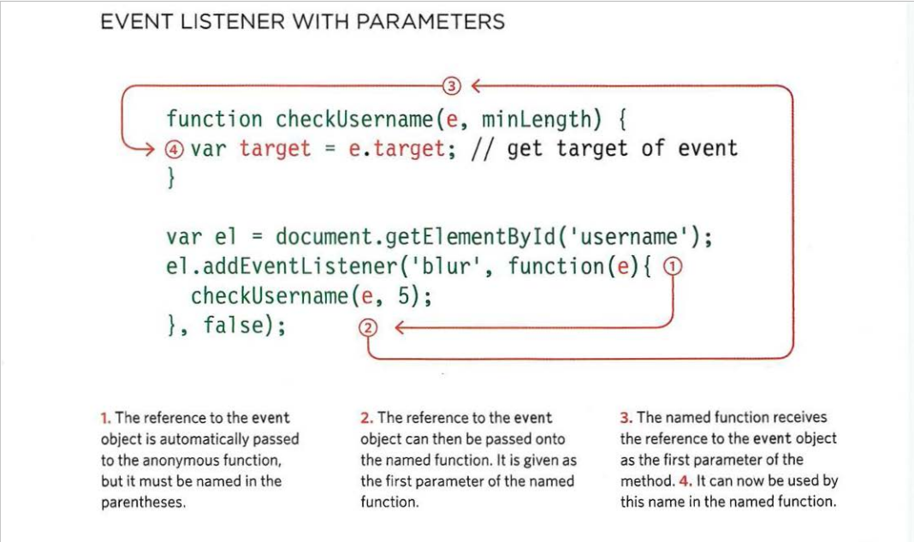
Event Listeners with Parameters

Slide 27
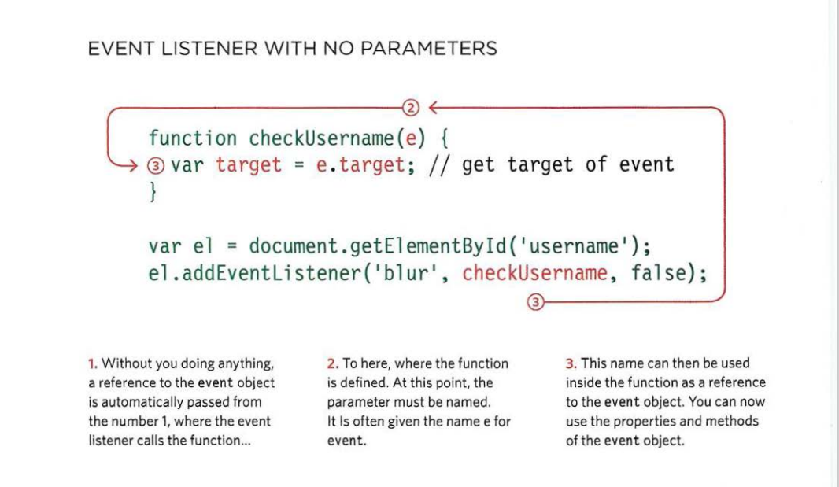
Event Listener with No Parameters

Slide 28
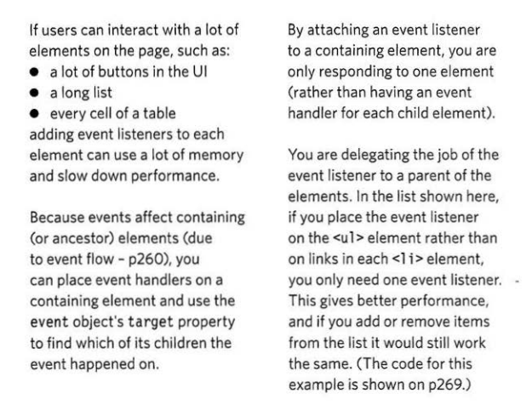
Event Delegation
Creating event listeners for a lot of elements can slow down a page, but event flow allows you to listen for an event on a parent element.
Additional Benefits:
1) Works With New Elements
If you add new elements to the DOM tree, you do not have to add event handlers to the new elements because the job has been delegated to an ancestor.
2) Solves Limitations with this keyword (only in IE)
3) Simplifies Your Code
It requires fewer functions to be written, and there are fewer ties between the DOM and your code, which helps maintainability.

Slide 29
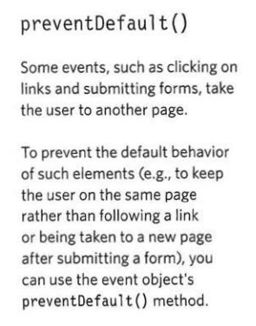
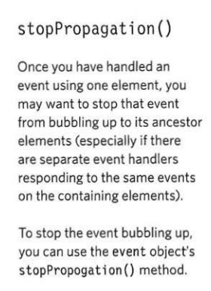
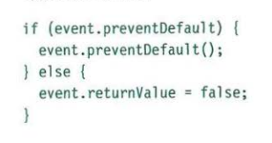
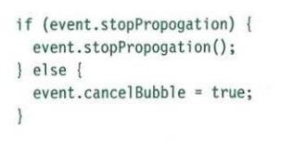
Changing Default Behavior
The event object has methods that change the default behavior of an element and how the element's ancestors respond to the event. These methods are preventDefault() and stopPropogation().

Slide 30
Using Event Delegation
To demonstrate event delegation, I’ll be using this example from javascript.info.
In this example, there is a table with nine cells. The number is not important, though, and we might want to add more. Each cell has a color assigned to it, and we want to highlight a cell <td> (or change its color to red) when we click on it, but set back its original color when not highlighted.
Rather than setting an event listener for every cell, we set a catch-all handler on the table element itself.
For more information on event delegation, I would suggest Duckett pages 268 and 269.

Slide 31
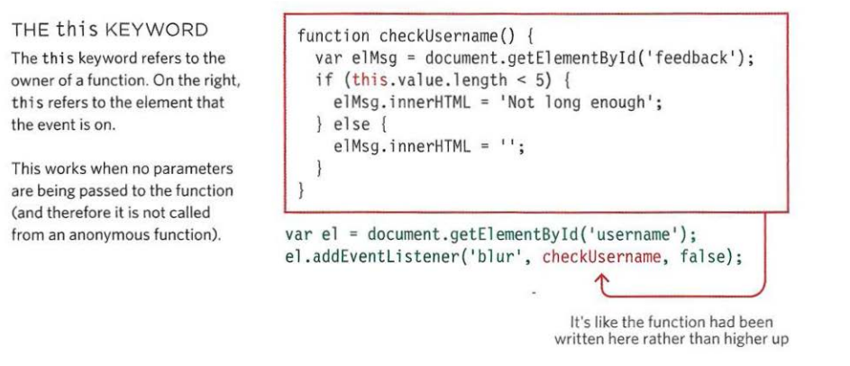
Which Element did an Event occur on?
When calling a function, the event object's target property is the best way to determine which element the event occurred on. But you may see the approach below used; it relies on the this keyword.

Slide 32
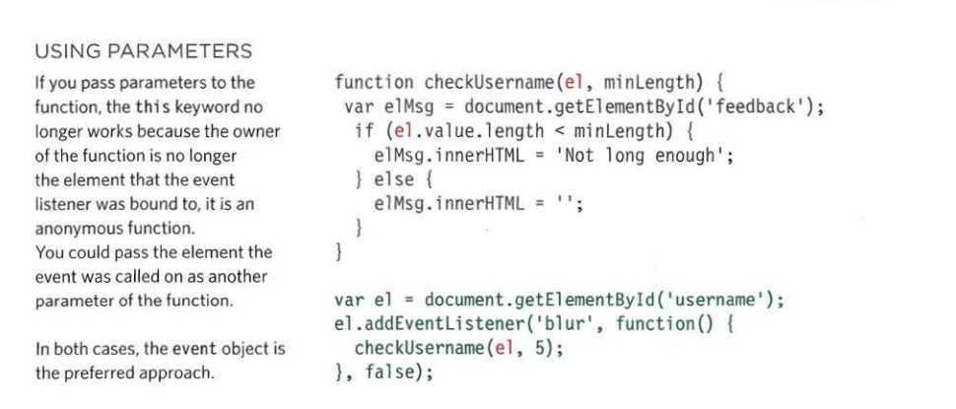
Which Element did an Event occur on?

Slide 33
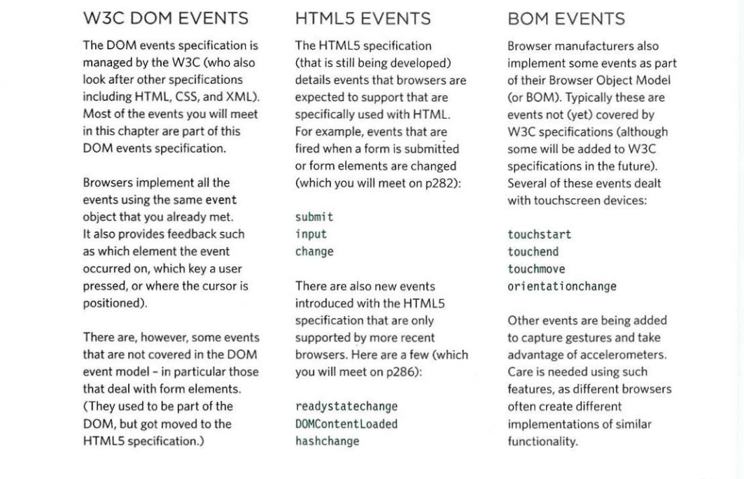
Other Event Types

Slide 34
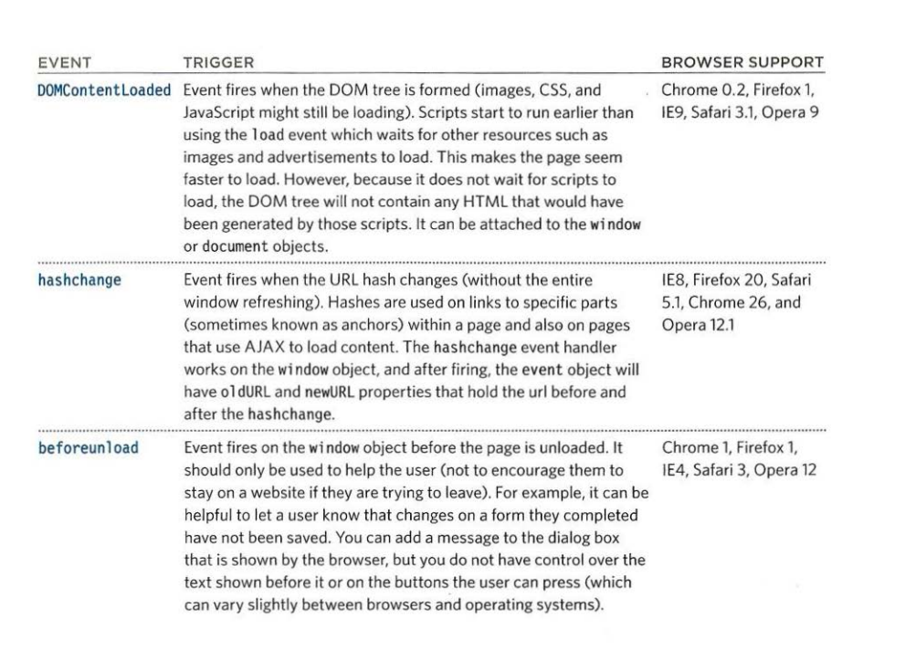
HTML5 Events

Slide 35
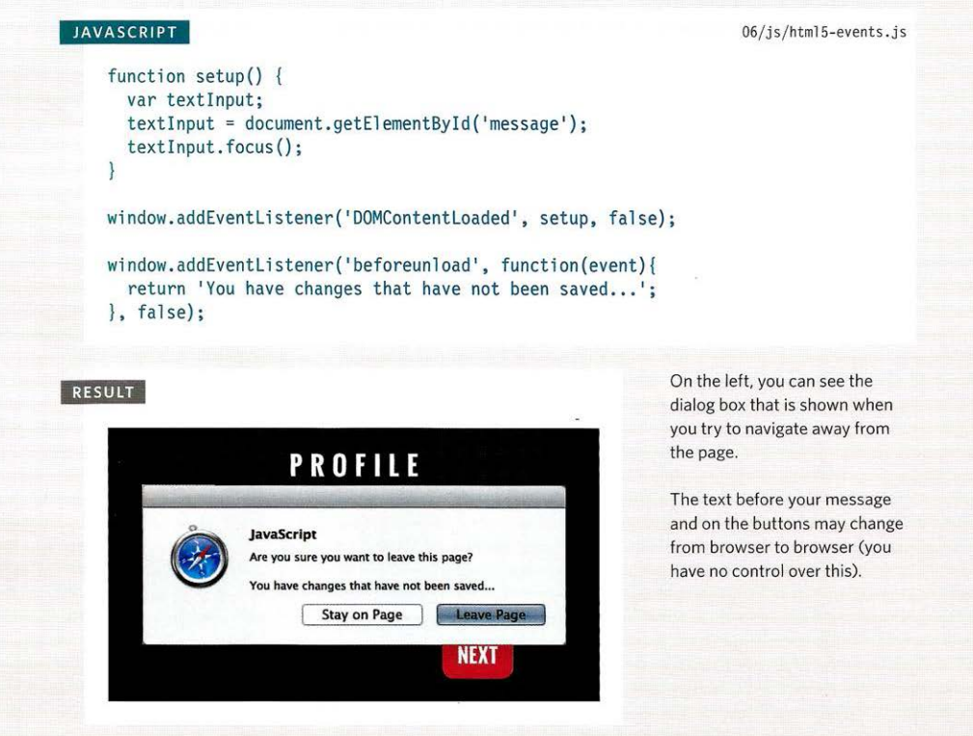
HTML 5 Event Examples

Slide 36
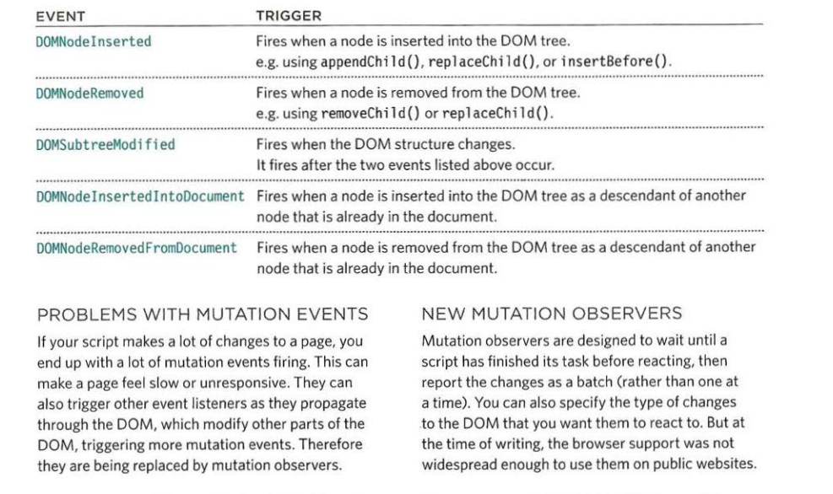
Mutation Events & Observers

Slide 37
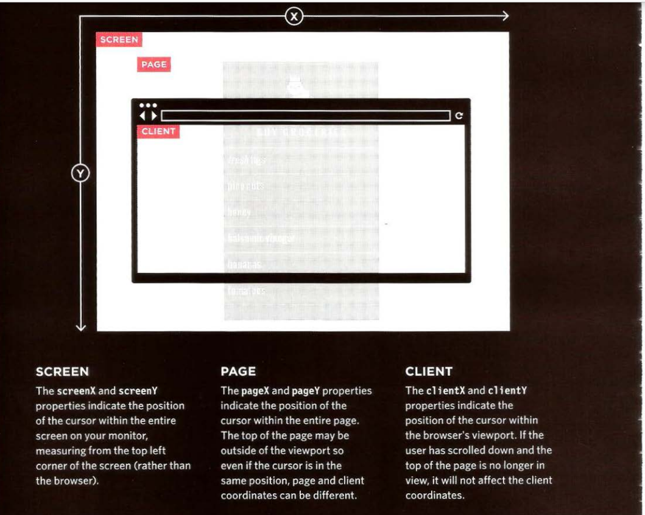
Miscellaneous Info: Where Events Occur
The event object can tell you where the cursor was positioned when an event was triggered

Slide 38
To summarize…
Events are the browser’s way of indicating when something has happened.
Binding is the process of stating which element you are waiting to happen, and which element you are waiting for that element to happen upon.
When an event occurs on an element, it can trigger a JavaScript function. When this function then changes the web page in some way, it feels interactive because it has responded to the user.
You can use event delegation to monitor for events that happen on all of the children of an element.
The most commonly used events are W3C DOM events, although there are others in the HTMLS specification as well as browser-specific events.

Slide 39
Sources
Duckett, Jon. JavaScript and jQuery: Interactive Front End Web Development. John Wiley & Sons Inc. 2014
https://www.w3schools.com/js/js_events_examples.asp
https://www.w3schools.com/jsref/met_element_addeventlistener.asp

