Slide 1

JavaScript DOM
Hussein & Abiral

Slide 2
DOM?
A way for JS to see and change the page
Just imagine a tree of boxes built by the browser from HTML

Slide 3
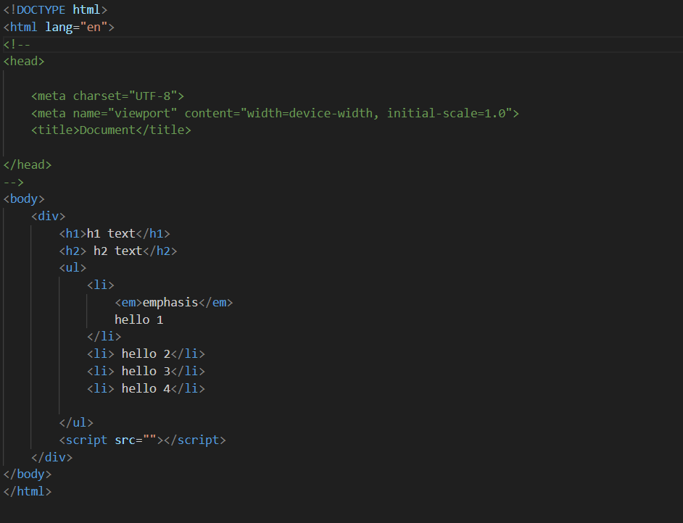
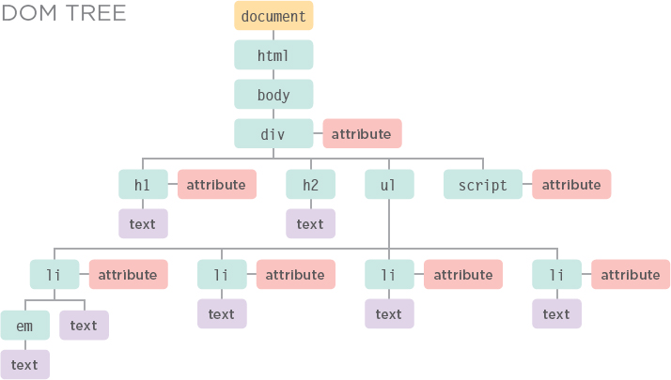
DOM VISUAL

Slide 4
Objects
Each box is like an object, like you see in Java
What do objects have?
    Properties(attributes)
    Methods
We can use JS to manipulate these objects

Slide 5
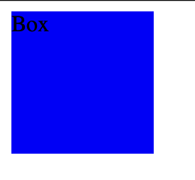
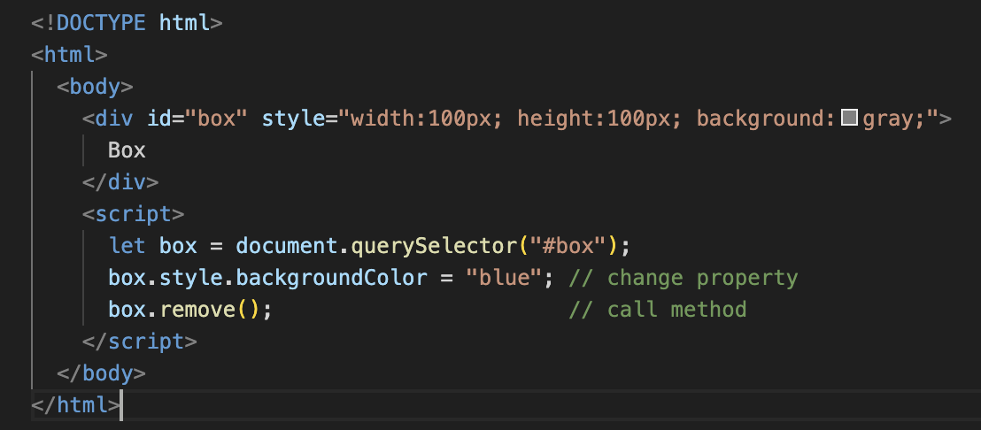
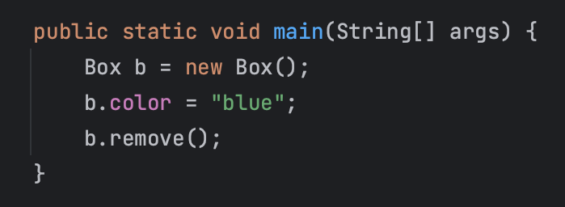
Java vs JS

Slide 6
DOM Nodes
THE DOCUMENT NODE
ELEMENT NODES
ATTRIBUTE NODES
TEXT NODES

Slide 7
Accessing Elements document.methodName()
getElementById() //get element by id
querySelector() //first matching element . or # or >
getElementsByClassName() //gets element by class name
querySelectorAll() //get all matching elements

Slide 8

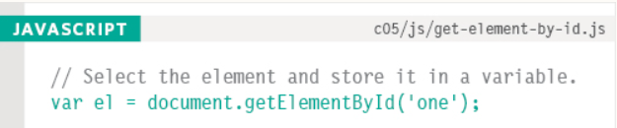
Examples
getElementsByTagName():
getElementByID():

Slide 9

Examples
getElementsByClassName():
querySelectorAll():

Slide 10
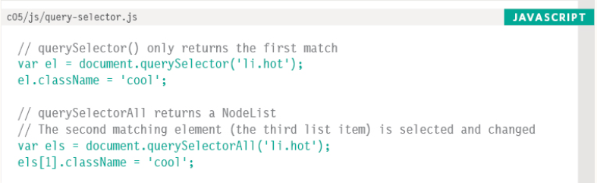
querySelector() vs querySelectorAll()

Slide 11
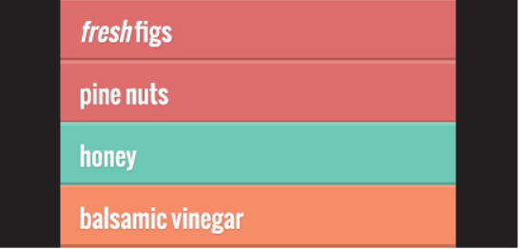
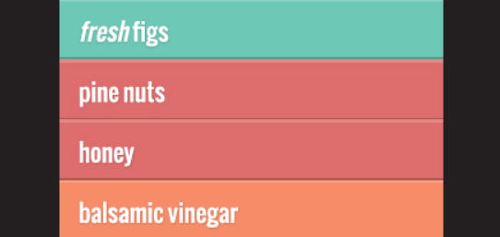
querySelector() (CSS)

Slide 12
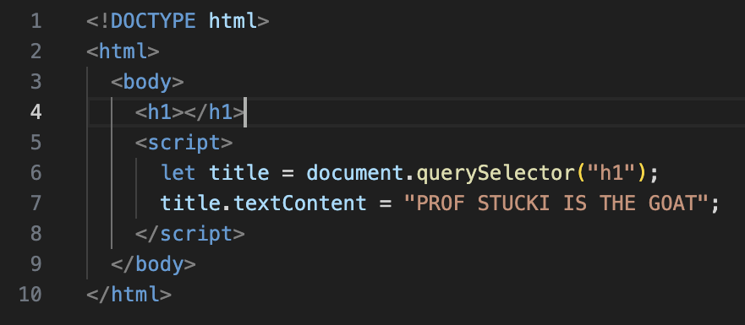
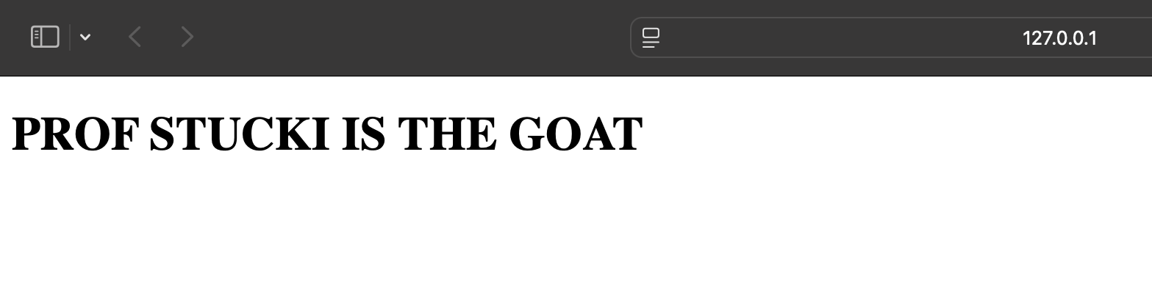
Manipulating the Content

Slide 13
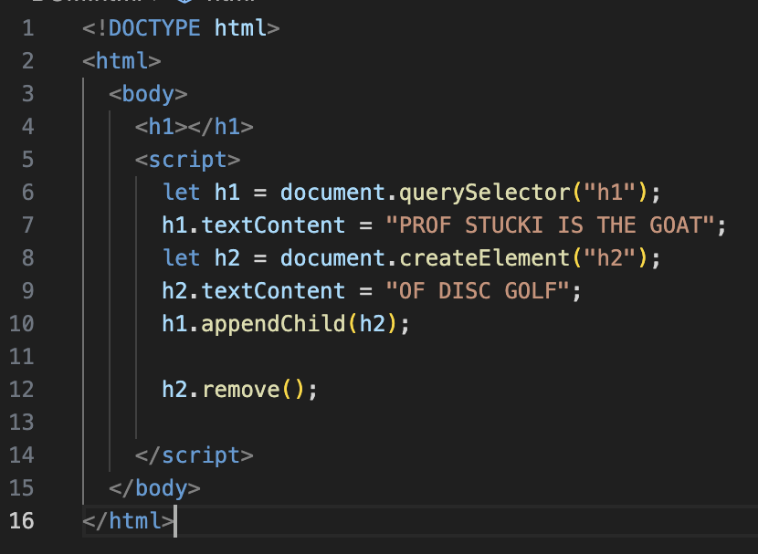
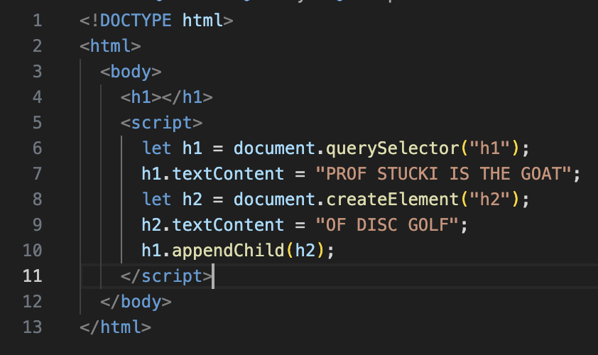
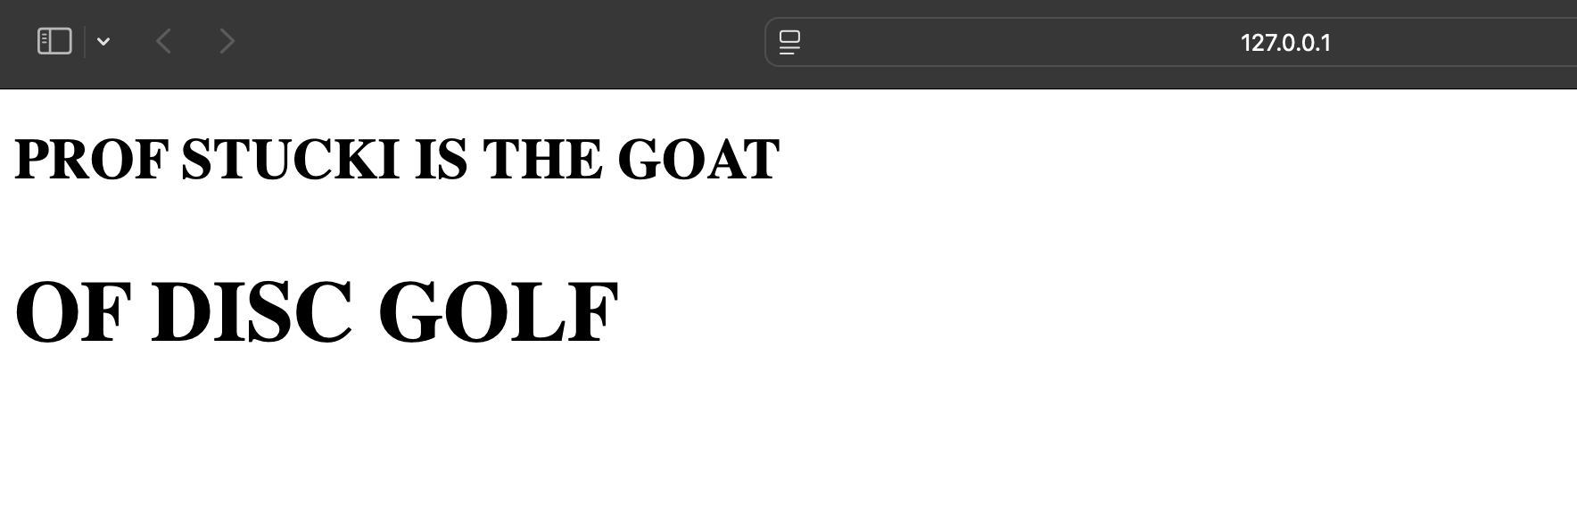
Create, Add and Remove Element

Slide 14
More methods...
.previousSibling / .nextSibling
.createTextNode()
.removeChild()
.getAttribute() / setAttribute()

Slide 15
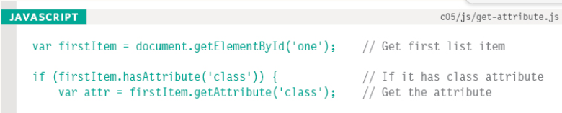
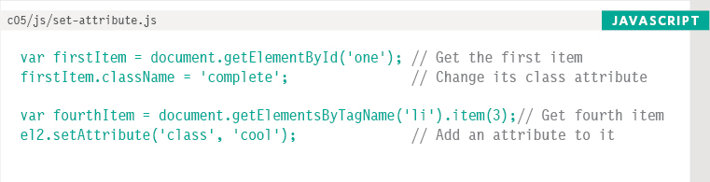
Examples
getAttribute():
setAttribute():

Slide 16
DANGER DANGER
.innerHTML
Cross-Site Scripting(XSS)

Slide 17
Resources
JavaScript | MDN
JS DUCKETT BOOK
ELOQUENT JS (THE BOOK)

