Slide 1
More JavaScript
COMP 3700

Slide 2
Alerts
Presentation schedule & assignment details on website
Small project #2 due Wednesday
Small project #3 will be available on Wednesday
Quizzes!!

Slide 3
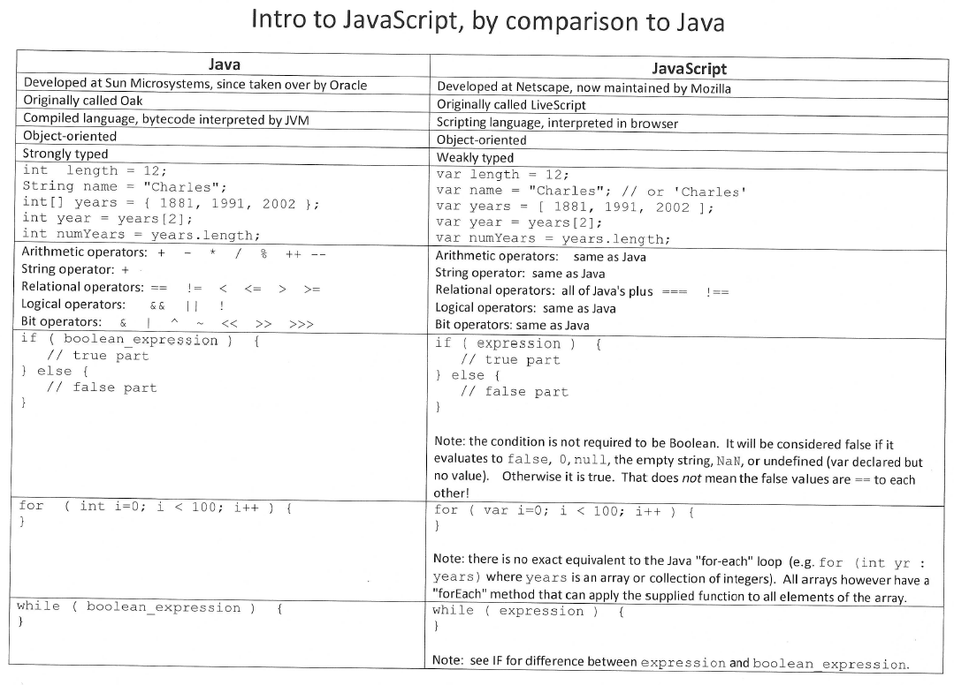

Slide 4
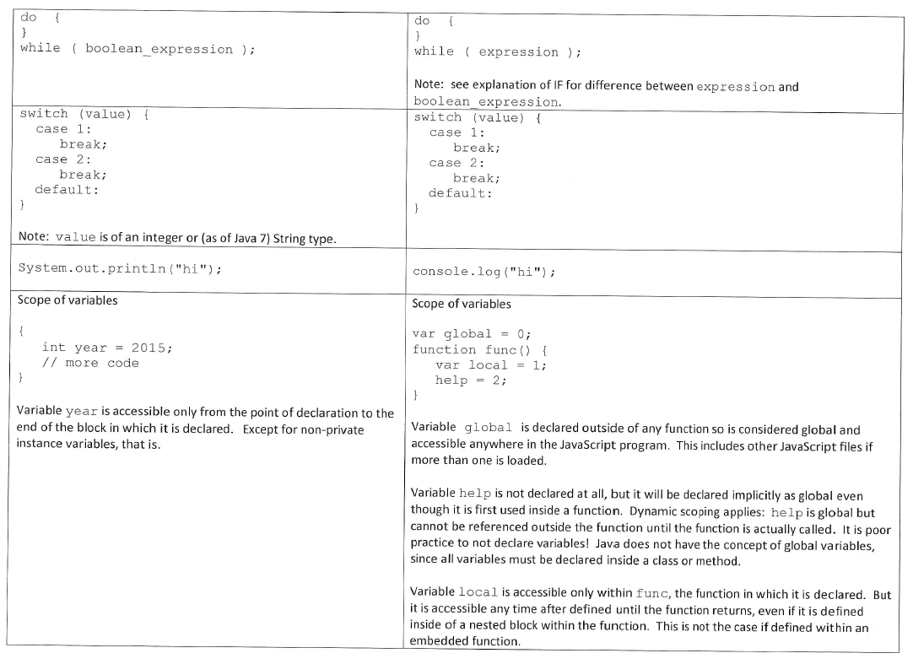

Slide 5
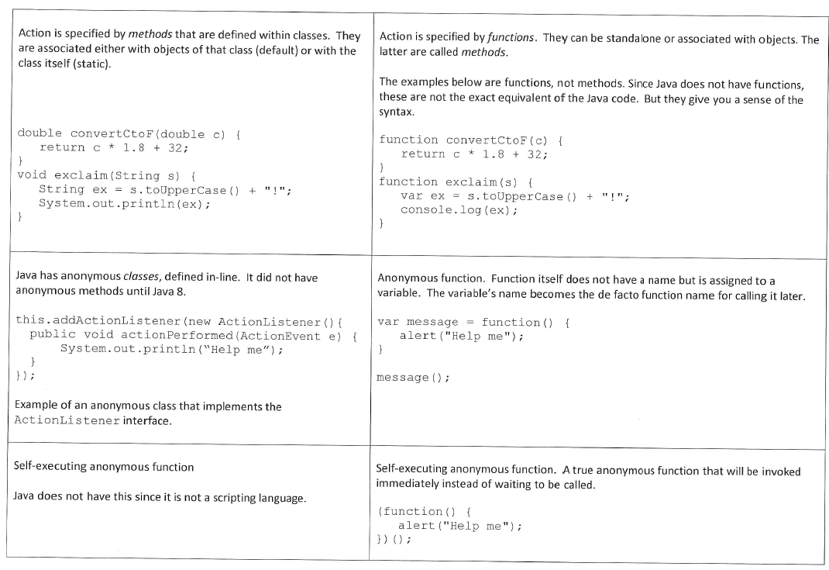

Slide 6
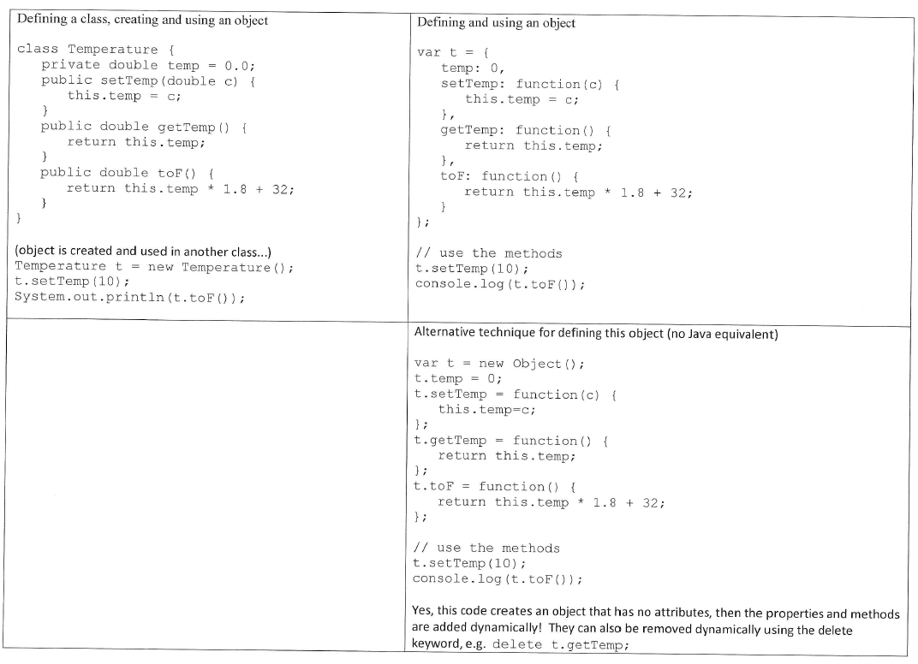

Slide 7
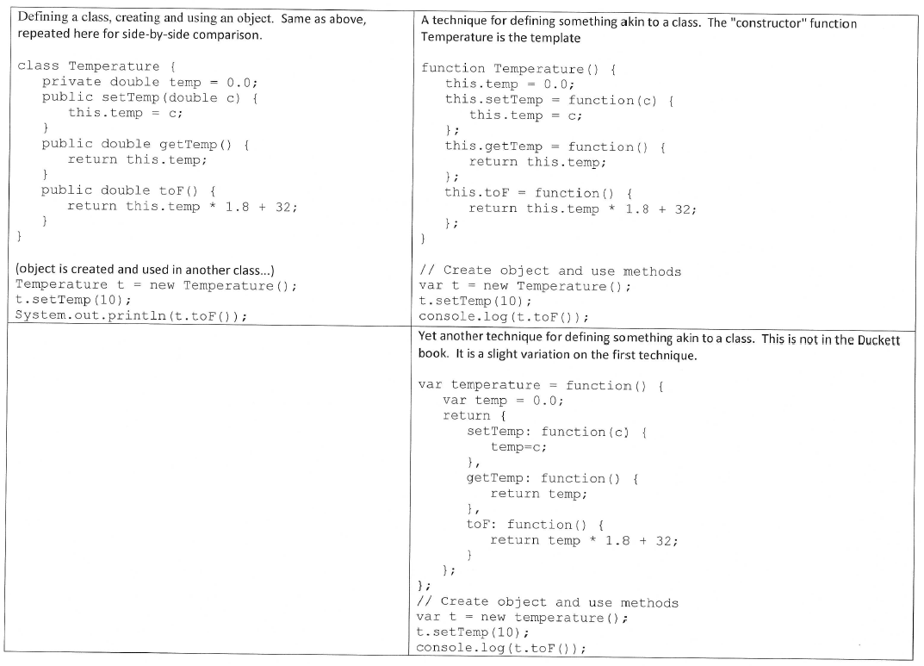

Slide 8
