Slide 1
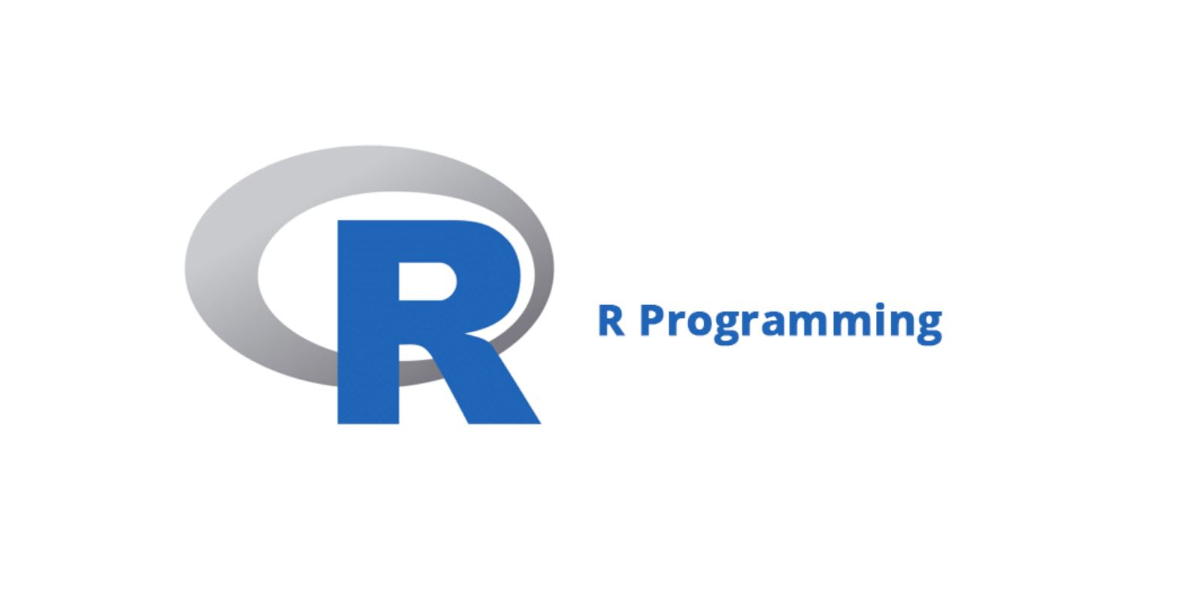
Tony Nguyen

Slide 2
What is R?
Is a programming language and free software environment designed for statistical computing and graphics. It is widely used among statistician and data minors for developing statistical software and data analysis.

Slide 3
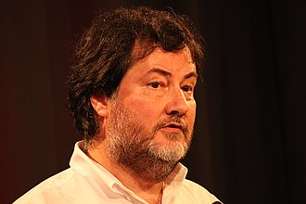


History
1976: Roots of R is traced back to the S programming language, which was developed by John Chambers and his colleagues at Bell Laboratories.
1991: Ross Ihaka and Robert Gentleman at the University of Auckland, New Zealand, started working on R as a Project. Influenced by S, and aimed to make a open-source version of S.
1993: First Public announcement of R was made by Robert and Ihaka in a paper at the Data Science Conference in Montpellier, France.
1995: The R core group was formed to oversee the development of R. Prominent members include, Ross Ihaka, Robert Gentleman, and Martin Maechler
2000: R 1.0.0 first official version release on February 29th
R
Ross Ihaka
Robert Gentleman
Martin Maechler

Slide 4
Why it was created
The purpose for the development of R was to provide a statisticians and data analysts with a powerful tool for manipulating, analyzing and visualizing data

Slide 5

Main languages that influenced R
S: R was essentially an open-source implementation of the S programming language. R is technically a similar to S
Scheme: R borrowed some of its features, such as lexical scoping and closures, from the Lisp programming language family, particularly from Scheme. Lexical scoping is a programming language feature used for managing variable access and binding.
S

Slide 6
Intended use/purpose
Statistical Computing: Be a comprehensive and extensible platform for statistical analysis. Includes a wide amounts of statistical and mathematical techniques. Making it suitable for a rage of data analysis tasks.
Data Visualization: Advance tools for data visualizations, which allows the user to create graphs, charts, and plots.
Data Manipulation: Allows cleaning, transforming, aggregating, and merging datasets.
Community and Collaboration: allows a vibrant community of users and developers to create packages and extensions to make R more powerful.
Reproducibility: Allows the analysts to document their analyses and create reports that can be easily reproduced by others.
Flexibility and Extensibility: You can create your own functions and packages to extend its capabilities.

Slide 7
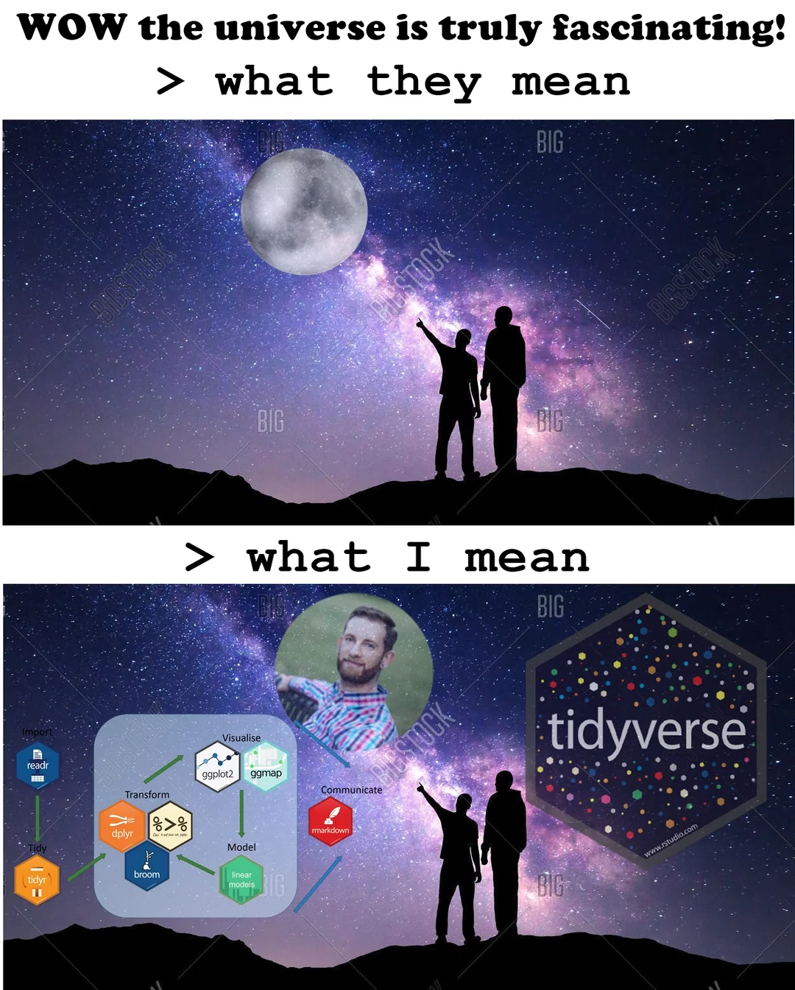
The many Packages
There are total of 27,458+ R packages however, here are the Essential Packages …
ggplot2 - visualization
ggraph - The cooler ggplot2
tidyr - tidy up your data, a evolution of Reshape2, considered tidy if each variable represents columns, and each row represents an observation.
dplyr - to data wrangle and data analysis only
tidyquant - deals with financial data
shiny - Creates a interactive and nice web interface.
caret - deals with classification and regression problems.
tidyverse - for data manipulation
e1071 - deals with clustering Fourier Transform, Naive bayes, SVM, etc
plotly - used for interactive and high-quality graphs
knitr -It’s reproducible, used for report creation, and integrates with various types of code structures like LaTeX, HTML, Markdown, LyX, etc
mlr3 -to do machine learning
xgboost - implementation of the gradient boosting framework.
xml - web scraping or extracting data from online sources.
memer - generates some dank memes
dadjoke – Displays bad jokes only dads will enjoy

Slide 8
Who uses R
Fintech Companies (financial service)
Academic Research
Government (FDA, National Weather Service)
Retail
Social Media
Data Journalism
Some specific examples.
Airbnb
Microsoft
Uber
Facebook
Ford
Google
Twitter
IBM
American Express
HP

Slide 9
Demo

Slide 10
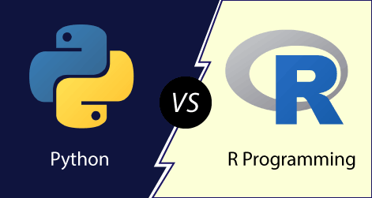
The R and Python War whose better?
R: Is built mainly for statisticians and leans more heavily into statistical models and specialized analytics. People use R for deep statistical analysis, with just a couple lines of code, to create graph visualization.
Python: Is a multi-purpose language, like C++ and Java. People use Python to work on data analysis or use machine learning in a scalable production environments.

Slide 11
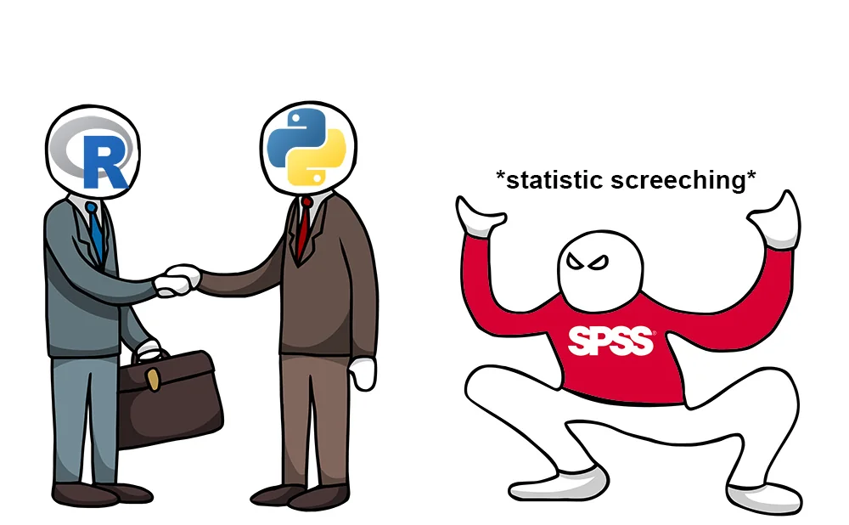
Both are good, better than SPSS

Slide 12
Sources
https://www.r-project.org/
https://thedatastudent.com/a-short-history-of-r-r-studio/
https://www.r-bloggers.com/2021/04/15-essential-packages-in-r-for-data-science/#:~:text=Essential%20Packages%20in%20R%201%201.%20ggplot2%20In,caret%20...%208%208.%20tidyverse%20...%20More%20items
https://www.rdocumentation.org/
https://www.datacamp.com/blog/python-vs-r-for-data-science-whats-the-difference
https://www.simplilearn.com/what-is-r-article
https://www.w3schools.com/r/default.asp
https://pathrise-splash-prod.herokuapp.com/guides/python-vs-r-data-science-languages-to-master/

Slide 13
Questions?

