Slide 1
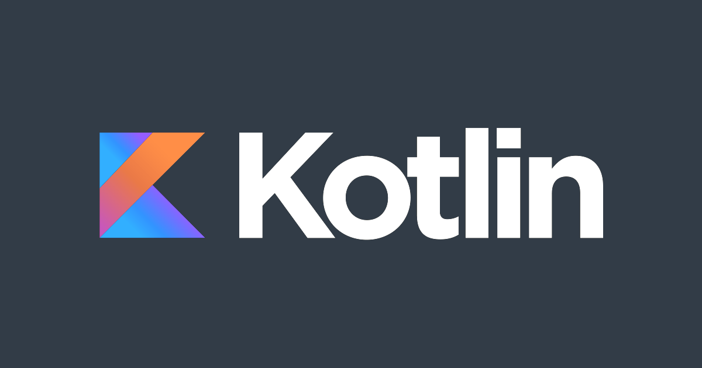
Jacob Ramstetter

Slide 2

History
Named after Kotlin Island
Initial idea Created by JetBrains in 2011
New language for the JVM
Dmitry Jemerov sought features he couldn’t find in Java
Officially Released in 2016, with Google giving their full support in 2017

Slide 3


Slide 4
History
Named after Kotlin Island
Initial idea Created by JetBrains in 2011
New language for the JVM
Dmitry Jemerov sought features he couldn’t find in Java
Officially Released in 2016, with Google giving their full support in 2017

Slide 5


Overview
open-source, statically-typed programming language that supports both object-oriented and functional programming
similar syntax and concepts from other languages, including C#, Java, and Scala
Not trying to be unique
Managed by Kotlin Foundation
Fully adopted by Google as the official language for Android development
It is designed to improve productivity in an ecosystem primarily dominated by Java and is fully interoperable with Java

Slide 6
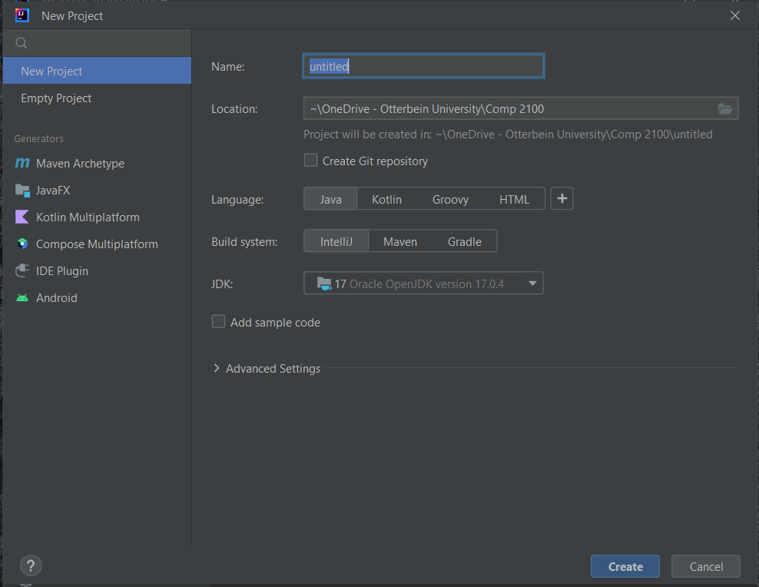

Slide 7
Applications
Widely Used in Android Application development
Full-Stack web-development
  Building a full-stack web-app in Kotlin | by Ali Muzaffar | BCG Digital Ventures Engineering | Medium
Data Science
Multi-platform Mobile development
Used at Netflix, Amazon, Uber, Foursquare

Slide 8
Advantages
concise, saving time that you’d otherwise spend writing boilerplate code in Java.
You can convert a Java file into a Kotlin file with just a script.
has no runtime overhead.
Kotlin has a large community.
Kotlin streamlines asynchronous programming. Making network and database calls asynchronously in Java is clumsy and painful
handles nulls. you can add a simple operator to variables that may be null to prevent these crashes.
Kotlin can run on multiple platforms. Kotlin can run anywhere Java runs, so you can use it to build cross-platform apps.
It’s easy to switch to Kotlin. Kotlin is fully compatible with Java, so you don’t have to change all your code at once.

Slide 9
“Fun” Example

Slide 10
Sources
What is Kotlin? 12 Interesting Facts About Kotlin | OpenXcell
Kotlin Program to Add Two Integers (programiz.com)
Kotlin overview | Android Developers
Building a full-stack web-app in Kotlin | by Ali Muzaffar | BCG Digital Ventures Engineering | Medium

