Slide 1

UCBLogo
(And a brief history of OG Logo)
By: Zane Neuhardt

Slide 2

History: Beginnings
Logo was created in 1967 at Bolt, Beranek and Newman (BBN), a Cambridge, Massachusetts research firm by Wally Feurzeig, Cynthia Solomon, and Seymour Papert.
Originally modeled on LISP
Used virtual “turtles” to give immediate visual feedback for graphic programming.

Slide 3

History: What is a Turtle?
The reptile, right?
NO!!!!
The turtle is an on-screen cursor that shows output from commands for movement producing line graphics.
It is called a turtle because the cursor itself is usually represented as an image of a turtle, but can also be a triangle or any other shape

Slide 4

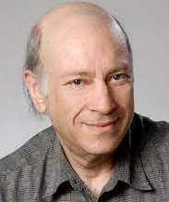
History: Where Does UCB Come in?
Developed in the 1990s at UC Berkley by Brian Harvey
Dialect of the original Logo

Slide 5





UCBLogo Influences
There’s really only two
  LISP (Like the original Logo)
  Logo itself
Implemented using C

Slide 6
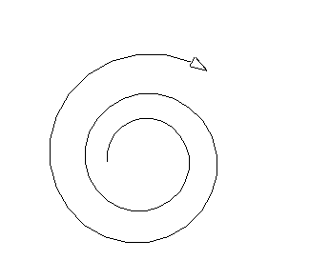
Purpose and Features
Like the original Logo, UCBLogo was made as an educational language for beginners
UCBLogo was made to teach K-12 students the basics of programming
Includes any new additions that the original Logo did not have:
  Lists
  Files
  Recursion
Uses “The Pen” for its turtle cursor

Slide 7
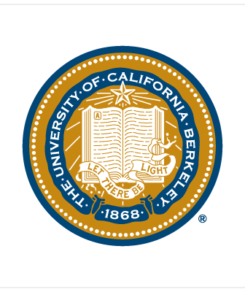

Who Uses UCBLogo?
As the name suggests, it was first used at UC Berkley
  Brian Harvey used it in his class Computer Science Logo Style
Used to teach programming in many educational institutions including:
  Elementary schools
  Middle schools
  High schools
Elementary school student discovering the power of programming though UCBLogo

Slide 8
Demo!
https://www.calormen.com/jslogo

Slide 9
Sources
https://en.wikipedia.org/wiki/Logo_(programming_language)
https://en.wikipedia.org/wiki/UCBLogo
https://en.wikipedia.org/wiki/Brian_Harvey_(lecturer)
https://www.calormen.com/jslogo

Slide 10

Any Questions?
Note: This turtle is asleep, not dead.

