Slide 1
F#
COMP 3200
Ezra Morales

Slide 2
Quick Overview
F# is a functional-first, general-purpose, strongly typed, multi-paradigm programming language that encompasses functional, imperative, and object-oriented programming methods.
  An open-source universal programming language for writing succinct, robust and performant code.
  Allows you to write uncluttered, self-documenting code, where your focus remains on your problem domain, rather than the details of programming.
  It does this without compromising on speed and compatibility - it is open-source, cross-platform and interoperable.
F# is a member of the ML family and originated as a .NET Framework implementation of a core of the programming language OCaml. It has also been influenced by C#, Python, Haskell, Scala and Erlang.

Slide 3
History
Developed in 2005 by Microsoft research. The language, essentially, was a .NET implementation of OCaml since it combined the syntax and power of functional language with the thousands of library functions available with all .NET languages.
  Basically, sought to create a variant of the OCaml language running on top of the .NET platform.
Was maintained by Microsoft, then it became open-source in 2010.
In 2013, an independent group of developers and companies joined forces to create the F# Software Foundation, a non-profit organization. Their goal was to “promote, protect, and advance the F# programming language, and to support and facilitate the growth of a diverse and international community of F# programmers.
F# is now primarily maintained by Microsoft, the F# Software Foundation, and open contributors.

Slide 4
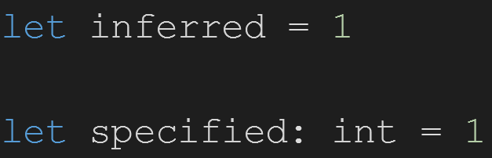
Type Declaration
F# has type inference, you do not have to specify the types of F# constructs except when the compiler cannot conclusively deduce the type.
  Omitting explicit type information does not mean that F# is a dynamically typed language or that values in F# are weakly typed. F# is a statically typed language, which means that the compiler deduces an exact type for each construct during compilation. If there is not enough information for the compiler to deduce the types of each construct, you must supply additional type information, typically by adding explicit type annotations somewhere in the code.

Slide 5
It’s not just Functional
F# is fundamentally a functional programming language at heart, yet Object Oriented features have been integrated.
  Doesn’t necessarily have classes but can make something similar.

Slide 6
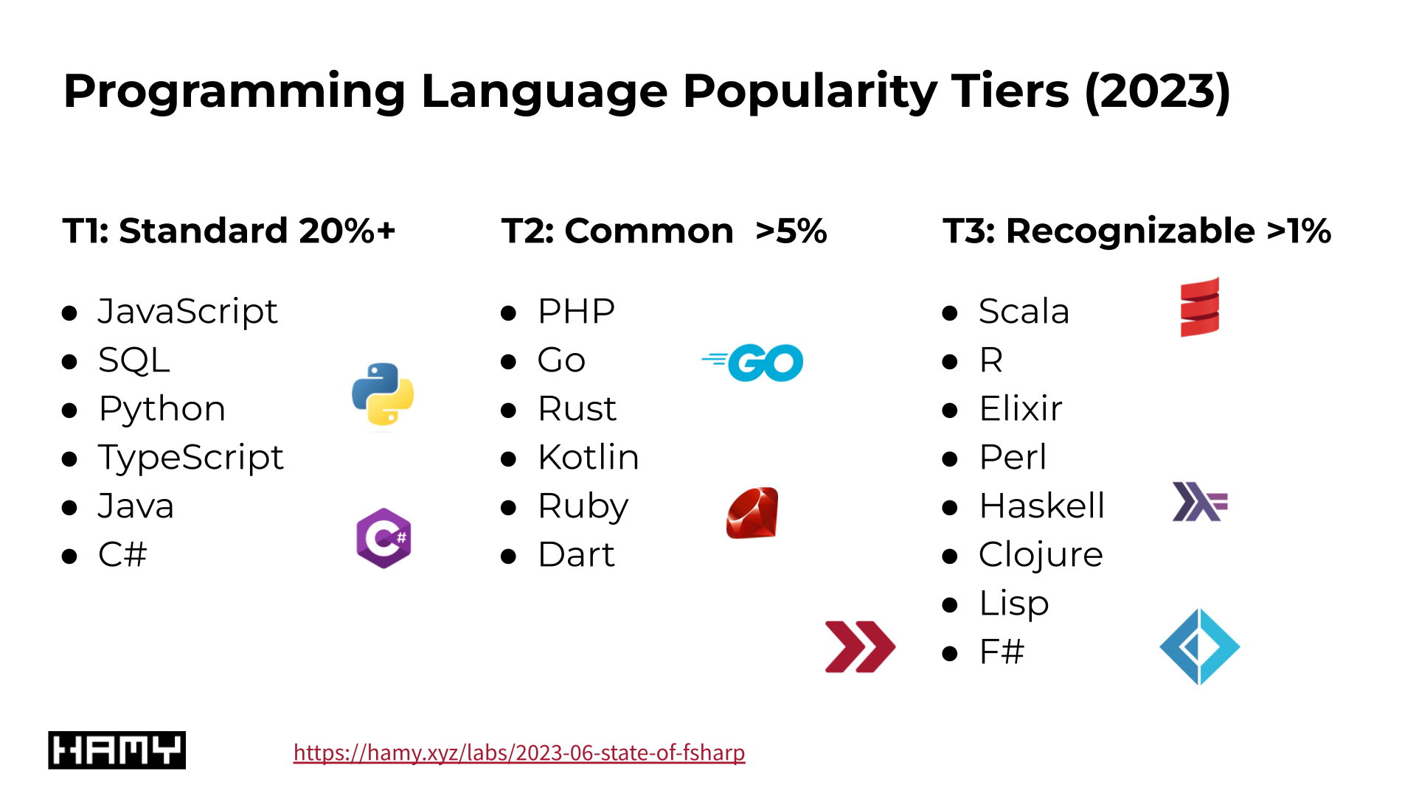
Who uses F#?
Not many companies use F#
  Most of the time, if F# is used, it is not the primarily language used, and it is used in conjunction with other languages.
  https://github.com/fsprojects/fsharp-companies
F# has been described as Microsoft’s “ugly step-child” with C# being their “golden child”

Slide 7
Conclusion
F# is a relatively easy introduction to functional programming, which opens up many other techniques and languages once you're comfortable with the paradigm.
Not the most popular language, but it has a small, but dedicated, user-base. So, it has plenty of documentation.
Built upon .NET framework, so can run on many platforms; anywhere C# is supported, F# is as well!
  Can use it for web, desktop, mobile, even games via MonoGame or Godot.

Slide 8
Questions?

Slide 9
Sources
https://learn.microsoft.com/en-us/dotnet/fsharp/what-is-fsharp
https://fsharpforfunandprofit.com/posts/classes/
https://hamy.xyz/labs/2023-06-state-of-fsharp
https://en.wikipedia.org/wiki/F_Sharp_(programming_language)
https://en.wikipedia.org/wiki/F_Sharp_Software_Foundation
https://foundation.fsharp.org/

