Slide 1
COBOL
BY Jy’el mason

Slide 2
History
In the late 1950s, computer users and manufacturers were becoming concerned about the rising cost of programming
On April 8, 1959, Mary K. Hawes, a computer scientist at Burroughs Corporation, called a meeting of representatives from academia, computer users, and manufacturers at the University of Pennsylvania to organize a formal meeting on common business languages.
At the April meeting, the group asked the Department of Defense (DoD) to sponsor an effort to create a common business language. The delegation impressed Charles A. Phillips
The meeting resulted in the creation of a steering committee and short, intermediate and long-range committees.

Slide 3
History
The steering committee met on June 4, and agreed to name the entire activity as the Committee on Data Systems Languages, or CODASYL, and to form an executive committee
The short-range committee members represented six computer manufacturers and three government agencies.

Slide 4
Represented agencies & companies
Companies
Burroughs Corporation
IBM
Minneapolis-Honeywell
RCA
Sperry Rand
Sylvania Electric Products
Government Agencies
US Air Force
The Navy’s David Taylor Model Basin
National Institute of Standards and Technology

Slide 5
History
The sub-committee did most of the work creating the specification, leaving the short-range committee to review and modify their work before producing the finished specification
The specifications were approved by the executive committee on January 8, 1960, and sent to the government printing office, which printed them as COBOL 60.
Eventually a sub-committee was formed to analyze existing languages and was made up of six individuals:
William Selden & Gertrude Tierney – IBM
Howard Bromberg & Howard Discount – RCA
Vernon Reeves & Jean E. Sammet – Sylvania Electric Products

Slide 6
History
The CODASYL Executive Committee later created the COBOL Maintenance Committee to answer questions from users and vendors and to improve and expand the specifications.
During 1960, the list of manufacturers planning to build COBOL compilers grew. By September, five more manufacturers had joined CODASYL
all represented manufacturers had announced COBOL compilers. GE and IBM planned to integrate COBOL into their own languages, GECOM and COMTRAN, respectively. In contrast, International Computers and Tabulators planned to replace their language, CODEL, with COBOL
COBOL is an industry language and is not the property of any company or group of companies, or of any organization or group of organizations.

Slide 7
Program Structure
Sections are the logical subdivision of program logic. A section is a collection of paragraphs.
Paragraphs are the subdivision of a section or division. It is either a user-defined or a predefined name followed by a period, and consists of zero or more sentences/entries.
Sentences are the combination of one or more statements. Sentences appear only in the Procedure division. A sentence must end with a period.
Statements are meaningful COBOL statements that perform some processing.
Characters are the lowest in the hierarchy and cannot be divisible.

Slide 8
COBOL Demonstration
https://www.tutorialspoint.com/compile_cobol_online.php
https://www.jdoodle.com/execute-cobol-online/

Slide 9
Languages that influenced COBOL
FLOW-MATIC created by grace hopper had a large influence on COBOL. Specifically contributing long variable names, English words for commands and the separation of data descriptions and instructions
COMTRAN, FLOW-MATIC’s competitor also played a role in COBOLs creation adding formulas, the Picture clause, improved if statements ridding the need of GO TO and a robust file management system
9

Slide 10
Flaws in early Cobol
COBOL is a difficult language to write a compiler for
due to the large syntax and many optional elements within syntactic constructs
Due to a need to generate efficient code for a language with many possible data representations, implicit type conversions, and necessary set-ups for I/O operations.
Early COBOL compilers were primitive and slow

Slide 11
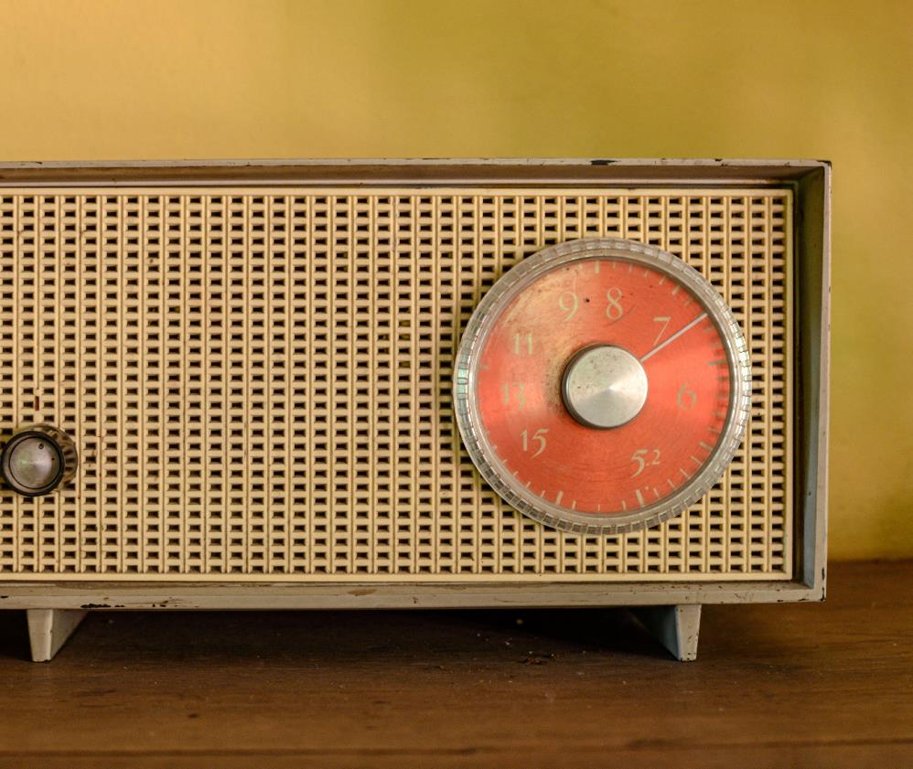
Purpose
It was created as part of a US Department of Defense effort to create a portable programming language for data processing
furthermore, it was created as a cheaper and faster alternative to current data processing software given that a survey found that in any data processing installation, the programming cost $800,000 on average and that translating programs to run on new hardware would cost $600,000

Slide 12
Who still uses COBOL?
COBOL is still very popular today. Depending on the source you’re looking at, there are still between 200 and 250 billion lines of COBOL code in production.
Many large corporations, 70% in fact, still rely on COBOL for much of their mission critical work. Government, finance, insurance, automotive and banking industries are still heavy users.
Roughly 43% of banking systems use COBOL and every time you swipe an ATM card, it executes COBOL code 95% of the time. There are 1.5 billion new lines of COBOL programmed each year.

Slide 13
Why we still uses COBOL
For companies Cobol was used for the majority of their internal software. With many managers saying they planned to migrate from COBOL, while some said that they would do so if not for the expense of rewriting legacy code. Alternatively, some businesses have migrated their COBOL programs from mainframes to cheaper, faster hardware
Furthermore, due to the increasing retirement of COBOL programmers there is an increasing skill gap in business and government organizations
Efforts to rewrite systems in newer languages have proven expensive and problematic, as has the outsourcing of code maintenance, thus proposals to train more people in COBOL are advocated

Slide 14
Features of COBOL
Additions with cobol-2002
Cobol adds object orientation
Free-form code
User-defined functions
Recursion
Locale-based processing
Support for extended character sets such as Unicode
Floating-point and binary data types (until then, binary items were truncated based on their declaration's base-10 specification)
Portable arithmetic results
Bit and Boolean data types
Pointers and syntax for getting and freeing storage
Initially COBOL-60 included
COBOL is self-documenting
No pointers
No user defined types or functions
Portable across multiple platforms
advanced file handling capabilities enable it to handle huge volumes of data
14

Slide 15
The Y2K Problem
The Y2K problem, also known as the Year 2000 problem, was a defect in millions of computer programs that caused erroneous handling of date information. The problem was that many computer programs only allowed two digits for the year, instead of four.
The cost of year 2000 preparations in the U.S. was estimated at $100 billion, with 8.4% of that amount spent by the government. However, observers' estimates put the figure much higher -- from $150 billion to $225 billion in U.S. government and business expenditures
The Y2K problem required the cooperation of governments, institutions, and other organizations around the globe. The USA and UK worked day and night to fix the issue, while the Australian government invested millions of dollars to fix the issues

Slide 16
The Y2K Problem
The majority of programs with Y2K problems were business applications written in COBOL.
To correct the Y2K problem, the first step was to find people who knew COBOL and could read the old lines of instruction. Sophisticated commercial products were also available to help programmers find and fix Y2K bugs in COBOL applications

Slide 17
Why COBOL is a legacy language
COBOL is different, and in some ways was very limited:
you can't do dynamic memory allocation
you can't easily access low-level features of the operating system or particular computer architecture
The most common forms of the language can't use recursion.

Slide 18
Thank You

