Slide 1
X86 Assembly

Slide 2
Origins & Creator
Developed in 1978
Stephen Morse
Notes:
The x86 assembly programming language is a family of complex instruction architectures, initially developed by intel in 1978. At the time, intel needed a 16-bit successor to its earlier 8-bit 8080 processor that would maintain backward compatibility. Stephen Morse and his team were up to the task

Slide 3
Influences
Earlier intel architectures
Notes:
X86 was mainly influenced by it’s earlier iterations, like 8080, 8008, and the DEC PDP-11 minicomputer instruction set. X86 assembly’s syntax and design were shaped mainly by the need for compatibility with these earlier chips, making it more evolutionary than revolutionary at first.
The engineers weren’t trying to reinvent the wheel, they were aiming to generalize it, and create a language that works for ALL intel chips.

Slide 4
Newly implemented features
Segmented Memory Architecture | Backward Compatibility
Complex Instruction Set | Addressing Modes
Interrupt and I/O Mechanisms | Protected Mode
Notes:
Segmented Memory Architecture:
Divided memory into different logical segments (code, data, stack, extra, etc.). This allowed x86 to segment code so that older systems are still compatible, without losing any of the new space available
Backward Compatibility:
X86 was designed to run software from its predecessor, the intel 8080
Complex Instruction Set:
X86 expanded the idea of ‘complex’ instructions. It implemented single commands that could perform multi-step operations, such as string copying, multiplication, and memory arithmetic
Addressing Modes:
Introduced several flexible addressing modes, ways to refer to data in memory
- Direct (access a fixed memory address)
- Indirect (access memory through a register)
- Indexed (register + offset)
Interrupt and I/O mechanics:
Built in hardware interrupts and I/O port instructions for direct device communication. This standardized how software interacted with hardware and formed the foundation of BIOS calls in later operating systems
Protected Mode:
A CPU mode that supports virtual memory, multitasking and privilege levels

Slide 5
Features added over the years
1980: Floating Point Arithmetic
1985: 32-bit support
1989: On-chip FPU & pipelining
2003: 64-bit support
2011: 256-bit & 512-bit support
Notes:
1980: Floating Point Arithmetic handled on the CPU
1985: implemented support for 32-bit systems
1989: On-chip FPU & pipelining – Integrated floating-point unit and pipelined execution. This meant that the FPU was now built into the CPU, which introduced instruction pipelining, allowing for multiple instructions to overlap in execution. Which translated into a major speed boost

Slide 6
Who uses x86 today
Legacy systems
Gamers and developers
Cloud providers
Industrial PC’s / Machines
OS developers
YOU!
Notes:
Legacy Systems: Servers, workstations, financial systems, and office PC’s still use x86 CPU’s, with new code being written daily for use in datacenters
Gamers and Developers: Many game development software is optimized for increased performance on x86 CPU’s via x86 assembly
YOU: Nearly all mainstream consumer CPU’s are x86 based

Slide 7
X86 Code: Simple Calculator

Slide 8
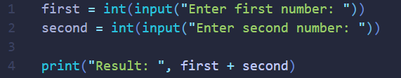
Python Implementation

Slide 9
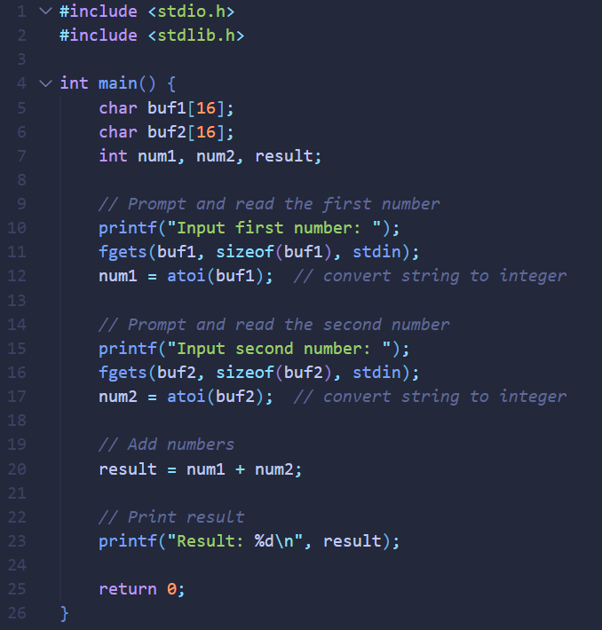
C Implementation

Slide 10
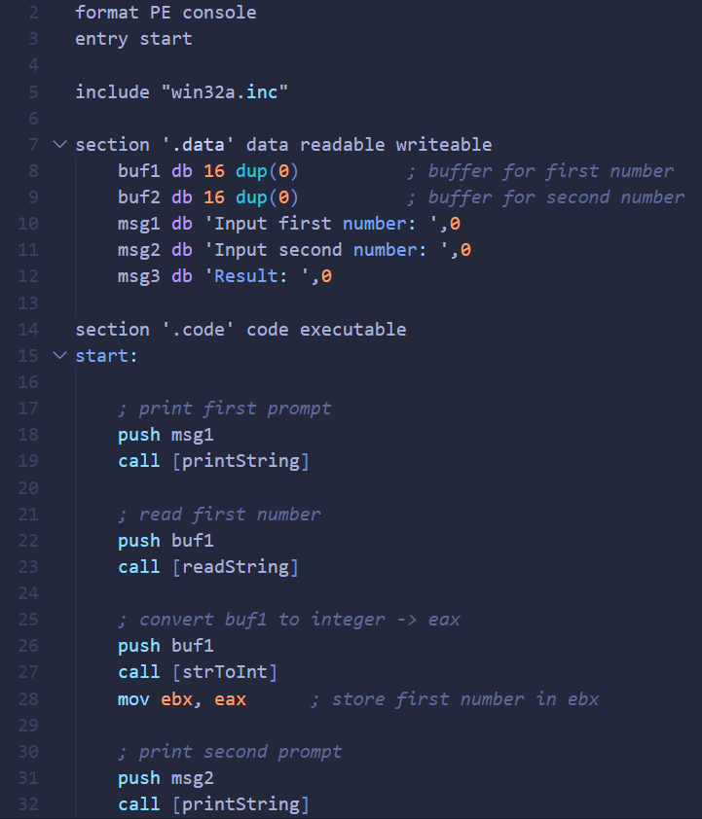
X86 Implementation

Slide 11
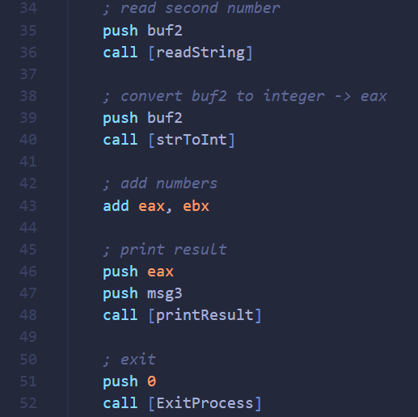
X86 Implementation (Cont.)

Slide 12
X86 Explained
Register | Purpose | Typical Use
EAX | Accumulator | Arithmetic, return values from function
EBX | Base | Hold base address
ECX | Counter | Loops, and shifting/rotating bits
EDX | Data | Used with EAX for multiplication and division
ESI | Source index | String/memory source pointers
EDI | Destination Index | String/memory destination pointers
EBP | Base Pointer | Points to the base of the current stack frame
ESP | Stack Pointer | Points to the top of the stack (Grows downward)
Notes:
EAX – EDI: General purpose; can hold integers, pointers, bit patterns, and 32-bit value

Slide 13
Questions?

