Slide 1
F#
Ashley Gutierrez

Slide 2

Origins & Purpose
Created by Don Syme at Microsoft Research, Cambridge
Started as “Project 7”, exploring how functional programming could fit within .NET
At the time, industry languages (like C# and Java) were heavily object-oriented
Goal: Merge ML-style functional safety with practical programming for real-world applications
Simplify complex, data-heavy programming and enable type-safe functional constructs

Slide 3

History Context
Early 2000s: OOP dominates (C#, Java)
Functional languages powerful but mostly academic
2002–2004: Project 7 tests .NET Generics internally
2005: First public F# compiler released
2007–2009: Collaboration with Visual Studio team to make F# production-ready
2010: Officially released as part of Visual Studio 2010
Post-2014: Open-sourced

Slide 4
Language Influences
OCaml – major influence; inspired F#’s syntax, type system, and pattern matching
ML family – contributed type inference, immutability, and functional programming approach
Haskell – introduced higher-order functions and some advanced functional concepts
.NET languages (like C#) – object-oriented design and interoperability with existing libraries
Result – F# is a flexible, multi-paradigm language that bridges functional and practical programming on the .NET runtime

Slide 5
Core Philosophy
Designed for conciseness, correctness, and productivity
Functional-first but not functional-only” approach
Emphasizes immutability, type safety, and predictable code
Balances academic research and practical application

Slide 6
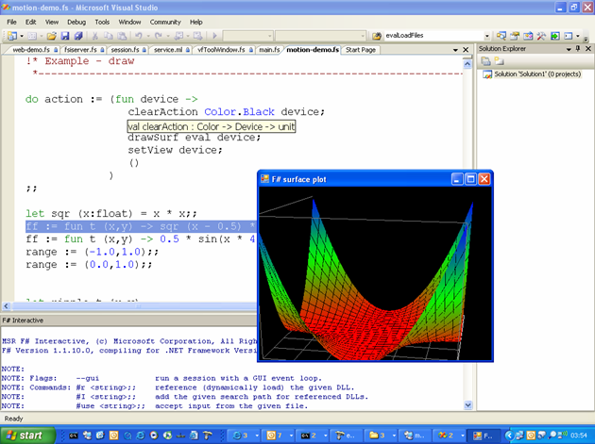
Key Language Features
Type Inference: Minimal explicit typing
Pattern Matching: Simplifies complex logic
Immutable Data Structures: Reduces side effects
Discriminated Unions: Flexible and safe data modeling
Asynchronous Workflows: Supports parallel and asynchronous tasks
F# Interactive (REPL): Instant feedback for experimentation

Slide 7
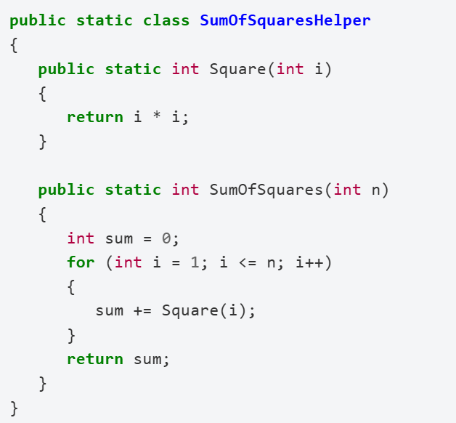
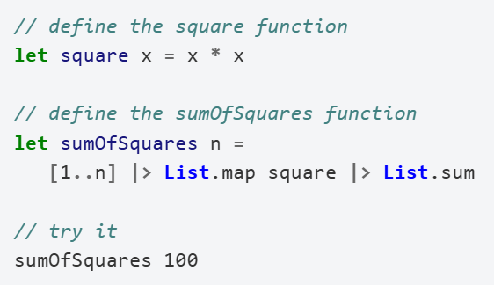
Comparison
F#
C#

Slide 8
Who Uses F#
Used by financial institutions for modeling & trading systems
Popular in data science, AI, and simulation
Strong adoption in academic research and education
Preferred when reliability and math-heavy logic are critical

