Slide 1

Swift
Cameron Uhl

Slide 2
What is Swift?
Swift is a modern, fast, and safe programming language created by Apple
Built to create applications across the Apple ecosystem
Used for:
  iOS
  macOS
  watchOS
  tvOS
  Server-side development

Slide 3
History
Created in 2010 by Chris Lattner in 2010 for Apple
Swift was designed to replace Objective-C
Set out to improve:
  Dynamic dispatch
  Widespread late binding
  Extensible programming
Wanted to implement these features in a “safer” way to make catching bugs easier
Supports the concept of Protocol Extensibility
  Apple claims it is “protocol-oriented programming”
Open-sourced in 2015 with goals of a broader adoption in the field

Slide 4
Key Features
Safety:
  Strongly typed: variables are a set type when declared
  Optionals (?) to prevent null pointer crashes
  Memory management with ARC: automatically allocates and deallocates memory for objects
Performance:
  Compiled language: Code is compiled into machine code and uses an LLVM-based compiler
  Faster than python, and more efficient than Objective-C

Slide 5
Key Features
Modern Syntax
  Clean, readable, and beginner friendly syntax
  Type Inference: Variables are assumed to be a certain type depending on what data is stored in it
  Functional programming features: Map, Filter, Reduce
  Contain closures, structs, enums, and protocols
Integration
  Works seamlessly with Objective-C
  Has the ability to integrate with existing Apple codebases

Slide 6
Syntax Examples

Slide 7

Variables and Constants

Slide 8
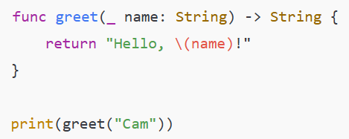
Functions

Slide 9
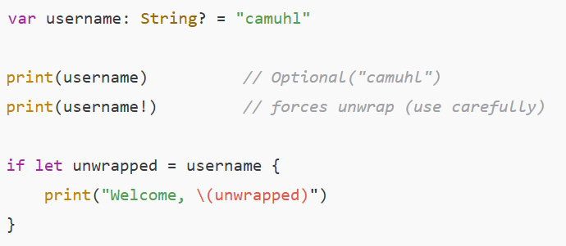
Optionals

Slide 10
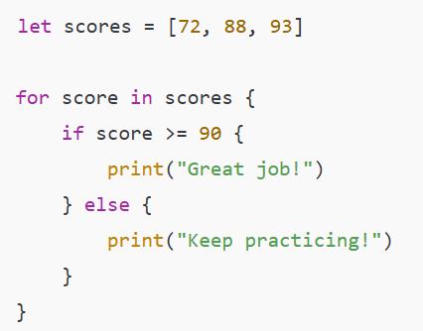
Control Flow

Slide 11
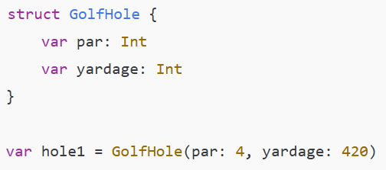
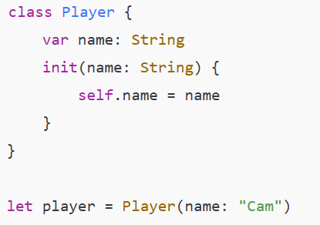
Struct vs Class
Struct Class

Slide 12
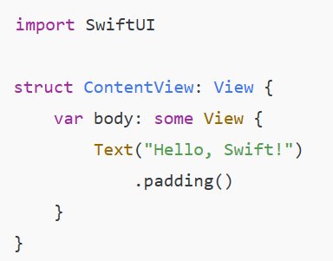
SwiftUI

Slide 13
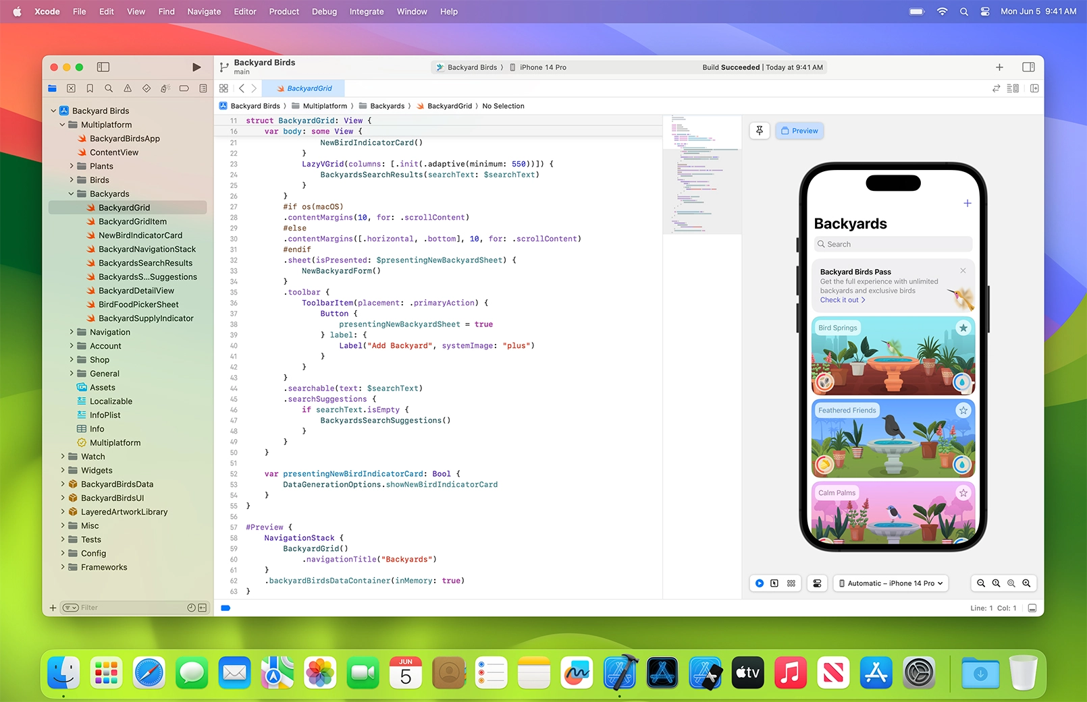
Development Tools
The main IDE for Swift development is Xcode
There are also Swift playgrounds online

Slide 14
Companies that use Swift
Apple
Lyft
Slack
Airbnb
LinkedIn
Facebook
FireFox
Robinhood
Etc.

Slide 15
Advantages of Swift
Safe and expressive
Rapid Development: new features are always being added
Strong community since it is part of the open-source ecosystem
There is a high demand for iOS developers

Slide 16
Limitations of Swift
Very Apple-centric
  Though they are gradually branching out into other systems
Limited use on non-Apple devices
Learning curve for beginners with the introduction of optionals and protocols

Slide 17
Conclusion
Swift is a modern, fast, safe, and expressive programming language built for the Apple ecosystem
It combines strong safety features, high performance, and a clean syntax
  This makes it beginner friendly while also being useful for professional development
Xcode, SwiftUI, and Swift Playgrounds make development in Swift accessible to all
The expansion of Swift onto other platforms, server-side apps, and machine learning make the future for this language very promising

