Slide 1




Scheme

Slide 2
What is Scheme?
Functional programming language: Scheme is based on the functional programming paradigm, emphasizing functions as first-class values, recursion, and mathematical-style computation instead of step-by-step instructions.
Minimalist core design: Scheme intentionally has a very small set of built-in constructs. This minimalism encourages clarity, avoids unnecessary complexity, and allows powerful features to be built from simple foundations.
Strong use in computer science education and research: Scheme plays a major role in teaching fundamental concepts such as recursion, abstraction, interpreters, and programming language design. It is also used in research on AI, compilers, and formal models of computation.
Uses symbolic S-expressions: Both code and data are written in simple parenthesized expressions (S-expressions), giving Scheme a uniform structure that is easy to parse, manipulate, and reason about.

Slide 3
Origins
Created by Gerald Jay Sussman & Guy L. Steele Jr.
Developed at MIT Artificial Intelligence Lab in 1975
Started as an experiment in language design and AI research
Its design later influenced many modern programming languages

Slide 4
Influences
Lisp
ALGOL
Provided S-expressions, symbolic processing, and the functional paradigm
Scheme is a streamlined dialect of Lisp with a cleaner, smaller core
Inspired Scheme’s lexical scoping and block-structured control

Slide 5
Key Features
Lexical Scoping
Variable scope is determined by the program’s structure
Enables reliable closures and modular functions
First-class functions
Functions can be passed as arguments, returned as values, and stored in variables
Encourages higher-order programming and abstraction
Proper tail-call optimization
Allows recursive functions to run with constant memory, like loops
Makes tail recursion a natural, efficient control structure

Slide 6
Key Features
Minimalist design philosophy
Very small set of core constructs
Promotes simplicity, clarity, and expressive code
Many features are built from simple primitives rather than special cases
Homoiconicity (code is data)
Code and data share the same S-expression structure
Makes metaprogramming and macro creation straightforward and powerful

Slide 7
Who Uses Scheme Today?
Universities
MIT, Northeastern, UC Berkeley, and many others
Intro CS classes, especially for recursion and functional programming
Researchers
Programming languages, compilers, formal methods, and AI experiments

Slide 8

Basic Syntax

Slide 9
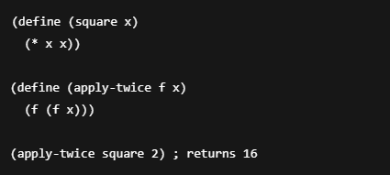
First-Class Functions
z

Slide 10
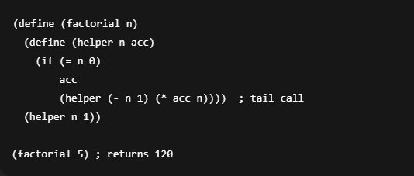
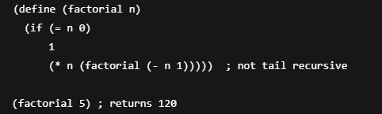
Recursion Functions
z

Slide 11
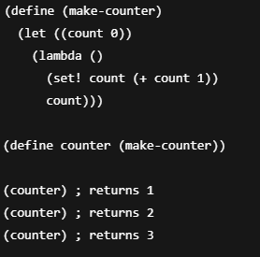
Lexical Scoping
z

Slide 12
Summary
Simple but powerful: Scheme has a minimalist core with uniform syntax using S-expressions, enabling expressive functional programming with first-class functions, recursion, and lexical scoping.
Efficient recursion: Proper tail-call optimization allows recursion to act like loops, making recursive algorithms memory-efficient.
Important in education and research: Scheme is widely used in universities to teach programming fundamentals and functional programming, as well as in language design and AI research.
Influential and extensible: Its minimalist design, macros, and code-as-data philosophy have helped to inspire modern languages

Slide 13
Additional Resources
Scheme Programming Language
Scheme Coding Demo/Tutorial

