Slide 1
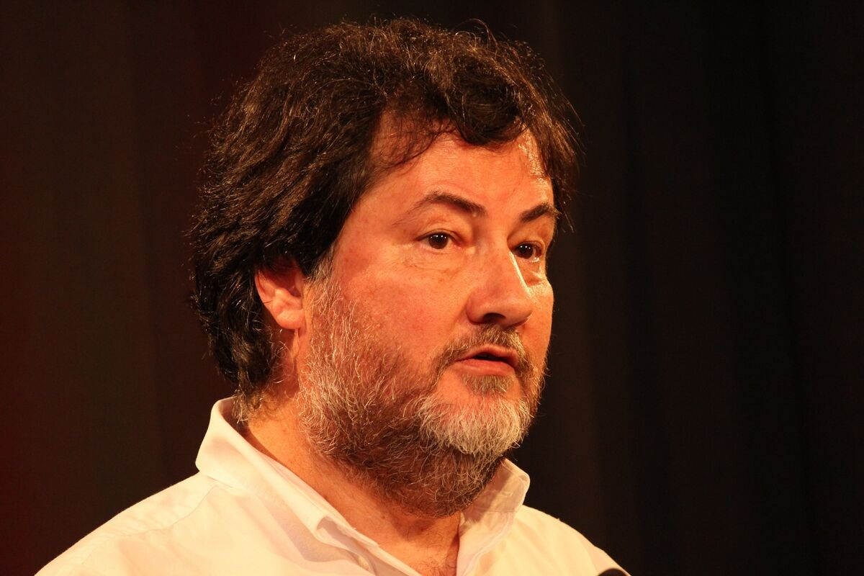


1/16
Ross Ihaka
Robert Gentleman

Slide 2
What?
2/16
Statistical/data analysis
Not only limited to this…
Interpreted language
Free
Opensource

Slide 3
History
3/16
1991: Ross Ihaka and Robert Gentleman created R
1993: R announced to public
1995: R distributed as open source software under GPL2
1997: Comprehensive R Archive Network (CRAN) founded by Kurt Jornik and Fritz Liesch
1997: R Core Team founded
2000: version 1 released
2025: currently at version 4.5.2

Slide 4
4/16
S
Lisp
Scheme

Slide 5
Why is it called R?
5/16
Ross & Robert -> take initials from first name = R
Successor of S, therefore R

Slide 6
Who
6/16
Statistician
Data scientist
Biologist
People working with data

Slide 7
Why
7/16
Good graphics to work with data
Very interactive
Great community
Packages
Base Package

Slide 8
Tidyverse
8/16
Package with functions that makes accessing and processing tidy data easier.
Tidy data: data in row column format where each row is one observation and each column represents one characteristics.

Slide 9
Quickly getting started
9/16
Install r
Install r studio
Install from here

Slide 10
10/16
We are quickly going to find :
mean
median
generate and plot random points

Slide 11
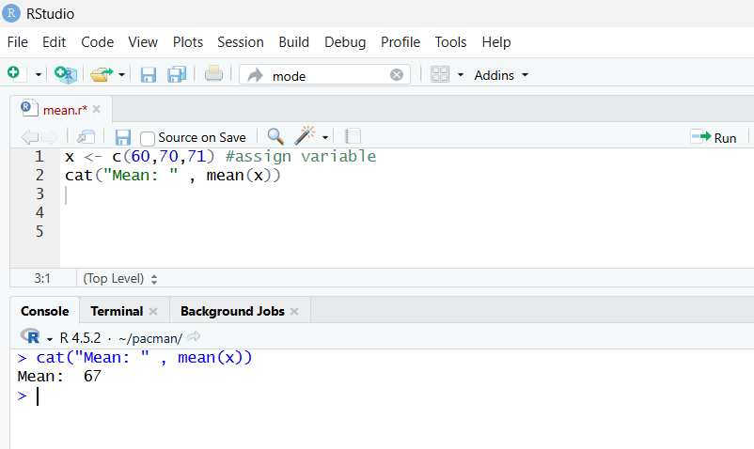
Mean
11/16

Slide 12
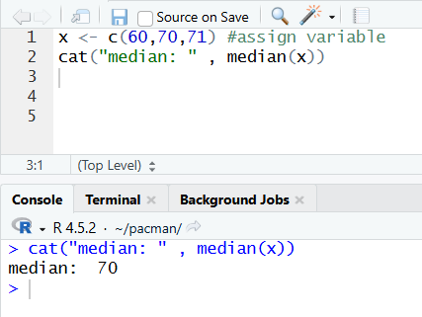
Median
12/16

Slide 13
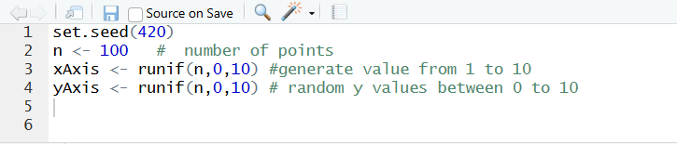
Generating Random Points
13/16

Slide 14
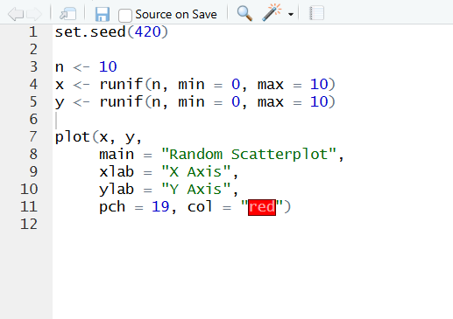
Plot
14/16

Slide 15
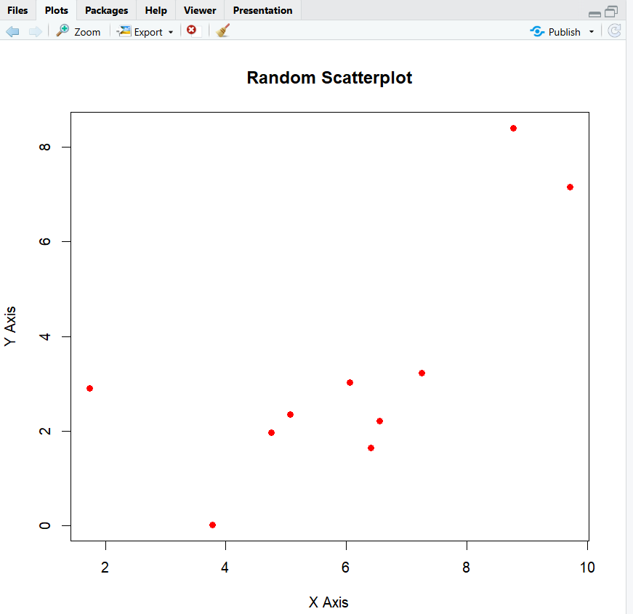
Result
15/16

Slide 16
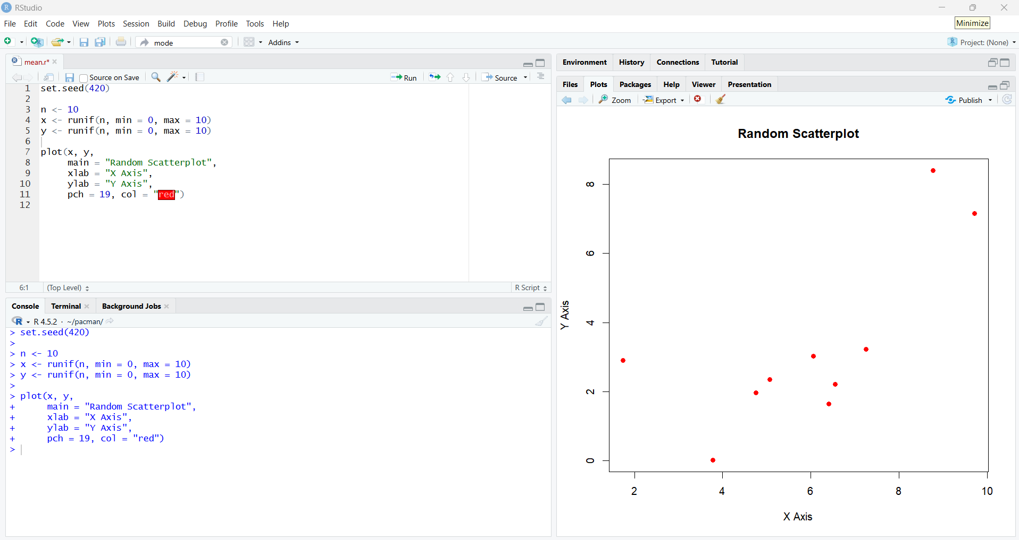
16/16

Slide 17
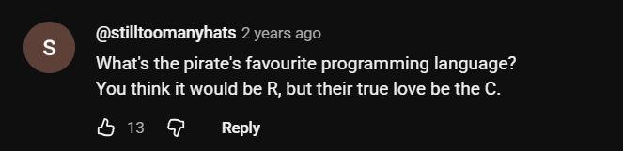
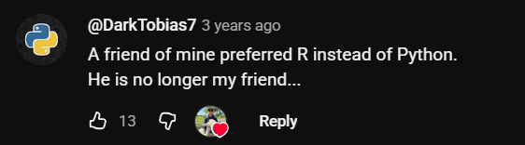
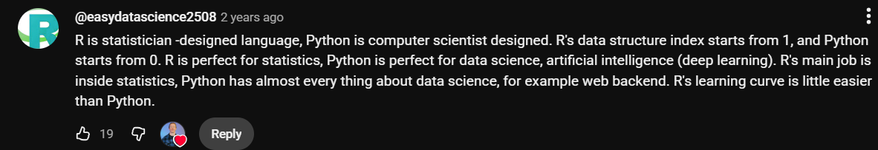
bonus

Slide 18
resources
bonus
R (programming language) – Wikipedia
Tutorial To Get Started
Install here
The History of R (updated for 2020) | R-bloggers

