Slide 1
Prolog

Slide 2
1972
The Year was..

Slide 3
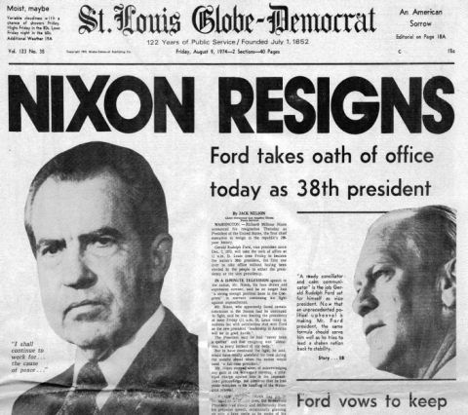
Notes:
The water gate scandal happened

Slide 4
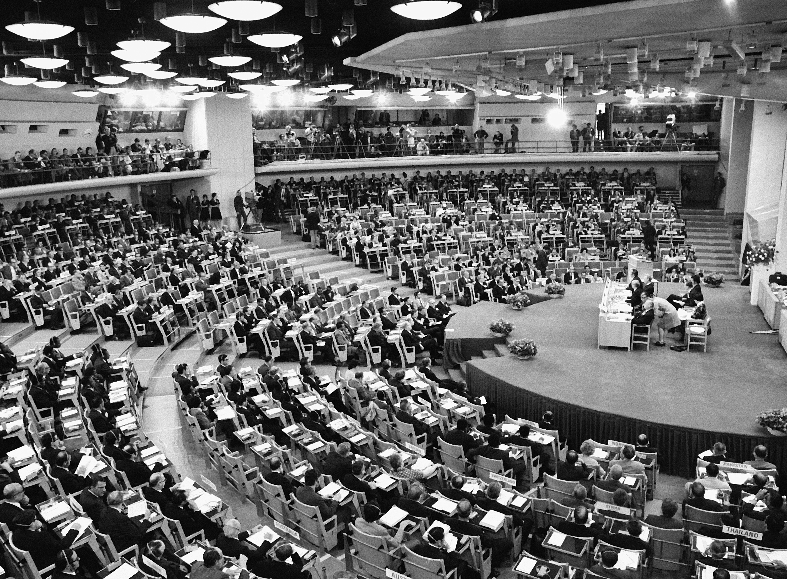
Notes:
United Nations Conference on the Human Environment: The first global conference to focus on environmental issues was held in Stockholm, Sweden

Slide 5
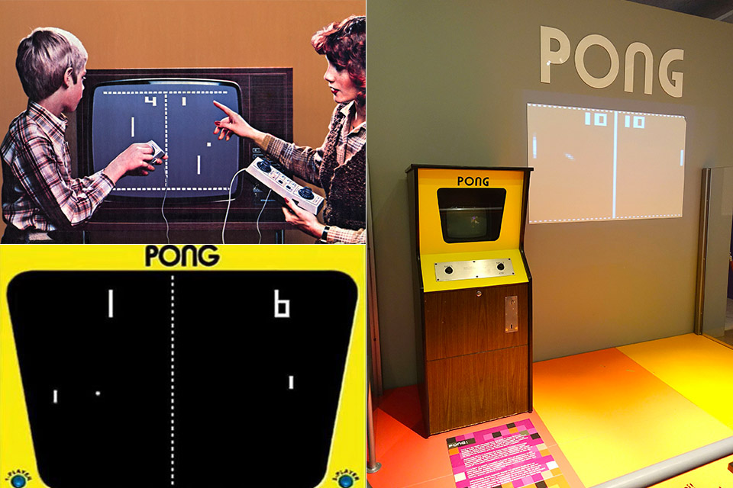
Notes:
Atari's Pong: Atari's groundbreaking video game was released.

Slide 6
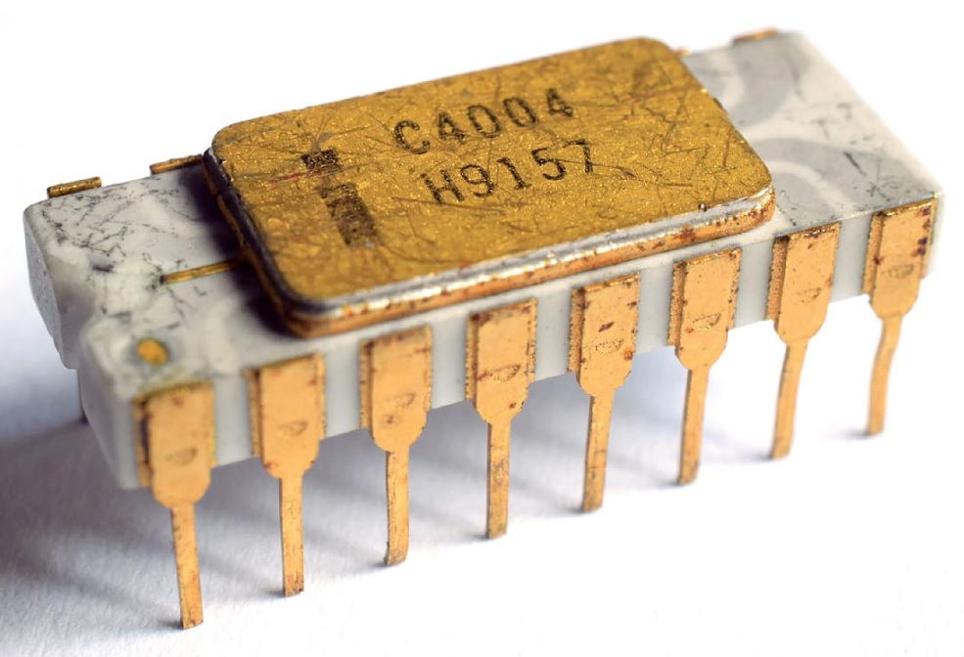
Notes:
intel introduced the 8008, one of the first microprocessors.

Slide 7
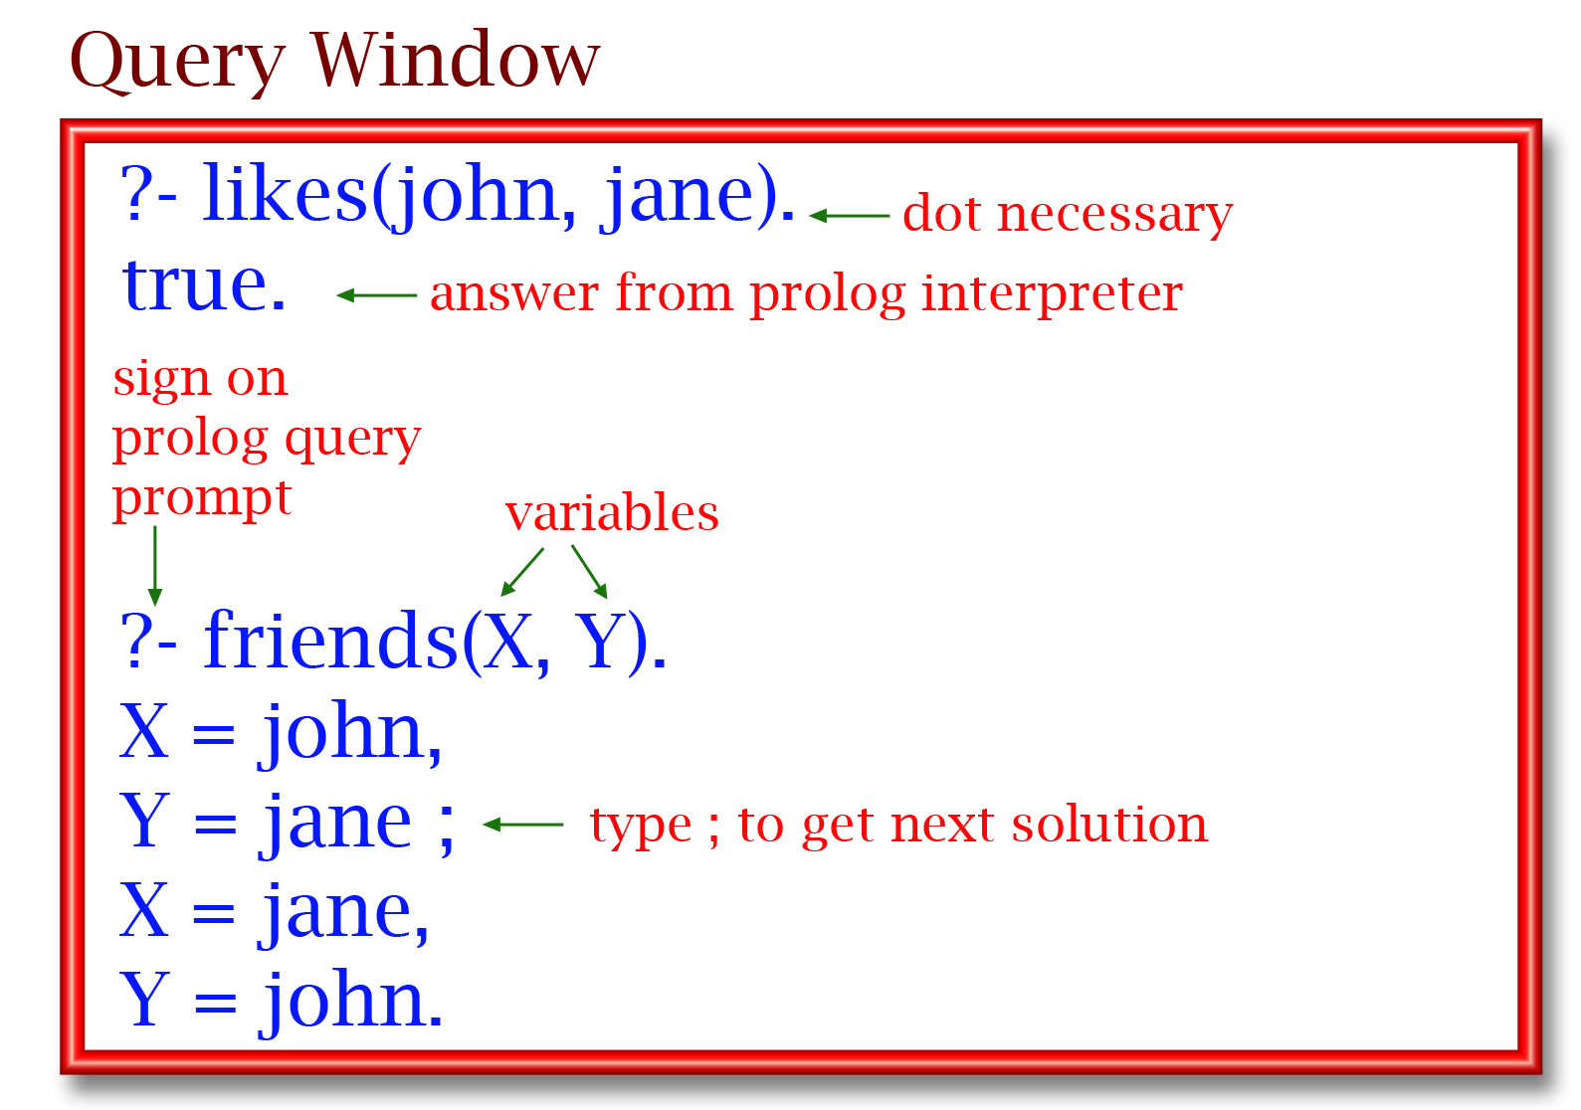
Notes:
Prolog was created in 1972 by computer scientists Alain Colmerauer and Philippe Roussel in France, with critical theoretical contributions from Robert Kowalski in the UK. The first interpreter was developed at the University of Aix-Marseille.

Slide 8
Prolog
Programmation en logique (programming in logic)
It was created by in 1972 by French computer scientists Alain Colmerauer and Philippe Roussel at Aix-Marseille II University in France.
Prolog is based on formal logic, it lets you describe rules and relationships instead of step-by-step instructions
It became extremely popular during the 80s AI boom
Notes:
It focuses in what is true
The idea grew come from natural language processing
scientists were trying to make computers understand human language through logical reasoning.
Japan chose it as the core language for their ambitious Fifth Generation Computer Systems Project aimed to build computers that could think logically.

Slide 9
How it works
three main ideas: facts, rules, and queries
Fact: its something that it knows to be true
likes(alice, pizza).
likes(bob,pizza)
Rules: describes a relationship between facts.
friend(X, Y) :- likes(X, Z), likes(Y, Z).
Queries: are questions you ask the program
?- friend(alice, bob).
Notes:
At the heart of Prolog are three main ideas: facts, rules, and queries.
What makes Prolog unique is that it doesn’t follow a set of instructions;
it searches for logical connections between facts and rules to find an answer.
It’s like teaching the computer how to reason, instead of just how to calculate.”

Slide 10
But how does it actually work?
Unification: it tries to match your query with facts or rules in its knowledge base. If it finds a match, it unifies the variables and builds a logical connection.
Backtracking: If one possible path doesn’t work, it goes back and tries different combinations until it either finds a solution or runs out of options.
?- friend(alice, Y).
Notes:
“So how does Prolog actually figure things out?
Ex
Prolog checks all the facts and rules involving Alice, tries every possibility for Y, and tells you who her friends are
This combination of unification and backtracking makes Prolog a kind of logical search engine

Slide 11
Uses
AI
Expert systems
Natural language processesing
Chatbots
Puzzles
Notes:
because it’s built on logic and reasoning, Prolog is great for problems where you need to represent relationships or draw conclusions from facts
In the 1980s, Prolog was even chosen for Japan’s Fifth Generation Computer Systems Project
aimed to build computers that could think logically and solve problems the way humans do.
today, Prolog is still used in AI research, natural language processing, game logic, and even puzzle solving — like creating Sudoku solvers or planning routes.

Slide 12
Its Great but…
Pros
Excellent logical reasoning
Concise and elegant
Great for natural language processing, puzzle solving, constraint solving
Cons
Not efficient in numerical computation or large-scale data processing
Syntax and train of though a bit difficult to get used to
It’s a smaller language with few libraries
Notes:
In short, Prolog shines when you need a computer to reason logically, but it’s not always the best choice for everything else.”

Slide 13
In conclusion
Prolog is a logic-based, declarative programming language
Its important in
artificial intelligence research
logic-based problem solving,
knowledge representation.
Notes:
hat allows computers to reason with facts and rules rather than follow step-by-step instructions.

