Slide 1
The Oz Programming Language
Kristin Nickerson

Slide 2

Who made it?
First designed by Gert Smolka and some students at Saarland University in Germany in 1991
In 1996 development continued the previous group plus Seif Haridi & Peter Van Roy at the Swedish Institute of CS
In 1999 development switched to the Mozart Consortium, made up of Saarland University, the Swedish Institute of CS, and Université Catholique de Louvain in Belgium.
Finally in 2005 development was switched to the Mozart Board to open development to a larger community.

Slide 3
What is it?
Object-Oriented
Concurrent Language
Features from logic & constraint programming
Designed for advanced, concurrent, networked & reactive applications
Mostly a kernel language

Slide 4
Object Oriented, remember that?
Oz provides all the salient (aka the most important) aspects of OO
  States
  Abstract Data Types
  Classes
  Objects
  Inheritance

Slide 5
It's a special little snowflake
Oz is a concurrent language, right?
It does this by dynamically making any number of sequential threads that interact with each other
What makes it special is that each of these threads is a dataflow thread
Basically, until a thread won't execute until it has all the information it needs

Slide 6
Logic & Constraint?
Oz provides the top level features for logic and constraint programming
  Logic variables
  Disjunctive constructs
  Programmable search strategies

Slide 7
Well what do you mean a kernel language?
Duh, a language designed to be used at the core of an operating system
  Aka the Kernel
Let's see what some of this "kernel language" looks like

Slide 8
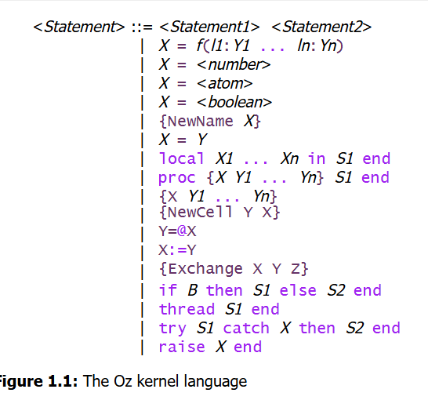
Example
That’s a lotta stuff
  Not really important right now what's going on here, just look at this
    Isn't it pretty?

Slide 9
Can I connect different Oz programs?
Yes!
Network-transparent distribution of Oz programs allows for multiple programs to connect and behave like one application
  They can share variables, objects, classes and procedures
  Then they disconnect when the references to other applications cease to exist

Slide 10

Built-in language security!
All entities in Oz are passed and created explicitly
Applications can't reference things that they're not given access to explicitly

Slide 11
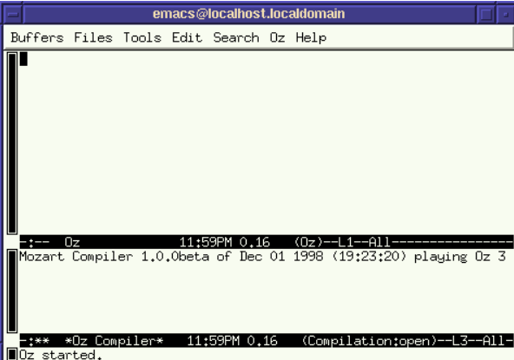
How do we start an OZ program?
With Unix, you just use the oz command in the shell prompt
Windows is more complicated though
  When you install Mozart and therefore Oz, you get a Mozart program you need to open
  There are two parts to this program, the upper area where Oz code is written, and the lower part is the compiler

Slide 12
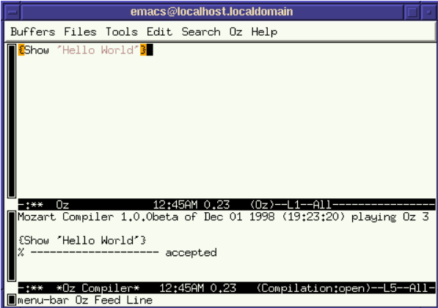
Hello World!
Curly braces are used to encase the code, and the Show command is used to display the 'Hello World' text
  Below we can see that the compiler accepted the code, but why don't we see it printed?

Slide 13
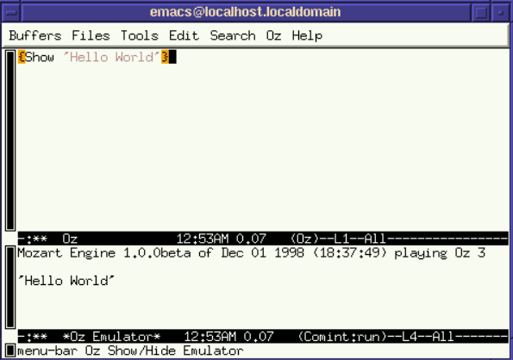
But I want to see it!
To do that you need to go to the Oz menu seen along the top row
Then navigate to an option called Show/Hide Emulator
  The emulator is where all output of an Oz program is displayed

Slide 14
Well why should we care?
It's still used for ongoing research into language design and implimentation, constraint logic programming, distributed computing and human-computer interfaces
It also inspired the creation of Alice and Scala
  The last stable release of Oz was in 2018

Slide 15
Works Citied
http://mozart2.org/mozart-v1/doc-1.4.0/tutorial/index.html
https://en.wikipedia.org/wiki/Oz_(programming_language)

