Slide 1
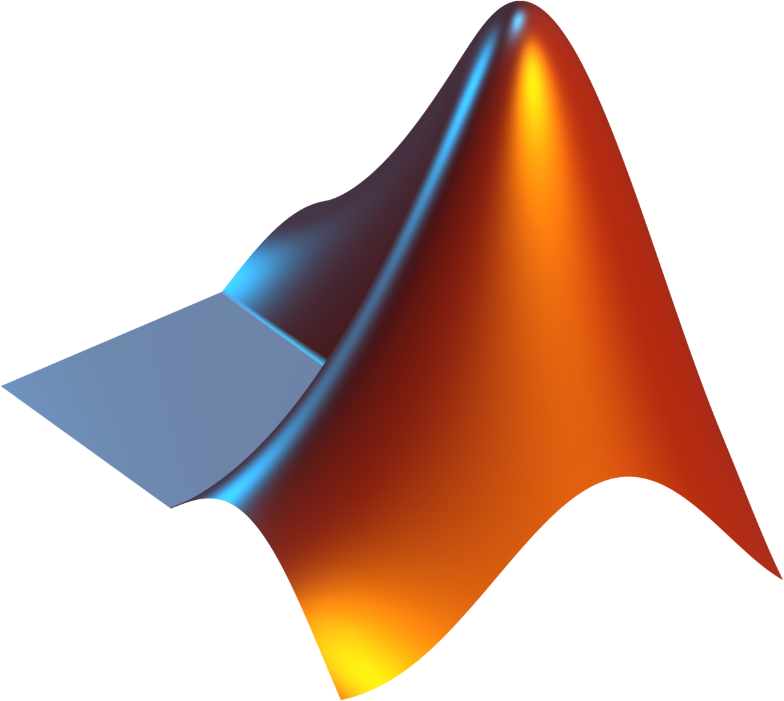
MATLAB
Notes:
Talking Points:
MATLAB is a commonly used programming languages for engineers and scientists.
Notes:
Well known for its technical computing, data analysis, and simulation tools.

Slide 2

Origins
Created in the late 1970s by Cleve Moler, a professor of computer science and mathematics at the University of New Mexico.
Moler developed MATLAB as an easy-to-use interface to access LINPACK and EISPACK libraries.
The name MATLAB stands for 'Matrix Laboratory.'
Notes:
Talking Points:
MATLAB was developed in the late 1970s by Cleve Moler, a Mathematics professor at the University of New Mexico who taught Linear Algebra and Numerical Analysis.
Cleve originally wanted to make Numerical Analysis and Linear Algebra more accessible for his students — without requiring them to learn FORTRAN because MATRIX manipulation in FORTRAN was hard.
It served as an interactive “front-end” to the LINPACK and EISPACK libraries written in FORTRAN. LINPACK was used to solve linear equations and EISPACK was used for matrix manipulations.
“Matrix Laboratory” refers to the fact that MATLAB was built around matrix operations. Because its original purpose was to handle matrix problems
Notes:
MATLAB started as a teaching tool, not as a commercial product.

Slide 3
MATLAB History and Development
1970s
Created by Cleve Moler for teaching numerical analysis.
1984
The MathWorks company was founded by Moler and Jack Little to commercialize MATLAB.
1990s
Introduction of Simulink for simulation and control systems tools.
2000s–Present
Expanded into AI, machine learning, image processing.
Notes:
Talking Points:
1970s: Cleve Moler developed MATLAB for his students.
1984: Moler and Jack Little founded The MathWorks to commercialize MATLAB.
1990s: Launch of Simulink, expanding MATLAB into simulation and control systems.
2000s–Present: MATLAB became a multipurpose platform supporting AI, image processing, machine learning, and more.
Matlab originally started as a educational tool but was later commercialized

Slide 4
Intended Purpose
Originally designed to help students learn linear algebra and numerical analysis without learning FORTRAN code.
Provided a simple environment for matrix computations and algorithm testing.
Quickly gained popularity among engineers and scientists for prototyping and data visualization.
Notes:
Talking Points:
The goal was educational — to help students easily perform matrix computations and visualize results and also wanted to simplify numerical analysis problem-solving in classrooms.
Because of this ease of use MATLAB later gained traction among engineers and researchers who needed a fast way to prototype algorithms and visualize data.
Notes:
Highlight that MATLAB’s strength lies in its ability to bridge mathematical concepts and visualize them.

Slide 5
Languages That Influenced MATLAB
FORTRAN: Provided numerical computation routines that MATLAB initially relied on.
Lisp: Inspired MATLAB’s use of interpreted, interactive environments.
APL: Influenced MATLAB’s focus on array and matrix-based operations.
C: Later versions incorporated compiled C code for performance optimization.
Notes:
Talking Points:
MATLAB was influenced by several earlier programming languages:
FORTRAN: MATLAB relied heavily on FORTRAN libraries.
Lisp: Contributed to MATLAB’s interactive and interpreted nature.
APL: Inspired MATLAB’s array-oriented approach — where operations apply to whole matrices instead of individual elements.
C: Later used for performance optimization in compiled versions.
Notes:
It took the power of FORTRAN and combined it with the interactivity of Lisp/APL.
MATLAB’s design philosophy — simplicity for mathematical work — was unique for its time.

Slide 6
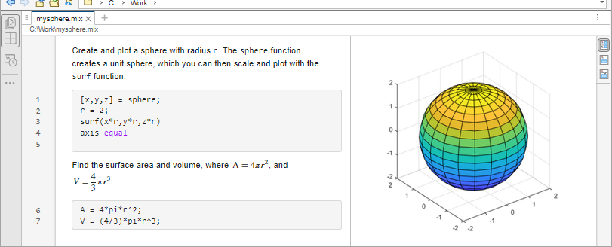
Innovations
Introduced easy matrix manipulation syntax.
MATLAB: A = [1 2; 3 4]
FORTRAN: A(1,:) = (/1, 2/)
A(2,:) = (/3, 4/)
Provided visualization and plotting tools.
Combined numerical computation with programming constructs (loops, functions, conditionals).
Later versions added toolboxes, GUIs, and object-oriented programming support.
Notes:
Talking Points:
MATLAB introduced intuitive matrix syntax — users could define and manipulate matrices easily using concise notation.
It integrated plotting and visualization directly within the environment, reducing the need for external tools.
The above image shows the use of the surf function which allows you to plot the surface of a 3D object and MATLAB will plot the shape
Supported loops, functions, and conditionals; It blended programming with mathematical scripting.
Over time, MATLAB added toolboxes, graphical user interface (GUI) design tools, and object-oriented programming.
Notes:
Emphasize how this ease of use made MATLAB revolutionary for engineers and scientists.

Slide 7
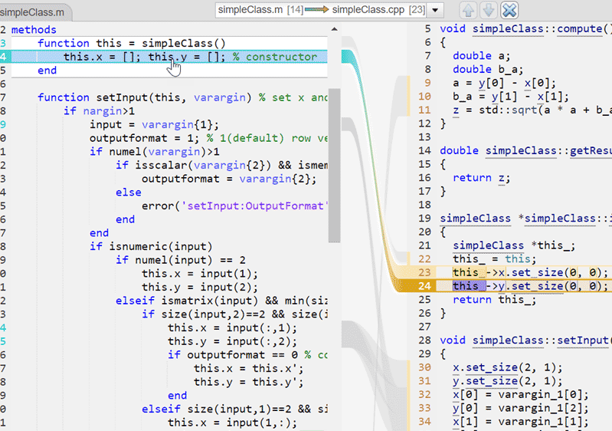
Notes:
Some example code of MATLAB utilizing object-oriented principles such as classes and using constructors, and functions as well as other common coding features such as conditional statements.

Slide 8
Who Uses MATLAB Today?
Engineers, scientists, and researchers
Used in fields like control systems, signal processing, machine learning, and computational finance.
Common in automotive, aerospace, and communications industries.
Also widely used for education in engineering and applied mathematics.
Notes:
Talking Points:
MATLAB is widely used by engineers, scientists, and researchers in academia and industry.
Applications include control systems, signal processing, robotics, data analytics, and machine learning.
It’s especially prominent in aerospace, automotive, communications, and finance.
Also serves as a teaching tool in universities for engineering, physics, and applied matematics.

Slide 9
Summary
MATLAB began as a teaching tool but evolved into a powerful engineering environment.
Influenced by FORTRAN, APL, Lisp, and C.
Introduced intuitive matrix manipulation and built-in visualization.
Today, MATLAB remains a standard for technical computing and simulation.
Notes:
Talking Points:
MATLAB started as a simple educational tool and evolved into a comprehensive engineering platform.
Influenced by FORTRAN, APL, Lisp, and C.
Introduced new ways to think about matrix-based computation and data visualization.
Notes:
Even after 40+ years, MATLAB remains a benchmark in scientific computing.

