Slide 1
IO
Adam Garantche
Introduction
What is IO?
History
Philosophy
Features
Hello World
Syntax
Prototypes
Concurrency
Why Io?

Slide 2
IO
Expressiveness through simplicity
Introduction
What is IO?
History
Philosophy
Features
Hello World
Syntax
Prototypes
Concurrency
Why Io?

Slide 3
IO is a pure object-oriented programming language
IO has a prototyped based object model
In IO, everything is an object, and it uses dynamic typing
IO uses dynamic typing and message passing for everything
Programs in IO are represented internally as data trees
Introduction
What is IO?
History
Philosophy
Features
Hello World
Syntax
Prototypes
Concurrency
Why Io?

Slide 4

Introduction
What is IO?
Created by Steve Dekorte in 2002
Dekorte made IO to study how languages work and experiment with simplicity.
IO was Heavily inspired by: Smalltalk, Self, Lua, Lisp, Act1, and Newton Script
History
Philosophy
Features
Hello World
Syntax
Prototypes
Concurrency
Why Io?
Notes:
Created after trying to help friend, dru nelson with his langgae Cel. Learned he really didn’t know much about languages

Slide 5
Introduction
What is IO?
History
IO focuses on conceptual unification
Emphasizes Simplicity over raw performance
Everything in IO should feel consistent and minimal
Philosophy
Features
Hello World
Basic Syntax
Prototypes
Concurrency
Why Io?
Downsides

Slide 6
Introduction
What is IO?
History
Lazy evaluation of function parameters
High-order functions
Coroutine-based concurrency
Incremental garbage collection
Highly Portable
Clear and minimal syntax
Philosophy
Features
Hello World
Basic Syntax
Prototypes
Concurrency
Why Io?
Downsides

Slide 7

Introduction
What is IO?
History
Philosophy
Features
Hello World
Basic Syntax
Prototypes
Concurrency
Why Io?
Downsides

Slide 8


Introduction
What is IO?
History
Philosophy
Features
Hello World
Basic Syntax
Prototypes
Concurrency
Why Io?
Downsides

Slide 9
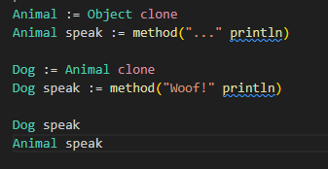

Introduction
What is IO?
History
Philosophy
Features
Hello World
Basic Syntax
Prototypes
Concurrency
Why Io?
Downsides
Conslusion

Slide 10
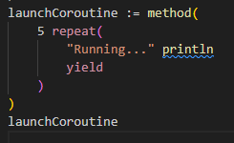
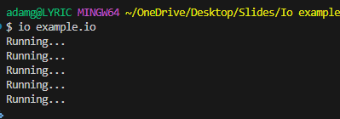
Introduction
What is IO?
History
Philosophy
Features
Hello World
Basic Syntax
Prototypes
Concurrency
Why Io?
Downsides
Conclusion

Slide 11
Introduction
What is IO?
History
Philosophy
Features
Hello World
Basic Syntax
Prototypes
Very small and elegant
Cleanest example of prototype-based OOP
Good for learning:
  Message passing
  Object models
  Concurrency
  Language design principles
Concurrency
Why Io?
Downsides
Conclusion

Slide 12
Introduction
What is IO?
History
Philosophy
Features
Hello World
Basic Syntax
Prototypes
Concurrency
Slow compared to compiled languages
Niche and not widely used today
Smaller community and fewer libraries
Mostly used for experimentation and education
Why Io?
Downsides
Conclusion

Slide 13



Introduction
What is IO?
History
Philosophy
Features
Hello World
Basic Syntax
Prototypes
Concurrency
Why Io?
IO is a minimalistic, prototype-based language
Designed to explore language theory and simplicity
Inspired by many classic languages
Despite its small size, IO show powerful ideals about objects, concurrency, and message passing
Downsides
Conclusion
Questions?

Slide 14
Introduction
What is IO?
History
Philosophy
Features
Hello World
Basic Syntax
Prototypes
Concurrency
Why Io?
Downsides
Conclusion
Questions?

Slide 15
Sources
https://www.howdy.com/glossary/io
https://en.wikipedia.org/wiki/Io_(programming_language)

