Slide 1

Elixir: Origins, Features & Evolution
A deep dive into the Elixir programming language: Nfaly

Slide 2

What is Elixir?
Elixir is a dynamic general purpose programming language that is designed to build scalable concurrent applications.
Elixir is trusted by companies that value real-time performance, fault tolerance, and scalability.

Slide 3
What does that mean?
It means it’s flexible you can use it to build many different kinds of software, from websites to chat apps to smart devices.
Runs on top of the Erlang beam virtual machine, which is the engine that runs both Erlang and Elixir programs. You can think of it as the heart or brain that keeps Elixir applications alive, managing all their tasks behind the scenes.
Erlang made in the 1980s by Ericsson for telecommunications systems that had to be always online (like phone networks)

Slide 4


Why people love Elixir?
Elixir ranks as one of the most loved programming languages. Elixir special is that it’s designed to build scalable and concurrent applications.
Dynamically typed language
Minimal Ruby inspired syntax
Delivers better performance and scalability compared to other interpreted languages

Slide 5

Who uses it?
Discord - Handles millions of concurrent users in real time; Elixir powers its chat and messaging backend.
WhatsApp - Though built in Erlang, Elixir apps share the same BEAM technology that allows massive scalability.
PepsiCo - Uses Elixir to manage supply chain systems and real-time logistics.
Pinterest - Uses Elixir for event tracking and sending notifications to millions of users quickly.
Bleacher Report - Built its live sports notification system in Elixir for instant updates.

Slide 6
Why These Companies Use Elixir
Scalability: It can handle huge amounts of traffic effortlessly.
Reliability: Thanks to the BEAM virtual machine, apps rarely crash — even when something goes wrong.
Performance: Elixir’s lightweight processes let apps run fast and efficiently, even under stress.
Maintainability: The code is clean, readable, and built for long-term projects.

Slide 7
When was Elixir Released
Elixir was released in First released 2012.

Slide 8

Who made Elixir
Creator: José Valim, in 2012
He’s a Brazilian software engineer who was originally part of the Ruby on Rails core team
While working with Ruby, he loved its simplicity and productivity, but he also noticed that Ruby struggled with performance and scalability

Slide 9
Why was Elixir created?
José Valim wanted to make it easier for developers especially those from Ruby to build highly scalable, concurrent applications without sacrificing code clarity. Erlang was already excellent for telecom and messaging systems, but its syntax was hard to learn.
Elixir solved that by combining Erlang’s reliability with a cleaner, more modern syntax.

Slide 10
What influenced Elixir
Erlang is The biggest inspiration for Elixir. Erlang was created in the 1980s by Ericsson for telecommunication systems designed to handle millions of connections, never crash, and run 24/7.
Elixir runs on the Erlang BEAM Virtual Machine, meaning it inherits Erlang’s strengths:
Massive concurrency (many tasks at once)
Fault tolerance (self-healing systems)
Distributed computing (runs across many servers)
José Valim was part of the Ruby on Rails core team before creating Elixir.
He loved Ruby’s clean, human friendly syntax and developer productivity, so he brought that same friendliness into Elixir.
Elixir code looks beautiful and easy to read like Ruby but performs like Erlang.

Slide 11
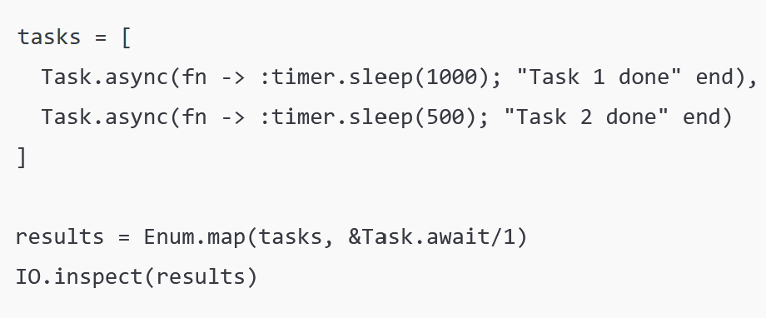
What does Elixir Code look like?
Runs two tasks at the same time.
Each task waits a different amount of time.
Collects the results when both are finished.
(Task 1 done, Task 2 done)

Slide 12
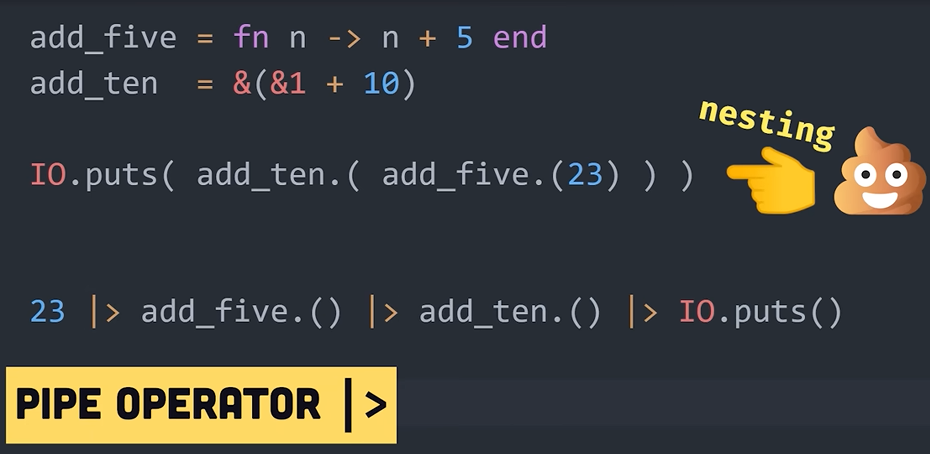
Another Example
When using function expressions, you can use the pipe operator to pass the value to one expressions to another.

Slide 13
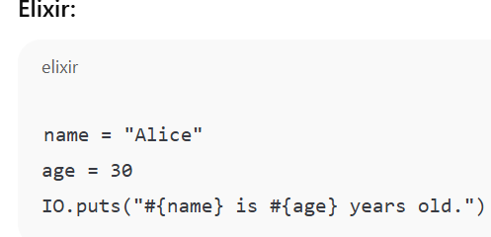
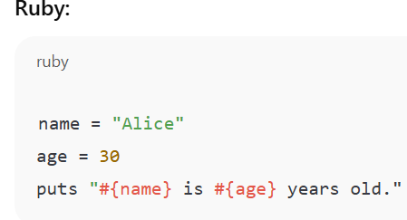

Exilir Vs Ruby Code
Both dynamically typed.
Elixir variables work by once assigned, you can’t change them you can rebind, but the original value is preserved
Ruby variables are changeable.

Slide 14

New features & unique constructs
Instead of traditional if statements, Elixir uses pattern matching to make decisions.
Data in Elixir can’t be changed once created instead, new versions are made.
Elixir allows updating code without stopping the program.

Slide 15
Interesting Facts
José Valim has said he worked on early versions of Elixir in Brazilian coffee shops while trying to improve scalability problems in Ruby on Rails projects.
Elixir Apps Can Run Forever
Systems written in Elixir often run for years without restarting because of its fault-tolerant design.
Most programming languages are either functional or concurrent — Elixir is both.

Slide 16
Thank You Questions?

