Slide 1
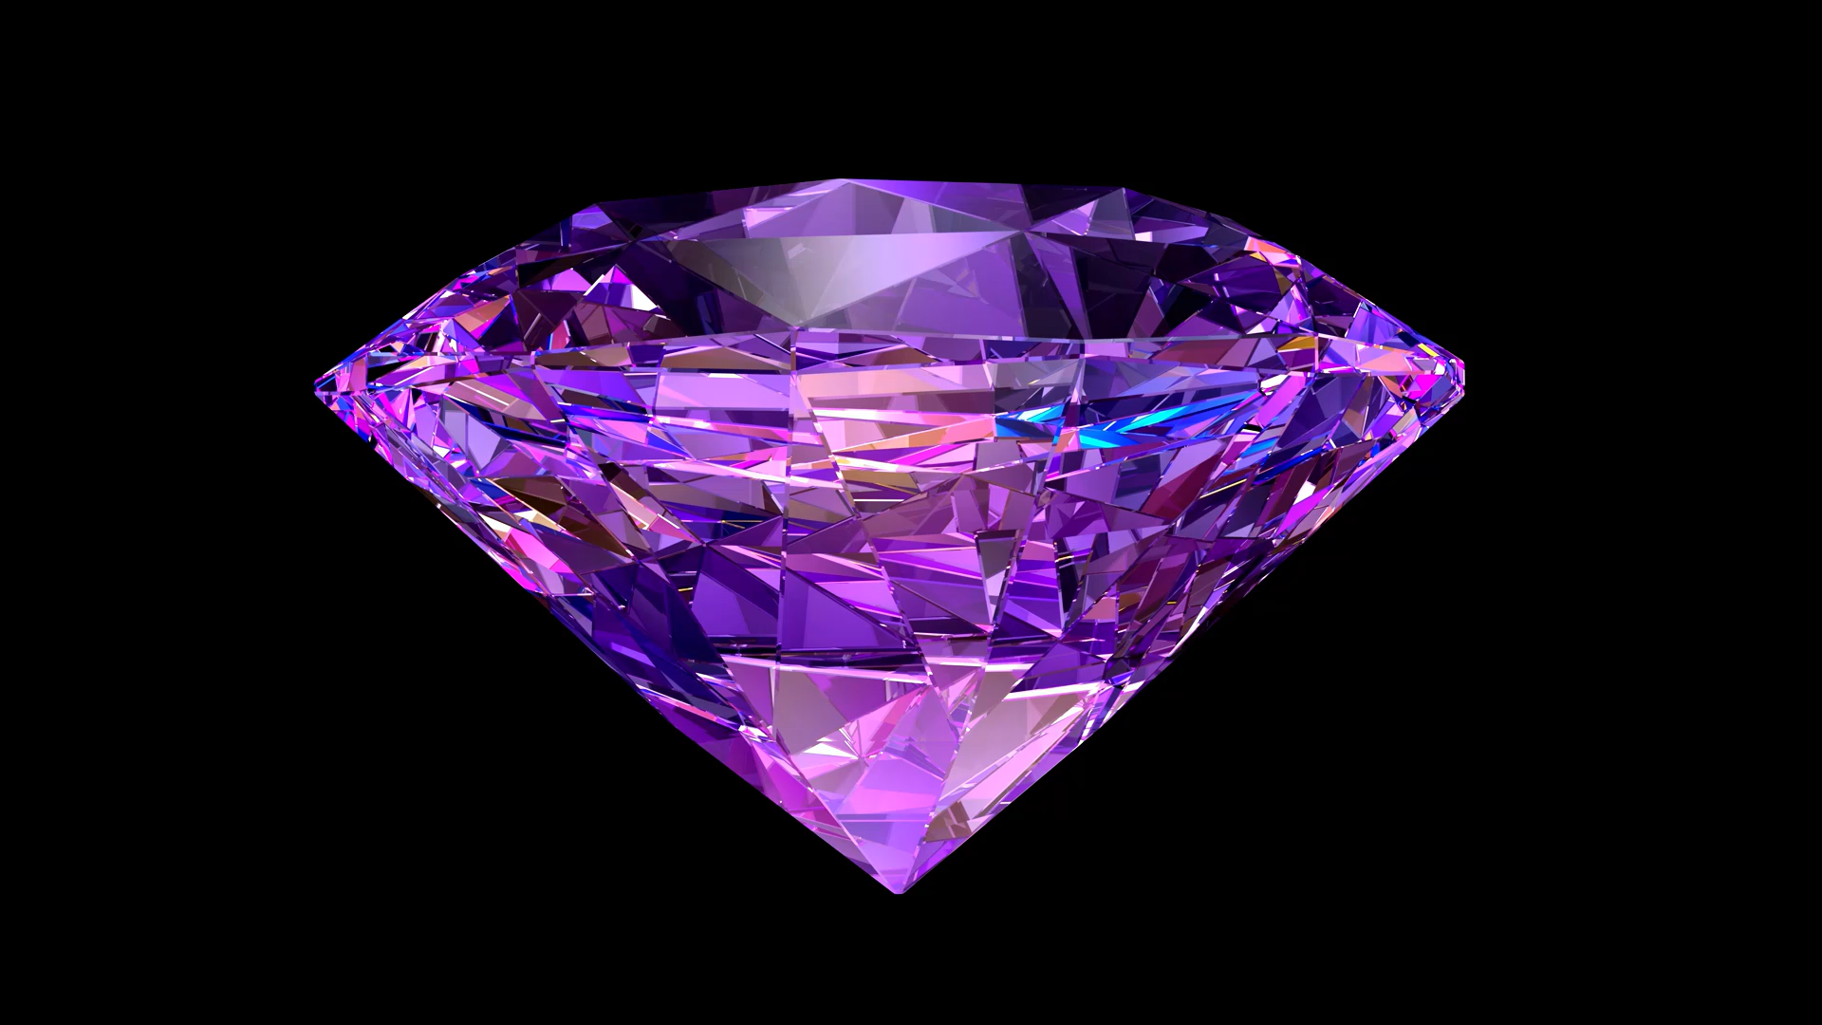
Crystal Language
By Kyle Hinkle

Slide 2

Crystal Origins
Crystal was created by Ary Borenszweig, Juan Wajnerman, and Brian Cardiff, all developers from Manas Technology Solutions.
The team at Manas loved using Ruby they admired its elegance and developer productivity.
But there was a catch: Ruby is a bit too slow and not type-safe enough for their more demanding projects.
So, they asked the golden question: “What if we could have Ruby’s beauty but the speed and safety of a compiled language?”

Slide 3
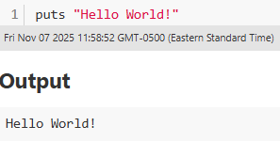
Crystal’s History
Crystal’s story starts in June 2011, when development began under the original name Joy before being renamed to Crystal.
The first official release, version 0.1.0, came out on June 19, 2014, a small but confident step into the programming world.
Fast forward to March 2021, when version 1.0 finally launched a major milestone marking language and standard library stability.
Crystal continues to evolve, focusing on:
Concurrency improvements (fast and safe multitasking),
Broader platform support,
And ecosystem growth tools, libraries, and community.

Slide 4
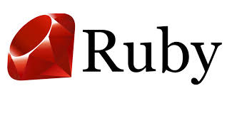

What Languages Influenced Crystal?
The syntax and developer experience of Crystal are heavily influenced by Ruby.
The goal was simple: make Ruby developers feel right at home but without sacrificing performance.
Crystal’s creators have said they wanted a language that looked and felt like Ruby, but compiled like C.
Under the hood, Crystal compiles to native machine code through the LLVM backend, borrowing ideas from C and C++ for speed and efficiency.
The key differences are:
Ruby is interpreted and dynamically typed.
Crystal is compiled and statically typed with type inference, meaning it figures out types for you without slowing you down.
Notes:
So, in spirit its Ruby’s elegance meets C’s performance.
LLVM: Low-Level Virtual Machine

Slide 5
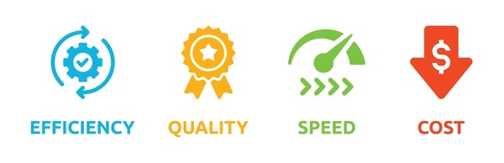
Development Goals
Compiling to native code using the LLVM backend for high performance.
Preserving Ruby-like syntax for readability and elegance.
Leveraging type inference to make code safe without excessive type declarations.
Building concurrency features for parallel execution.
And expanding the standard libraries and ecosystem.
In short, the developers want Crystal to feel like Ruby, but run like C.
Notes:
LLVM is an open-source compiler infrastructure that provides a modular framework for building compilers and other development tools.

Slide 6

Crystal’s Development
Crystal is developed as an open-source project under the Apache License 2.0, meaning anyone can contribute.
Its core creators remain the same trio: Ary Borenszweig, Juan Wajnerman, and Brian Cardiff.
Over time, the project has grown to include 400+ contributors worldwide, helping with everything from compiler development to library design and tooling improvements.
Development is coordinated by a core team with guidance from the community, corporate sponsors, and Manas.Tech, the company that originally incubated the language.

Slide 7
What New Features Did Crystal Introduce?
Crystal doesn’t reinvent programming; it blends familiar ideas from other languages in a way that fits its own unique niche.
Most languages make you choose between productivity or performance. Crystal says, “Why not both?”
Static typing with powerful type inference:
Types are checked at compile-time, preventing many runtime bugs.
But you rarely need to write type annotations, because the compiler is smart enough to infer them.
Macros and compile-time metaprogramming:
Crystal includes compile-time macros that let developers generate code, inspect the AST, and reduce boilerplate.
You can write programs that write programs safely.
Notes:
An Abstract Syntax Tree (AST) is a tree-structured intermediate representation of the source code's structure and essential meaning. It abstracts away non-essential details like punctuation (e.g., semicolons, parentheses in many cases) and formatting, focusing solely on the structural and content-related elements. Boilerplate code is any section of code that is necessary for a program to function but is largely repetitive or standard and provides little new logic or value beyond its structural necessity. Writing this code can be tedious and time-consuming. Crystal macros are designed to automate the generation of this repetitive code. For example, instead of manually writing similar methods for many different class properties, a developer can write a single macro that automatically generates those methods at compile-time based on the structure of the code's AST. This saves development time and reduces the chance of manual errors.

Slide 8
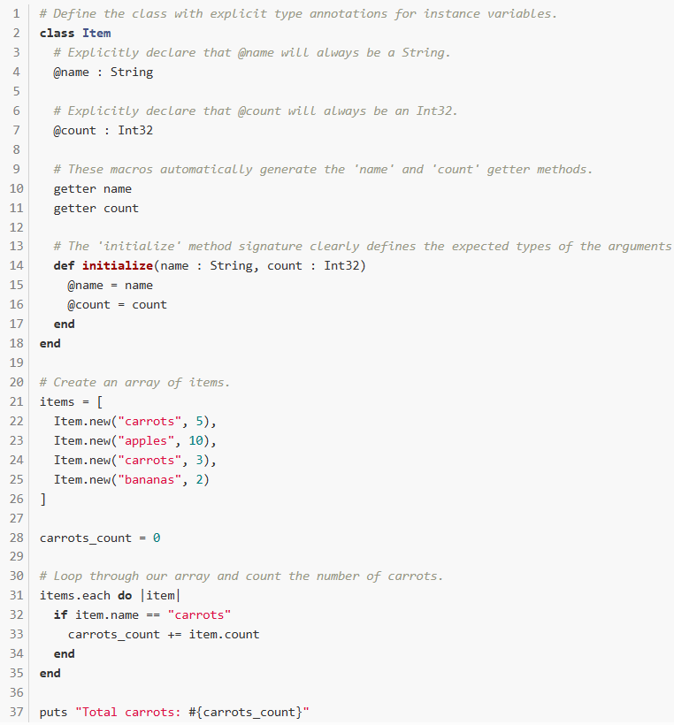
Code example using macros
@name is private by default. Must use a getter method to get the name and count.
Output: Total Carrots: 8

Slide 9
What New Features Did Crystal Introduce?
Concurrency using fibers and channels:
Inspired by Go and CSP (Communicating Sequential Processes), Crystal allows lightweight fibers that communicate through channels.
This makes concurrent programming simpler and with fewer dead locks.
Bindings to C and native libraries:
Crystal can directly interface with C libraries, no wrappers or headaches required.
This gives it real potential for systems programming while keeping a high-level feel.
Native binaries and performance:
Compiled via LLVM, Crystal produces fast native executables.
In benchmarks, it often runs much faster than interpreted languages like Ruby, while keeping the same expressive syntax.

Slide 10
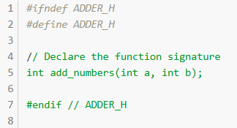
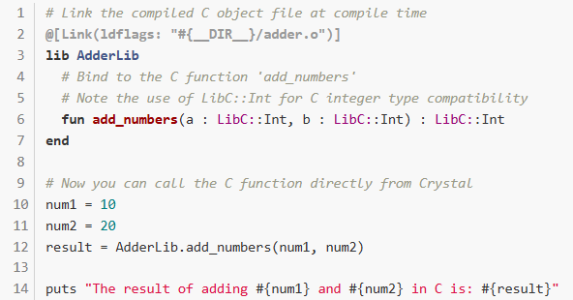
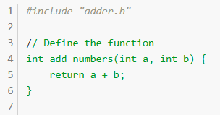
C embedded code example
The result of adding 10 and 20 in C is: 30

Slide 11



Who Uses Crystal Now?
Crystal is used in the modern day within, Bioinformatics, Communication and networking, Cyber Security, Gaming, Entertainment, Media Systems, and more.
Even if still niche compared to major languages, Crystal has matured to a level where production adoption is real.

Slide 12
Conclusion
Crystal is a modern, open-source programming language created to merge the best of both worlds. The readability and developer productivity of Ruby with the performance and safety of a compiled, statically-typed language.
It offers significant features: Ruby-style syntax, static typing with inference, macros, fibers/channels concurrency, native compilation, and C interoperability.
Remember, it is designed to feel like and act like Ruby, if you don’t like Ruby. you won’t like Crystal.

Slide 13
Sources
https://en.wikipedia.org/wiki/Crystal_(programming_language)
https://adlerhsieh.com/p/why-use-crystal-lang
https://crystal-lang.org/
https://crystal-lang.org/used_in_prod
https://crystal-lang.org/2013/11/14/good-bye-ruby-thursday/
https://manas.tech/blog/2016/04/01/the-story-behind-crystal/
https://www.cloudbees.com/blog/an-introduction-to-crystal-fast-as-c-slick-as-ruby
https://play.crystal-lang.org/#/r/iduv

