Slide 1
Cobol:
A brief, yet sufficient summary

Slide 2
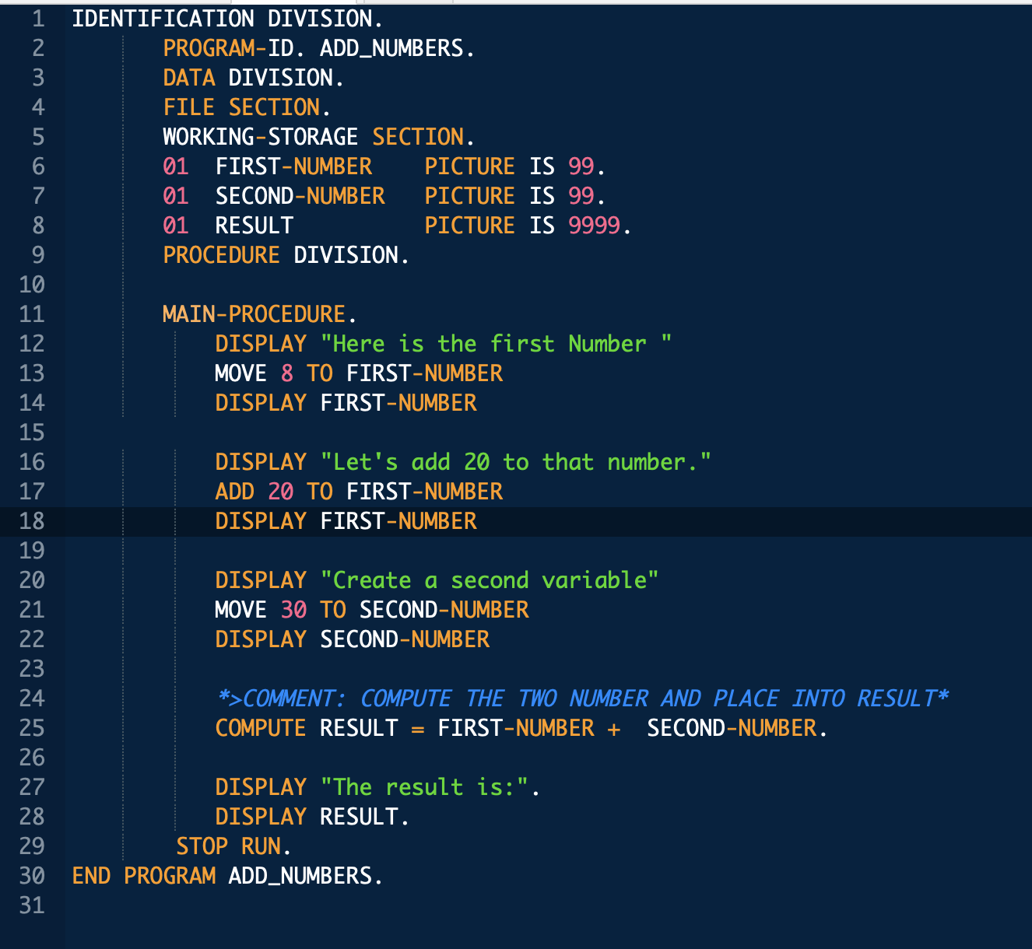
Cobol:
(Kow·baal)
Common Business-Oriented Language
Created in 1959
By CODASYL
Cobol is:
Procedural: - sequences of instructions perform tasks
Imperative: - statements change a programs state
Object Oriented: (as of 2002)

Slide 3
It's 1959
Here's what you need to know

Slide 4
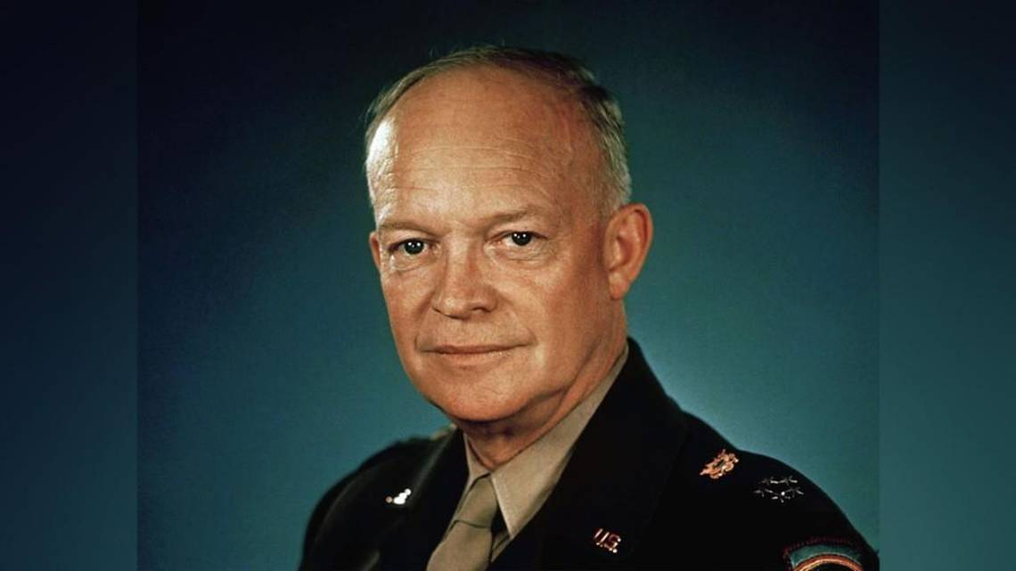
Quote
This is the president

Slide 5
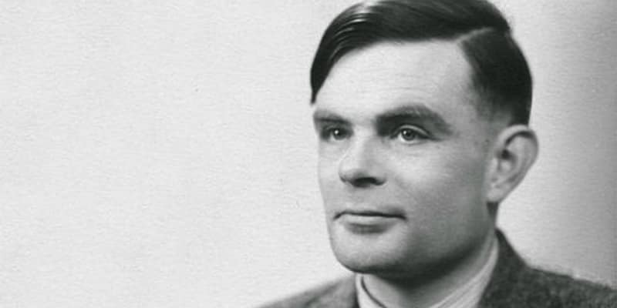
Quote
This is alan turing

Slide 6
Quote
This is how much $1 is
$11.13

Slide 7
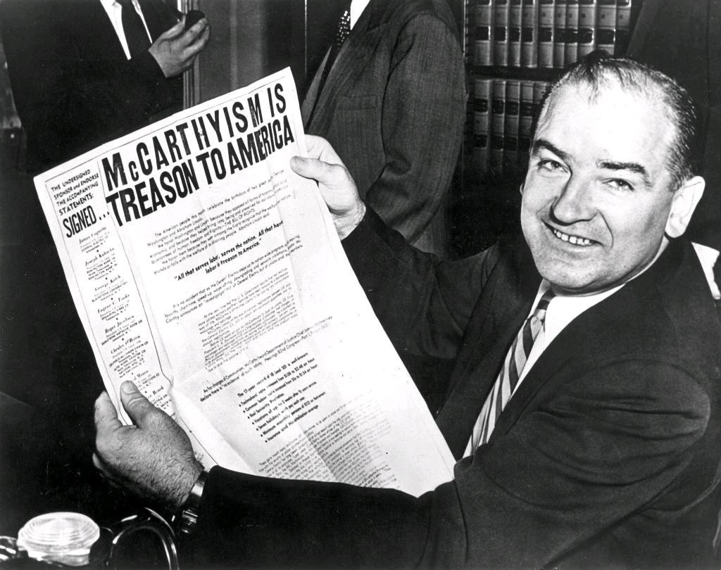
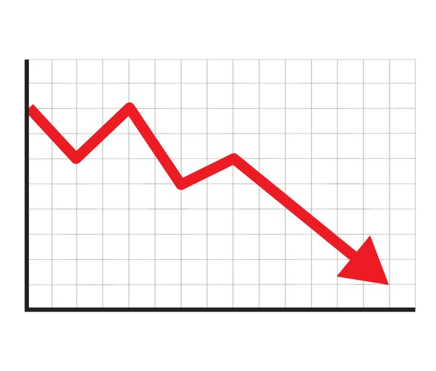
Quote
This is mccarthyism

Slide 8
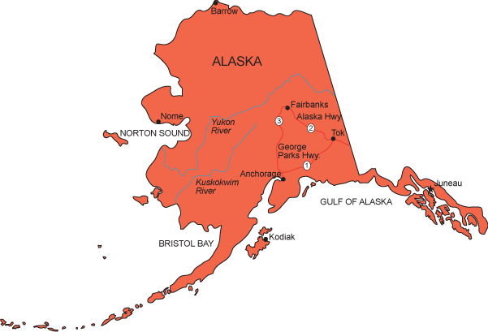

Quote
This Alaska

Slide 9

Quote
This hawaii

Slide 10

Quote
This is the first microchip

Slide 11
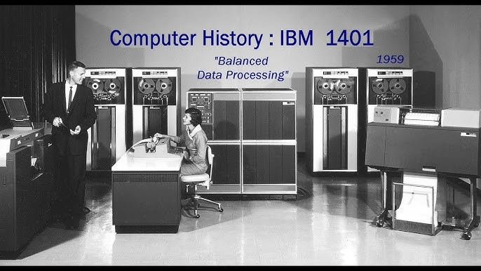
Quote
This is what a computer is

Slide 12

Why do we need cobol in 1959
Businesses were beginning to invest in computers as a primary infrastructure
Flow-Matic
Created by Grace Hopper
Designed for the UNIVAC I
… and only the UNIVAC I
Every time a business wanted to use FLOW-MATIC on a different machine, they had to reengineer the compiler itself.
So, we needed to make FLOW-MATIC, but portable

Slide 13
codasyl
Conference/Committee on Data Systems Languages

Slide 14
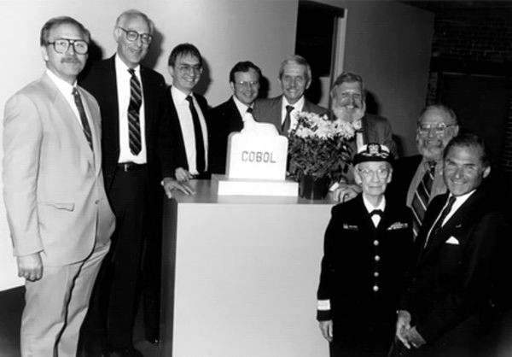
CODASYL
Formed in 1959 with the mission of guiding the development for programming languages.
Also did substantial work in the standardization of databases
Sponsored by the Department of Defense, who had spent a LOT of money translating programs prior to COBOL
Consisted of academics, government officials, industry professionals

Slide 15
Who is using cobol?

Slide 16
Of Credit-transactions rely on COBOL
80%

Slide 17
Of ATM Transactions rely on COBOL
95%

Slide 18
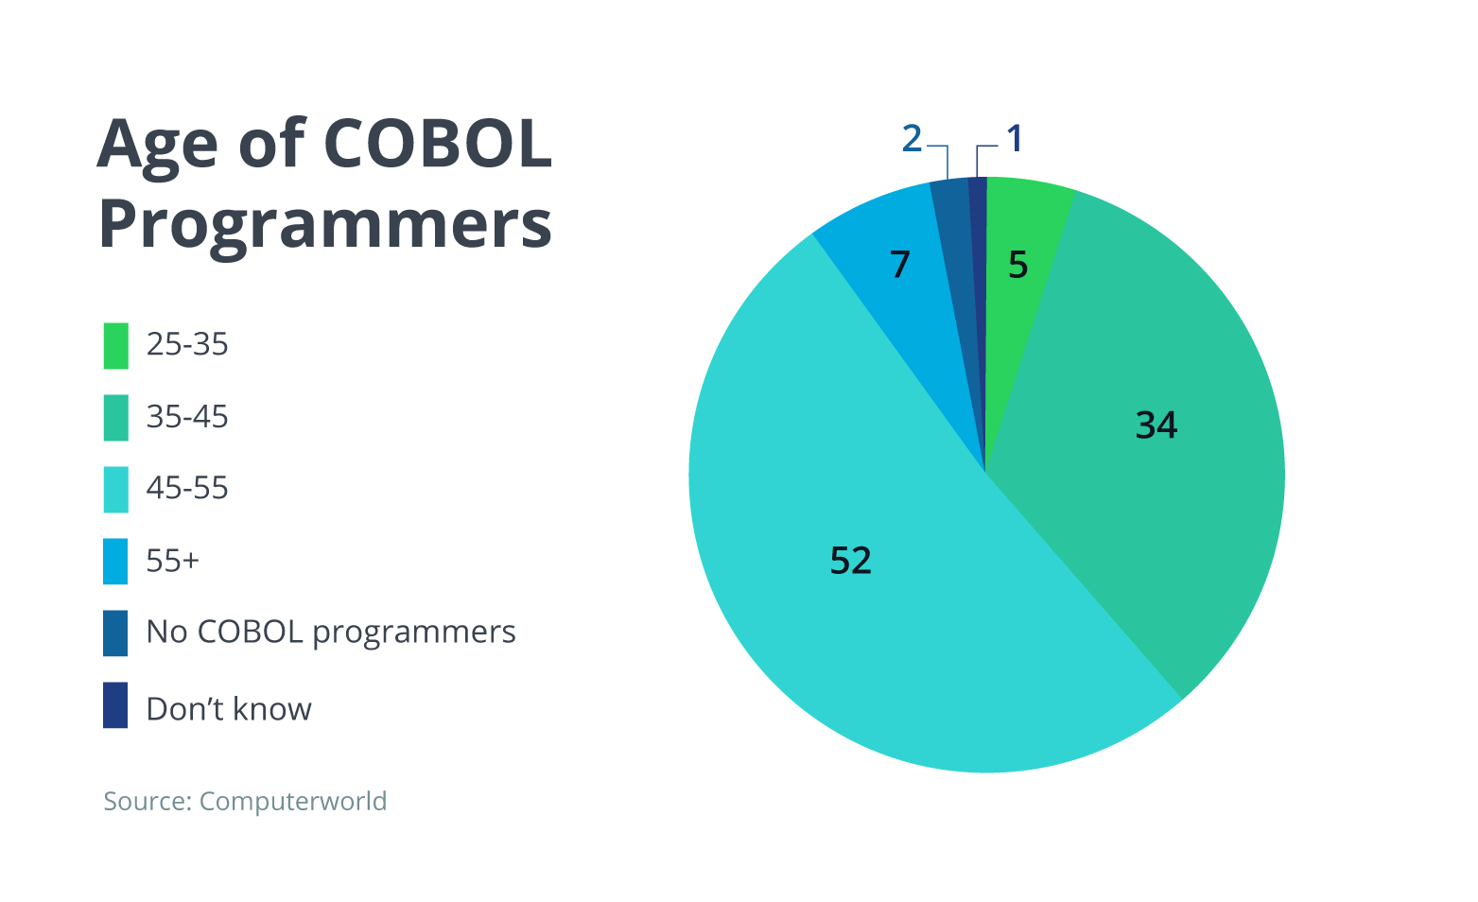
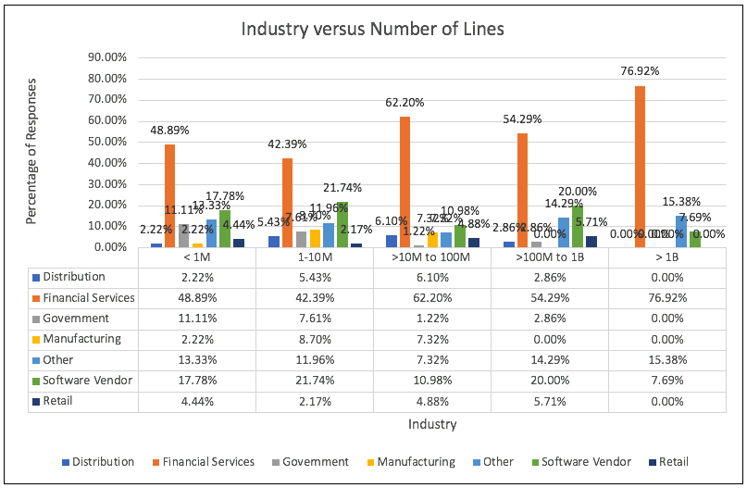
Who's using it?
Organizations which need infrastructure which will function NO MATTER WHAT.
Finance, insurance, banking, fortune 500 companies.
Places which have been around for long enough to have roots within the language itself.
General bulk fiscal exchanges

Slide 19
The evolution of cobol

Slide 20
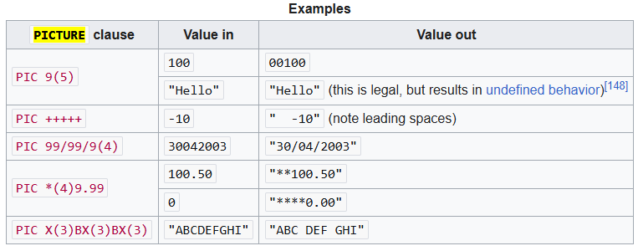
Cobol 60
Key Features:
Controversial Features:
PICTURE clause
Booleans
Formulas
IF statements (deprecated GOTO)

Slide 21
Cobol 74
New Features:
Cobol becomes the most used language in the world
Inter-program communication introduced
Formal debugging features
DELETE statement added
File merging capabilities
Library inclusions

Slide 22
Cobol 85
New Features:
Controversy surrounding backwards compatibility
Do we choose 60 features but lose some compatability
Continue
Thousands of pushback comments
Evaluate
They did it anyways.
Initialize
Looping without separate procedure declarations
Now, saying Cobol makes up so much legacy code means worrying about which version as well
I/O status codes

Slide 23
Cobol 2002
New Features:
At this point, 200 billion lines of COBOL exist
Took influence from C++ and adds objects
Recursion
80% of all business programs ran on COBOL
User-defined functions
Floating point values
Bit data types
pointers

Slide 24
Cobol 2014
Method overloading added

Slide 25
Cobol 2023
New Features:
Asynchronous messaging
Transactional processing (COMMIT)
XOR
80% of all business programs ran on COBOL
DELETE FILE
Infinite looping with PERFORM UNTIL EXIT
CONVERT for base conversions

Slide 26
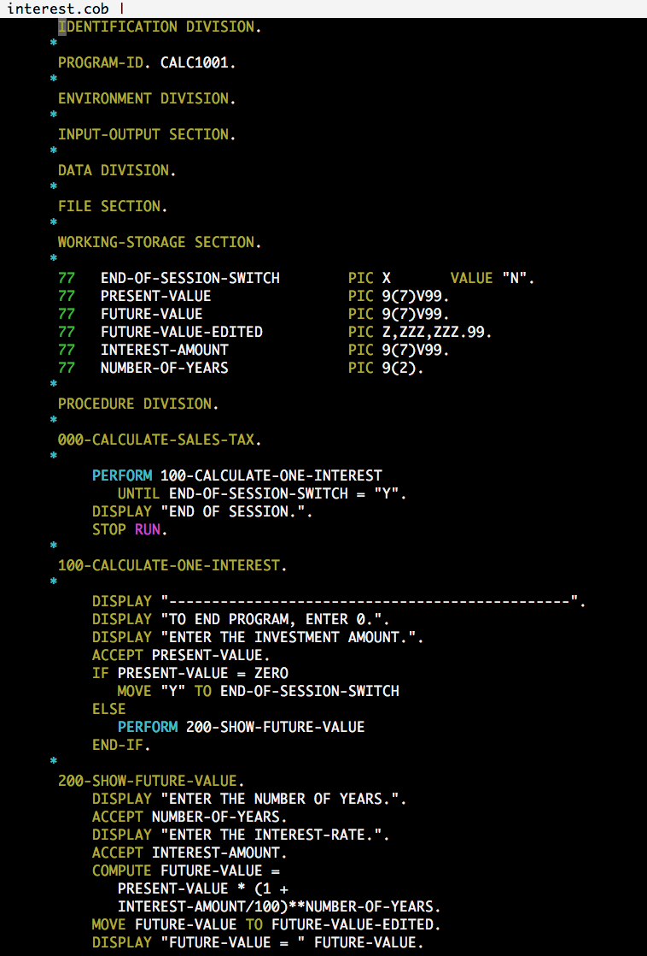
That's it
COBOL largely exists today to provide banking a solid infrastructure.
It's evolved slowly up to current day
Most projects in COBOL entail the maintenance of current systems within contemporary systems (i.e. y2k)

Slide 27
Questions?

