Slide 1
APL
It’s not just a programming language

Slide 2

…except it is
A Programming Language
One of the three longest running programming languages
Developed in 1960s by Kenneth E. Iverson
Array oriented
Mathematical

Slide 3

An Example of APL code
{(+⌿⍵)÷≢⍵}
What does this even mean???

Slide 4
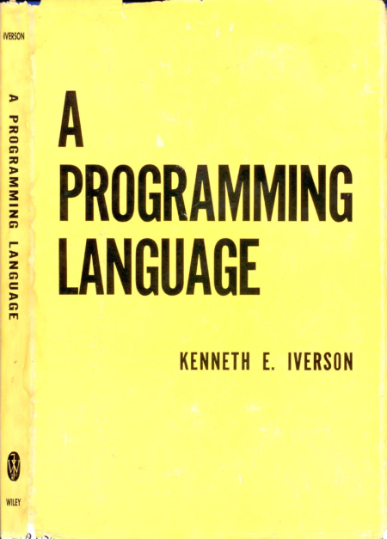
Math beginnings
Kenneth E. Iverson
Developed a mathematical notation for manipulating arrays
1957 – began developing a mathematical notation
1960 – began working at IBM
1962 – notation published in his book, A Programming Language

Slide 5
Preface of his book
“Applied mathematics is largely concerned with the design and analysis of explicit procedures for calculating the exact or approximate values of various functions. Such explicit procedures are called algorithms or programs. Because an effective notation for the description of programs exhibits considerable syntactic structure, it is called a programming language.”

Slide 6
Early Implementations
Early 1960s - partial implementation of notation
FORTRAN IV, IBSYS
Completed late 1965 – IVSYS
Used English reserve words instead of APL’s graphic symbols
1966 adapted for time-sharing
IBM system/360 Model 50

Slide 7
APL’s Legacy and Influence
1979 - Iverson receives Turing Award
Inspired languages
MATLAB
J (created by Iverson)
C++
Python
Wolfram language

Slide 8
What makes APL unique
Symbolic notation
Non-ASCII symbols
Complex expressions can be written in a single line
Array-centric design
Everything is an array – single numbers to multidimensional matrices
Concise and expressive
Entire algorithms fit on a single line

Slide 9
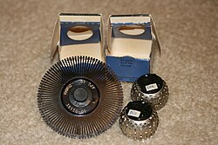

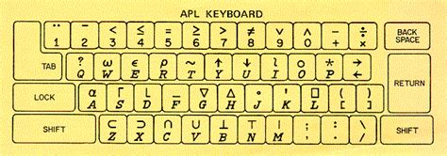
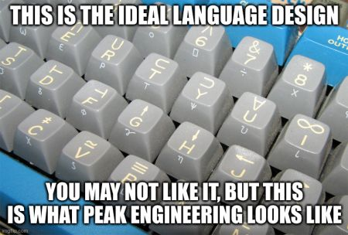
Hardware

Slide 10
Key symbols
⍝ (lamp) – for comments
∧ logical AND - lowest common factor
∨ logical OR – greatest common multiple
⍳ (iota) – index generator
{} - anonymous functions
⍵ - arguments

Slide 11
Back to Example - Demo
{(+⌿⍵)÷≢⍵}
What does this even mean???
https://tryapl.org/

Slide 12
Recommended resources
https://britishaplassociation.org/what-is-apl/
https://www.aplwiki.com/wiki/APL
https://tryapl.org/

Slide 13
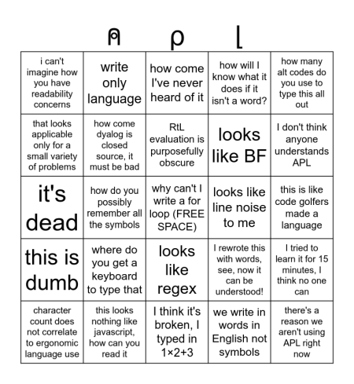
Thank you
APL complaint bingo
⍝ | ⍴ | ⌊
I know all sorts of languages but I give up now | Dijkstra knew unicode was a mistake | how come I've never heard of it | how will I know what it does if it isn't a word? | need a Ph.D. in linear algebra to use it
unusable outside a small set of problems | hieroglyphics | RtL evaluation is purposefully obscure | looks like BF | I don't think anyone understands APL
I used APL when I was new to computers, my code was bad | I'm not smart enough to remember all these symbols | FREE SPACE: write-only | line noise | wow a language for code golfers
have you heard of MATLAB | I'm not buying a keyboard for this | let me explain why regex is bad | I rewrote this with words, see, now it can be understood! | it's only for showing off
ergonomics isn't about character count | just define the functions in a better language | 1×2+3 is wrong | why would you ever learn a new writing system for this? | there's a reason APL's a dead language

