Slide 1
Swift
Johnathan Kneice

Slide 2
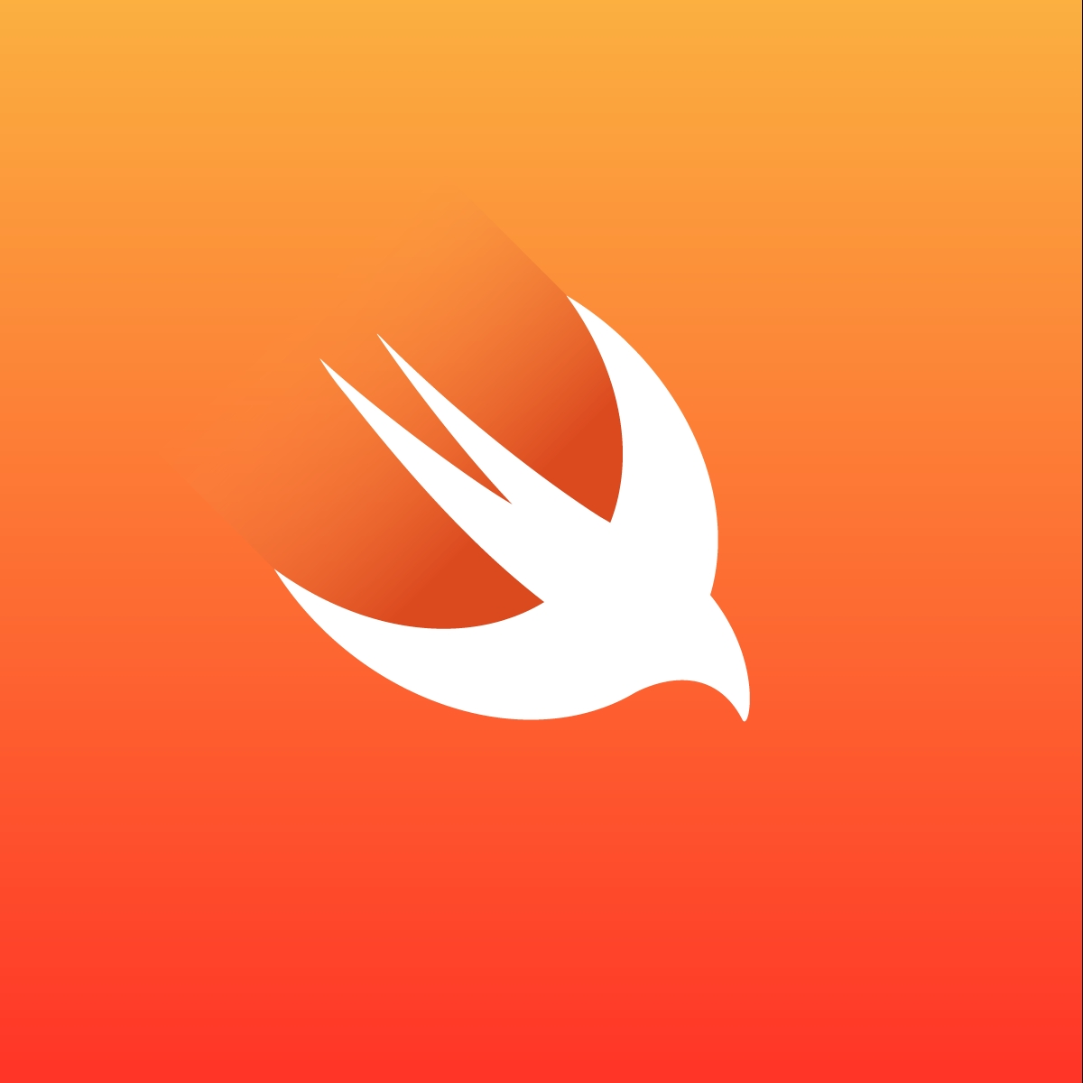
History of Swift
Development started in 2010
Created by
Chris Lattner,
Creator of clang
Bertrand Serlet
Head of apple development team
Created to be a better alternative to Objective-C.
Original called Shiny because it was "Shiny and New"
Was released in 2014.
This Photo by Unknown author is licensed under CC BY-SA-NC.

Slide 3
Why swift over Objective-C
Apple was impressed but was considering just slowly fixing Objective-C
They came to the conclusion that if they fixed all of the problems with Objective-C it would no longer be a C family language.
Was much easier to read then Objective-C
Was as fast as C.
A safe language.
Swift is takes a lot from Objective-C
This Photo by Unknown author is licensed under CC BY-SA-NC.

Slide 4
Safety of Swift
Swift handles Memory unlike C
Eliminates unsafe classes and pointers
Objects cannot be nil
Achieves this by using optional
var variable:String?
If it is nil the optional will handle it
This Photo by Unknown author is licensed under CC BY-SA-NC.

Slide 5
What is swift used for
Can be used to make applications for all apple platforms
IOS
MacOS
WatchOS
TVOS
Can be used for web Devlopment
Vapor
Kitura
Machine learning
Tensorflow
This Photo by Unknown author is licensed under CC BY-SA-NC.

Slide 6
Demo
https://www.programiz.com/swift/online-compiler/
This Photo by Unknown author is licensed under CC BY-SA-NC.

Slide 7
Questions
This Photo by Unknown author is licensed under CC BY-SA-NC.

Slide 8
Sources
https://developer.apple.com/documentation/swift/unsafepointer
https://www.freecodecamp.org/news/optional-types-in-swift/
https://www.swift.org/about/
https://exyte.com/blog/introduciton-to-swift

