Slide 1
Racket
Ian Johnston

Slide 2
What is Racket?
No
The programming language Racket

Slide 3
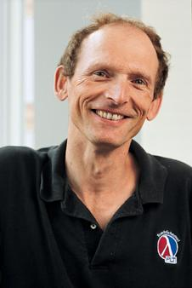
History and Creation
PLT Scheme was created in the late 1990s by a group of researchers which was led by Matthias Felleisen.
Used Scheme to serve his needs.
Introduced a syntax extension system on top of Schemes macros.
His language became a full-fledged tool for the working engineer.
PLT Scheme was renamed to Racket on June 7th, 2010
We are on version 8.0

Slide 4
What is Racket?
General purpose – it has a lot of applications
Free and open-source
Paradigms
Functional
Object-oriented
Imperative
Assignments, step-by-step
Logic
Syntax and Semantics of facts, rules and queries
Meta
Treat other apps as their data
Modular
Functions as independent pieces
Reflective
Process can examine and modify its own structure or behavior

Slide 5
Influences
Dialect of Lisp
Descendent of Scheme
Racket:
Scheme:

Slide 6
Features of Racket
Language Oriented
Allows developers to create their own languages
Macros
Extension of the Racket compiler
First-class Functions
Pass functions into functions, return functions and assign functions.
Libraries
raco is used to simplify installation
IDE Support
DrRacket – debugger – GUI – web server
Garbage Collection
Compatibility

Slide 7
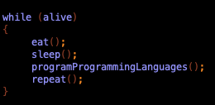
What makes Racket different?
Language Development
It’s a programming language for programming new programming languages
Rather than solving problems in a general-purpose language, the programmer can create one or many domain specific languages.
The languages are specifically created for the problem.

Slide 8
Syntax
Dynamic typing
Numbers: ints and floats
Characters: #/a
Booleans: #t or #f
Strings: “String”
Symbols: like an immutable string
Prefix notation
(+ 1 2)
Delimiters
(){}”,’`; and whitespace

Slide 9
Intended Use
Started out as a language to teach novice programmers.
Programming Language Design
Web Applications
AI
Game Development
Commercial Use

Slide 10
Who Uses Racket?
Companies
Small business
Startups
Untyped, Biomantica, YouPatch
Hacker News
Schools
Brown University
Indiana University
Undergraduate entry level classes

Slide 11
Community & Resources
Racket Manifesto
Discourse group
Racketeers: commit to Racket code base
YouTube
Discord
RacketCon: October 28-29

Slide 12
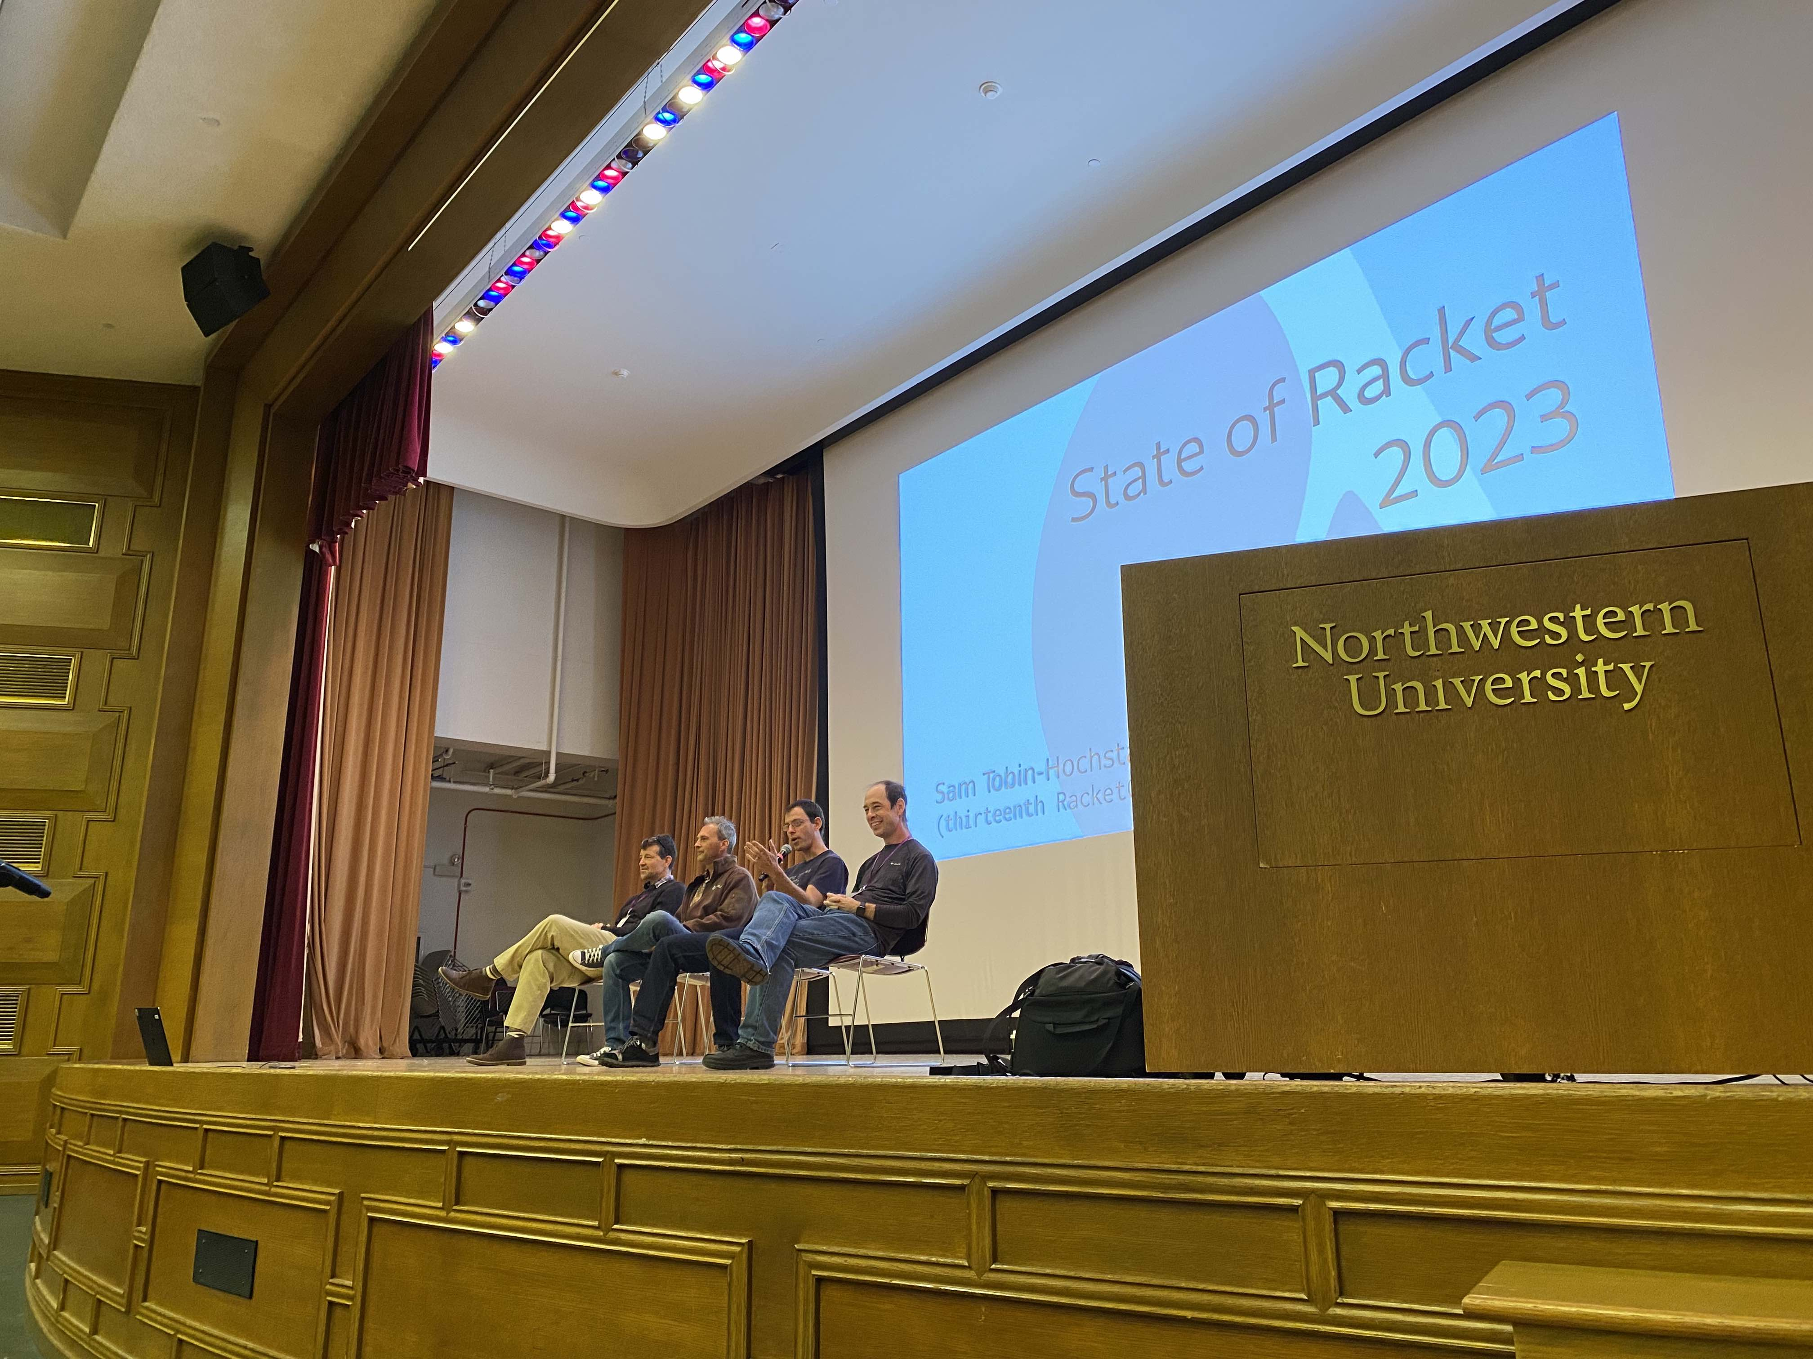
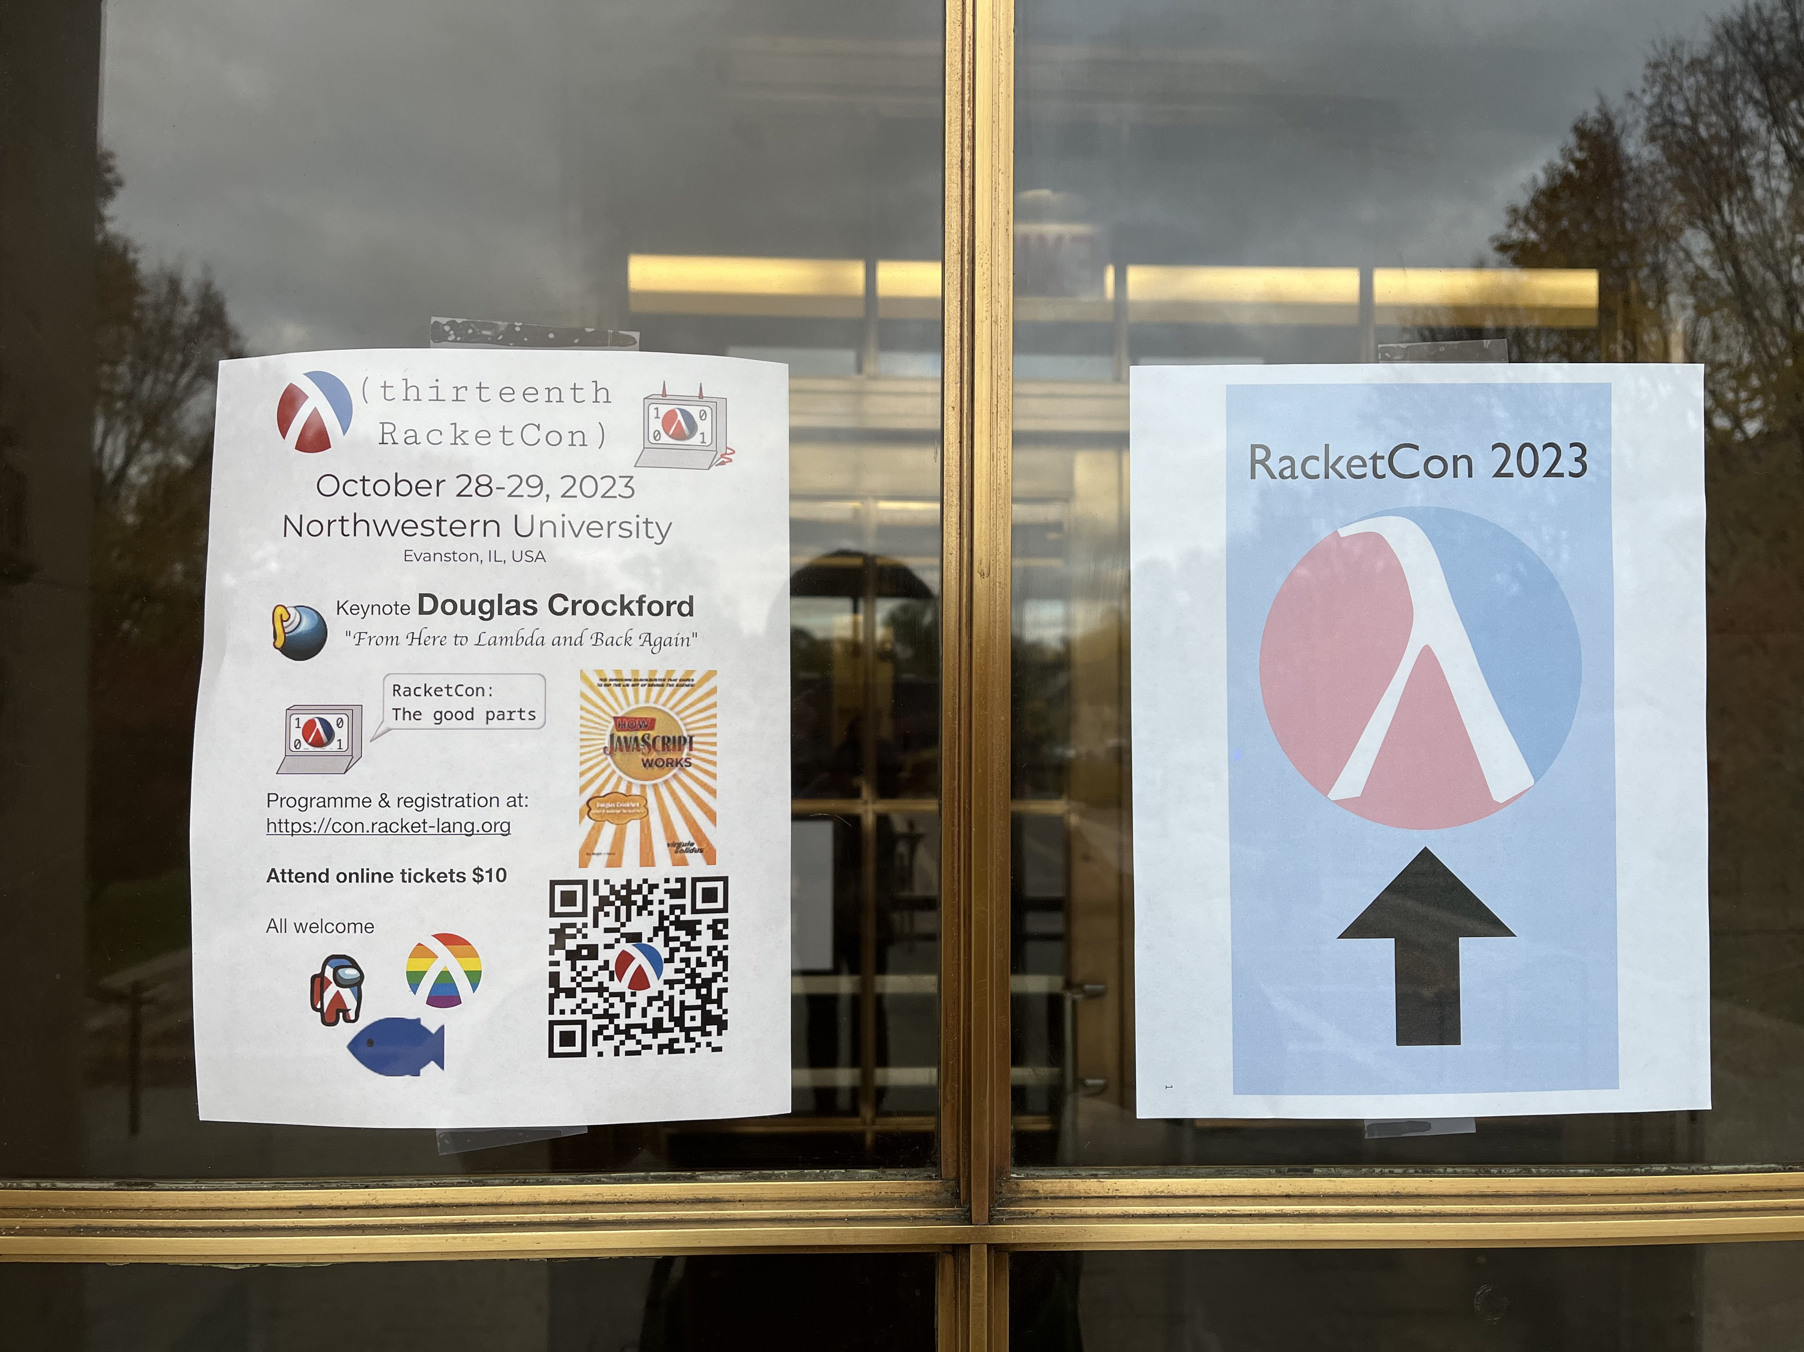
Source: micahcantor & Sid

Slide 13
Demo

Slide 14
Sources
https://medium.com/@G_Kumar/racket-programming-language-features-c71b83b625c4#:~:text=A%20Brief%20History&text=PLT%20Scheme%2C%20the%20predecessor%20of,Scheme%20and%20other%20programming%20languages.
https://en.wikipedia.org/wiki/Racket_%28programming_language%29
https://felleisen.org/matthias/manifesto/index.html

Slide 15
Questions?

