Slide 1
Scheme
David Carr

Slide 2
What is Scheme?
Functional Language
Lexically scoped
LISP based

Slide 3
Origins
LISP Inspiration
  LISt Processing
  Parenthesized Polish Notation
  The origin of the REPL
Created by Guy Steele and Gerald Jay Sussman in the 1970’s
Motivated by concurrency

Slide 4
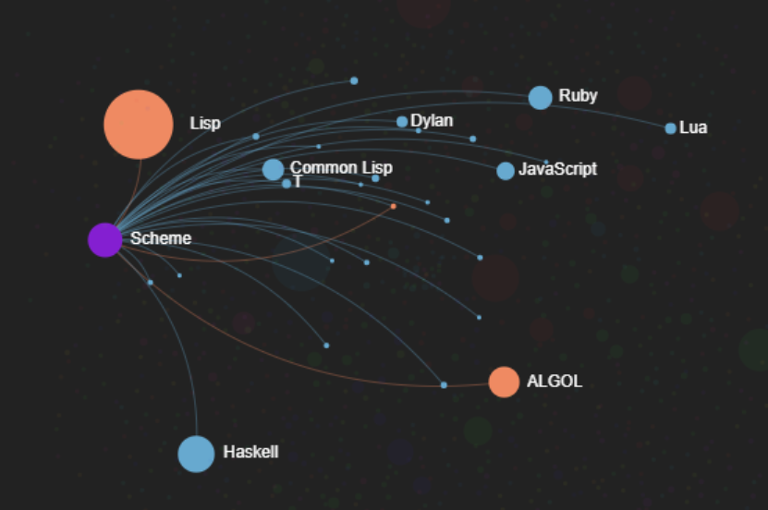

Slide 5
Features
Tail call recursion optimization
Minimalist
Lexically scoped
  Inspired by ALGOL

Slide 6
Simple Code
Add two numbers: (+ 6 7)
Add three numbers: (+ 6 (+ 7 7))
Get absolute value: (abs -25)
Print to screen: (display 5)
Create a procedure: (define foo
(display foo))

Slide 7
Code Example
((lambda (x y)
(x (x (x y y) y) y))
(lambda (x y)
(+ x y))
7)
((lambda (f) (f (f (f 7 7) 7) 7))
(lambda (x y) (+ x y)))

Slide 8
Usage
Scheme is a small language
Academics
  MIT
  Berkley
  Harvard
Artistic applications
  Rendering for Final Fantasy: The Spirits Within
Scripting
  Google Android app builder App Inventor

Slide 9
Sources
https://en.wikipedia.org/wiki/Scheme_(programming_language)#Review_of_standard_forms_and_procedures
https://www.scheme.org/
https://en.wikipedia.org/wiki/Lisp_(programming_language)
https://scheme.com/
https://stackoverflow.com/questions/34293064/understanding-lambda-in-scheme
https://inst.eecs.berkeley.edu/~cs61a/sp11/0.pdf
https://imai.fas.harvard.edu/research/files/MNPjss.pdf
https://exploring-data.com/vis/programming-languages-influence-network/

