Slide 1
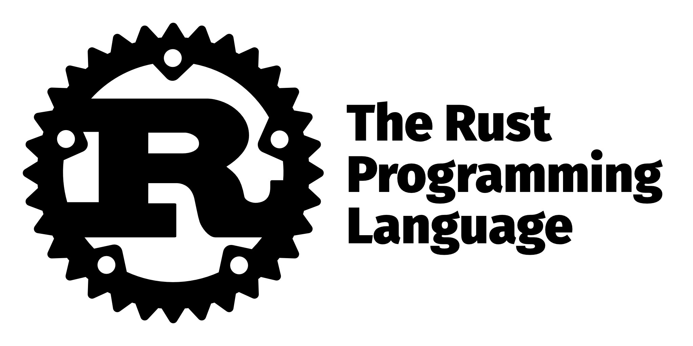
Rust
Shabib Ahmed

Slide 2
History of Rust
Rust was started in 2006 by Graydon Hoare, a Mozilla employee
Mozilla officially sponsored the language in 2009
The original Rust compiler was in OCaml, but it became a self compiling language in 2011
First stable Rust release was on May 15, 2015

Slide 3
Inspirational Languages
OCaml
Type inference, semicolon statement separation
C++
References, memory model
Cyclone
Region based memory management
Erlang
message passing, thread failure, linked thread failure, lightweight concurrency
Swift
C#
Ruby
Haskell

Slide 4
Overview of Rust
Named after a type of Fungi
The fungi is “over engineered for survival according to the creator of Rust
Self Compiling Language
Not garbage collected
WIll implicitly assume deallocation
Rust is memory-safe, null-safe, type-safe, and thread-safe and the compiler will check for all of those things.
You can still do unsafe things by using the unsafe keyword

Slide 5
Why should you use Rust
Rust directly compiles into machine code
First into LLVM bitcode
THen into machine code
Because this Rust has speed comparable to C, while being safer
Rust can reach lower level components like C
The main drawing point of Rust is that it’s a language that is similar to C but is safer, and removing limitations from older languages like C/C++ that is a result of decades of building on top of itself

Slide 6
Code Example

Slide 7
Companies using rust
Discord
Google
Meta
Firefox
Cloudflare
Dropbox

Slide 8
Sources
https://dl.acm.org/doi/10.1145/3510003.3510107#:~:text=Rust%20is%20a%20general%2Dpurpose,hard%20to%20learn%20and%20use.
https://doc.rust-lang.org/book/title-page.html
https://github.blog/2023-08-30-why-rust-is-the-most-admired-language-among-developers/#:~:text=Rust%20has%20been%20said%20to,with%20its%20memory%2Dsafe%20code.

