Slide 1
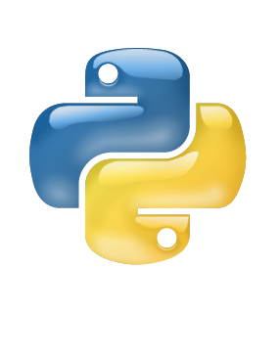
Overview of Python
Eric Finkenbiner
David J. Stucki

Slide 2
History of Python
“Bridge the gap between C and the shell.”
Why not Perl?
  Too tied into Unix
  Syntax
Languages that inspired Python
  C, Perl, Algol 60, Pascal, Algol 68, ABC

Slide 3
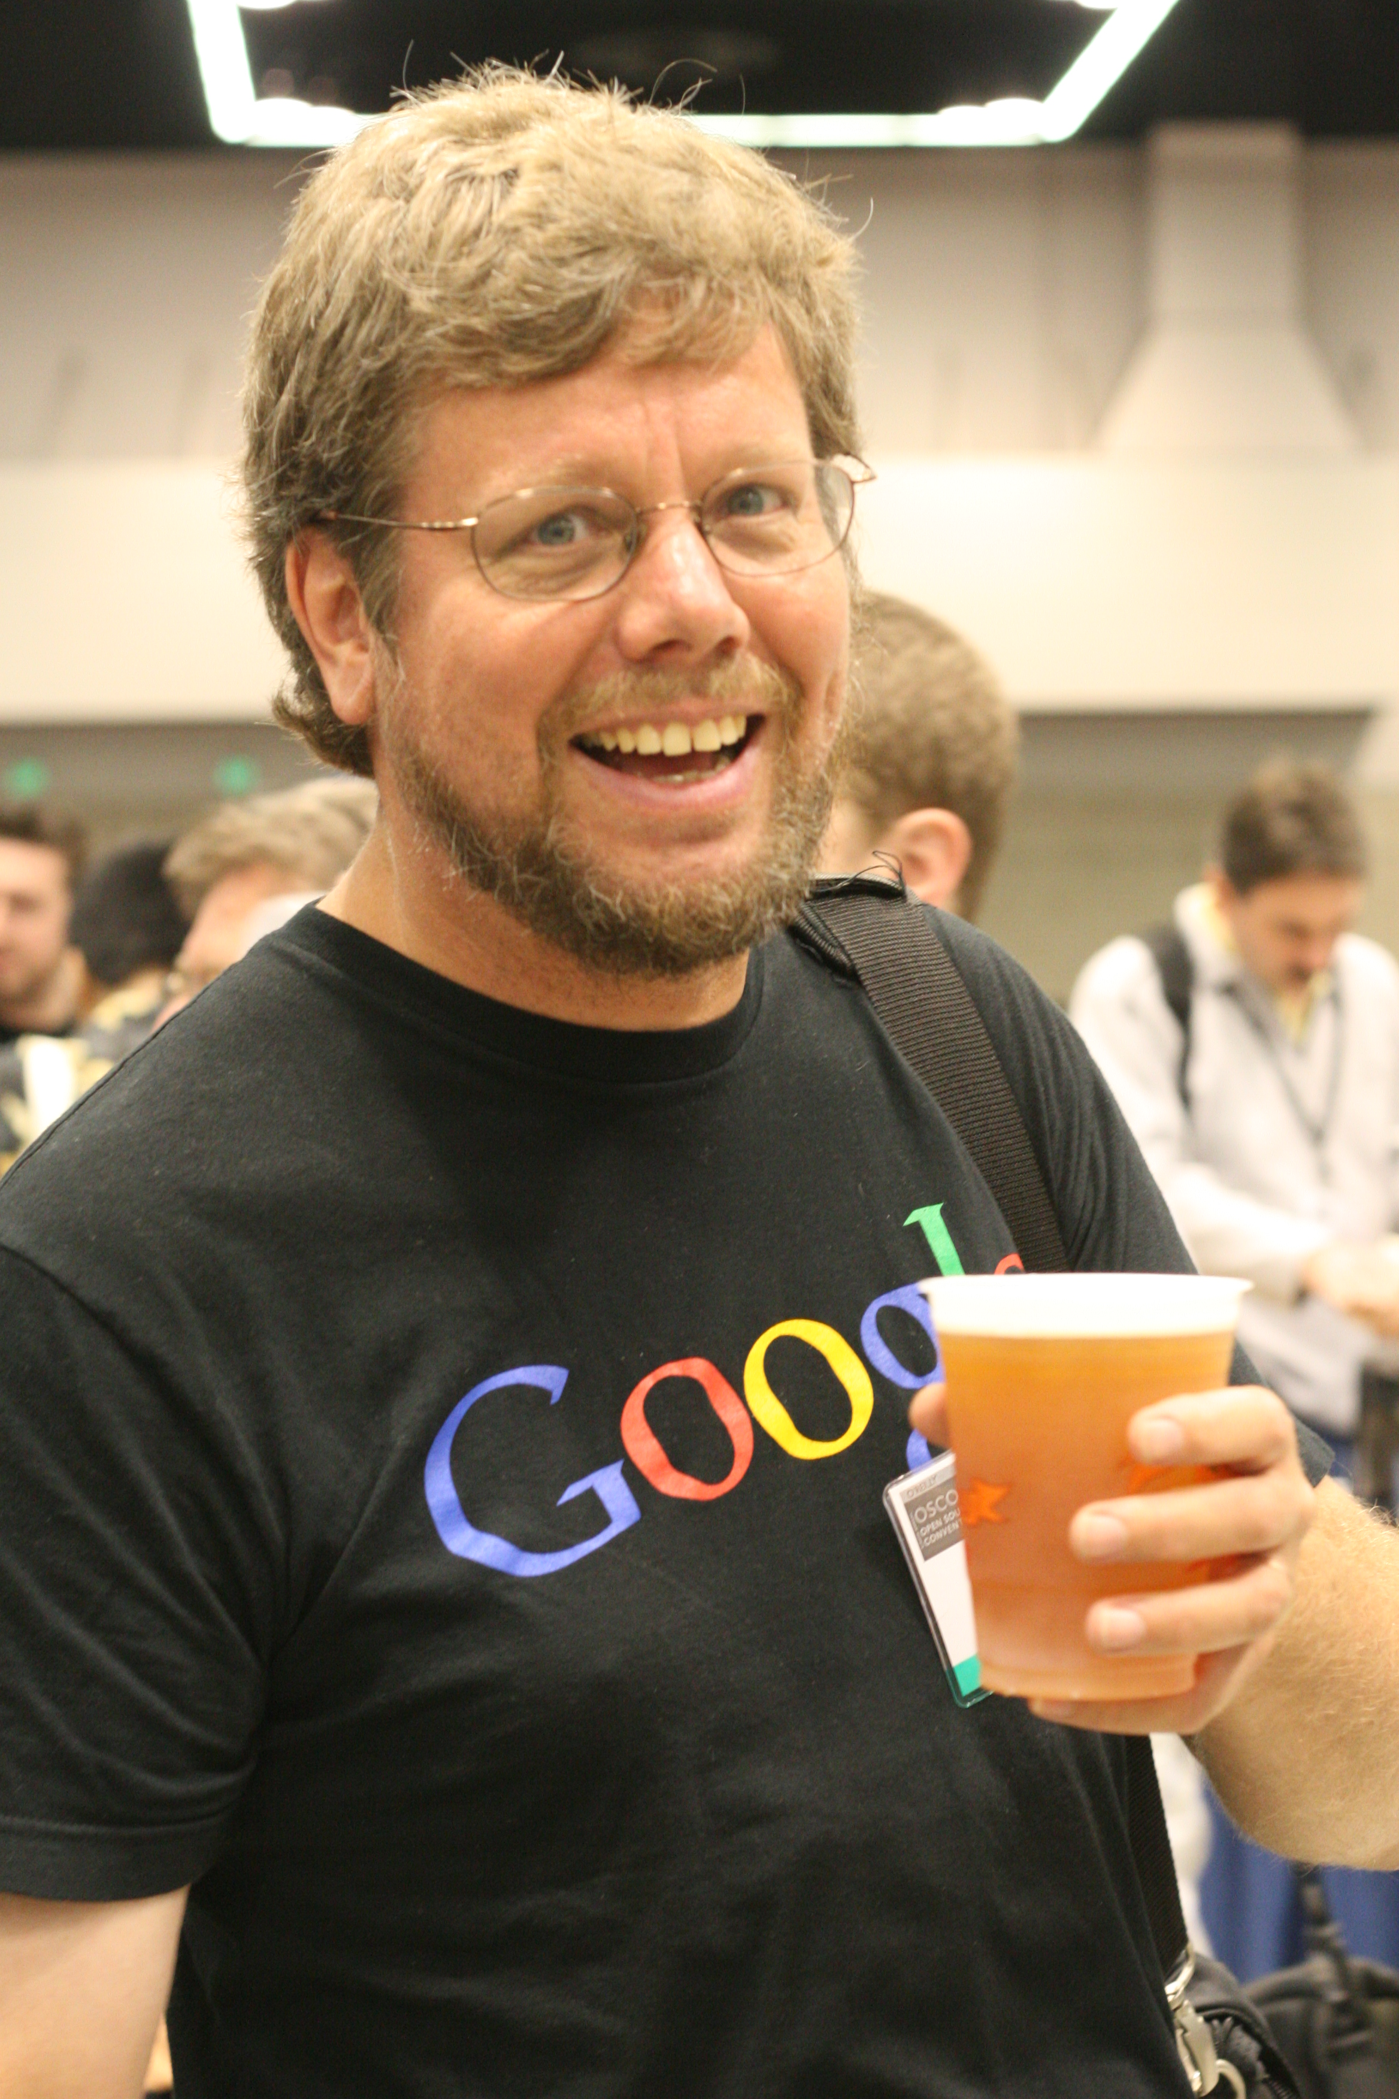
History of Python
Guido van Rossum
Development began in 1989 while at CWI (Centrum voor Wiskunde en Informatica) or National Research Institute for Mathematics and Computer Science in the Netherlands
Released 1991
http://en.wikipedia.org/wiki/File:Guido_van_Rossum_OSCON_2006.jpg

Slide 4
History of Python
1994, “If Guido were hit by a bus”
1995, Python development begins at CNRI (partly funded by DARPA)
DARPA funding allows for development of JPython (Java Implementation) as well as IronPython (.NET Implementation)
2001, Python Software Foundation created

Slide 5
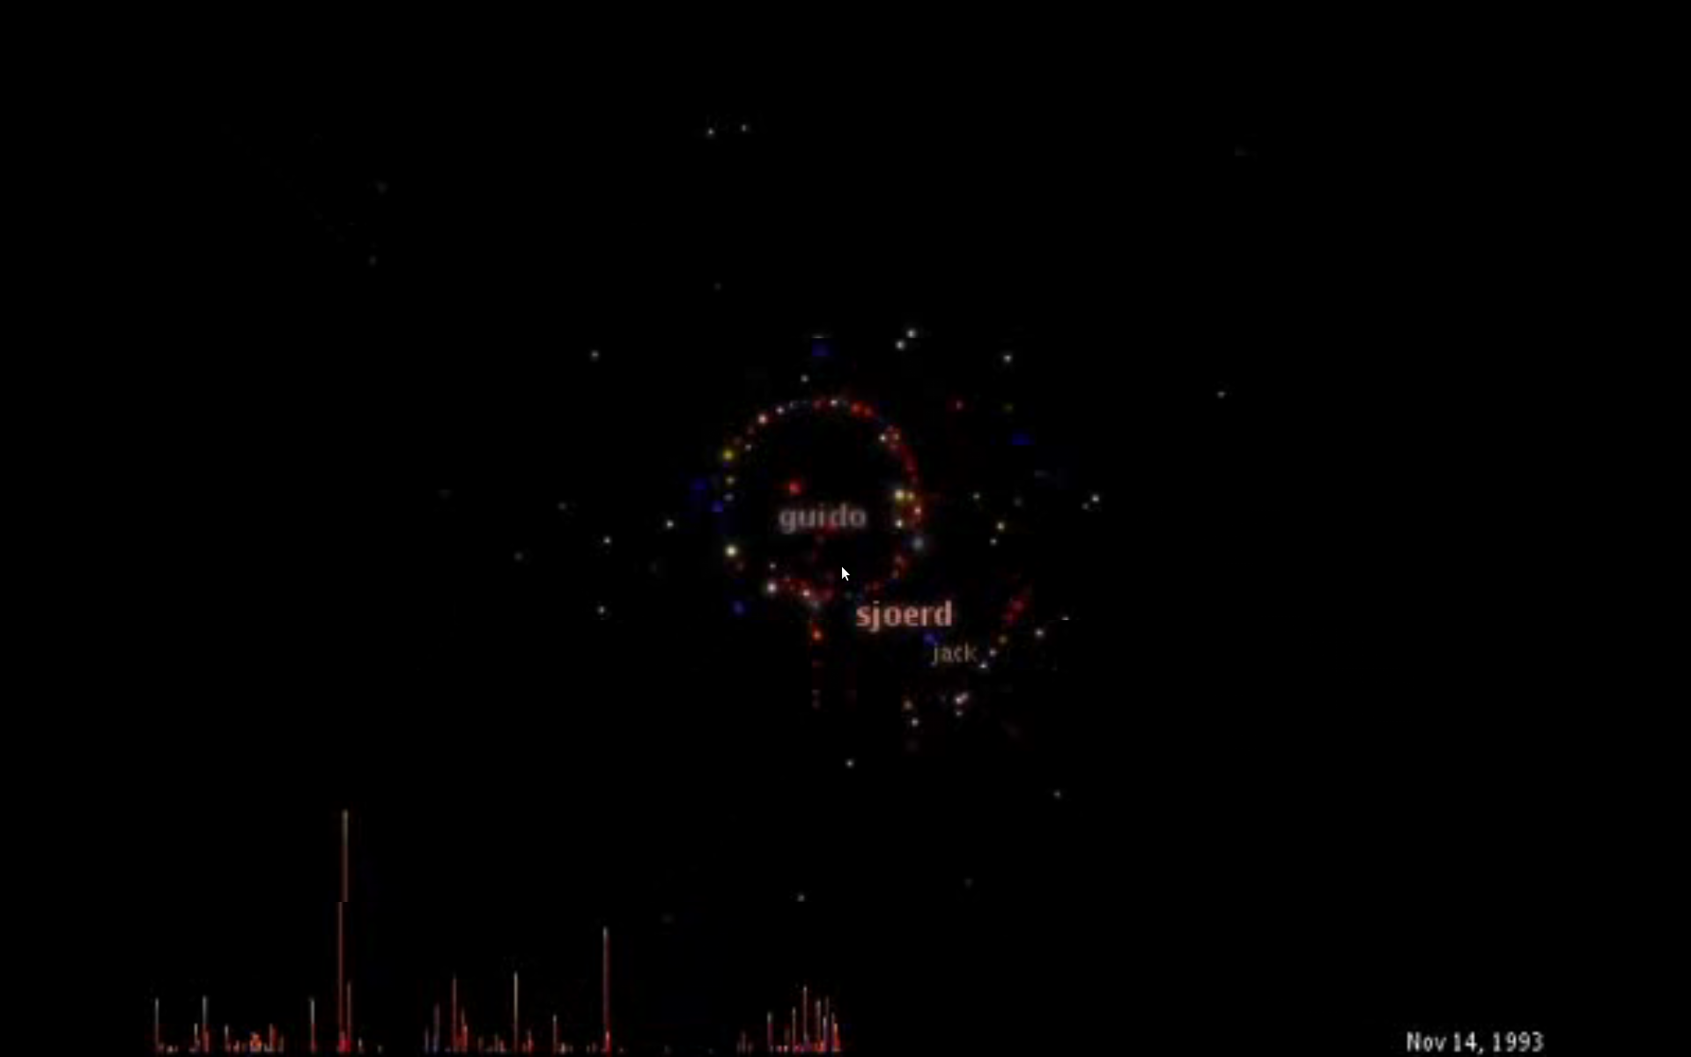
Timeline of Python Releases
Current Versions: Python 2.7 and Python 3.1.2.
http://python-history.blogspot.com/2009/01/brief-timeline-of-python.html
http://www.vimeo.com/1093745

Slide 6
Key Features of Python
Clear and readable syntax
Embeddable within applications as a scripting interface
Extensions and modules able to be written in C, C++, Java, and .NET
Extensive standard libraries and third-party modules for virtually every task
http://python.org/about/

Slide 7
Current Uses
Yahoo Maps
Google (spidering technology)
Civilization 4
National Weather Service
CIA.gov
http://wiki.python.org/moin/OrganizationsUsingPython

Slide 8
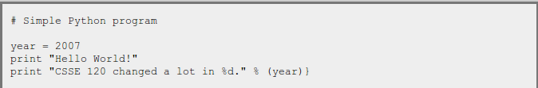
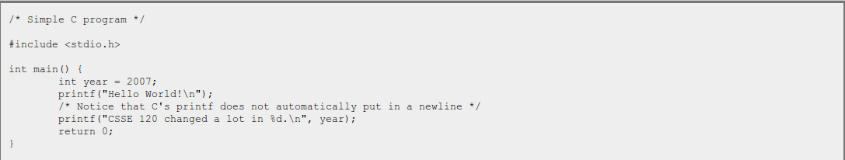
Comparison to C
http://www.rose-hulman.edu/class/csse/csse120/201020robotics/C-Programming/Python_vs_C.html

Slide 9
Sources
http://python.org/about/
http://en.wikipedia.org/wiki/Python_language
http://en.wikipedia.org/wiki/History_of_Python
http://python-history.blogspot.com/2009/01/personal-history-part-1-cwi.html
http://www.vimeo.com/1093745 - Code Swarm
http://groups.engin.umd.umich.edu/CIS/course.des/cis400/python/python.html
http://www.artima.com/intv/python.html
http://wiki.python.org/moin/OrganizationsUsingPython
http://www.rose-hulman.edu/class/csse/csse120/201020robotics/C-Programming/Python_vs_C.html

